Slide 1
Pulse Definition

Slide 2
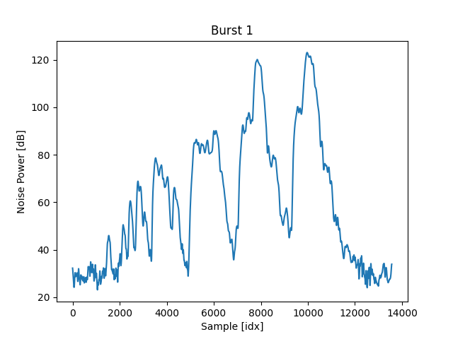
Burst 1
How many pulses are in this burst?
Is this 1, 3, or 4?

Slide 3
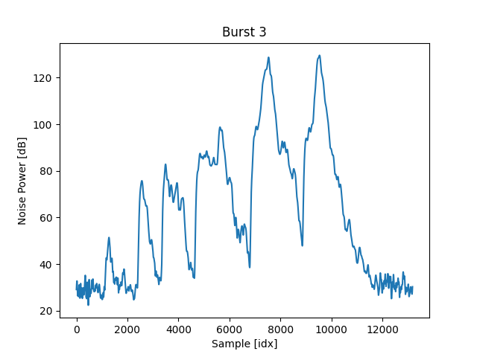
Burst 3
On the third burst, it appears to be distinctly one.

Slide 4
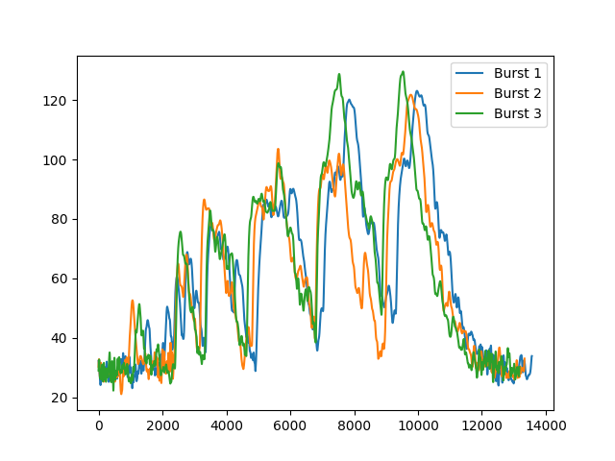
Overlapped Pulses
On every burst, the shape of each pulse changes shape but the general profile remains the same.
Do we expect the same number of pulses on each burst? Or do we believe that the cricket is making a slightly different call on each burst?

Slide 5
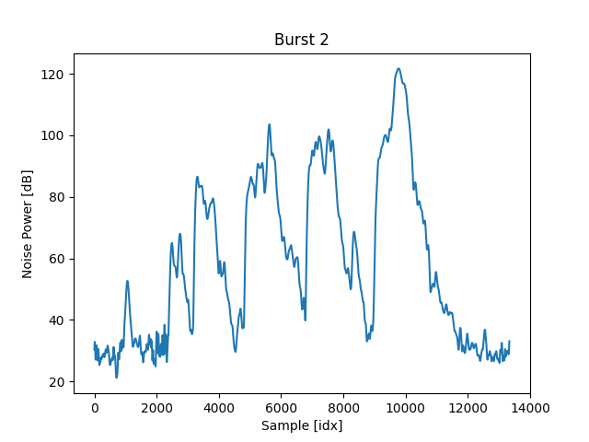
Burst 2
Shown for reference.

