Slide 1
Restaurant Music Recommendation Engine
Progress Update | Ryan Moh | June 2026

Slide 2
The Big Picture
Two datasets, one goal: match a restaurant’s vibe to the right music
Yelp dataset: 52,268 restaurants with attributes (ambiance, noise level, price, categories)
Spotify dataset: ~1.2 million tracks with 12 audio features (energy, danceability, valence, tempo…)
Linear algebra is the mathematical backbone connecting these two worlds
Covariance matrices, PCA, eigendecomposition - reduce noise, find signal
A transformation matrix W will learn to “translate” restaurant language into music language
Final output: given any restaurant, generate a curated playlist using cosine similarity

Slide 3
What I Learned: Linear Algebra Concepts
Column Space C(A)
Columns = Available Features (Loud, Energy, Ambiance)
Defines the limits of what a model can learn
Null Space Ax= 0
Overlap = Redundant Data (Unit of Measure: BPM vs dB)
Identifies duplicates to delete and simplify
Row Space C(A^T)
Rows = Actual Observations (Number of restaurants / Songs)
Reveal the true group / observations of the data
Left Null Space N(A^T)
Leftovers = Noise & Constraints
Identifies redundant observations

Slide 4
What I Learned: Linear Algebra Concepts
Matrix Factorization
LU Decomposition (A = LU): Factoring a matrix into Lower and Upper triangular components to record the steps of Gaussian elimination.
PCA
Eigenvectors: Direction of the variance of the dataset
Eigenvalues: Magnitude / importance of the direction
StandardScaler
Neutralize unit differences (Km vs Cm)
Matrix Transpose
A step to calculate covariance matrices and shift operations between features and observations.
Orthogonality (90-degree angle)
To make sure new dimensions capture only unique information without introducing new redundancies.

Slide 5
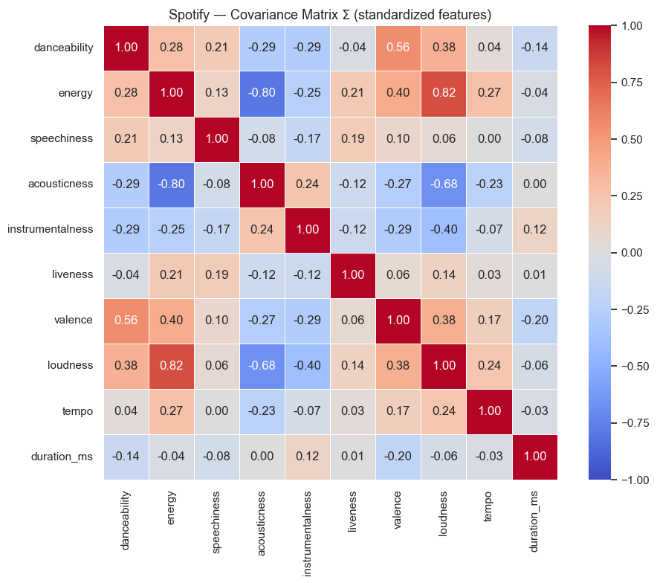
Covariance Matrix: Spotting Redundant Features
Key Findings:
Energy - Loudness: 0.82 (strongly correlated)
Energy Acousticness: -0.80 (near-perfect inverse relationship)
Danceability - Valence: 0.56 (happier songs)

Slide 6
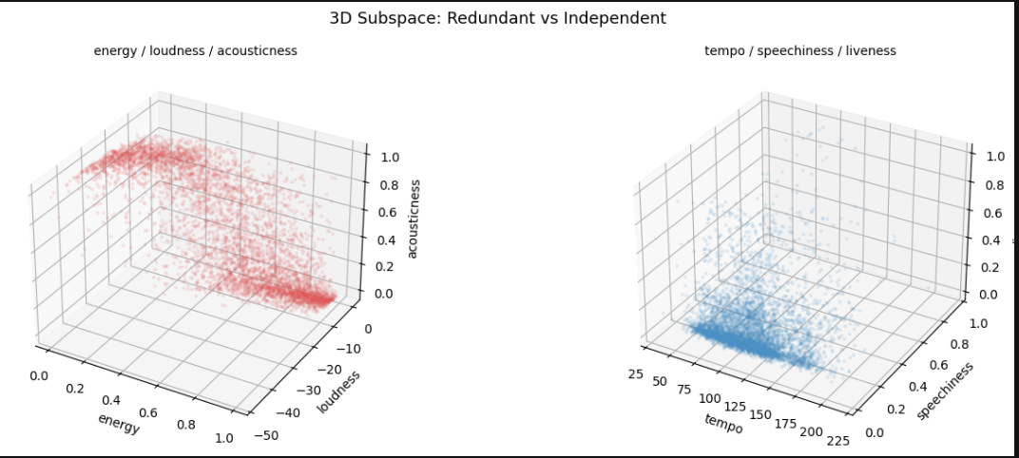
Redundant vs. Independent: Visualized in 3D
Data collapses into a flat plane.
3 features span only 2 dimensions.
Data fills the 3D volume.
These features are independent.

Slide 7
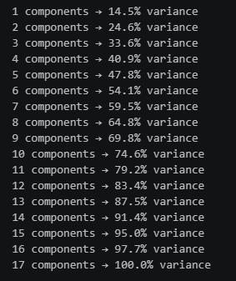
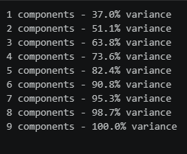
PCA: How Many Components Do We Need?
Spotify: 6 components 85%+ variance
Yelp: More spread out = More independent

Slide 8
The Problem: Two Datasets, Different Dimensions
Yelp: price, ambiance, noise level, categories
Spotify: danceability, acousticness, energy, tempo
PCA compresses each dataset separately, but it cannot bridge the gap between them
Cannot multiply a Yelp vector by a Spotify vector. Their dimensions don’t align
We need a transformation matrix W that acts as the bridge: Yelp - Spotify
A translation dictionary: for each restaurant profile, W produces a target audio profile
W * (Yelp vector) = predicted Spotify audio profile

Slide 9
What’s Next: The 5-Step Pipeline
1. Ground Truth
2. Train W Matrix
3. Cross-Domain Bridge
4. Cosine Similarity
5. Human Feedback Loop
Manually pair restaurants to target audio
(fine dining - low energy, high acousticness)
Find W minimizing error
between predicted and recommended song
W ⋅ (Yelp PCA vector) = target Spotify audio profile
Search songs for vectors
closest in angle to the predicted target
Human feedback tune the weights.

Slide 10
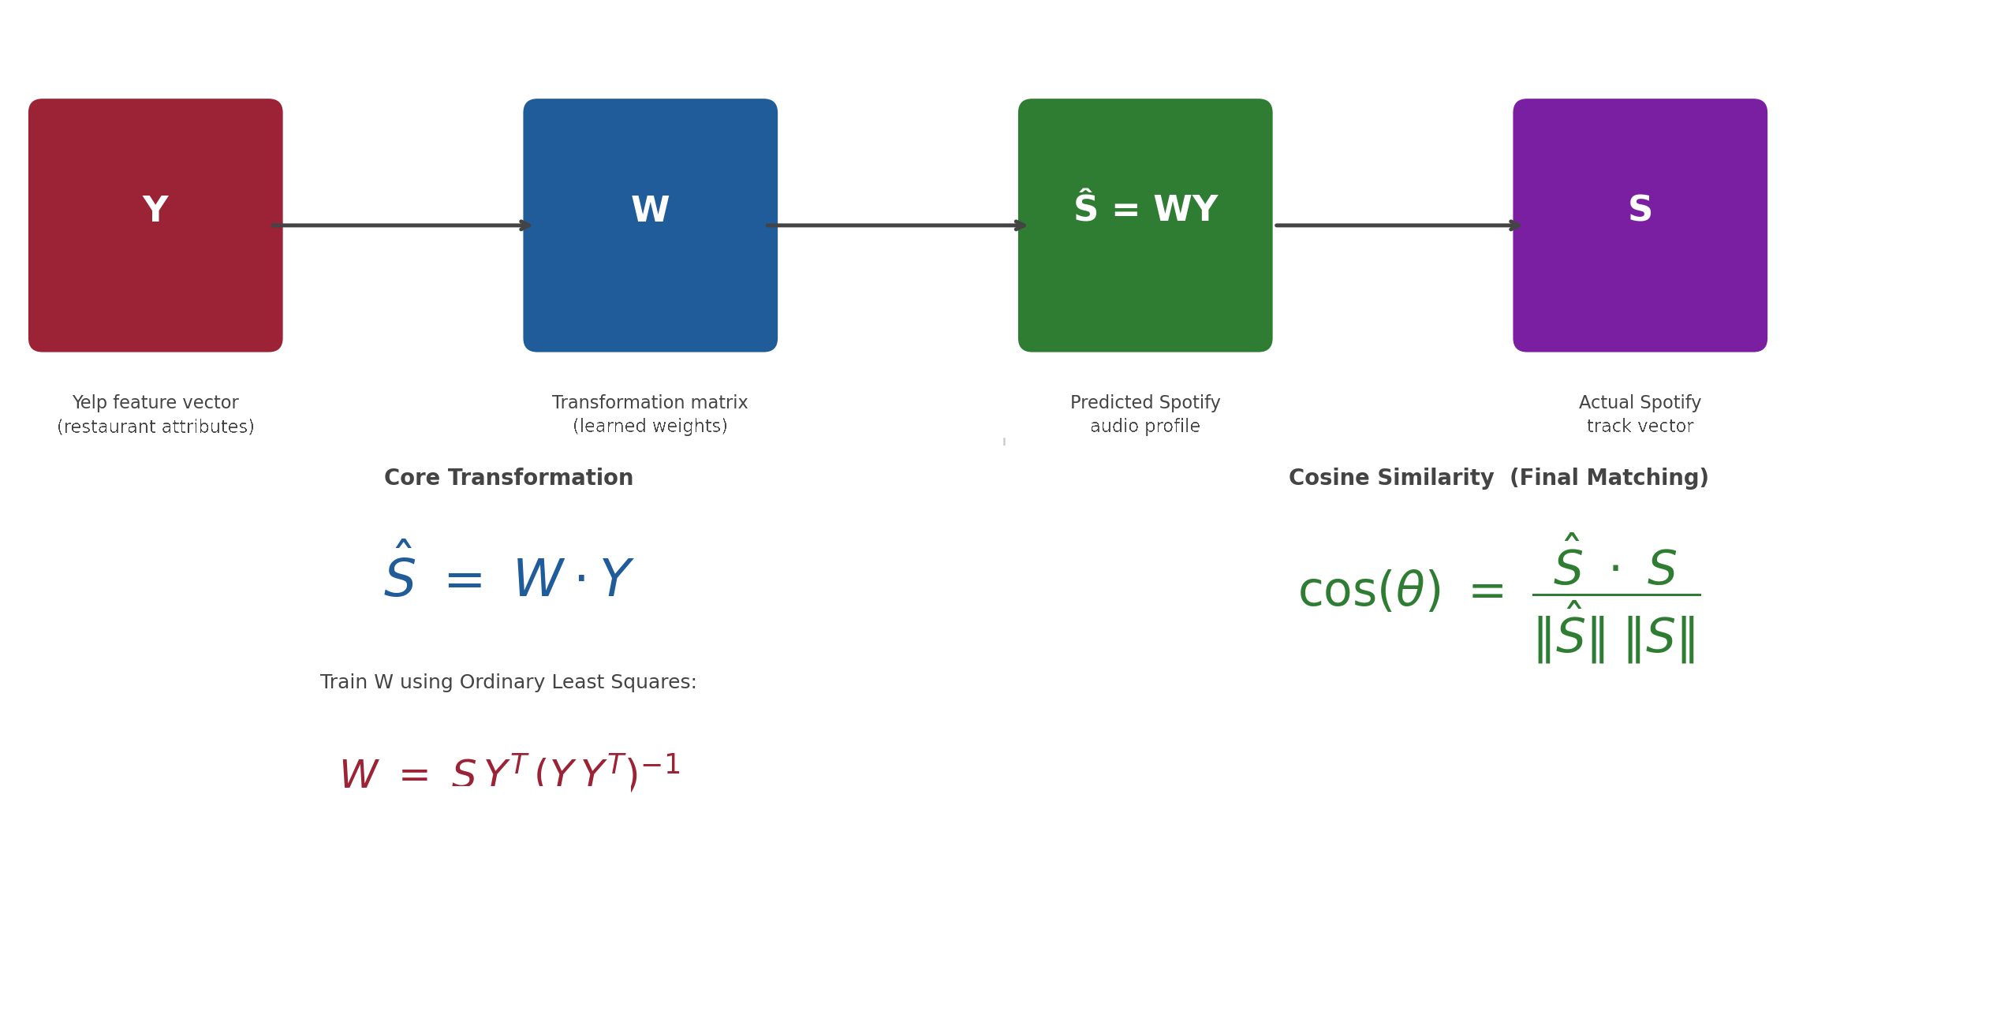
Math

Slide 11
Questions & Concerns
Time
What if there are multiple datasets (spanning more than 3 dimensions)?
Latent Space
SVD (Singular Vector Decomposition)
Two Tower Approach

Slide 12
Thank You

