Slide 1

twilio - SMS edition
By: Ryan Jones
Note: I am not affiliated with twilio.

Slide 2








Ryan Jones
@RyanonRails
ryan.michael.jones@gmail.com
www.RyanonRails.com

Slide 3
Overview
What is twilio?
Why use twilio for SMS?
Twilio analytics/logs/dev tools
Twilio + Ruby on Rails

Slide 4

What is twilio?
Cloud Communication - Scaling
SMS
Voice
API

Slide 5
Why use twilio for SMS?
The Good
The Bad
30$ Free Credit
1¢ per message US & Canada
1$ Phone #
Free Sandbox Dev
REST API
Gem
API Explorer
Shortcodes
Great Support
1 message per second
Sandbox # limited
1 number per application
No Canadian #’s

Slide 6
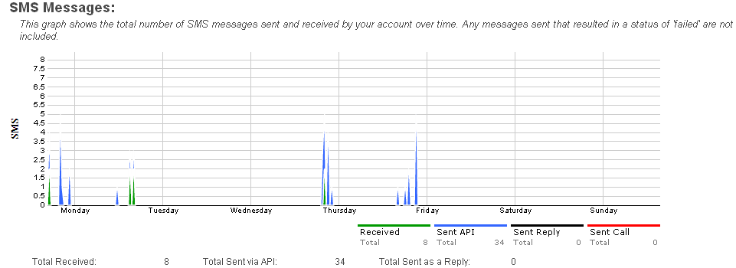
Twilio analytics/logs/dev tools
http://www.twilio.com/

Slide 7
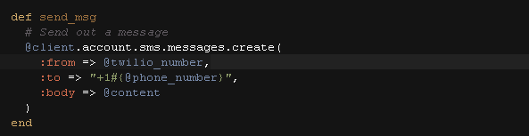
Twilio + Ruby on Rails
Gem: https://github.com/twilio/twilio-ruby
Example Code: https://github.com/RyanonRails/twilio_example_rails
REST API - Make calls, send messages, buy and manage phone numbers.
TwiML - Dynamically control live phone calls and respond to messages.
Twilio Client - Make and receive calls in a browser or on a mobile device.
Build a client object:
Send a message:

Slide 8

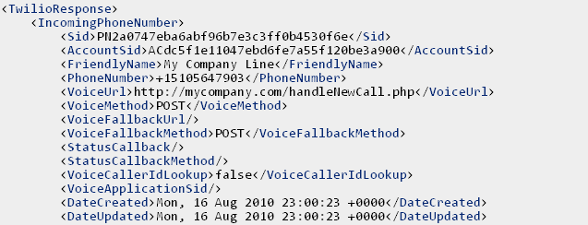
Twilio + Ruby on Rails
Get all of the associated account twilio #’s (array of phone numbers):

Slide 9
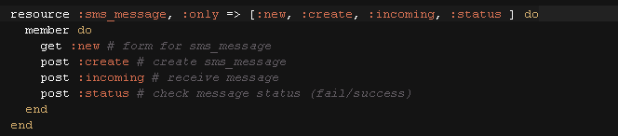
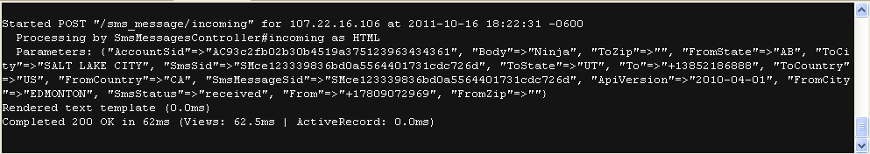
Twilio + Ruby on Rails
Receive incoming texts:

Slide 10
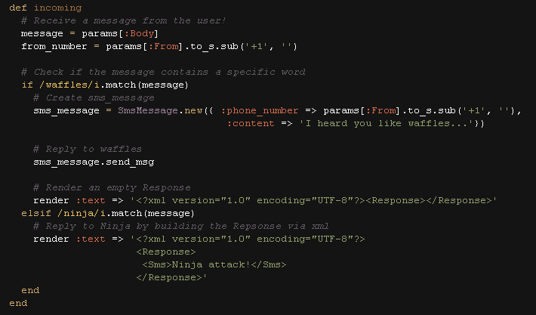
Twilio + Ruby on Rails
Incoming texts controller (reply via gem or via TwiML):

Slide 11

Fin

