Slide 1

twilio – Voice edition (twilio Client)
By: Ryan Jones
Note: I am not affiliated with twilio.

Slide 2








Ryan Jones
@RyanonRails
ryan.michael.jones@gmail.com
www.RyanonRails.com

Slide 3
Overview
What is twilio?
Why use twilio for Voice?
Twilio Client

Slide 4





What is twilio?
Cloud Communication - Scaling
SMS
Voice
API

Slide 5
Why use twilio for Voice?
The Good
The Bad
30$ Free Credit
1¢ Inbound 2¢ Outbound / per min
twilio client 1/4¢ / per min (in out?)
Conferencing
Gem
API Explorer
Great Support
Lots of technologies needed for twilio Client
Site Examples in C#/PHP

Slide 6
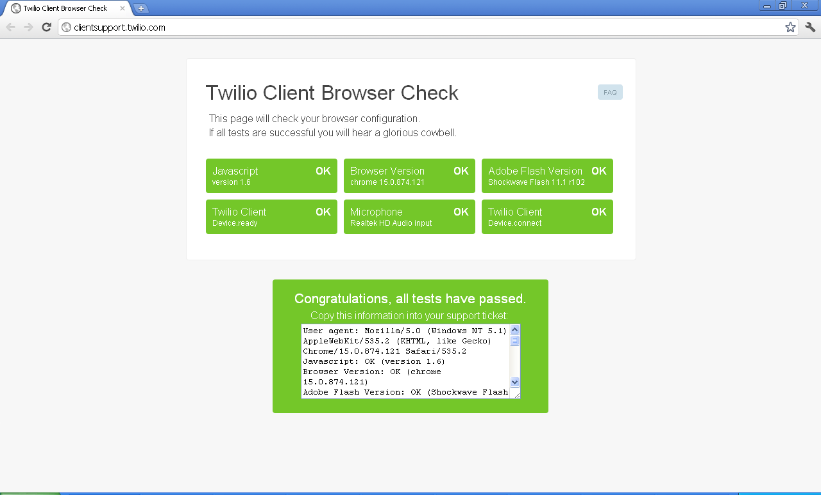
twilio Client Requirements

Slide 7
Let’s do it LIVE!
Don’t go here:
http://sharp-sunrise-1304.herokuapp.com/

Slide 8
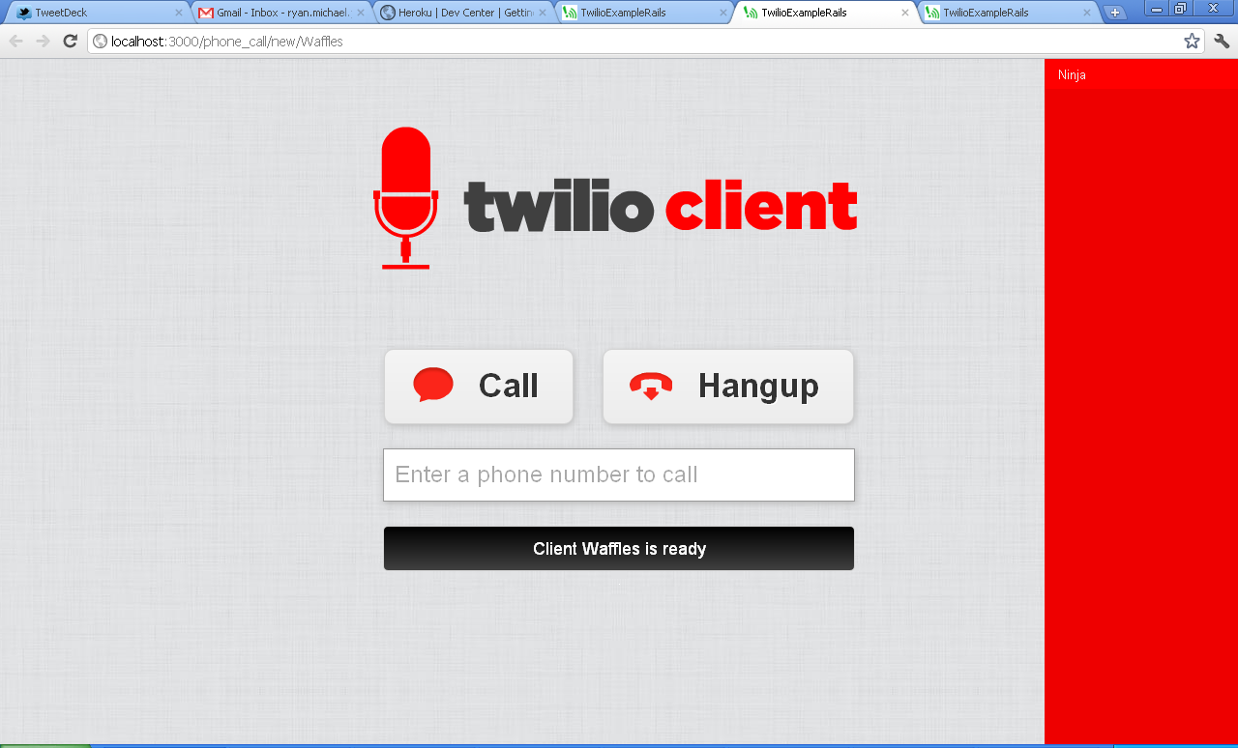
Client to Client Demo

Slide 9
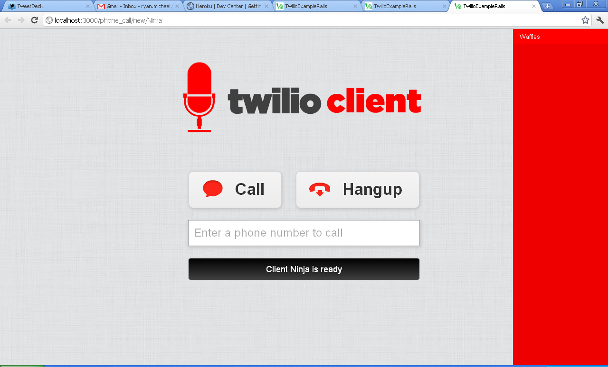
Client to Client Demo

Slide 10

Fin

