Slide 1
Calender

Slide 2
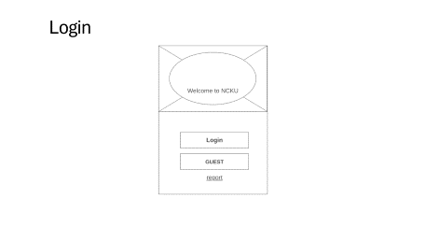
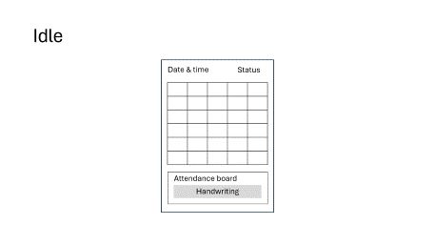
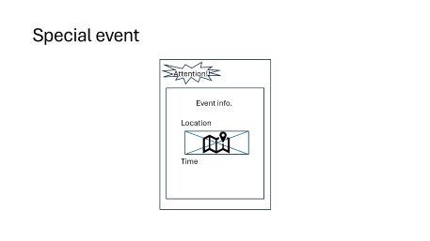
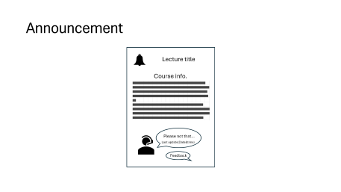
Diagram

Slide 3
Idle
Date & time
Status
Attendance board
Handwriting

Slide 4
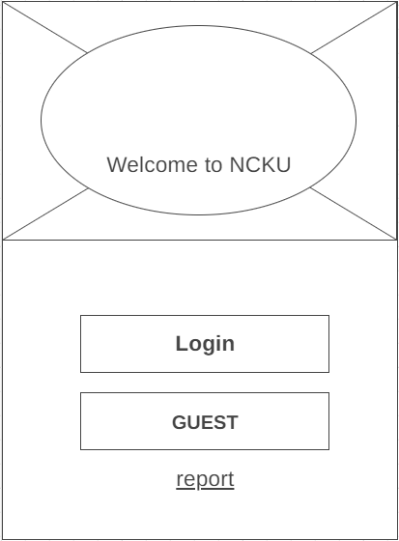
Login

Slide 5



Announcement
Lecture title
Course info.
Please not that…
Last update(Date&time)
Feedback

Slide 6

Special event
Attention!!
Event info.
Location
Time

