Slide 1

The Brewing Game
Sprint 1
By Gracjan Blazejowski
Sergio Eneide
Bruce Gray
Marta Grazia
Elaine Hardwidge
Aaron Stevens

Slide 2
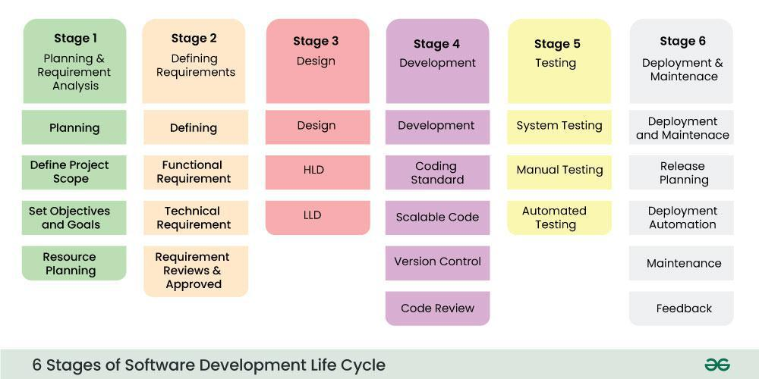
Sprint Goals - SDLC
Software Development Life Cycle implementation:
Geeksforgeeks.com

Slide 3

Sprint Goals:
User Analysis
Defined Scope
Software Requirements
Possible MVP
Justification of Choices
Directory Structure Document
Coding Standard Document
Onboarding Document

Slide 4

User analysis:
Defining User personas:
  Identified 3 user personas with different expectations and accessibility needs, helps identify requirements
Compiling user survey on current version of the game:
  Research on current pain points to identify points of improvement

Slide 5

Software Requirements Specification
Living Document to keep updated at each iteration with feedback integration
Defining functional and nonfunctional requirements balancing between must haves and constraints
Ready to check with client for feedback

Slide 6

Possible Minimum Viable Product
User Interface
  Interface-driven application
  Main menu/Pause menu
  Heads-Up Display
Accessibility
  Text to speech or narration
  Dyslexia friendly font
  High contrast readable text
  Low hardware requirements
  Multi platform (Windows, MacOS, Linux)
Few interactive objects
Small goal driven game loop
Simple game level
Game build
<a href="https://www.flaticon.com/free-icons/mvp" title="MVP icons">MVP icons created by Freepik - Flaticon</a>

Slide 7

Development Documentation
Justification of Choices
Directory structure
Coding Standards Document

Slide 8

Onboarding new members
Development tools accesses
Git and Github session
Onboarding documentation
Sprint ceremonies integration

Slide 9

Next Sprint
Client feedback on requirements
Roadmap and Gantt Chart
Preliminary design

Slide 10
Thank you
Any Questions?

