Slide 1
Sprint Review 7
The Brewing Game
27th February 2026
Gracjan Blazejowski
Bruce Gray
Marta Grazia
Sergio Eneide
Aaron Stevens

Slide 2
Sprint work
Reassess roadmap
Accessibility features
Tutorial + Text To Speech
Instrument Shop System
UI Bug Fixes and improvements
Basic Game Loop consolidation
Marta Grazia

Slide 3
Added
Tabbing Navigation and Selection Feedback
Additional way to interact with the game
Quality Of Life Additions
  Selection feedback
  Active/Inactive HUD
  Changed Hover Highlight color
  UI Improvements
Marta Grazia

Slide 4
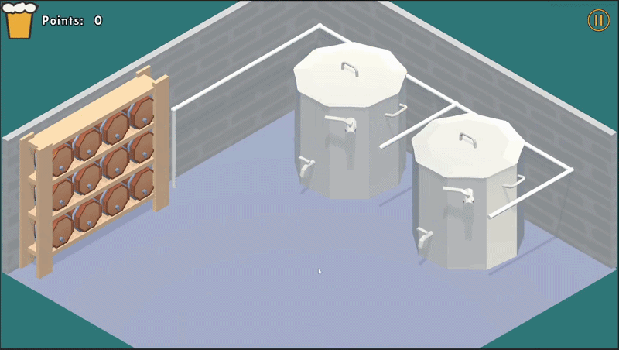

Added
Tabbing Navigation and Selection Feedback
Input Feedback integration + Quality of life
Keyboard Controls
Marta Grazia

Slide 5
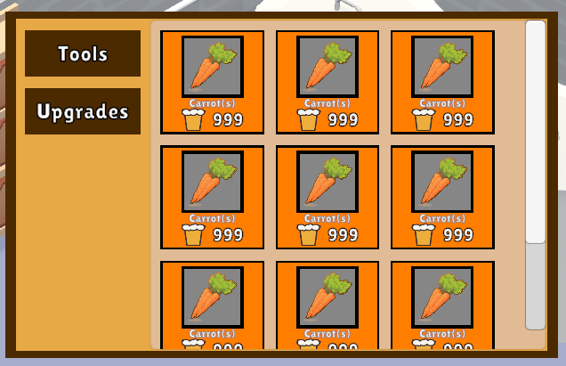
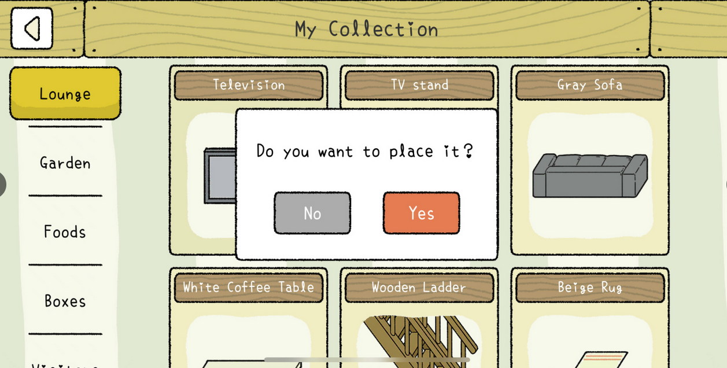
Implementing Instruments Shop UI
Initial UI Shop Design
Font size unifying script
New class: ShopItem
Gracjan Blazejowski

Slide 6
UI Bug Fixes
Problems:
You could click on Mash Tuns through the UI; UI did not stop raytracing
One class handled 3 separate
responsibilities
Gracjan Blazejowski

Slide 7
UI Bug Fixes - Code refactor
Changed the method for detecting mouse clicks; IPointerClickHandler
Split the responsibilities across multiple classes
Gracjan Blazejowski

Slide 8
Implementing Instruments Shop System
UML Diagram
Small Scale Shop Logic
Marta Grazia

Slide 9
Game loop - getting closer to the MVP
Added Win Conditions
Changed values for tolerance and fill rate
Polished UI
  Input feedback
  Interaction feedback
Marta Grazia

Slide 10

Getting closer to MVP…

Slide 11
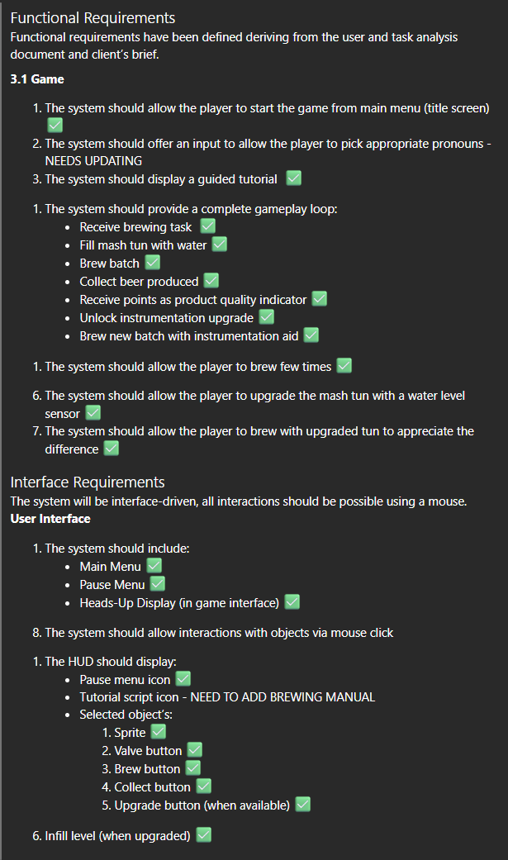
What went well
Referring back to the SRS document we met most of the requirements
Team Communication is excellent
Feedback from client and users
Getting closer to the MVP

Slide 12
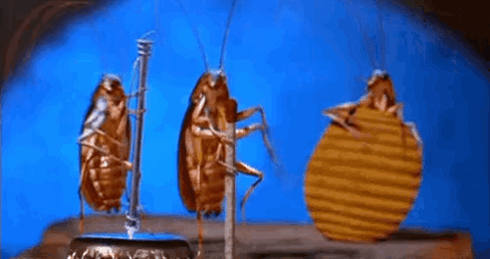
What went… not so well
Lack of Low Level design for certain elements

Slide 13
Up Next
UI/UX Ethics clearance for user testing
Shop System completion
Unit and Integration Tests
Marta Grazia

Slide 14
Thank you!
The Brewing Game’s Team

