Slide 1
Sprint 5 - Review
The Brewing Game
2nd February 2026

Slide 2
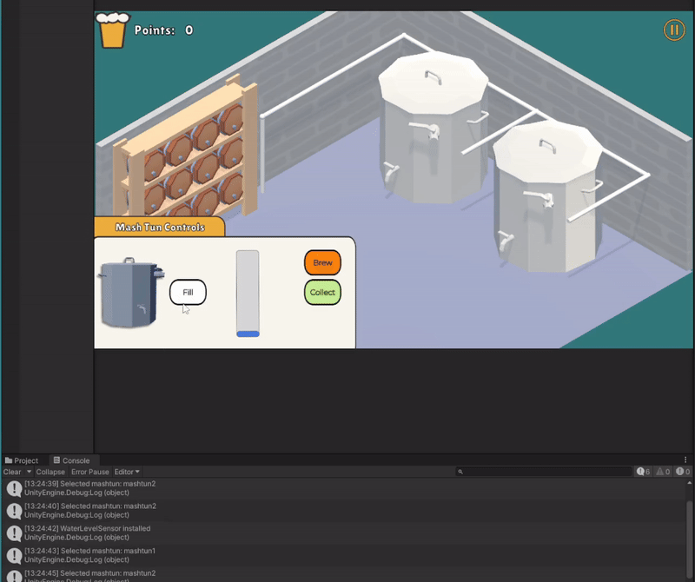
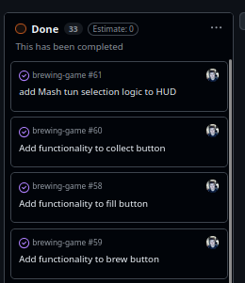
Added
Mash Tun Interactions
Marta Grazia

Slide 3
Mid-Sprint work
Game Manager Script
Tabbing Navigation
Text to Speech research
Marta Grazia

Slide 4


Slide 5

Created a score formula
Bruce Gray

Slide 6
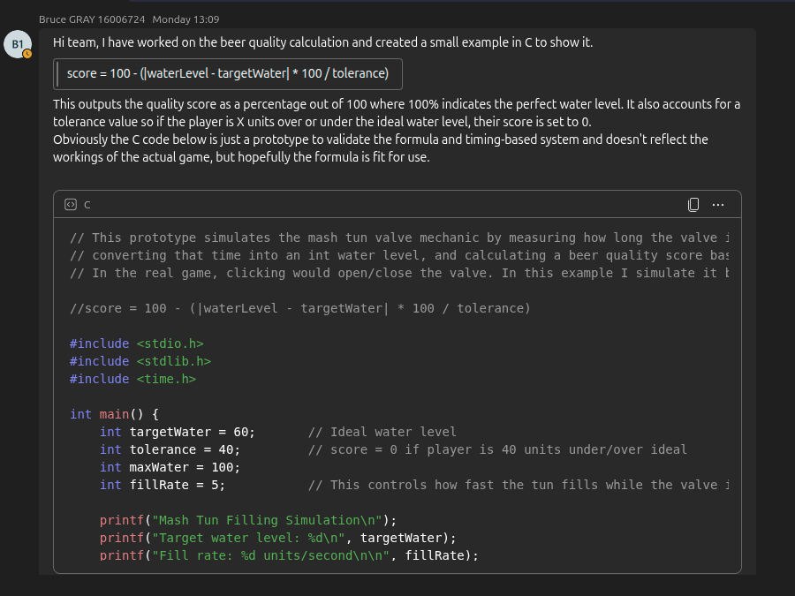

Slide 7


Added first FX + Track
Gracjan Blazejowski

Slide 8
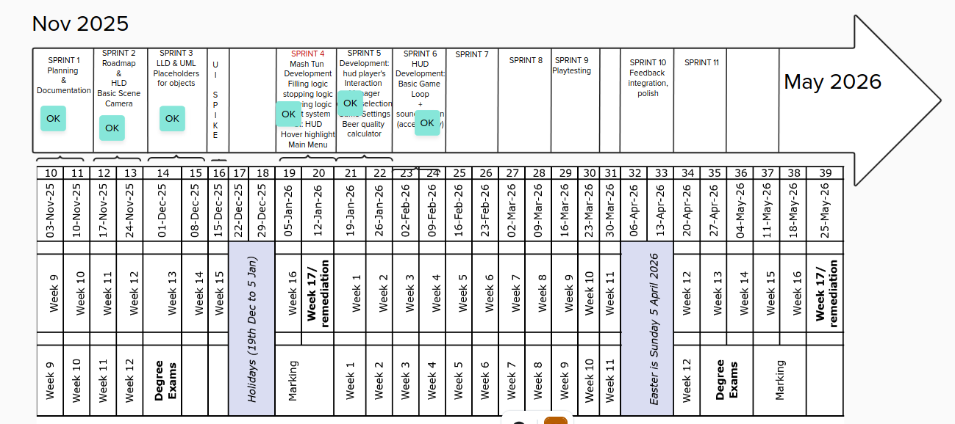

Slide 9
Thank you!
The Brewing Game

