Slide 1
Journal

Slide 4
What is it?

Slide 5

Journal

Slide 6
Journal
Diet

Slide 7
Journal
Diet
Exercise

Slide 8
Journal
Diet
Exercise
More productive

Slide 9
Journal
Diet
Exercise
More productive
Learn the law
Water the dog on time
Do the taxes
Eat more beans
Go to church
Fight crime
End starvation
Solve the rocket problem

Slide 10
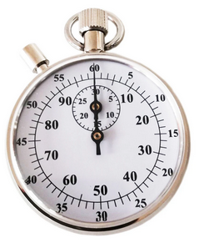

Accounting 101

Slide 11

Introducing

Slide 12
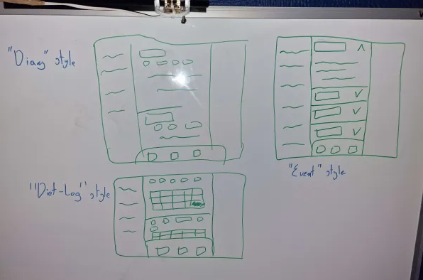
Fits different purposes

Slide 14
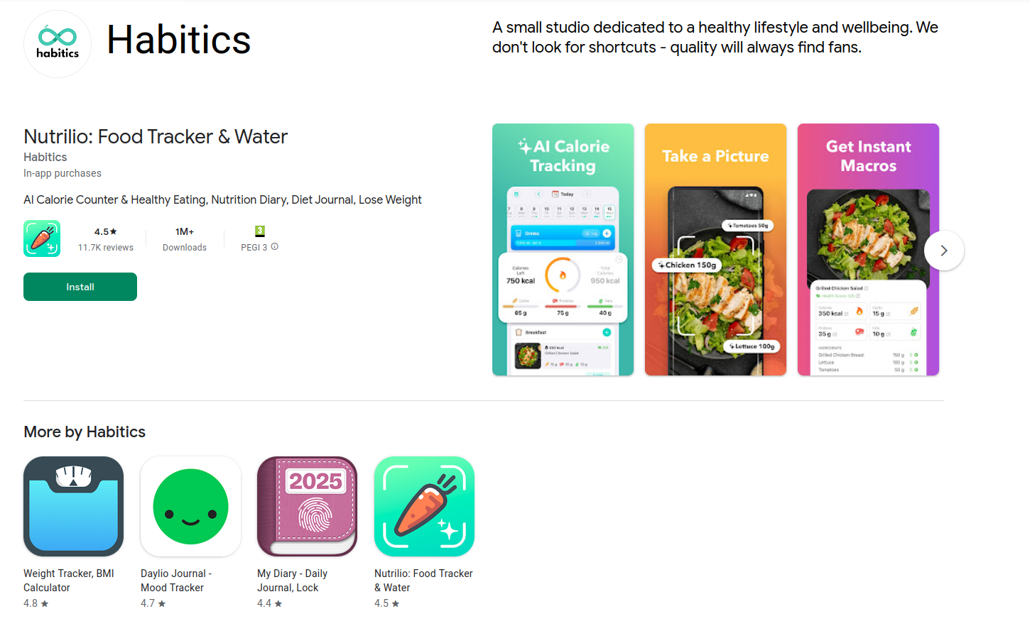
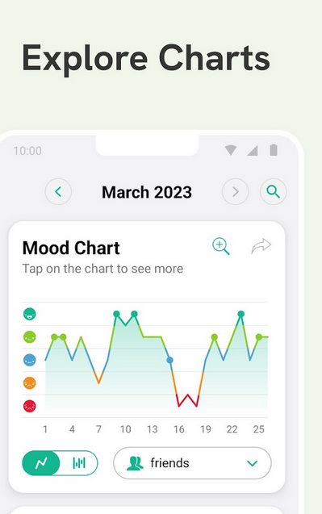
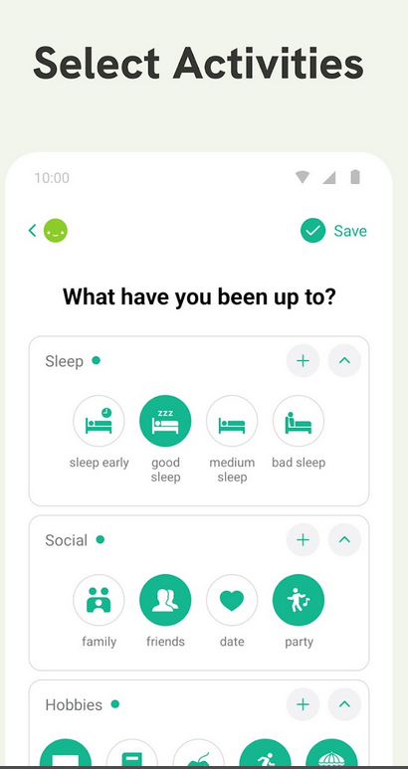

Main competitor

Slide 15
Caught lacking
PC integration
Single purpose
Low modularity

