Slide 1
Personal Developer API
Python/Flask

Slide 2
https://github.com/Ryboster/Personal_RESTful_API
https://blazejowski.co.uk

Slide 3


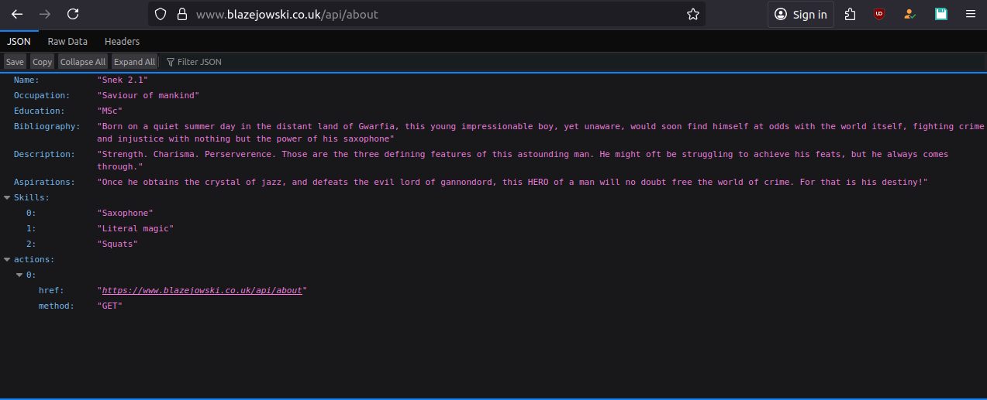
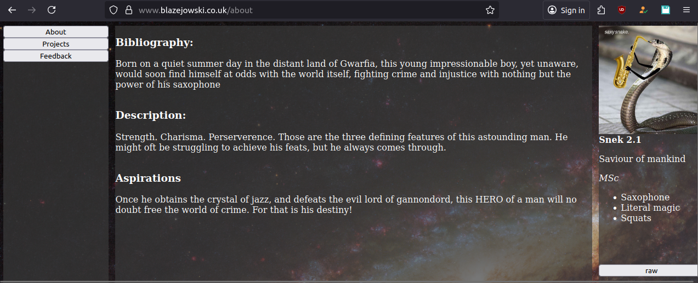

Slide 4
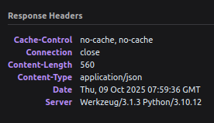
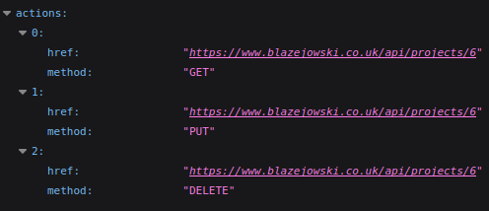
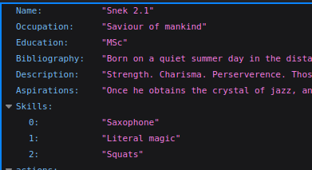
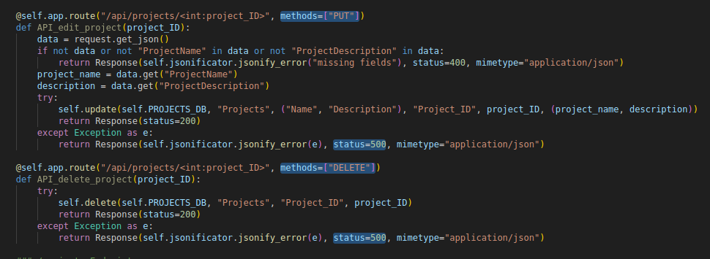
Fully REST compliant
JSON
HATEOAS explicit caching permissions layered system
Uniform identifiers status codes

Slide 5


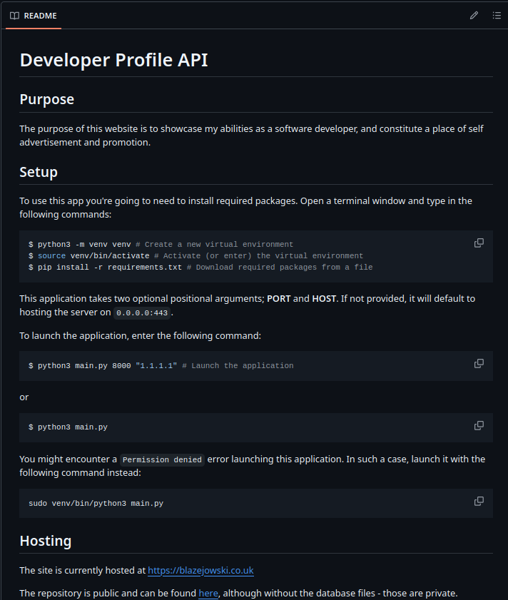
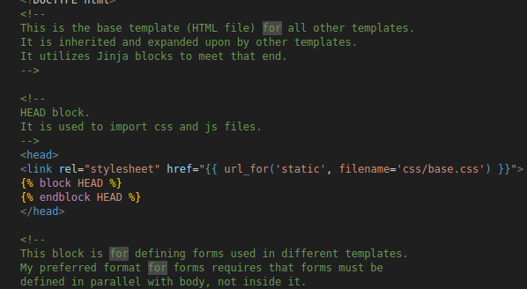
Documentation

Slide 6
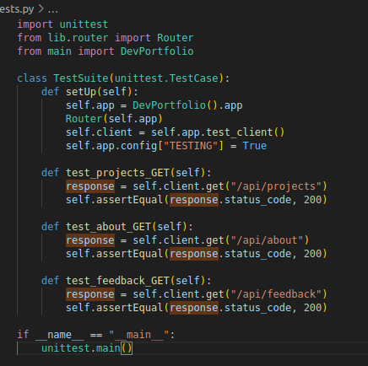
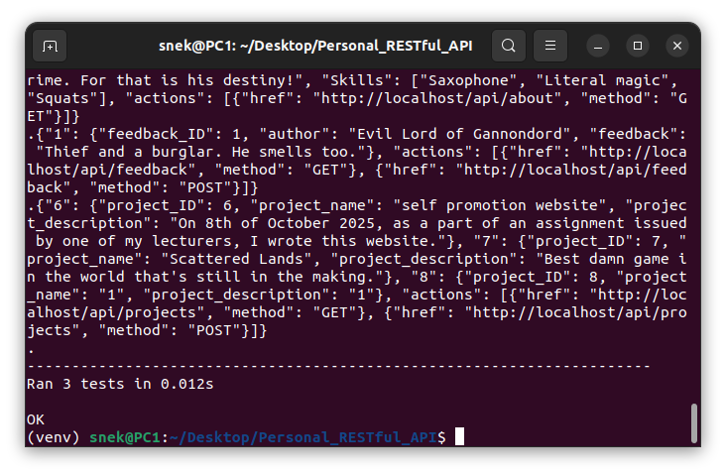
Unit Tests

Slide 7

Database

Slide 8

Future of the website

