Slide 1


Scattered Lands

Slide 2
What’s the product
World Design
Archipelago
Different races
Procedurally Generated
Different levels of technological advancement and different technological specializations
Art Style
3D
Low Poly
Isometric camera
Gameplay Focus
RPG
Tycoon
Farming simulator

Slide 3
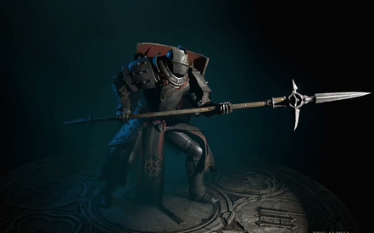
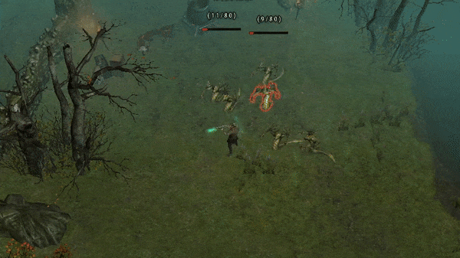
What will it look like?
Combat
Ranged & melee (no magic)
Skill trees
Real-time

Slide 4
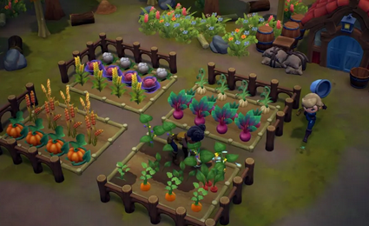
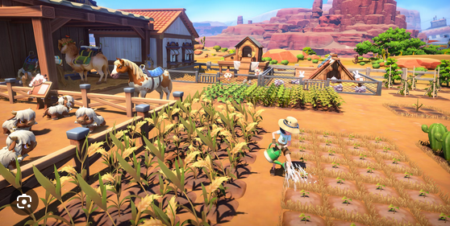
What will it look like?
Farming
Tiled
Animals & Crops
Automation

Slide 5
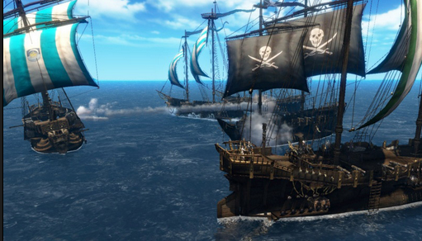
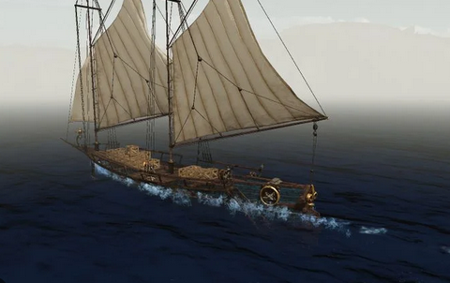
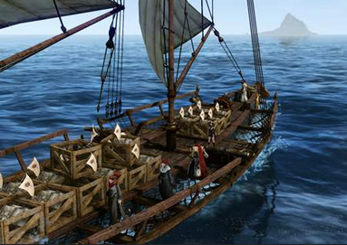
What will it look like?
Sailing
Cargo
Naval Combat
Different Specializations

Slide 6
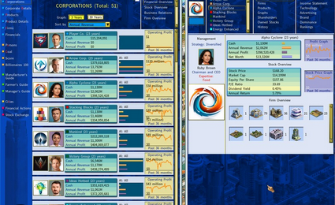
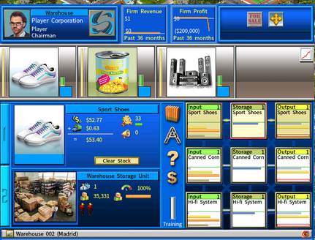
What will it look like?
Economy
Simulated
Trade Driven
Competitive

Slide 7
Milestones and Goals
Our goal is to:
Create a unique and memorable gaming experience
Gain recognition in game dev industry
Build a fan base

Slide 8
Why join us?
You will benefit by:
Hands-on C# experience
Receiving a share of any sales
Gaining a competent understanding of the gamedev toolkit

Slide 9



How to join us
Reach us on:
feazzzerssnake
23017998@uhi.ac.uk
vileider
bogdan@atodorow.com
GRACJAN BLAZEJOWSKI
BOGDAN TODOROW

Slide 10
Q&A
Ask us questions and question our answers

Slide 11
Thank you for your time

