Slide 1
Sprint 6 - Review
The Brewing Game
13th February 2026
Gracjan Blazejowski
Bruce Gray
Marta Grazia
Sergio Eneide
Aaron Stevens

Slide 2
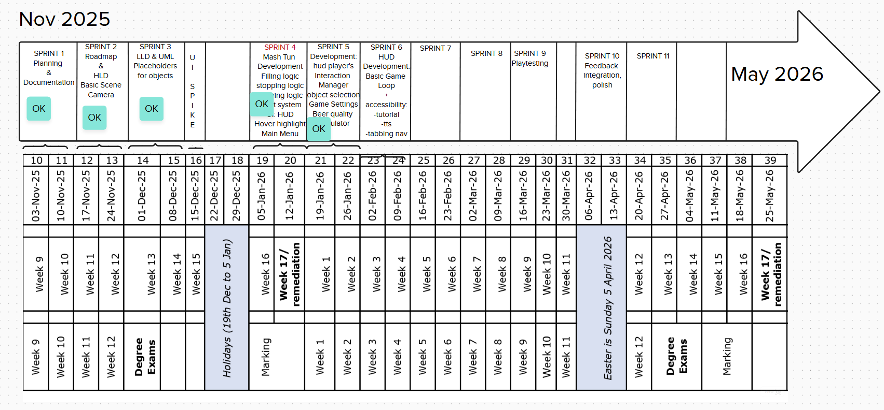

Slide 3
Sprint work
Adding a basic Game Loop
Adding a second Instrument
Adding Tabbing Navigation
Text to Speech research
User Experience Consultation
Adding a tutorial
Adding score calculation formula to the game
Marta Grazia

Slide 4
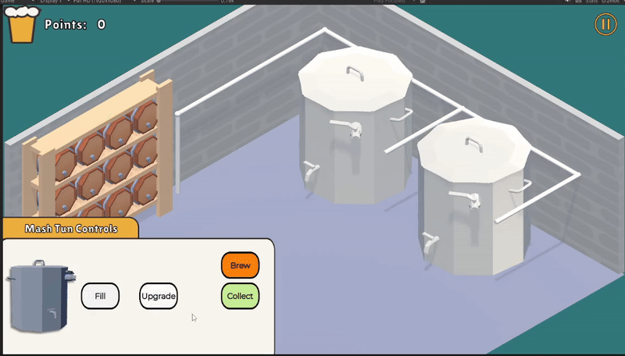
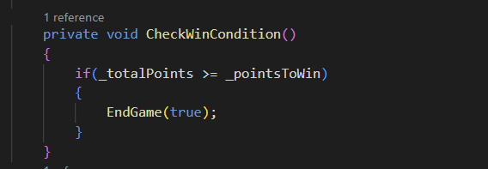
Added
Game Manager and score tracking
Adding a purpose to the game
Marta Grazia

Slide 5
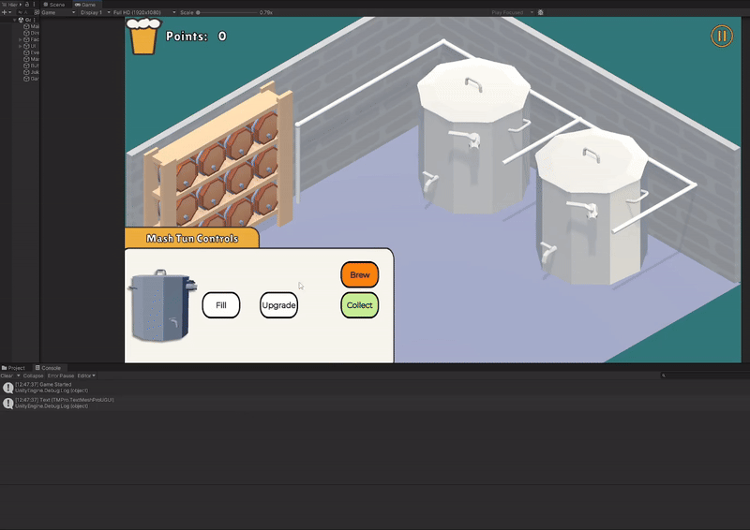
Added a second instrument
More gameplay mechanics
Marta Grazia

Slide 6
Adding accessibility features - Work In Progress
Consultation with Heckie
Tabbing Navigation
Text to Speech research
Marta Grazia

Slide 7
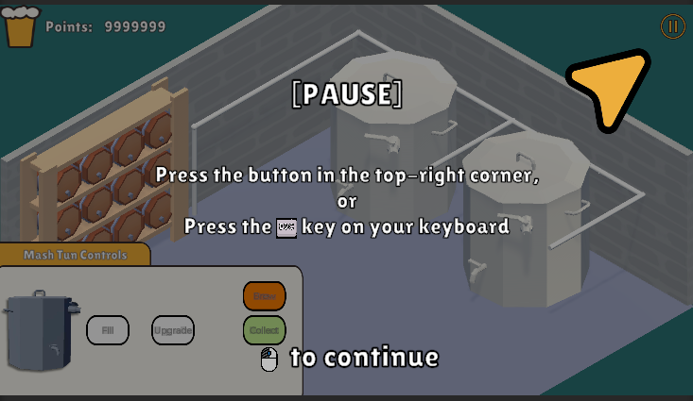
Added Game Tutorial
Decided on the format
Utilized in-text sprites to aid Accessibility
Looking for the most optimal way to “cut through” the fadeout revealing elements below it
Gracjan Blazejowski

Slide 8





Added Game Tutorial
10 slides for now
<15 slides upon completion
Gracjan Blazejowski

Slide 9
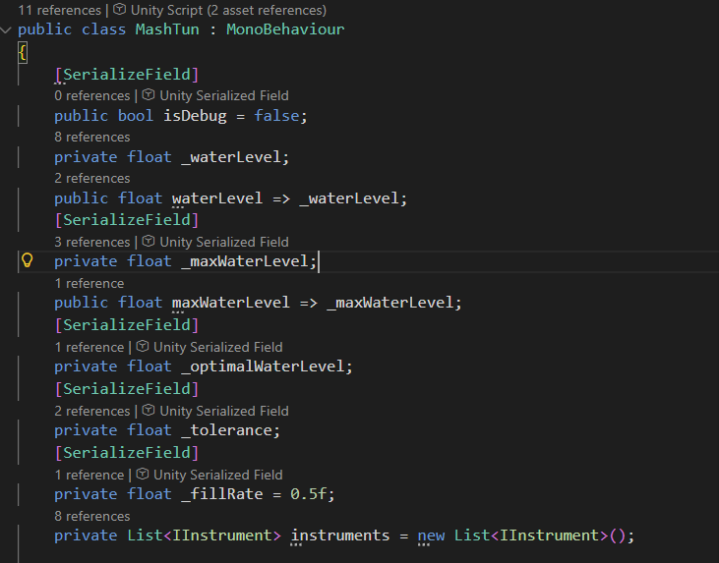
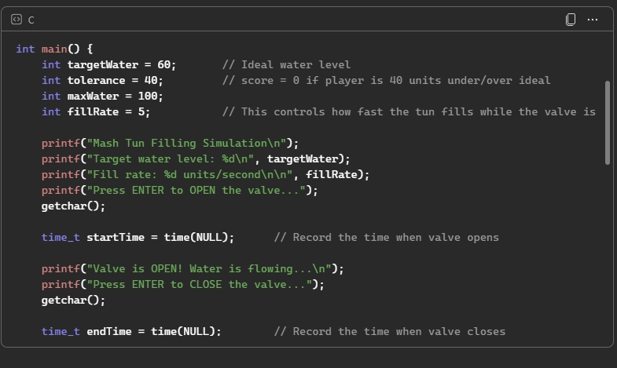
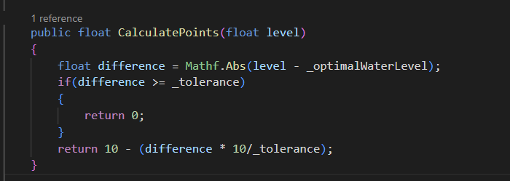
Implemented score calculation formula
Converting the formula in C# and integrating it in the existing codebase
Bruce Gray

Slide 10
Next Sprint
User Feedback integration
Reassess roadmap
Accessibility
Marta Grazia

Slide 11
Thank you!
The Brewing Game’s Team

