Slide 1
Sprint 7 - mid Sprint
The Brewing Game
20th February 2026
Gracjan Blazejowski
Bruce Gray
Marta Grazia
Sergio Eneide
Aaron Stevens

Slide 2
Sprint work
User Feedback integration
Reassess roadmap
Accessibility features
  Keyboard controls
  Text To Speech
  Tutorial
Intro Narrative Script
Rich text storage research and implementation
Instrument Shop System
Marta Grazia

Slide 3
Added
Tabbing Navigation and Selection Feedback
Additional way to interact with the game
Quality Of Life Additions
  Selection feedback
  Active/Inactive HUD
  Changed Hover Highlight color
Marta Grazia

Slide 4
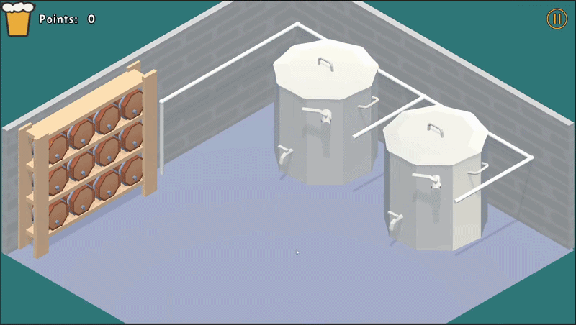
Added
Tabbing Navigation and Selection Feedback
Input Feedback integration + Quality of life
Marta Grazia

Slide 5

Added
Tabbing Navigation and Selection Feedback
Marta Grazia
Keyboard Controls

Slide 6
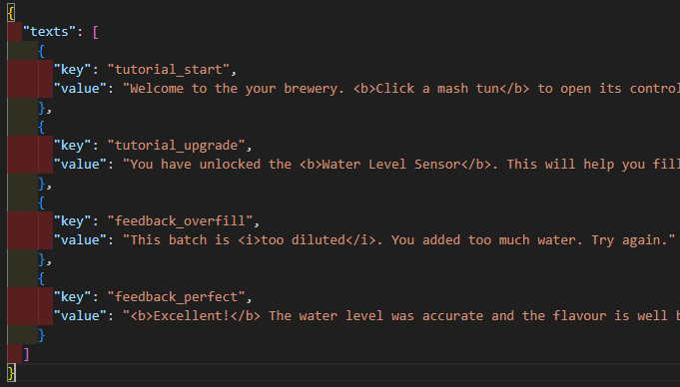
Researched Rich Text Storage in Unity
Researched rich text loading and storage in unity
  Direct storage in Unity objects
  JSON storage
Text To Speech considerations
Bruce Gray

Slide 7
Implementing Instruments Shop - WIP
Users expressed interest in puzzle-focused gameplay
Picking the instrument to install adds cognitive work helping the educational process
Current upgrade system already meets MVP
Gracjan Blazejowski

Slide 8
Thank you!
The Brewing Game’s Team

