Slide 1
Computer Science A
Session1

Slide 2
OBJECTIVE
Why programming ? Why Java?
Variables and Data Types
Expressions and assignment Statements
Compound Assignment Operators
Casting and Ranges of Variables.

Slide 3
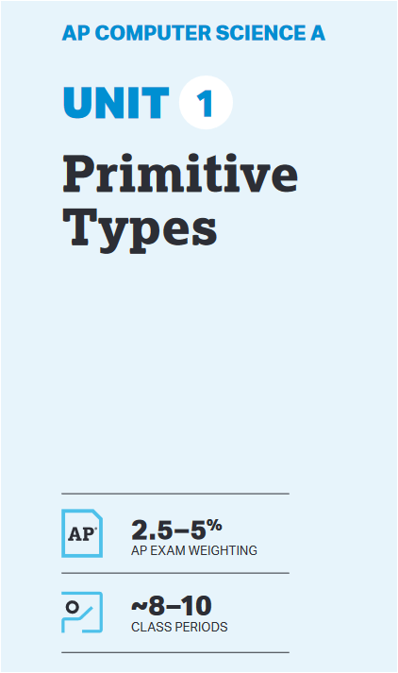
UNIT at a Glance

Slide 4
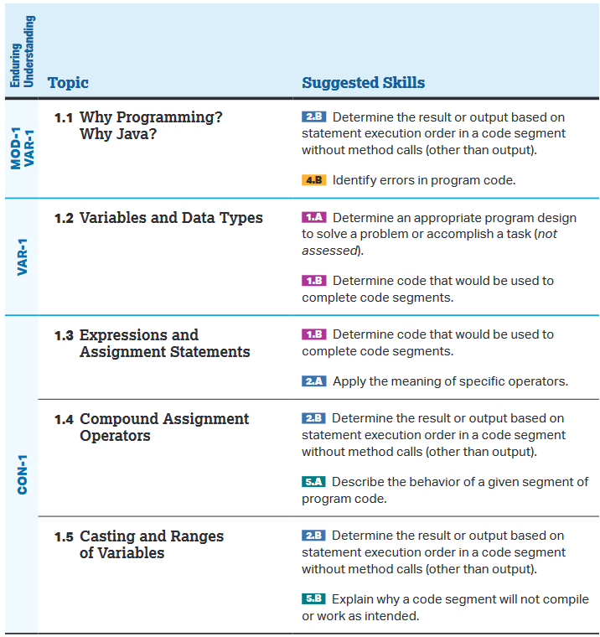
UNIT at a Glance

Slide 5
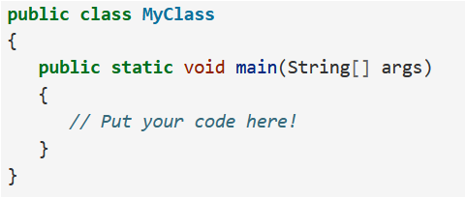
1.1 Why Programming? Why Java?
What do Android phones, Minecraft and Netflix have in common?
Ans→ They are all programmed in Java
Java is a programming language that is used worldwide to create software that we all use.
First Java Program
Every open curly brace must have close curly brace.

Slide 6
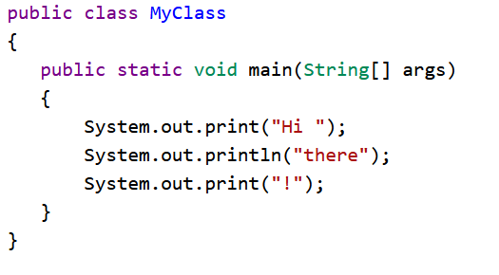
1.1 Why Programming? Why Java?
Print Commands in Java
Java has two different print commands to print output to the screen:
System.out.println() : prints the value followed by new line(ln).
System.out.print(): prints the value without advancing to the next line.
Run this code:

Slide 7
1.1 Why Programming? Why Java?
Important Rules:
Class name must have first letter as capitalized letter.
Methods(function) never ends with semicolon(;)
All other java statement must have semicolon(;) at the end to show end of statement.
Note: if you forget to use semicolon your program won’t compile and run.

Slide 8
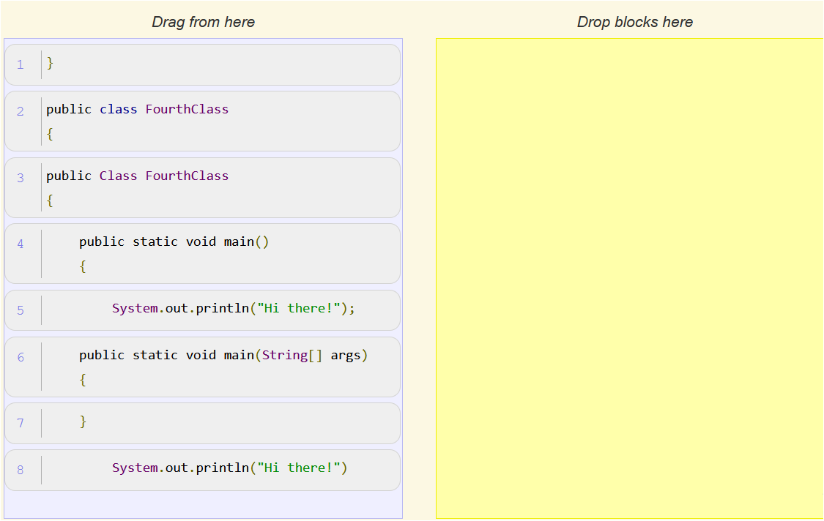
1.1 Why Programming? Why Java?
QUIZ:

Slide 9
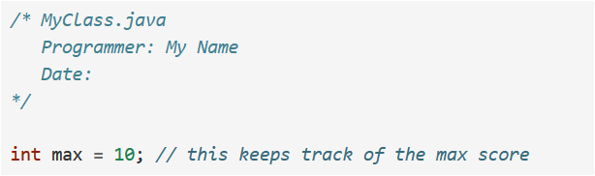
1.1 Why Programming? Why Java?
Comments:
it is a good idea to use comments to make notes to yourself and other programmers working with you.
Comments will not get translated to machine language by the compiler.

Slide 10
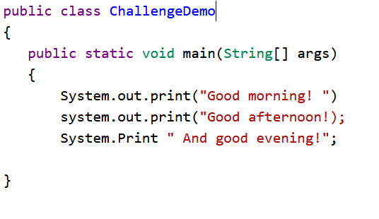
1.1 Why Programming? Why Java?
Debugging Challenge : Fix the code below and show the output.

Slide 11
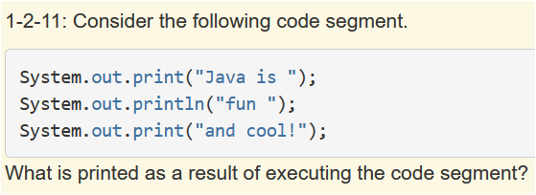
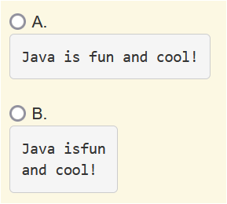
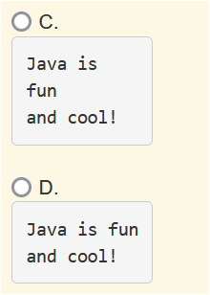
1.1 Why Programming? Why Java?
QUIZ 1.
Ans→ D

Slide 12
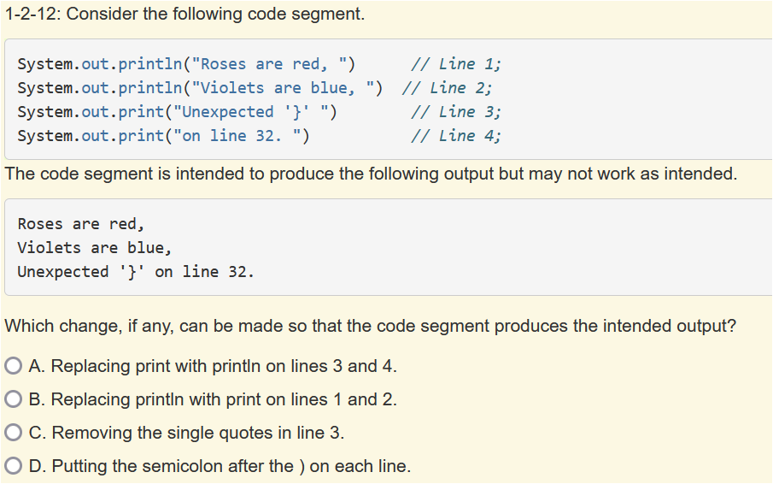
1.1 Why Programming? Why Java?
QUIZ 2.
Ans→ D

Slide 13
1.2 Variables and Data types
What is a Variable?
Ans→ A variable is a name associated with a memory location in the computer, where you can store a value that can change or vary.
What this video[VPN is needed]
https://www.youtube.com/watch?v=pHgYlVjagmA
If you are playing game then score starts at 0 and keeps increasing. So you can have a variable score to store the value.
int score=0;

Slide 14
1.2 Variables and Data types
Data Types?
There are two types of variables in Java
Primitive variables → variables holds the value
Reference variables→ variable holds the address of the location where the value is store
Primitive types on the AP CSA exam are :
int : which store integers(number like 3,-76,2033 and so on……..)
double : which store floating point numbers(decimal number like 6.3, -0.9 and 6623.8)
boolean: which store boolean values(either true or false)
Reference types on the AP CSA exam are:
String : which store text( like “Hello”, “Welcome”)
All other objects of a given class are reference type.

Slide 15
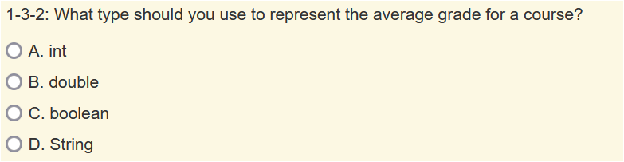
1.2 Variables and Data types
QUIZ 1:
Ans→ B

Slide 16
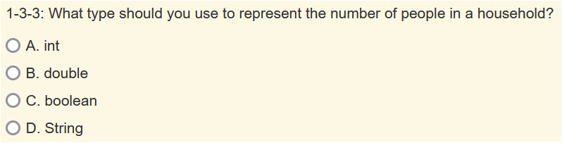
1.2 Variables and Data types
QUIZ 2:
Ans→ A

Slide 17
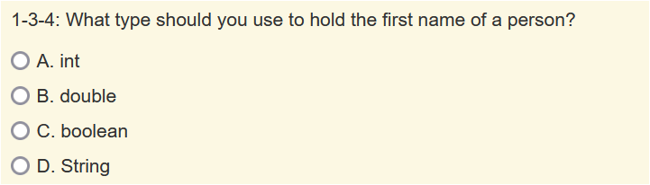
1.2 Variables and Data types
QUIZ 3:
Ans→ D

Slide 18
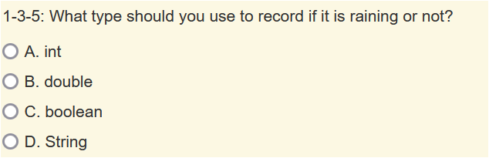
1.2 Variables and Data types
QUIZ 4:
Ans→ C

Slide 19
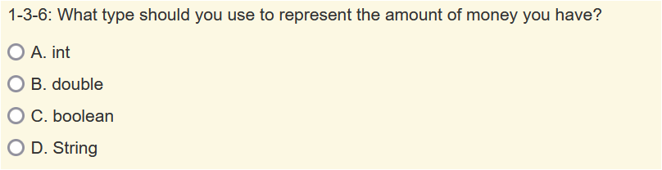
1.2 Variables and Data types
QUIZ 5:
Ans→ B

Slide 20
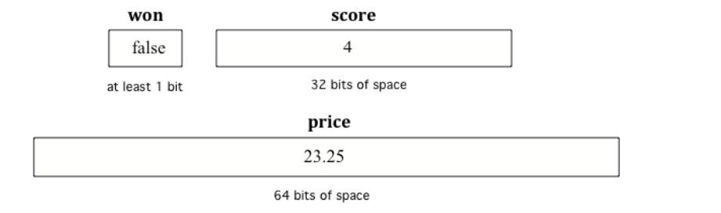
1.2 Variables and Data types
Declaring Variables:
To create a variable , you must tell java its data type and its name. creating variable is also called as declaring variable.
Example:
int age;
Computer allocated
Memory based on
Data types you used.
When we assign value to variable its called as initialization:
age=23; this is initialization.

Slide 21
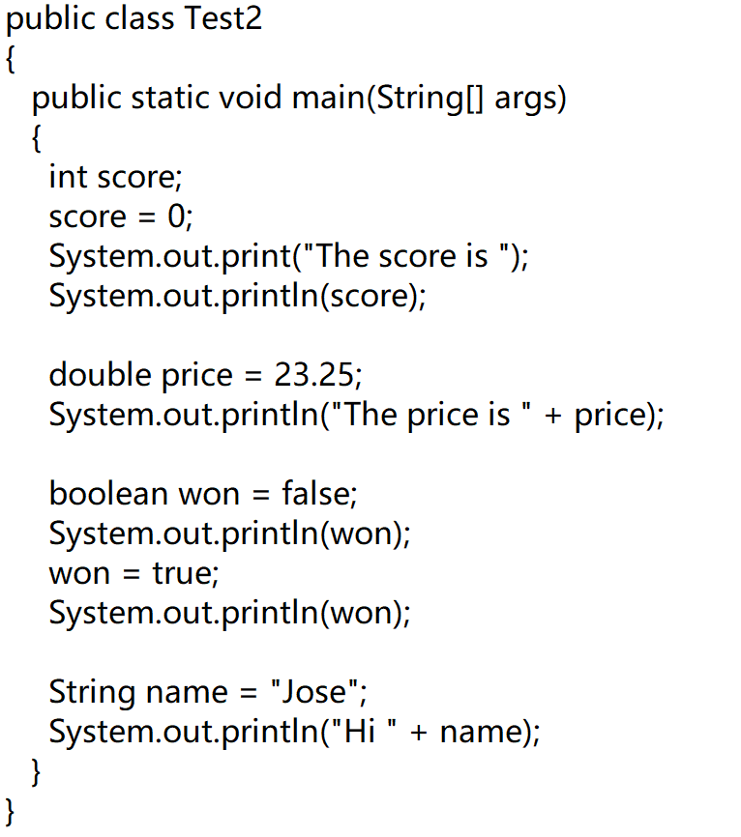
1.2 Variables and Data types
Write and Execute the below code:

Slide 22
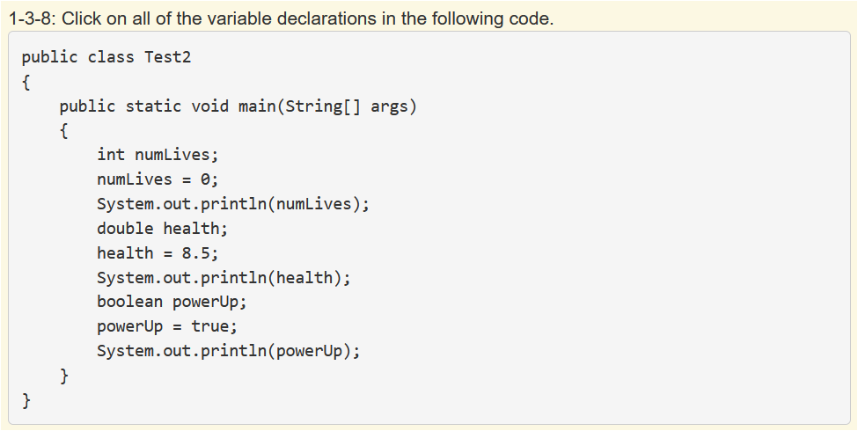
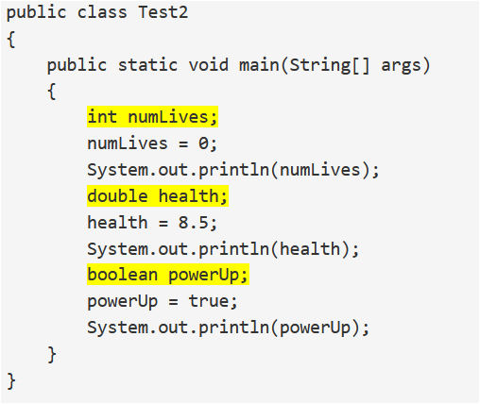
1.2 Variables and Data types
Quiz 1:

Slide 23
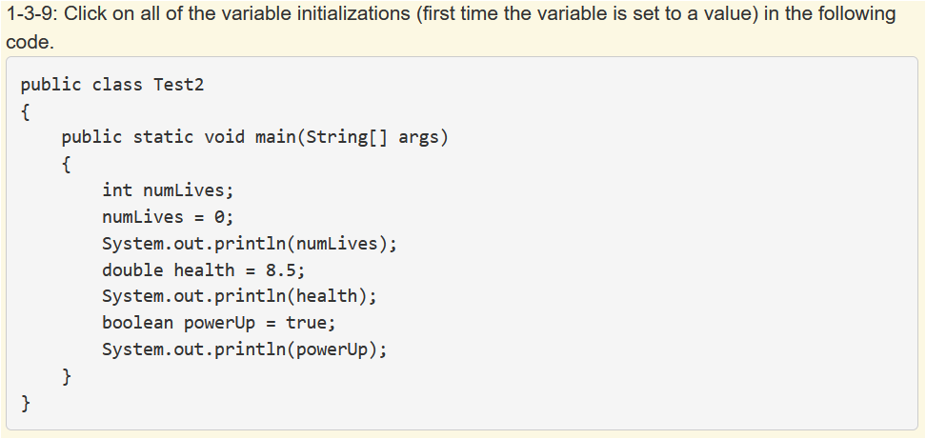
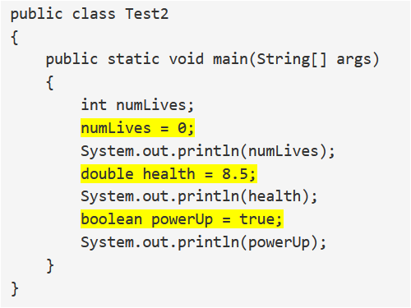
1.2 Variables and Data types
Quiz 2:

Slide 24
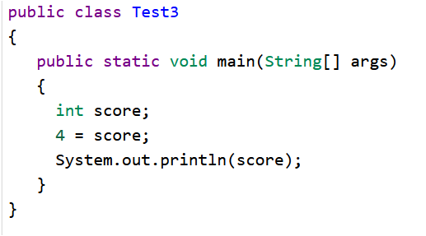
1.2 Variables and Data types
Fix the below code:

Slide 25
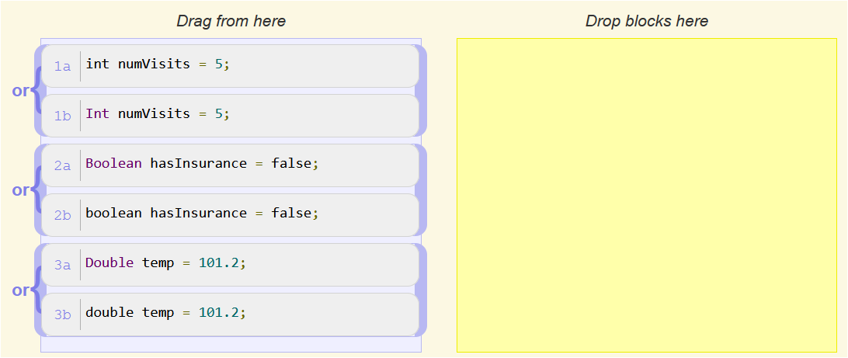
1.2 Variables and Data types
Quiz:

Slide 26
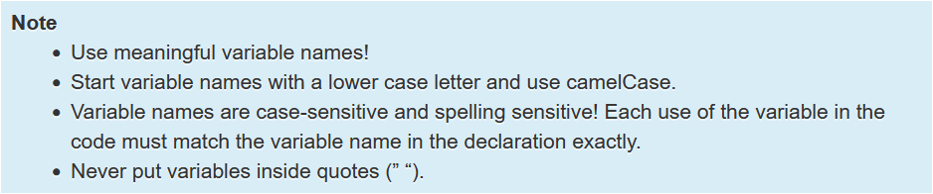
1.2 Variables and Data types
Naming Variables:

Slide 27
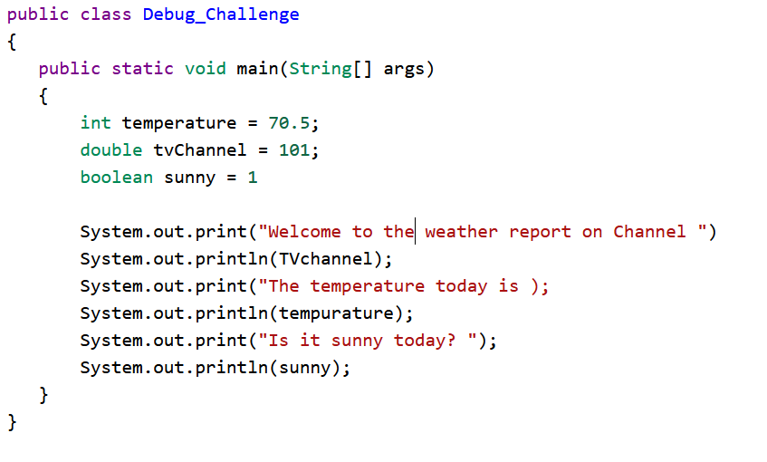
1.2 Variables and Data types
Debug the below code:

Slide 28
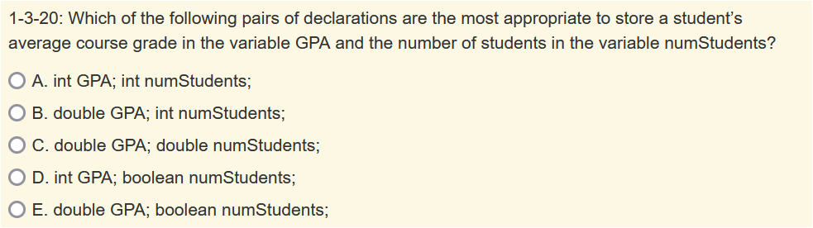
1.2 Variables and Data types
QUIZ :

Slide 29
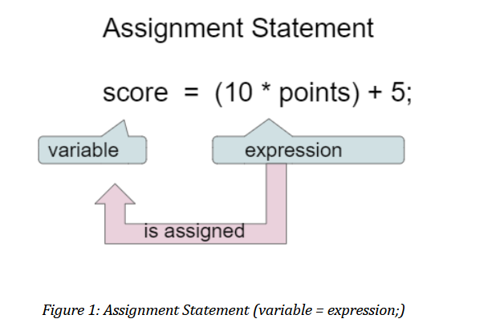
1.3 Expressions and assignment statements
Assignment Statements:
Assignment statements initialize or change the value stored in a variable using the assignment operator =.

Slide 30
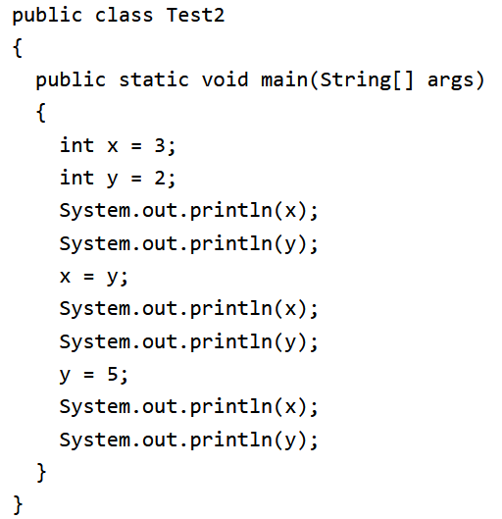
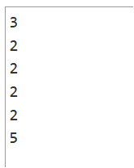
1.3 Expressions and assignment statements
Predict the output of the below code:

Slide 31
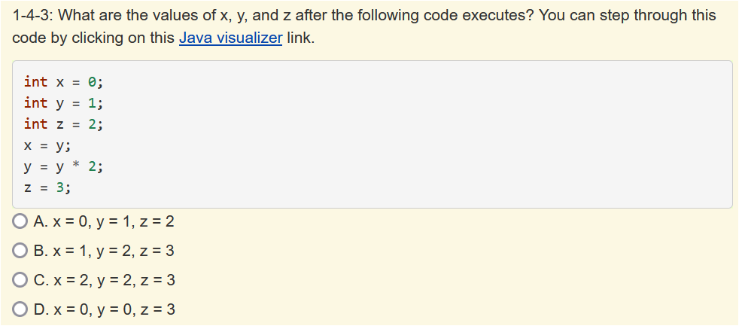
1.3 Expressions and assignment statements
QUIZ 1:
Ans→B

Slide 32
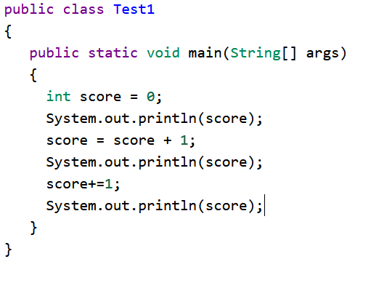
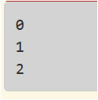
1.3 Expressions and assignment statements
Write a java program to swap values of two variable:
[hint : a=5, b=6 after swap a=6 and b=5]
Adding 1 to a variable:

Slide 33
1.3 Expressions and assignment statements
Operators :
Addition (+)
Subtraction(-)
Division (/)
Multiplication (*)
Double equal (==) → is used to compare values of two variables
Equal (=) → this operator is used to assign values to variable
Not equal (!=) → is used to compare values of two variable

Slide 34
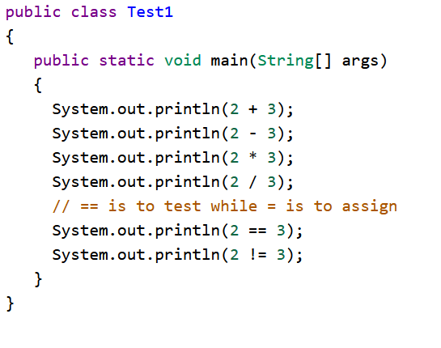
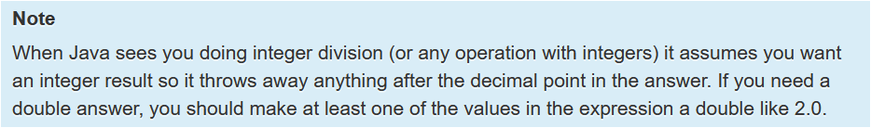
1.3 Expressions and assignment statements
Operators Example: Check this code

Slide 35
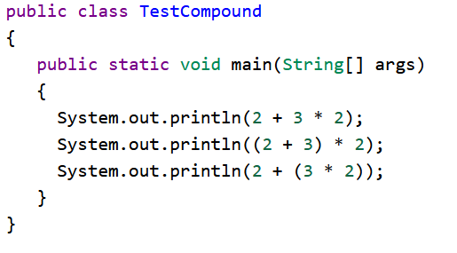

1.3 Expressions and assignment statements
Operators Precedence:
When compound expressions are evaluated , operator precedence rules are used , so that * , / and % are done before + and -.
Anything in parentheses is done first.
Predict the output of the below code:

Slide 36
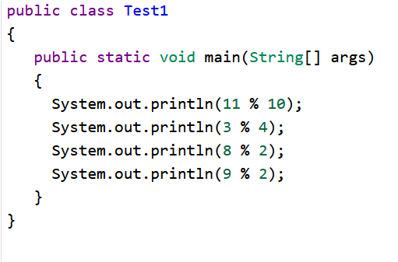
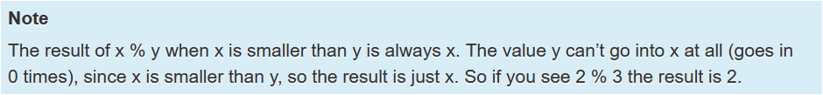

1.3 Expressions and assignment statements
Predict the output of the below code:

Slide 37
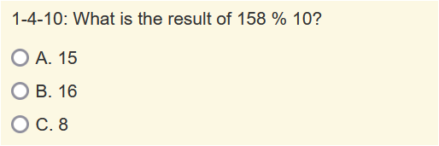
1.3 Expressions and assignment statements
Quiz 1:
Ans→ C

Slide 38
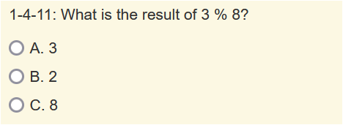
1.3 Expressions and assignment statements
Quiz 2:
Ans→ A

Slide 39
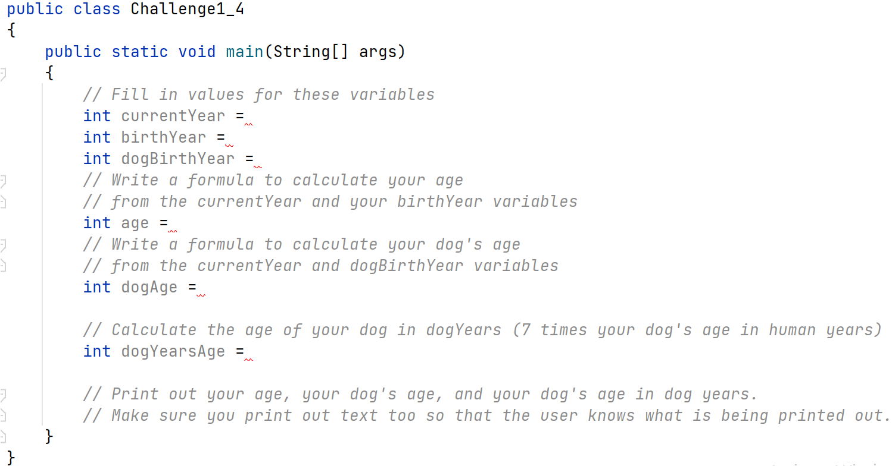
1.3 Expressions and assignment statements
Programming Challenge : Dog Years

Slide 40
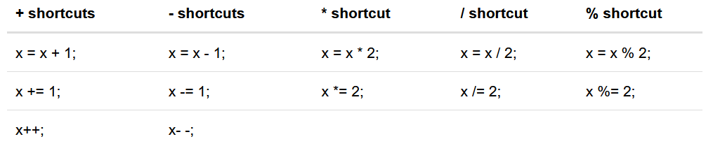
1.4 Compound assignment Operators
Compound assignment operators are shortcuts that do a math operation and assignment in one step.

Slide 41
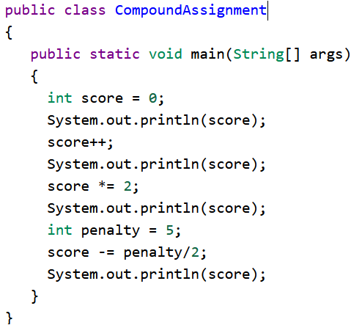
1.4 Compound assignment Operators
Compound assignment operators : Practice the below code.

Slide 42
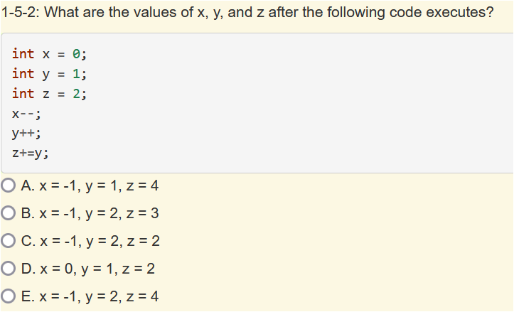
1.4 Compound assignment Operators
QUIZ 1:.
Ans→ E

Slide 43
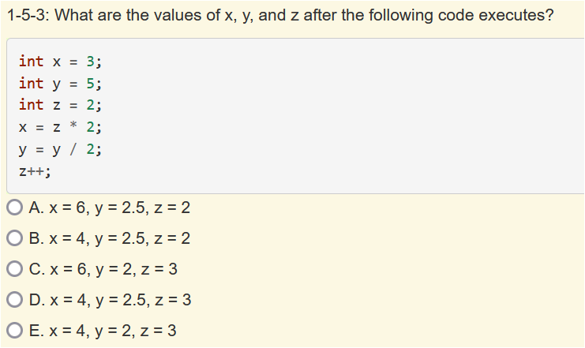
1.4 Compound assignment Operators
QUIZ 1:.
Ans→ E

Slide 44
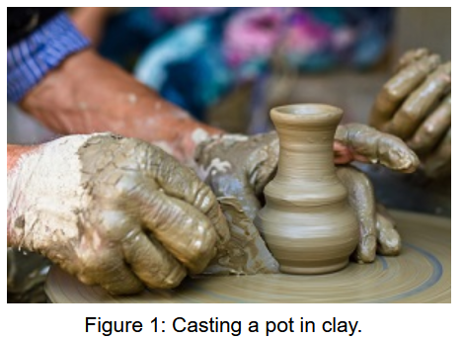
1.5 Casting and ranges of variable
Type Casting : is used to convert variable values from one type to another.
Example:
double money=5000/110 ;
System.out.print(money); -→ 45.0
double money=(double)5000/110; //[Example of Casting]
System.out.print(money); -→ 45.454545

Slide 45
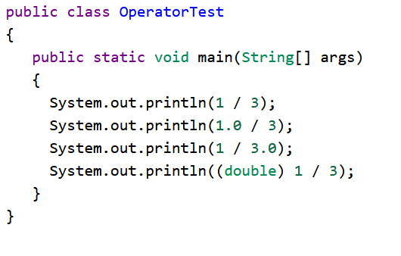
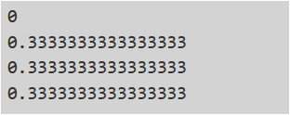
1.5 Casting and ranges of variable
Predict the output for the below code.

Slide 46
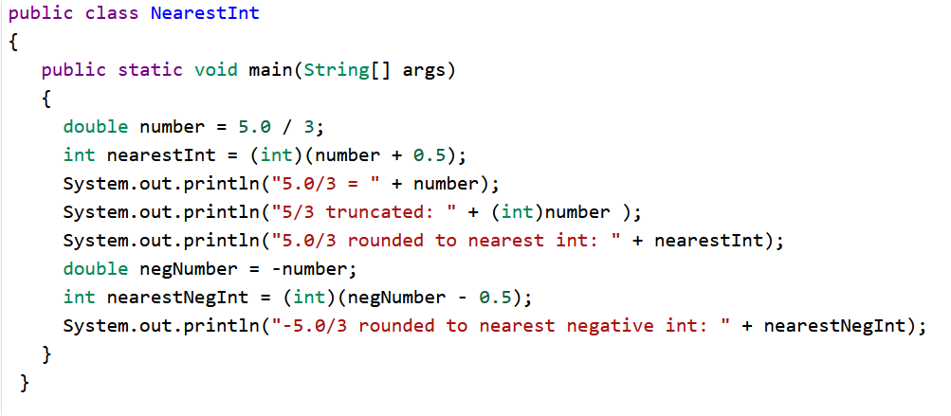
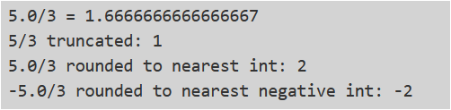
1.5 Casting and ranges of variable
Type the below code and check the output.

Slide 47

1.5 Casting and ranges of variable
QUIZ 1:
Ans→ B

Slide 48

1.5 Casting and ranges of variable
QUIZ 2:
Ans→ B

Slide 49

1.5 Casting and ranges of variable
QUIZ 3:
Ans→ C

Slide 50

1.5 Casting and ranges of variable
Programming Challenge:

Slide 51

1.5 Casting and ranges of variable
Practice below code:

