Slide 1
Computer Science A
Session1

Slide 2
OBJECTIVE
Objects: Instances of Classes
Creating and Storing Objects(Instantiation)
Calling a Void Method
Calling a Void Method with parameters
Calling a Non-void Method

Slide 3
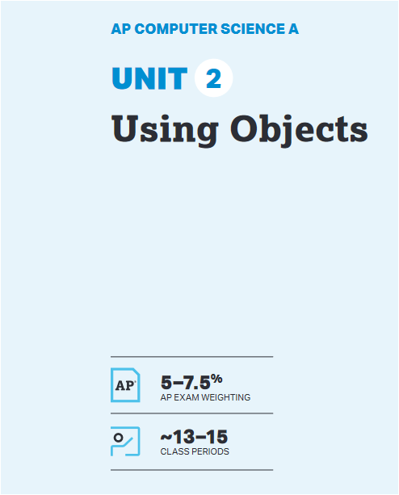
UNIT at a Glance

Slide 4
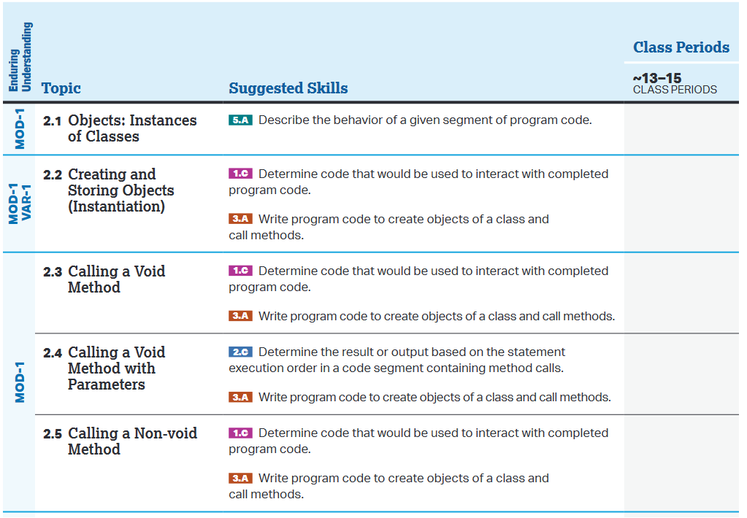
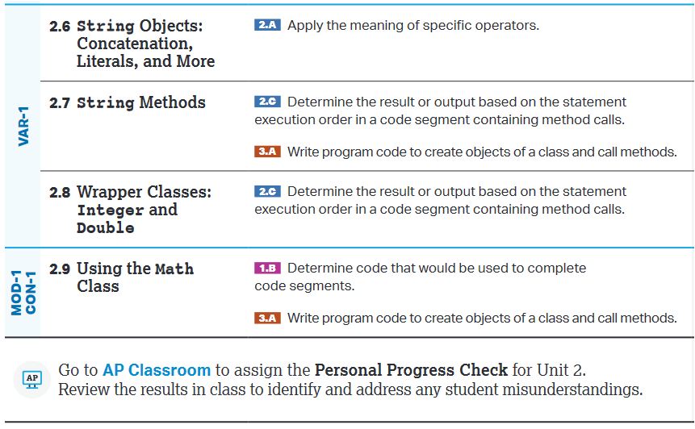
UNIT at a Glance

Slide 5
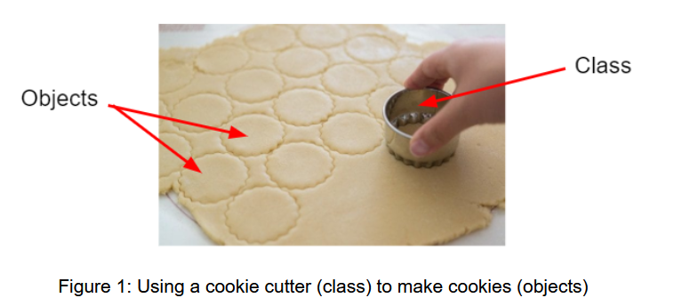
2.1 Objects: Instances of classes
What are Object and Classes?
Object :→ An Object is a specific instance of a class with defined attributes
Example: “akash” is an object or Instance of class Human
class Human has many attributes such as eyeColor, hairColor, height, age.
Class :→ A Class is a blueprint for objects
A Class is the formal implementation of the attributes and behaviors of an object

Slide 6
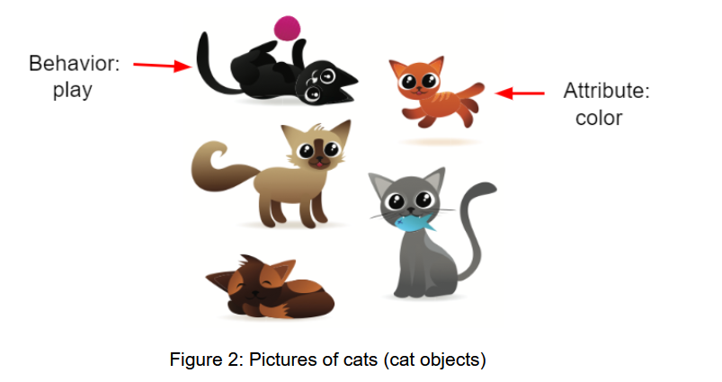
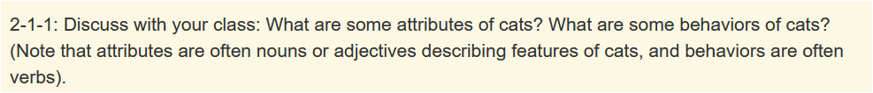
2.1 Objects: Instances of classes
Class implements attributes(Variables) and behaviors(Function/Method) of Objects.
Attributes(variables) in a class is also called as Instance Variable
Object is an Instance of Class

Slide 7
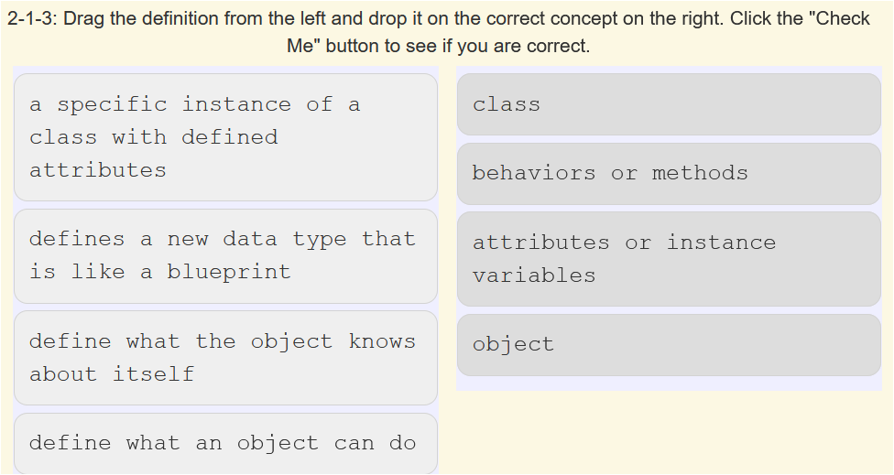
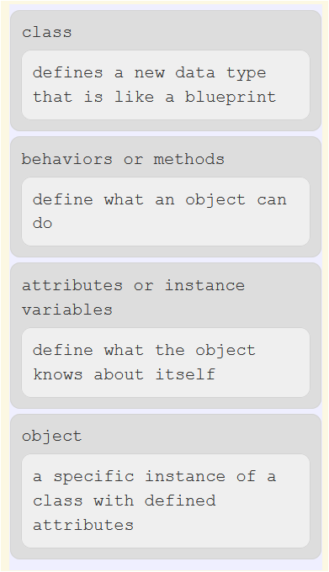
2.1 Objects: Instances of classes
QUIZ:

Slide 8
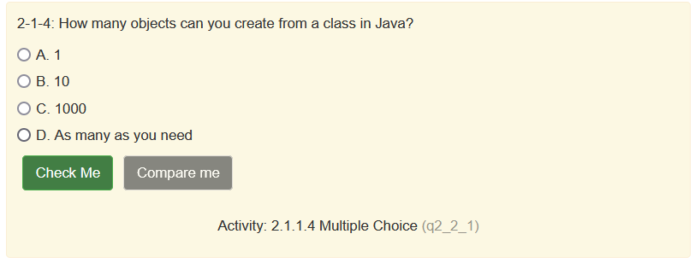
2.1 Objects: Instances of classes
QUIZ:
Ans→ D

Slide 9
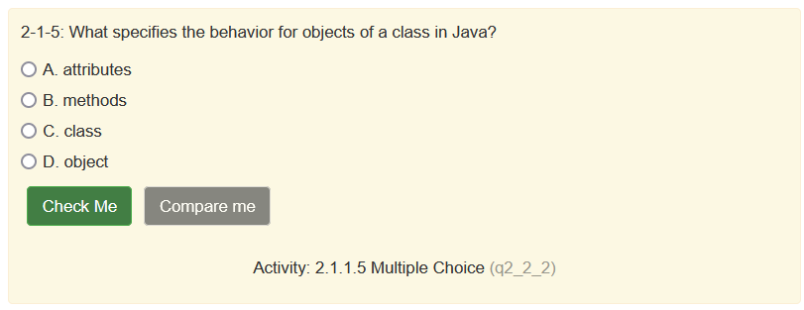
2.1 Objects: Instances of classes
QUIZ:
Ans→ B

Slide 10
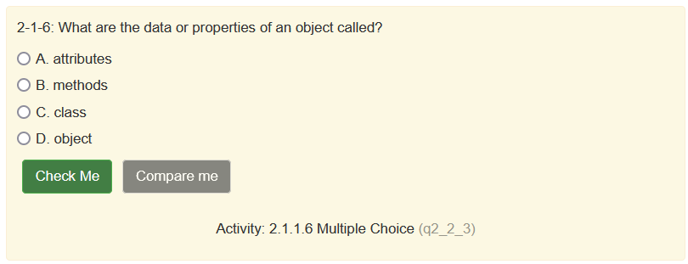
2.1 Objects: Instances of classes
QUIZ:
Ans→ A

Slide 11
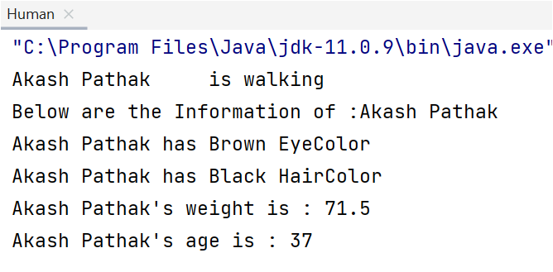
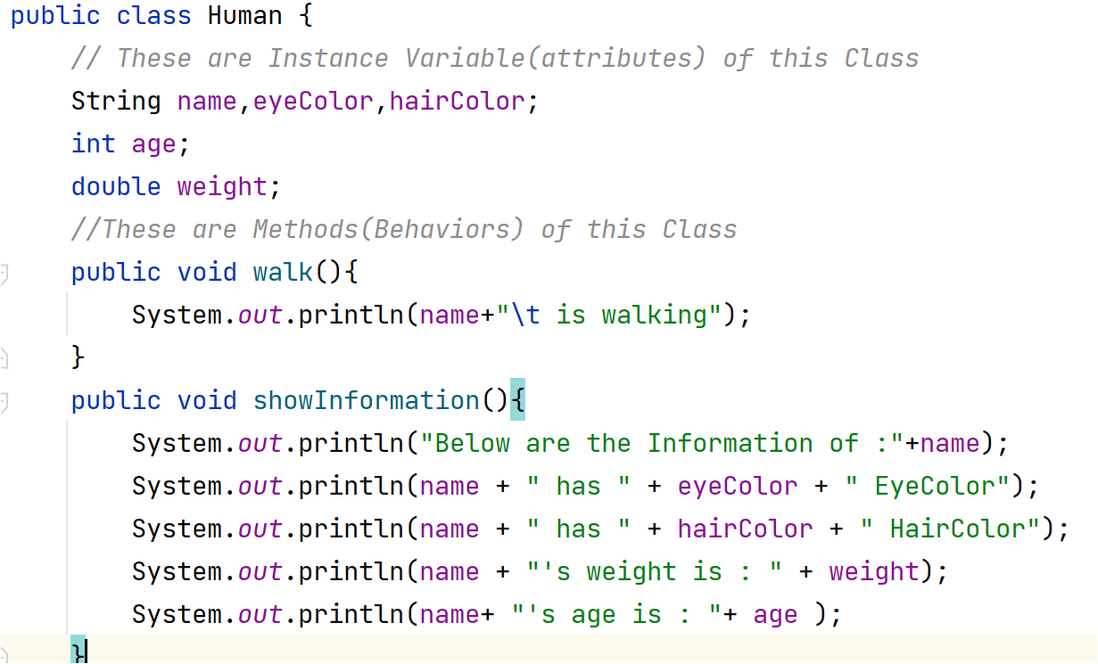
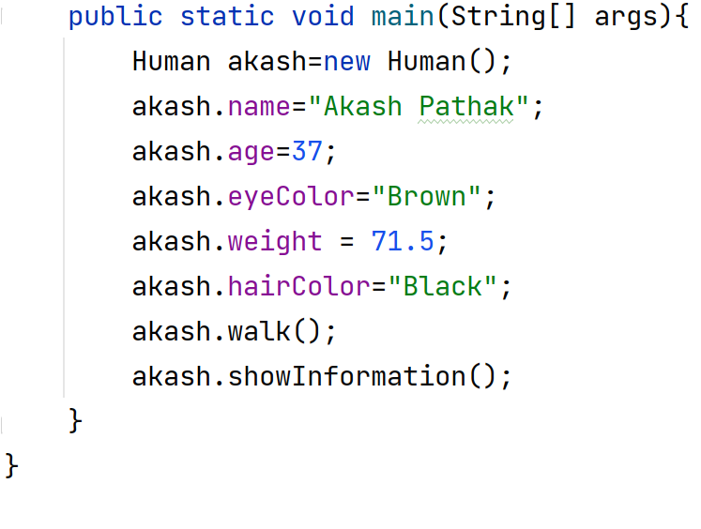
2.1 Objects: Instances of classes
Example :→ Create a Human Class With following attributes and methods
Attributes→ name, eyeColor, hairColor, age and weight
Methods → walk(), showInformation(), acceptInformation()
create objects(Instance) for class Human such as “akash” , “apollo”,”rin”.

Slide 12
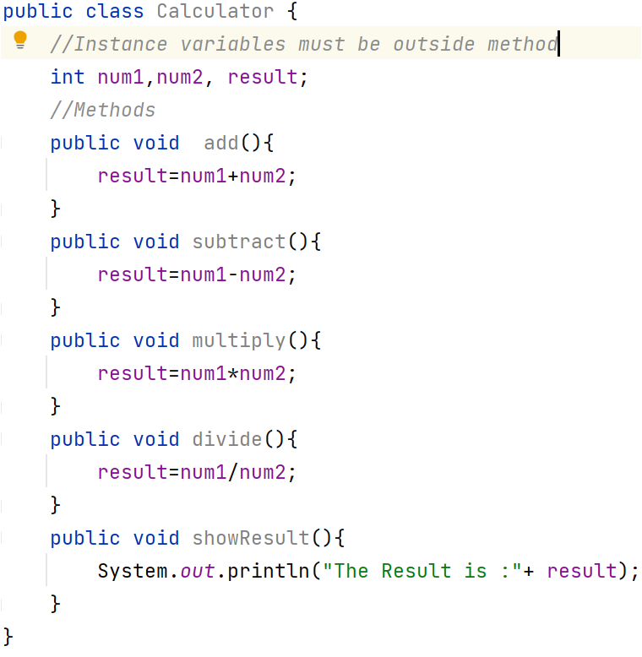
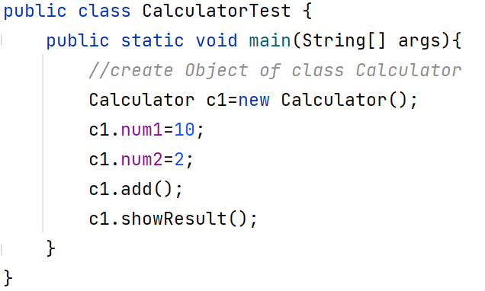
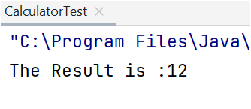
2.1 Objects: Instances of classes
Example :→ Create a class named Calculator with following attributes and methods.
Attributes → num1, num2, result
Methods → add(), subtract(), multiply(), divide(), showResult()
Create another class named CalculatorTest and use the attributes and methods of Calculator class

Slide 13
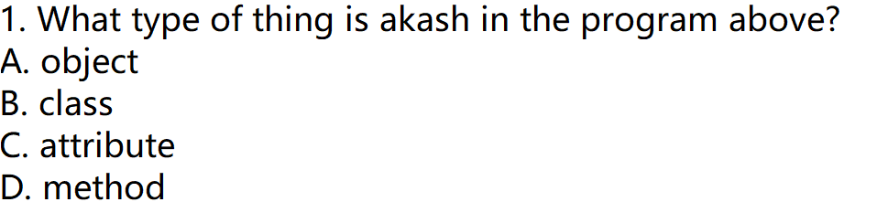
2.1 Objects: Instances of classes
Quiz:
Ans→ A

Slide 14
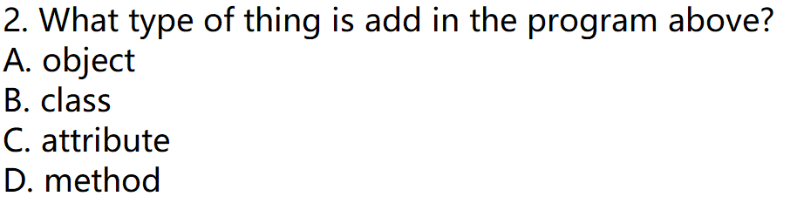
2.1 Objects: Instances of classes
Quiz:
Ans→ D

Slide 15
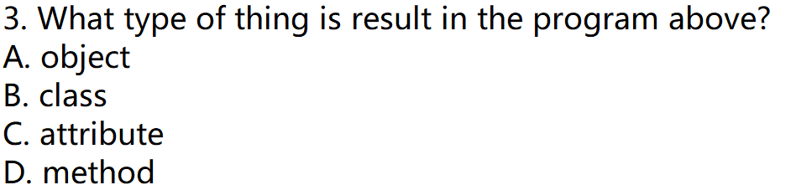
2.1 Objects: Instances of classes
Quiz:
Ans→ C

Slide 16
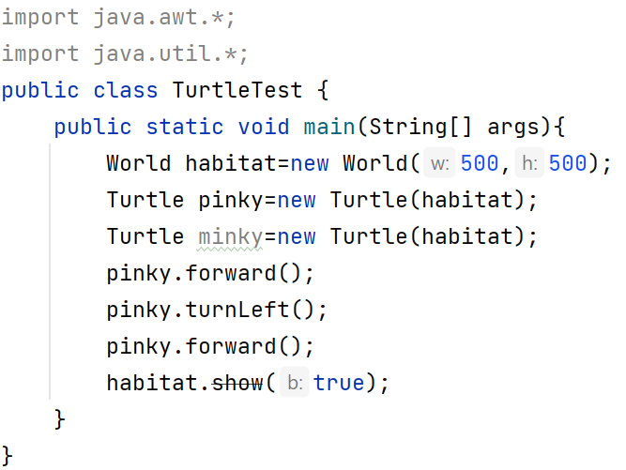
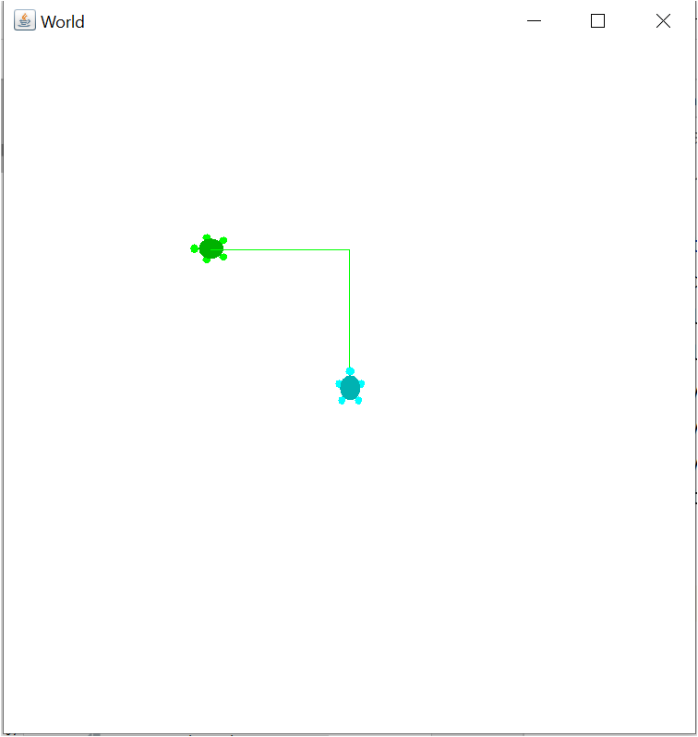
2.1 Objects: Instances of classes
Turtle Example: Use these files in IDE and Complete the task as asked below
Teacher will provide you a folder named “”AllJavaFilesforTurtleExample”
Copy all Javafiles and paste it in src folder of your project.
Recompile the entire project to create class files for the given java files.

Slide 17
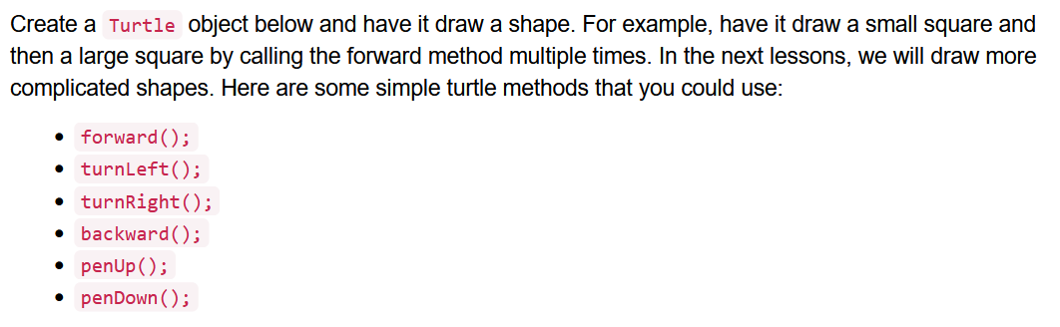
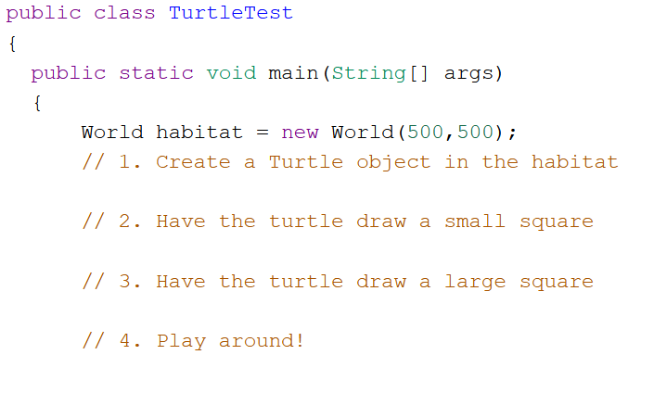
2.1 Objects: Instances of classes
HomeWork: Programming Challenge – 10 Point will awarded …

Slide 18
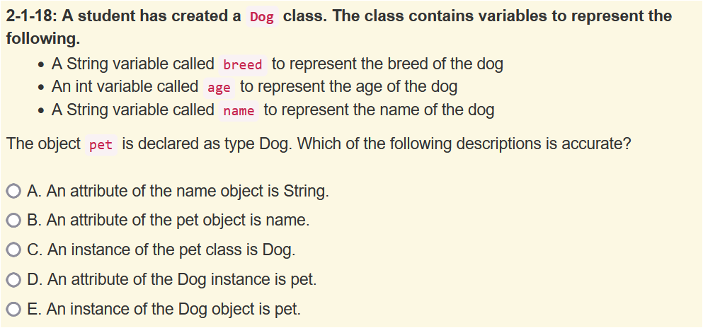
2.1 Objects: Instances of classes
Ans→B

Slide 19
2.2 Creating and Storing Objects(Instantiation)
Constructor : A Special Method
Constructor is a special method whose name is same as the name of the class.
Constructor have no return type.
Constructors are called when we create object of the class
Constructor can have parameter or without Parameter(default constructor)
Many constructors can be created for one class.
Constructors are said to be overloaded when there are multiple constructors with the same name but a different signature.
A Signature Consists of the Constructor name and the parameter list.
The parameter list, in the header of a constructor, lists the type of the values that are passed and their variable names. These are referred to as Formal Parameters.
A parameter is a value that is passed into a constructor . These are referred to as
Actual Parameters.

Slide 20
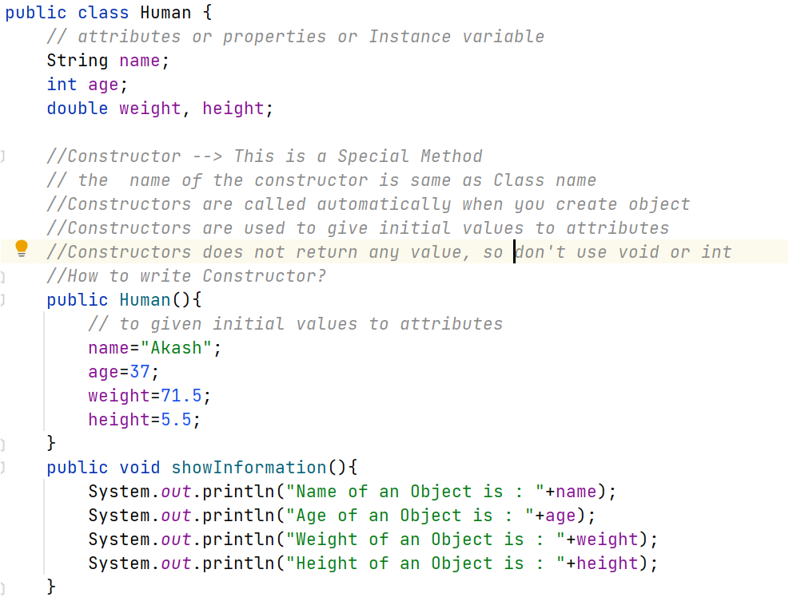
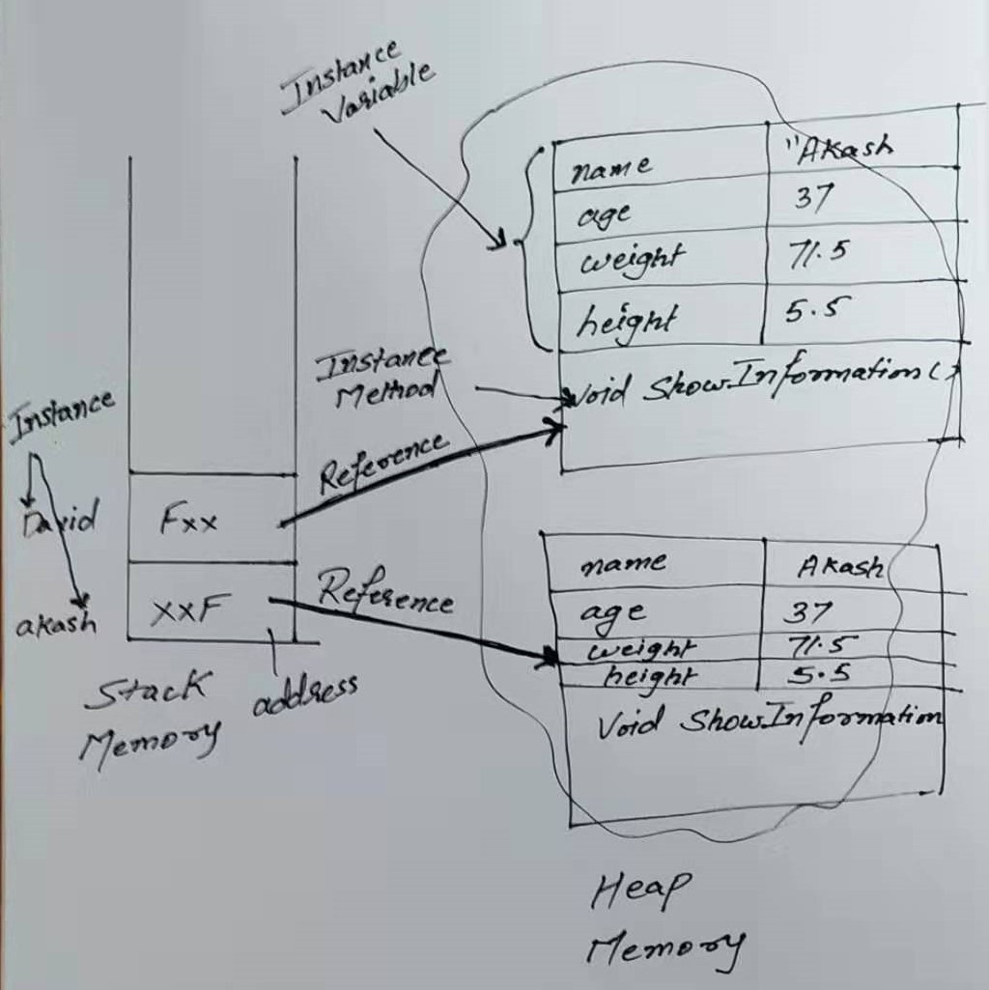
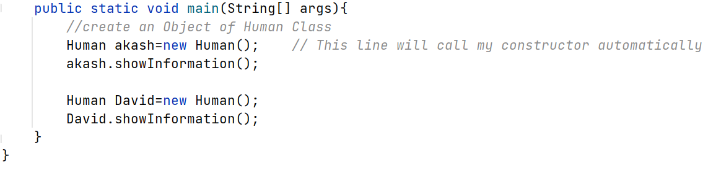
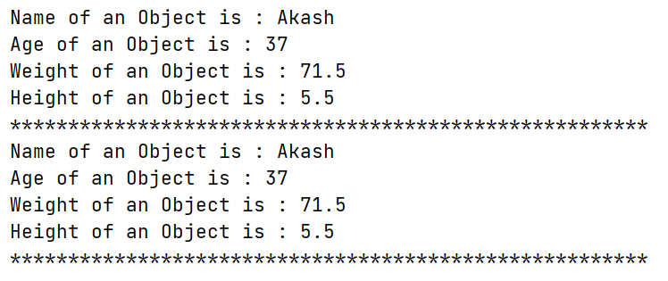
2.2 Creating and Storing Objects(Instantiation)
Constructor without parameter

Slide 21
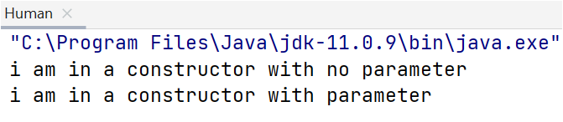
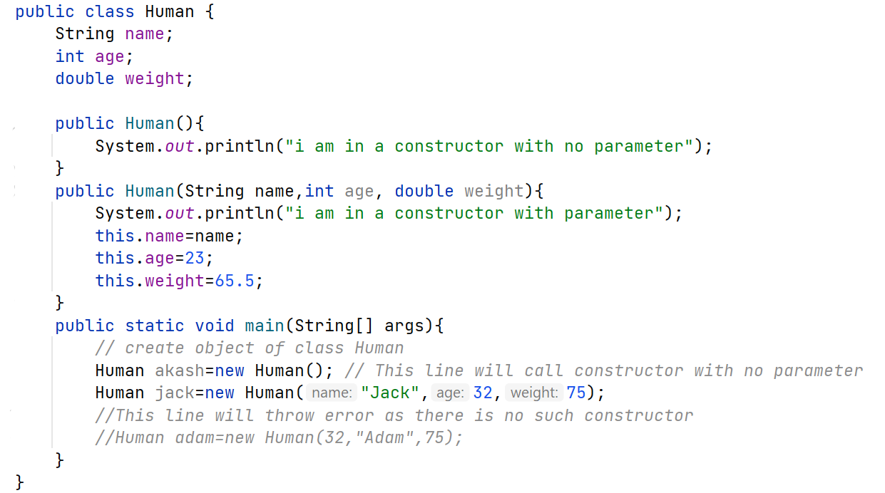
2.2 Creating and Storing Objects(Instantiation)
Constructor : Example
Constructor
Signature->name and parameter list
Parameter list are called formal parameter
Values are Actual parameter
Actual Parameter passed must be compatible with Formal parameter
If not compatible it will give error

Slide 22
2.2 Creating and Storing Objects(Instantiation)
Constructor : With Parameter : Call By Value
Parameters are passed using call by value.
Call by value initialized the formal parameters with copies of the actual parameters.
See the Example on the Next Slide………..

Slide 23
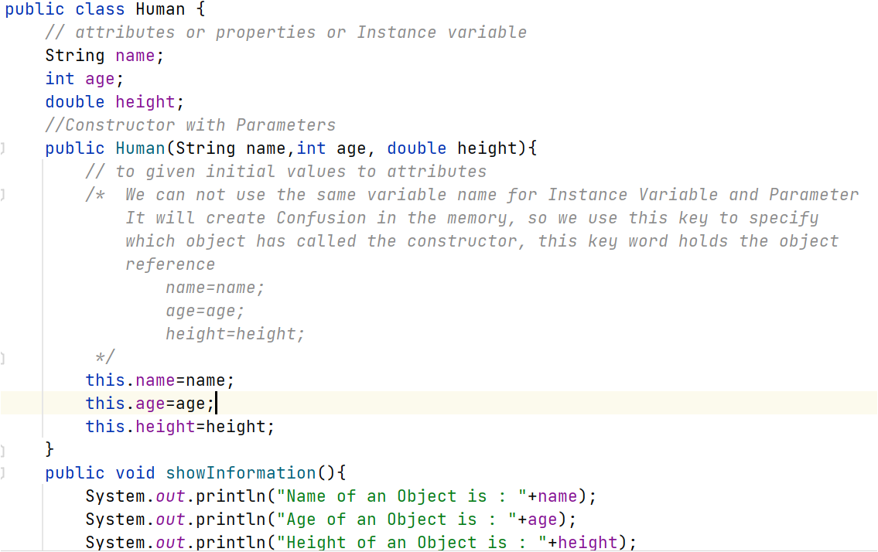
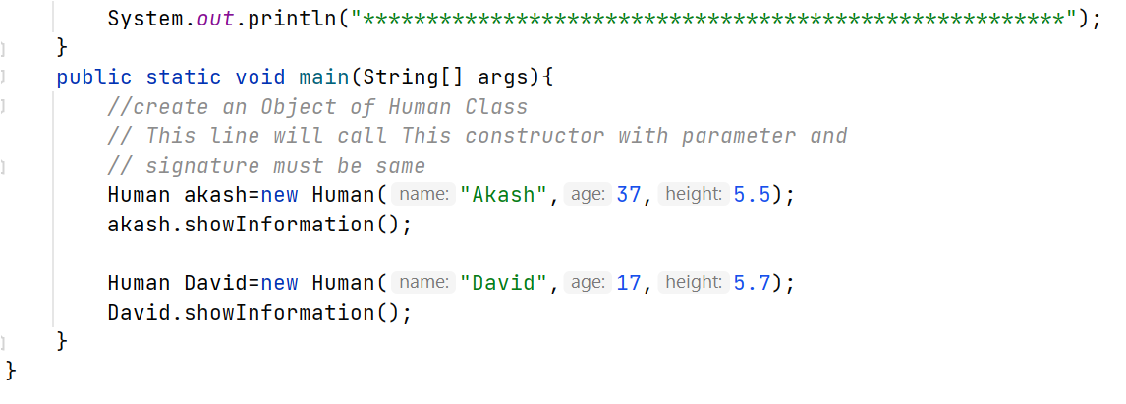
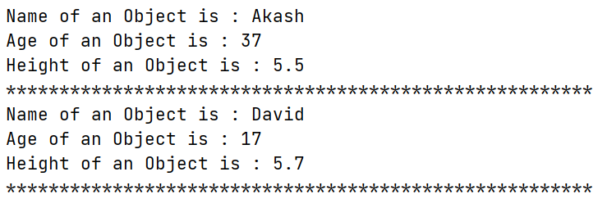
2.2 Creating and Storing Objects(Instantiation)
Constructor : With Parameter : Call By Value

Slide 24
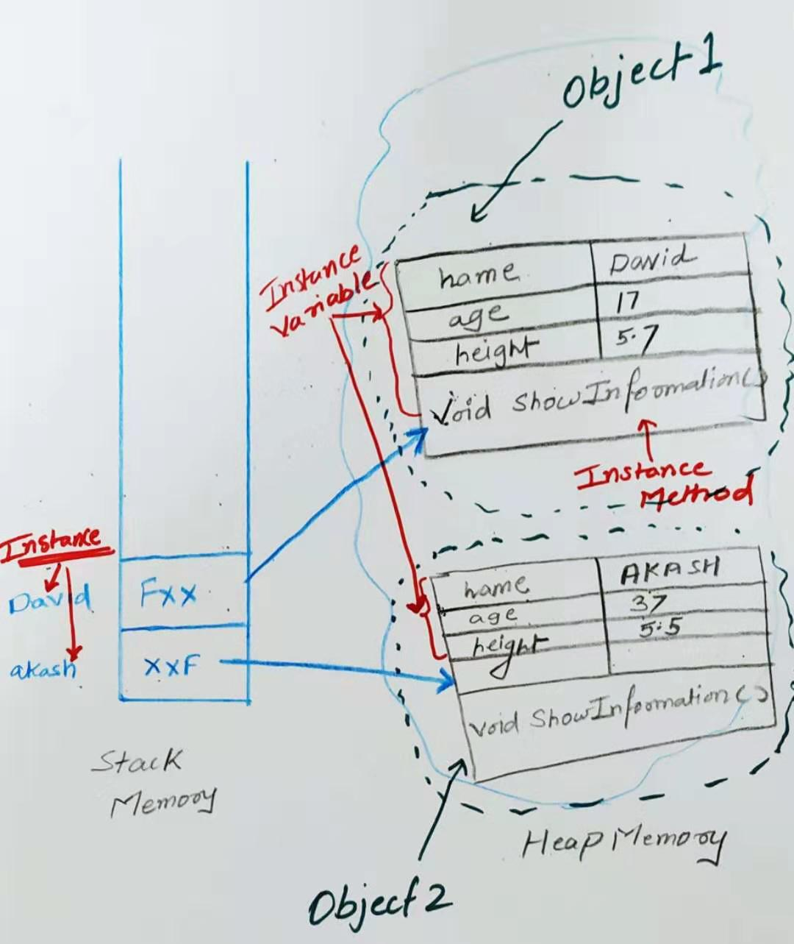
2.2 Creating and Storing Objects(Instantiation)
Constructor : With Parameter : Explanation

Slide 25
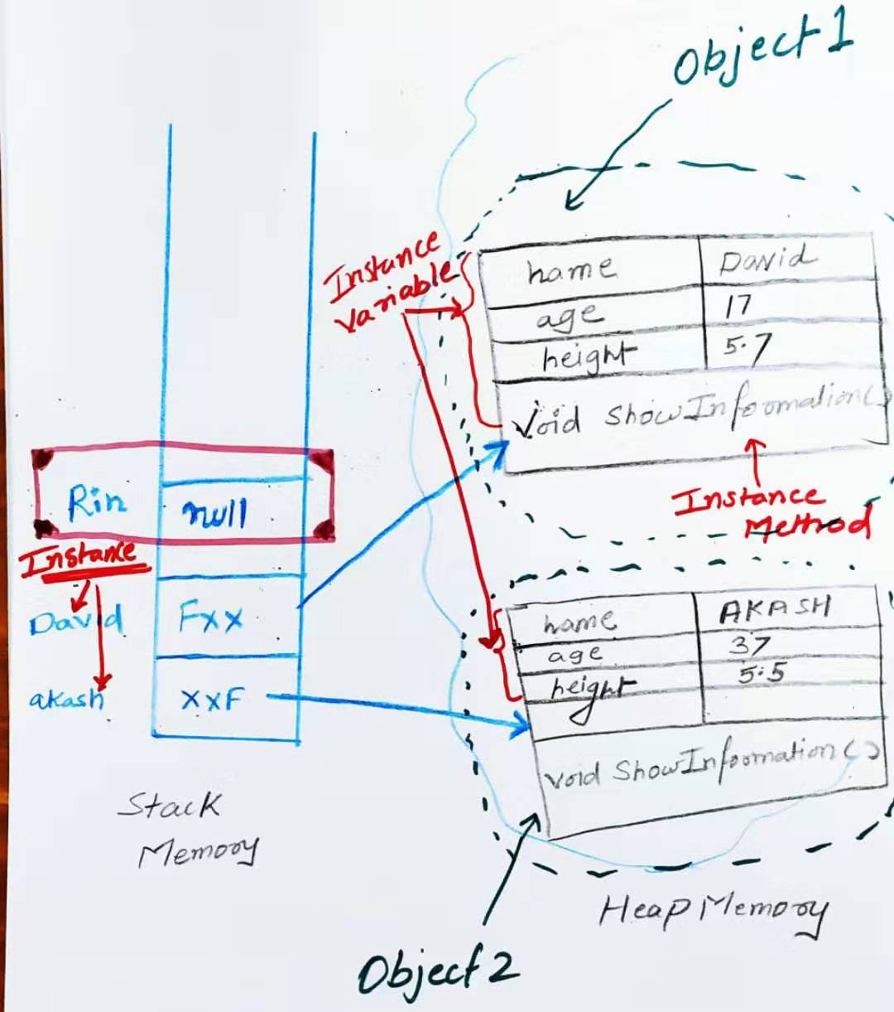
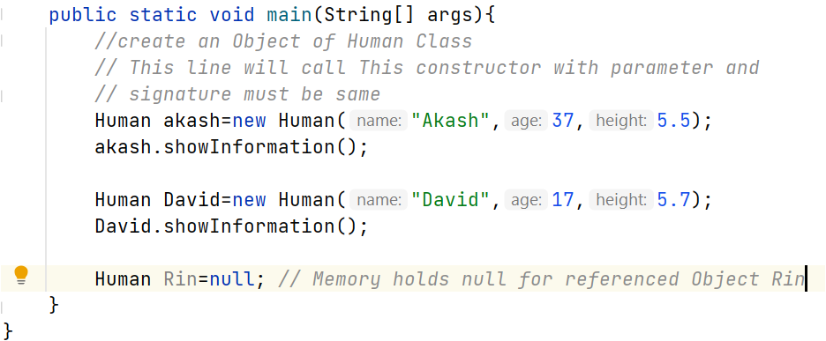
2.2 Creating and Storing Objects(Instantiation)
Keyword null
The keyword null is a special value used to indicate that a reference is not associated with any object.
The Memory associated with a variable of a reference type holds an object reference value
If no object, null is the memory address of the referenced object.

Slide 26
2.2 Creating and Storing Objects(Instantiation)
Constructor : With Parameter : Call By Value
HomeWork:
Create two programs
Class Teacher With Few Attributes , Methods and Constructor—without parameter.
Class Teacher With few Attributes, Methods and Constructor –With parameters.

Slide 27
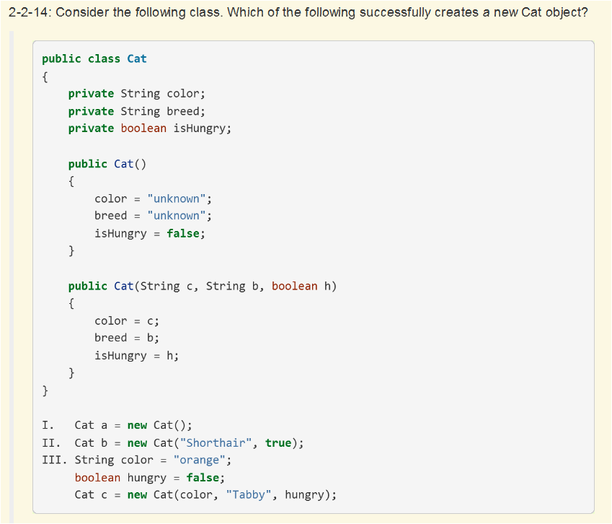
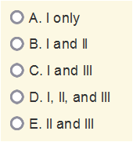
2.2 Creating and Storing Objects(Instantiation)
Quiz:
Ans->C

Slide 28
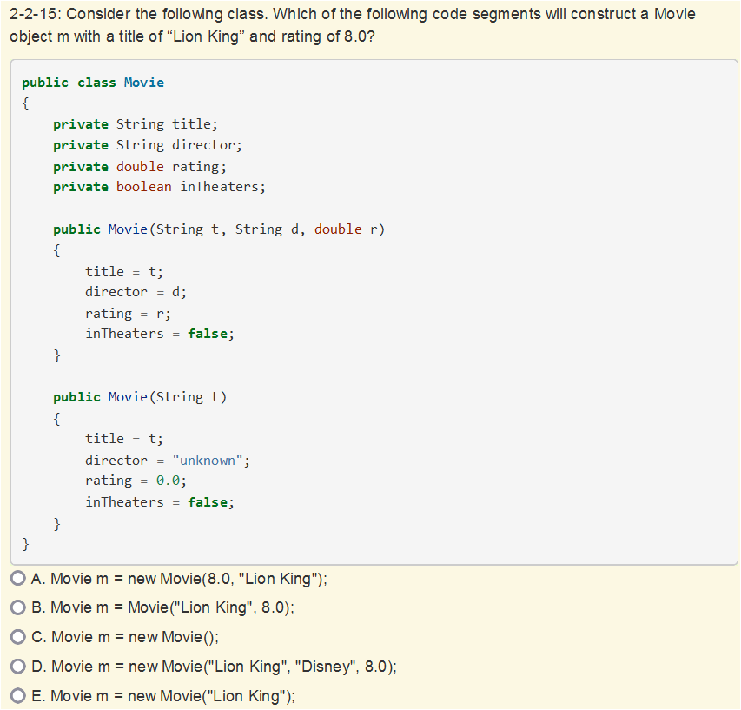
2.2 Creating and Storing Objects(Instantiation)
Quiz:
Ans->D

Slide 29
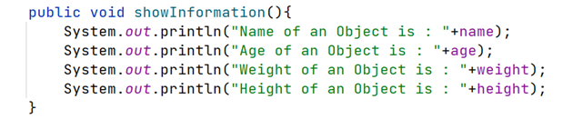
2.3 Calling a Void Method
Call non-static void methods without parameters.
An object’s behavior refers to what the object can do and is defined by methods.
Programmers doesn’t need how the method was written, they can use the method if the have the object of the class.
A method signature for a method without parameters consists of the method name and empty parameter list.
Example:
Return type can be: void , int , double, string or other reference type
Method name without parameters

Slide 30
2.3 Calling a Void Method
Method or constructor call interrupts the sequential execution
All the statements in Java program are executed sequentially but the moment we call methods or constructors, The sequential execution of the statements stops causing the program to first execute the statements in the method or constructor before continuing.
Once the last statement in the method or constructor has executed or a return statement is executed, flow of the control is returned to the point immediately following where the method or constructor was called.
See the Example on the next Slide…………

Slide 31
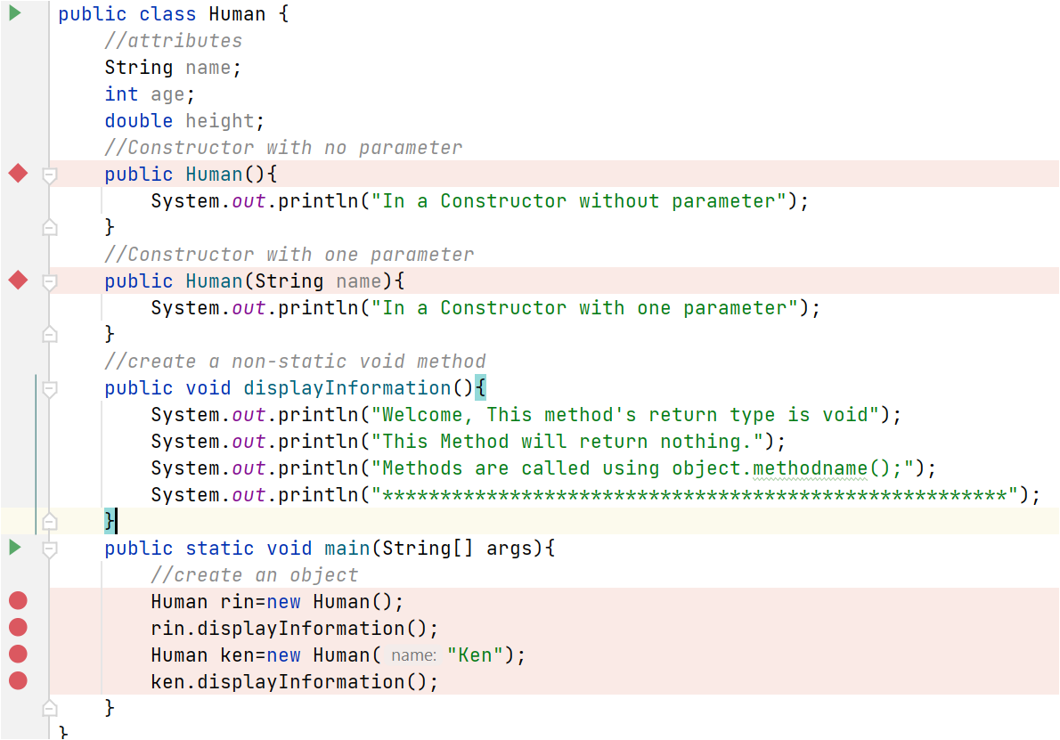
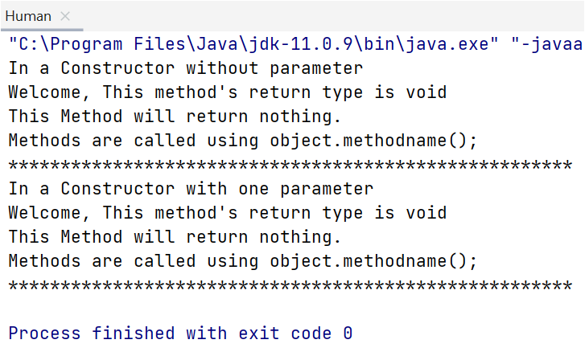
2.3 Calling a Void Method
Method or constructor call interrupts the sequential execution
Method Signature-> name, no parameter
Goes to constructor before moving to next line
Goes to method before moving to next line
dot operator is used along with object to call non-static methods

Slide 32
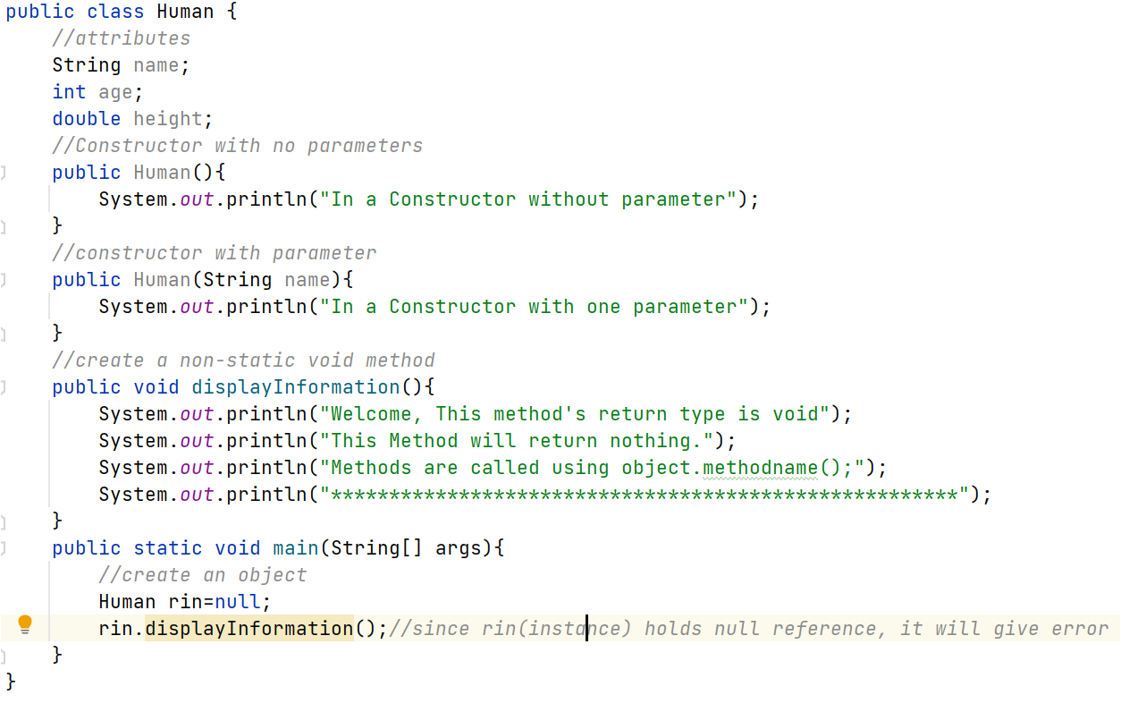
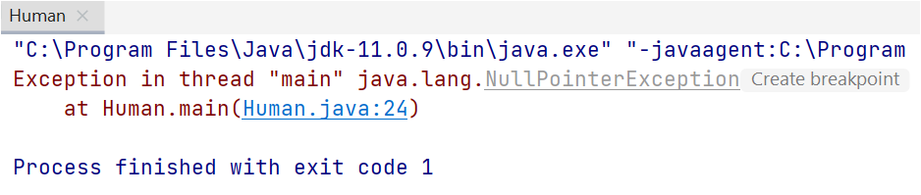
2.3 Calling a Void Method
NullPointerException

Slide 33
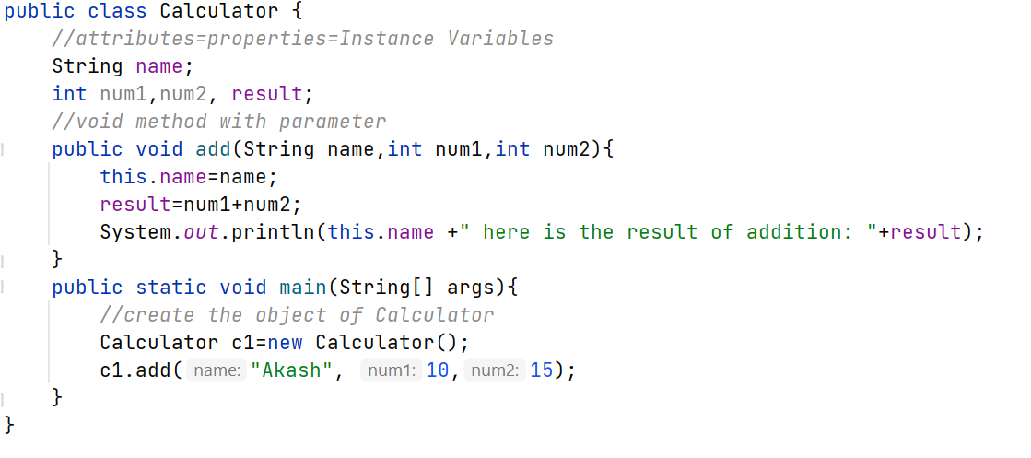
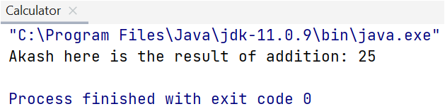
2.4 Calling a Void Method with Parameters
Method Signature of a Method with Parameters
A method signature for a method with parameters consists of the method name and the ordered list of parameter types.
Method signature consists of name and ordered list of parameters

Slide 34
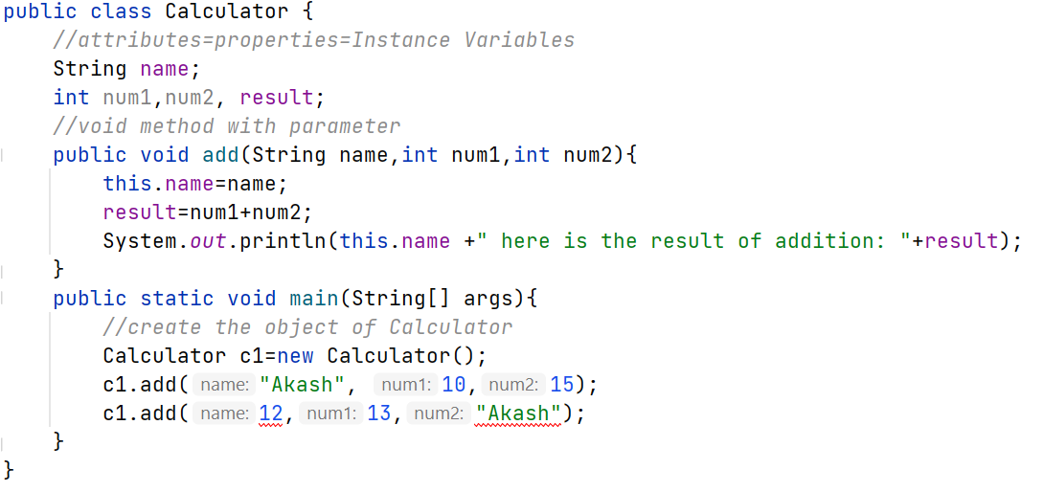

2.4 Calling a Void Method with Parameters
Method Signature of a Method with Parameters
Values provided in the parameter list need to correspond to the order and type in the method signature.
Parameter values are not in the
Order as defined by method
Signature. It’s ERROR

Slide 35
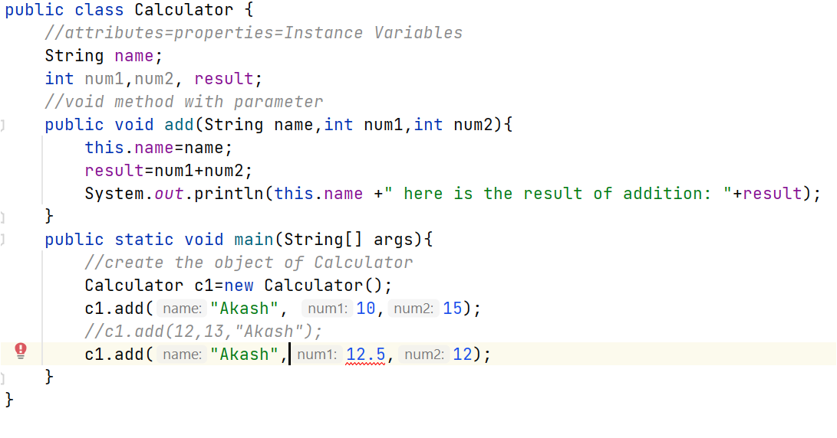
2.4 Calling a Void Method with Parameters
Method Signature of a Method with Parameters
Values provided in the parameter list need to correspond to the order and type in the method signature.
Parameter type does not match
as defined by method Signature.
It’s ERROR

Slide 36
2.4 Calling a Void Method with Parameters
What is Overloading?
Objects having more than one form is called overloading.
In Java Overloading is achieved by Method Overloading or Constructor Overloading.
What is Method Overloading?
Ans→ Using the same method name for more than once in a program is called Method overloading.
Overloaded Methods must have same name but different method signature.
What is Constructor Overloading?
Ans→ Using more than one constructor in the given class is called Constructor Overloading.
Overloaded Constructors must have same name but different signature.

Slide 37
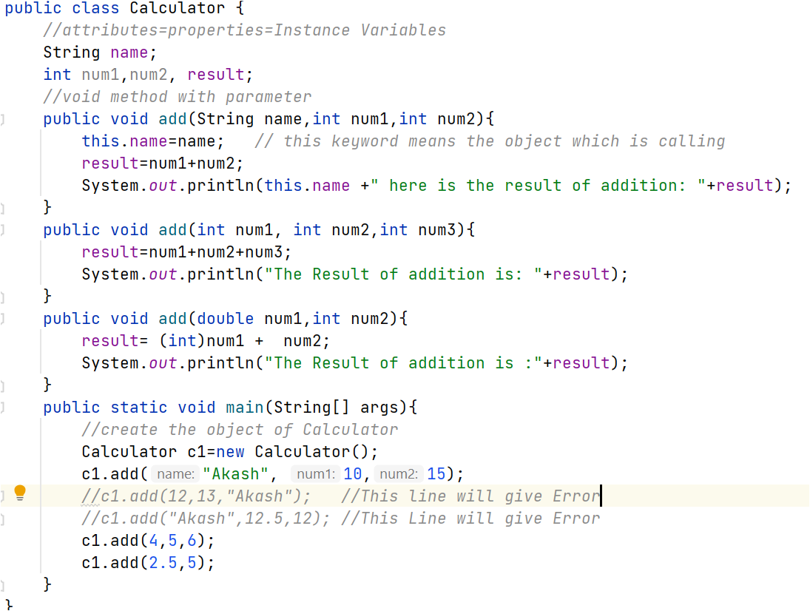
2.4 Calling a Void Method with Parameters
Overloaded Method
Methods are said to be overloaded when there are multiple methods with the same name but a different signature.
The Method name is same but signature is
different
If Actual parameter
Does not match to
Formal parameter
It’s ERROR
The Actual Parameter Must Match the Formal Parameter

Slide 38

2.5 Calling a NON-Void Method
Non-Void Method with parameter
Non-Static and Non-void methods return some value , the return value can be int, double or String.
This method returns value , the return value is of int type
Since add method returns value , you need to store

Slide 39

2.5 Calling a NON-Void Method
Non-Void Method without parameter
Non-Static and Non-void methods return some value , the return value can be int, double or String.
The methods accepts no parameters but it return String value

Slide 40


2.5 Calling a NON-Void Method
A method can be called from with another method without using object
No need to use object to call method from another within the class.
To method from main method, you need object
Can not call Instance method from static method

Slide 41



2.5 Calling a NON-Void Method
Static Method
Static Method are called as class level method and there is only one copy of Static method in the memory
Static Method can be called using classname.methodname(), there is no need to use object to call static method method.

Slide 42

2.5 Calling a NON-Void Method
Static Method

Slide 43

2.5 Calling a NON-Void Method
QUIZ:
Ans→D

Slide 44

2.5 Calling a NON-Void Method
QUIZ:
Ans→A

Slide 45


2.5 Calling a NON-Void Method
QUIZ:
Ans→C

Slide 46

2.5 Calling a NON-Void Method
QUIZ:
Ans→A

Slide 47

2.5 Calling a NON-Void Method
QUIZ:
Ans→E

Slide 48

2.5 Calling a NON-Void Method
QUIZ:
Ans→A

Slide 49

2.5 Calling a NON-Void Method
QUIZ:
Ans→B

Slide 50

2.5 Calling a NON-Void Method
QUIZ:
Ans→D

Slide 51

2.5 Calling a NON-Void Method
QUIZ:
Ans→E

Slide 52

2.5 Calling a NON-Void Method
More Practice QUIZ: HomeWork
Ans→D

Slide 53

2.5 Calling a NON-Void Method
More Practice QUIZ: HomeWork
Ans→A

Slide 54

2.5 Calling a NON-Void Method
More Practice QUIZ: HomeWork
Ans→C

Slide 55

2.5 Calling a NON-Void Method
More Practice QUIZ: HomeWork
Ans→A

Slide 56


2.5 Calling a NON-Void Method
More Practice QUIZ: HomeWork
Ans→D

Slide 57


2.5 Calling a NON-Void Method
More Practice QUIZ: HomeWork
Ans→E

Slide 58

2.5 Calling a NON-Void Method
More Practice QUIZ: HomeWork
Ans→C

Slide 59

2.5 Calling a NON-Void Method
More Practice QUIZ: Home Work
Ans→A

Slide 60

2.5 Calling a NON-Void Method
More Practice QUIZ: Home Work
Ans→C

Slide 61

2.5 Calling a NON-Void Method
More Practice QUIZ: Home Work
Ans→C

