Slide 1
Computer Science A
Session2

Slide 2
OBJECTIVE
String Objects: Concatenation, Literals and More
String Methods
Wrapper Classes: Integer and Double
Using the Math Class

Slide 3
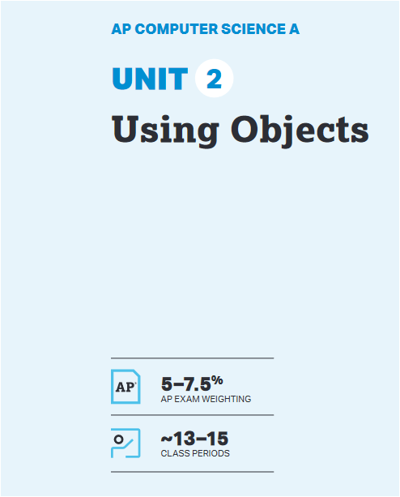
UNIT at a Glance

Slide 4
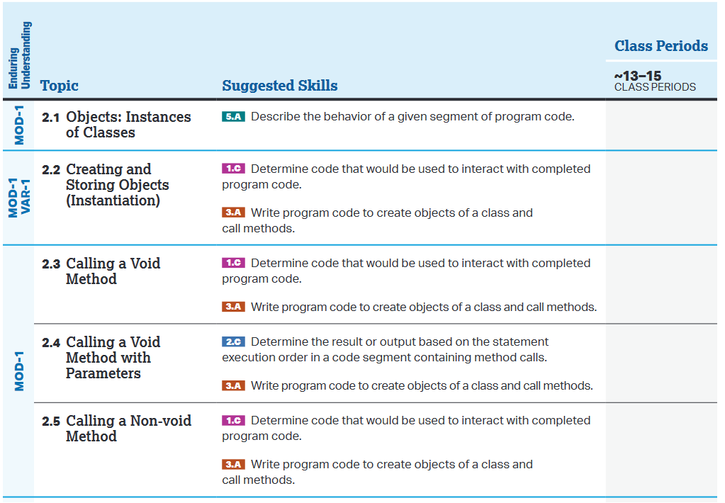
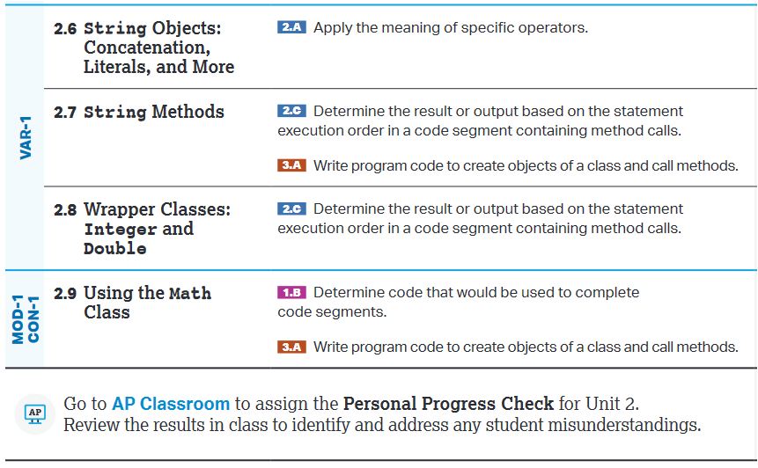
UNIT at a Glance

Slide 5
2.6 String Objects: Concatenation, Literals and More
Primitive Type vs. Reference Type:
Type means we are talking about data type, the data type can be int, double and String.
1. Primitive Type → The primitive type variable holds the value directly , int and double are primitive type.
int → A variable of type int can store integer values as given below.
int x=5;
x
double →A variable of type double can store fractional numbers as given below
double height=5.6
height
2. Reference Type → The reference type variable holds address of the memory location where value is store. String and any object of a class are reference type.
5
5.6

Slide 6
2.6 String Objects: Concatenation, Literals and More
String→ A variable of type String holds the address of the value as given below.
String name=“Steven”;
0 1 2 3 4 5
XXF
S | t | e | v | e | n
name
Stack Memory
Heap memory

Slide 7
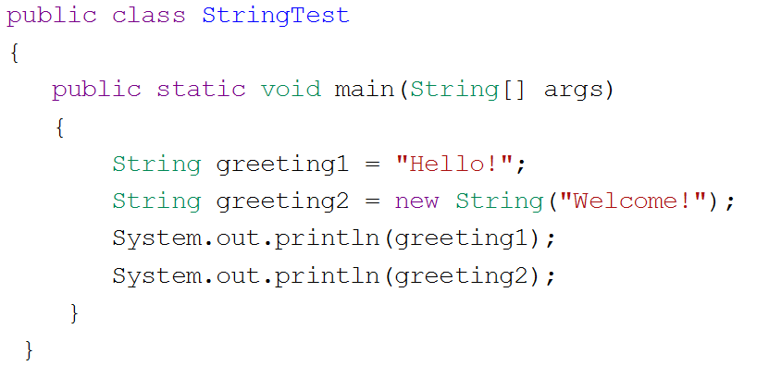
2.6 String Objects: Concatenation, Literals and More
How to create String Object
There are 2 ways to create String Object
By using Literals(Text Value):
  Example:
  String name=“Ken”;
By calling String class constructor :
  Example:
  String name=new String(“Ken”);
  Note : Any one rule can be used to create String object.

Slide 8
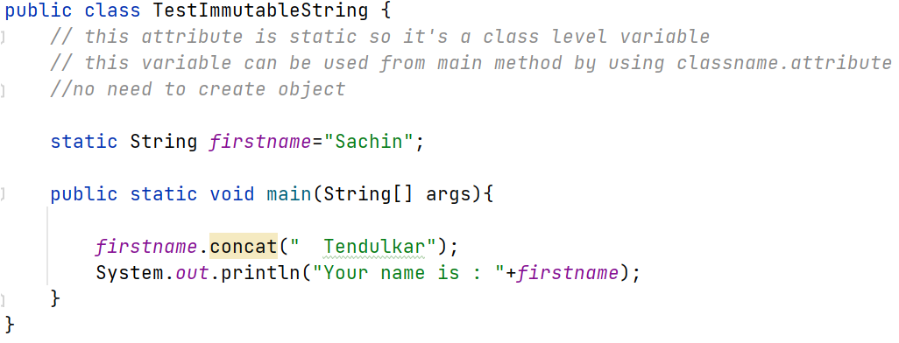
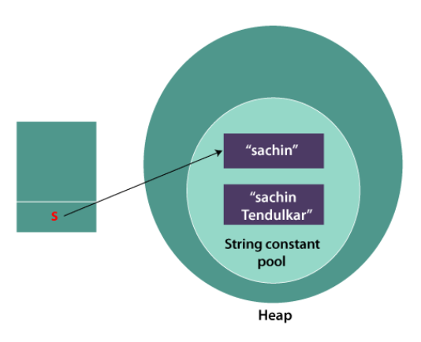
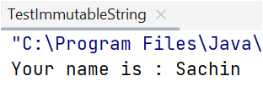
2.6 String Objects: Concatenation, Literals and More
String Objects are Immutable(Can not change):
String variable value can not be changed….If you change the value a new memory will be allocated.
firstname

Slide 9
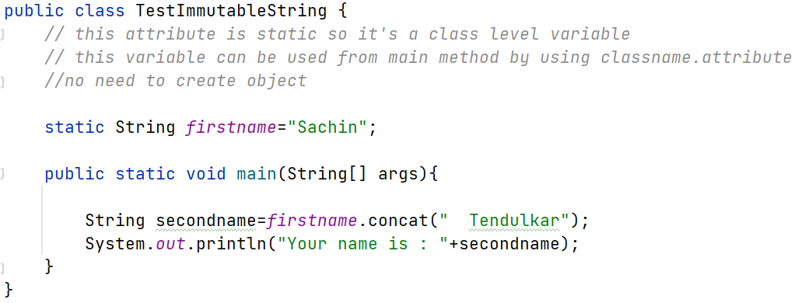
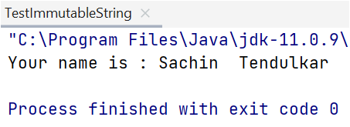
2.6 String Objects: Concatenation, Literals and More
String Objects are Immutable(Can not change):
String variable value can not be changed….If you change the value a new memory will be allocated.

Slide 10
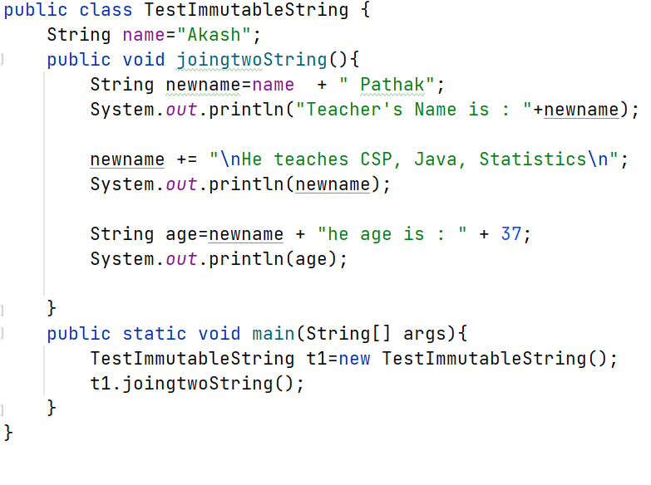
2.6 String Objects: Concatenation, Literals and More
String Objects can be Concatenated (Joined)
String Objects can be concatenated using the + or += operator resulting a new String object.
+ operator can be used to concatenate 2 Strings
+= operator can also be used to concatenate 2 Strings,
+ operator can be used to join String with int.
int value will be converted to String
Primitive value can be concatenated with a String
Object

Slide 11
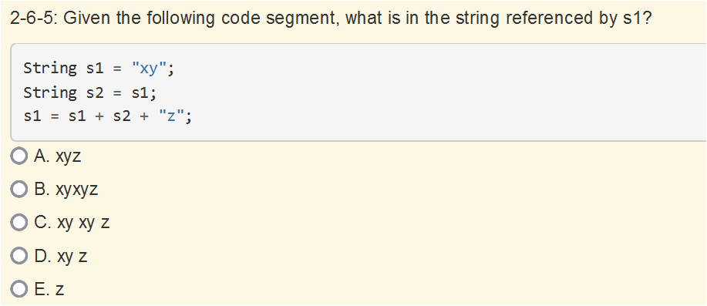
2.6 String Objects: Concatenation, Literals and More
Quiz:
Ans->B

Slide 12
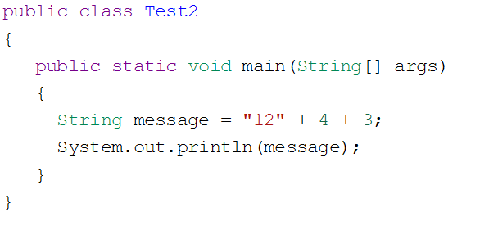
2.6 String Objects: Concatenation, Literals and More
Quiz:
Ans->1243

Slide 13
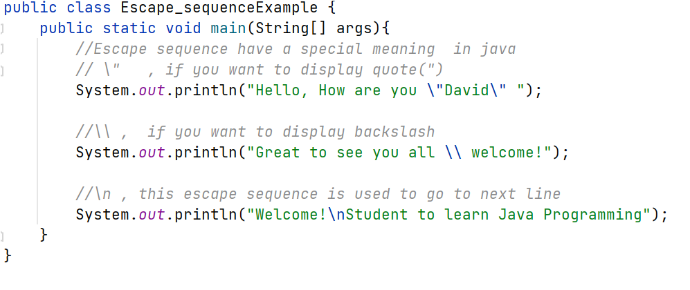
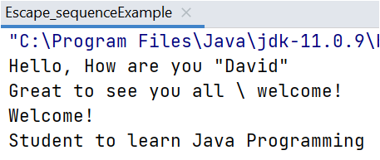
2.6 String Objects: Concatenation, Literals and More
Escape Sequences
The 3 important escape sequences are \”, \\ , \n

Slide 14
2.7 String Methods
https://docs.oracle.com/javase/8/docs/api/index.html
Above link opens Java API (Application program Interface) documentation.
What is API?
Ans→ Application Program Interface-> All inbuilt Java Packages, Classes and all methods and attributes of any given class is known as API. [Above link gives you all these information].
It’s Practically Impossible for any human being to remember all these information.
APIs(Application program interfaces and libraries simplify complex programming task.
Documentation for APIs and libraries are essential to understand the attributes and behaviors of an object of a class.
Classes in the APIs and libraries are grouped into packages.
Example:
Important : A String Class is part of the java.lang package.
java.lang package is a default package , so never write import java.lang in any java program

Slide 15
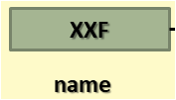

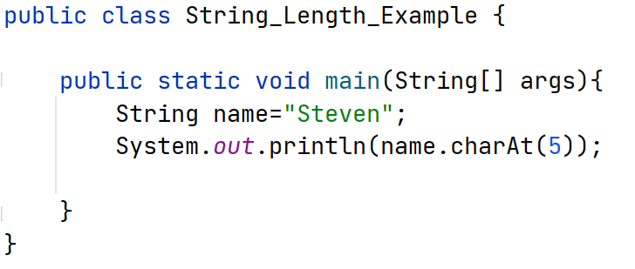
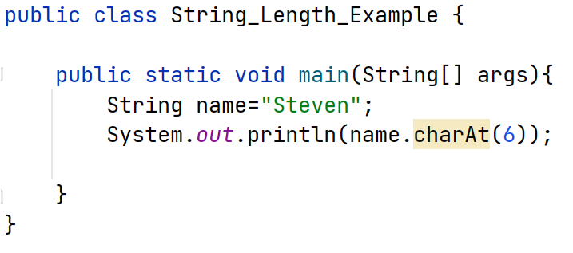
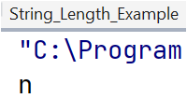
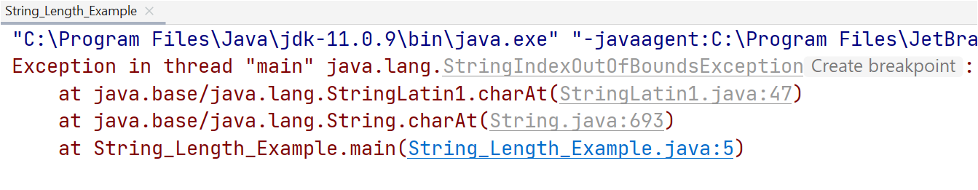
2.7 String Methods
A String object has index values from 0 to length-1 .
Attempting to access indices outside this range will result in an StringIndexOutOfBoundsException.

Slide 16
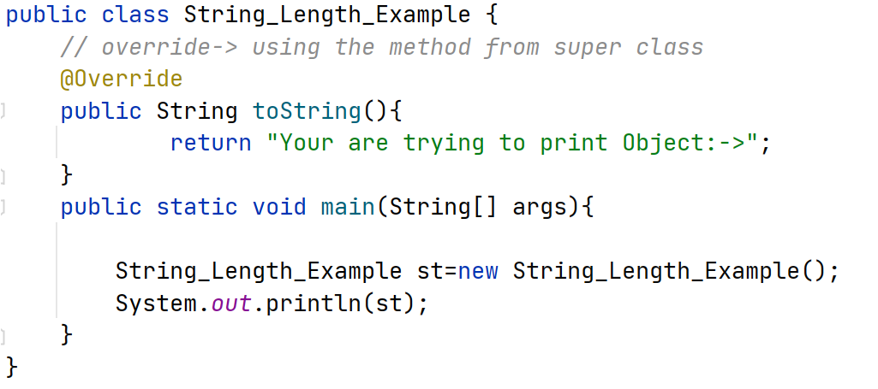
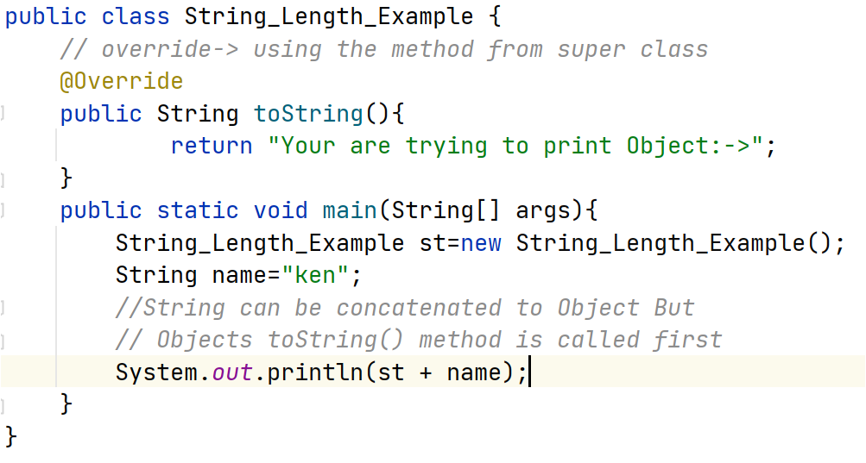
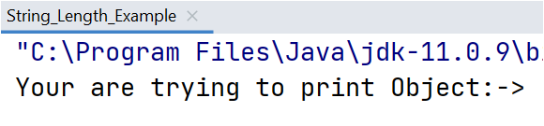
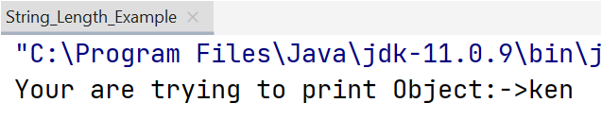
2.7 String Methods
A String object can be concatenated with an object reference, which implicitly(Automatically) calls the referenced object’s toString() method.
When we try to print any object of a class, the toString() method is called automatically(implicitly)
toString() is defined in Object class, By default all class we create in java are child class of Object class.
Example:

Slide 17
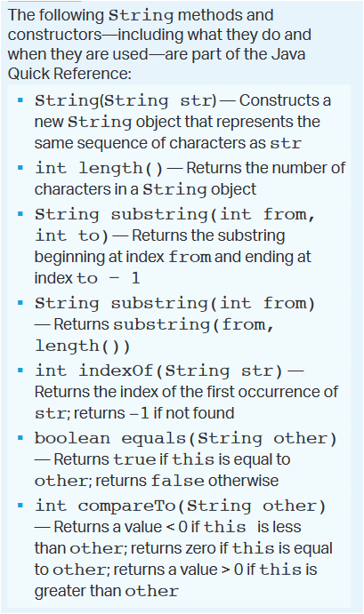
2.7 String Methods
There are many methods in API for String class but for AP course only below methods will be asked.
It’s a String class Constructor
Methods from String Class

Slide 18
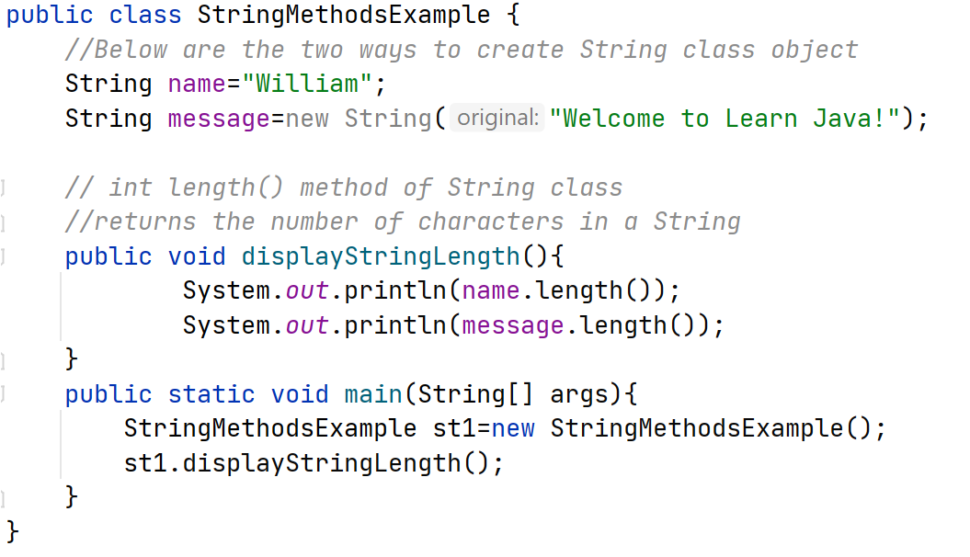
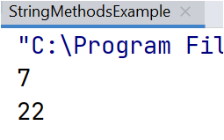
2.7 String Methods
String Constructor and length() method of String Class

Slide 19
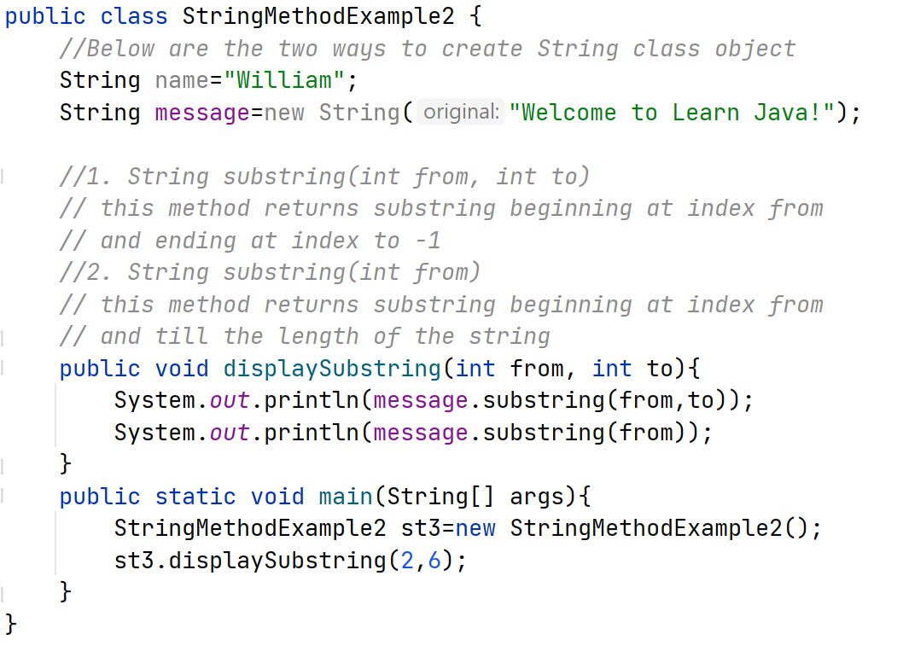
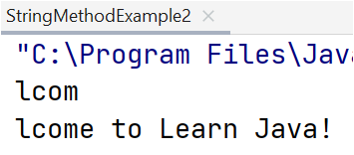
2.7 String Methods
String substring() method of String Class

Slide 20
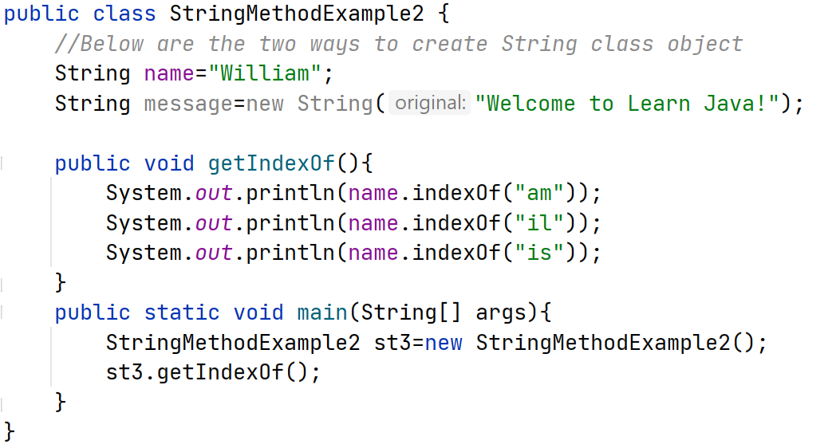
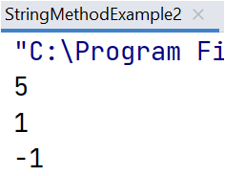
2.7 String Methods
int indexOf() method of String Class

Slide 21
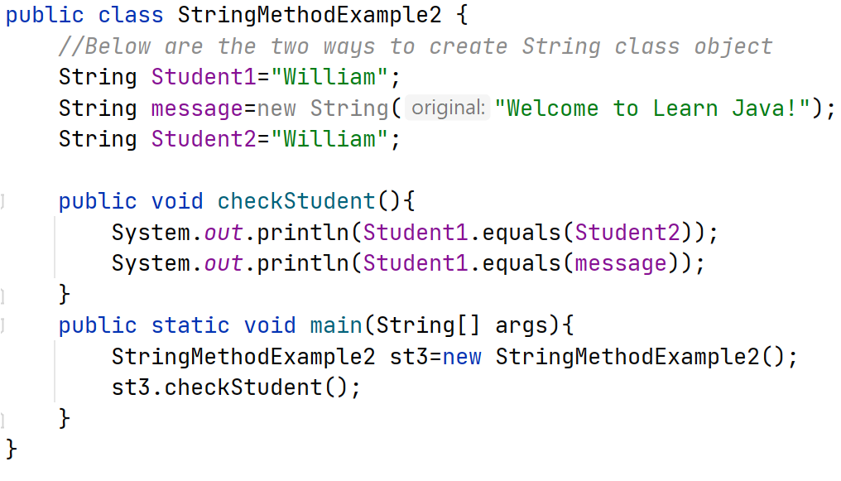
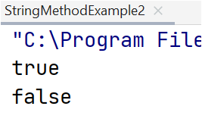
2.7 String Methods
boolean equals(String str) method of String Class

Slide 22
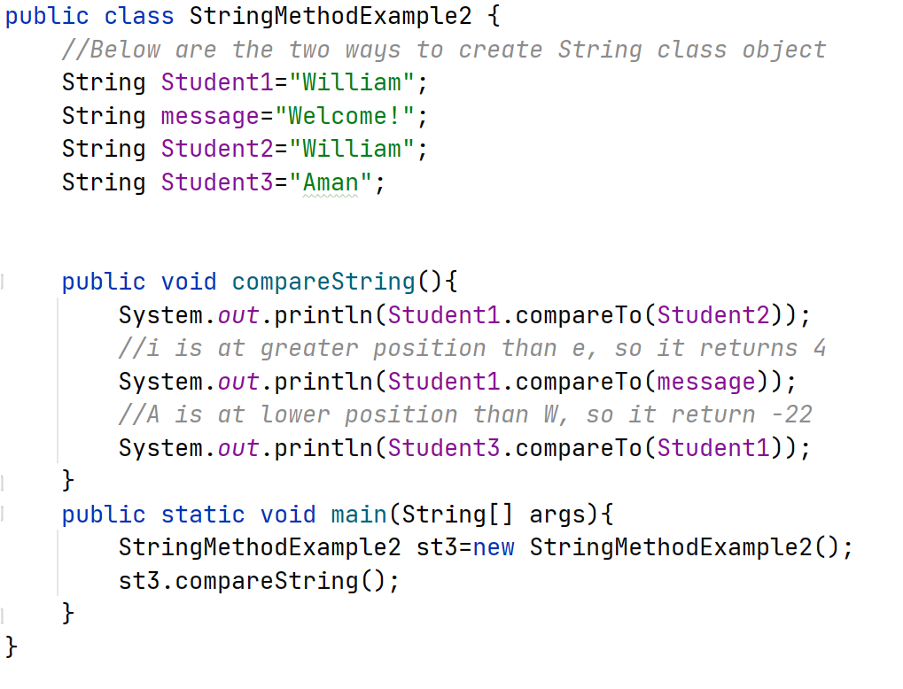
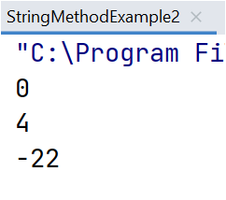
2.7 String Methods
int compareTo(String str) method of String Class

Slide 23
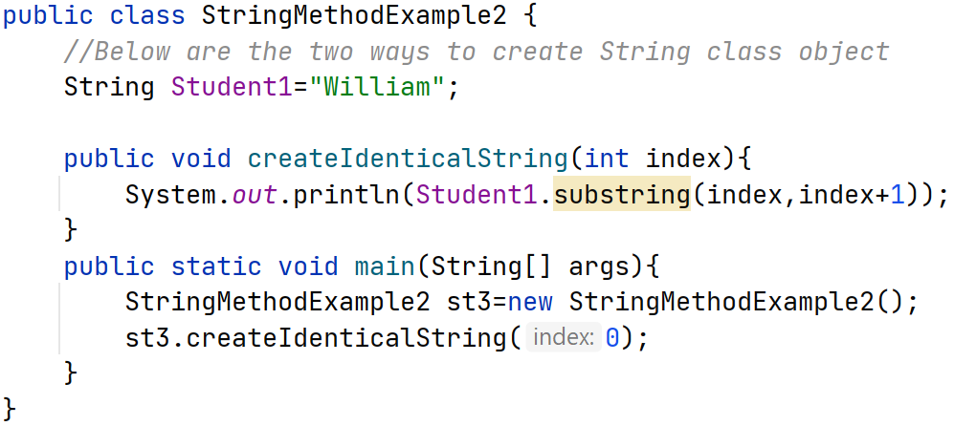
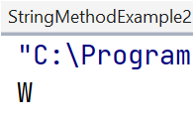
2.7 String Methods
A String identical to the single element substring at position index can be create by calling
Substring(index,index+1).

Slide 24
2.8 Wrapper Classes: Integer and Double
The Wrapper class for int is called Integer.
The Wrapper class for double is called Double.
Sometime you need to create wrapped object for a primitive type Like int and double.
Integer class and Double class are part of the java.lang package.
Example:
Integer i=new Integer(5);
or
Integer i=5; Both are ok!!! It will create an object of primitive type.

Slide 25
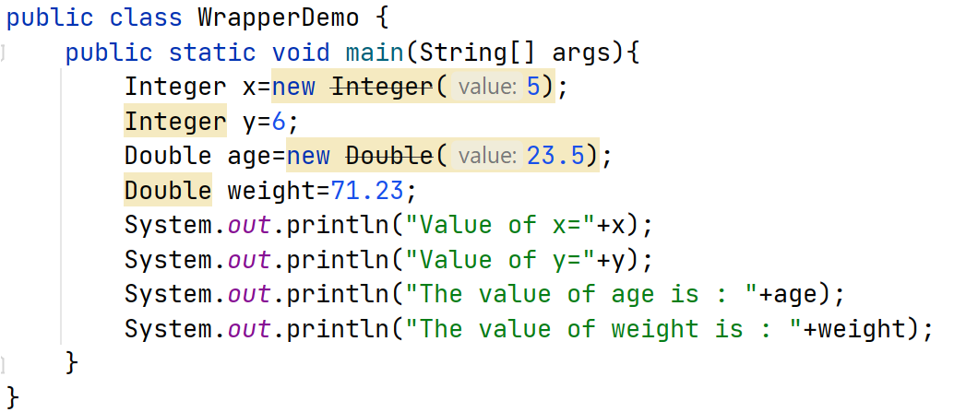
2.8 Wrapper Classes: Integer and Double
Below program show an example of how to create an object of Integer and Double class.

Slide 26
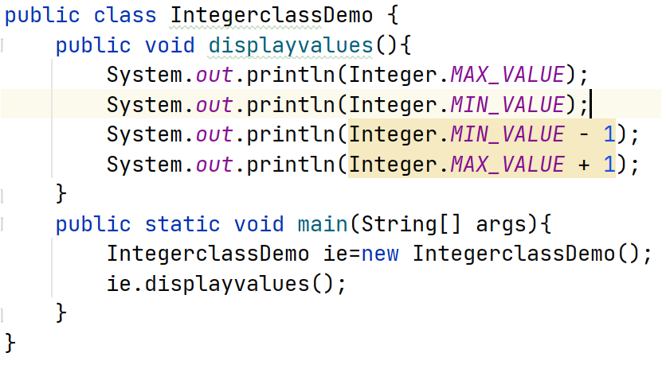
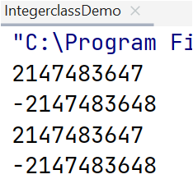
2.8 Wrapper Classes: Integer and Double
Try this program an remember few static attributes defined in Integer class, static attributes can be used directly by using class name.
Java can be used to represent any whole number from -2147483648 to 2147483647
Each integer gets 32 bit space to store values out of this 32 bit, 1 bit is for the sign(negative or positive)
Why is there one more negative number than positive number?
It is because 0 is considered a positive number.
Java returns the maximum integer Value
if you try to subtract one from The minimum
value. This is called as Underflow.

Slide 27
2.8 Wrapper Classes: Integer and Double
Boxing and UnBoxing
Boxing → When we convert primitive type to reference type(object) it is called boxing.
Unboxing→ When we convert reference type(object) to primitive type it is called unboxing.
Example Boxing:
int x=5;
double num=6.5;
Integer i=new Integer(x) ; // we are converting primitive type to reference type
// it’s an example of boxing
Double d=new Double(num);
int y=i.intValue(); //This is an example of unboxing
double yy=d.doubleValue();
AutoBoxing and AutoUnboxing:
Integer i=2; // Autoboxing
int x=i; // Auto unboxing

Slide 28
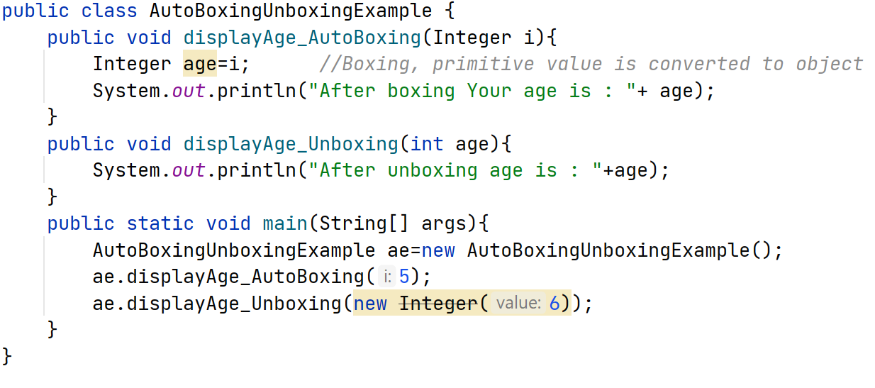
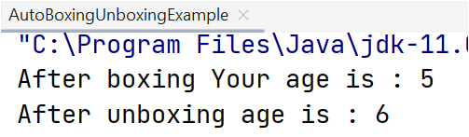
2.8 Wrapper Classes: Integer and Double

Slide 29
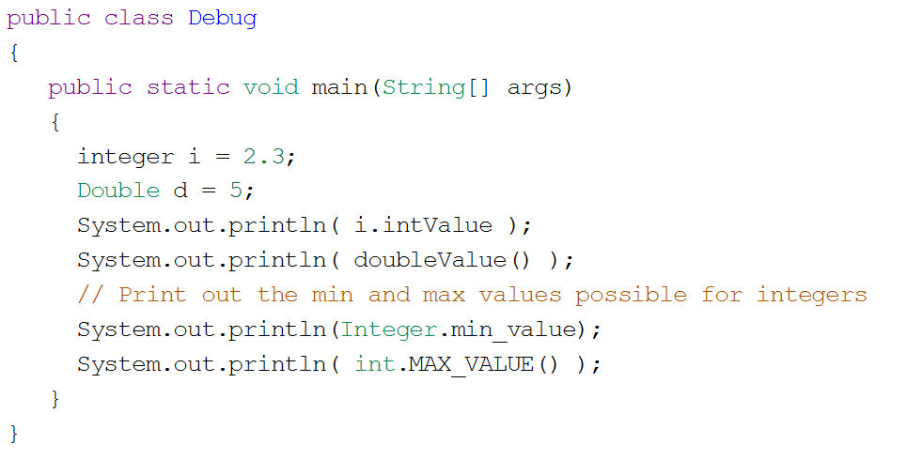
2.8 Wrapper Classes: Integer and Double
Find and Fix the Bug in this program

Slide 30
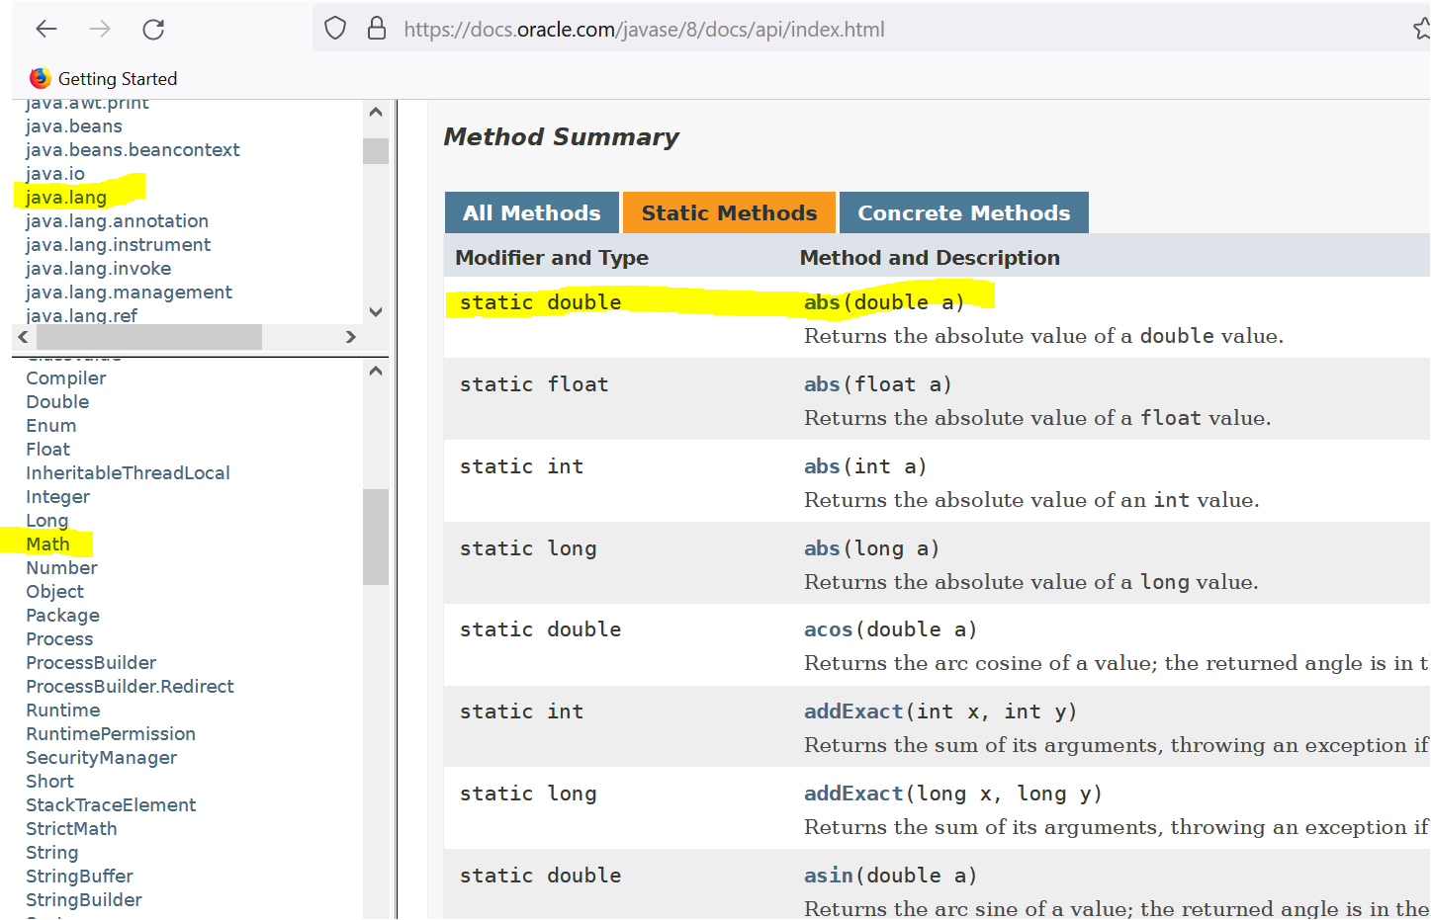
2.9 Using The Math Class
Static Methods are called using the dot operator along with the class name.
The Math class is part of java.lang package.
The Math class contains only static methods.

Slide 31
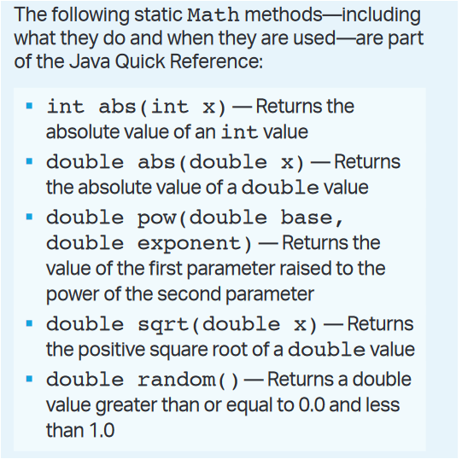
2.9 Using The Math Class
Below are few static methods of Math class that will be asked in AP Exam.

Slide 32
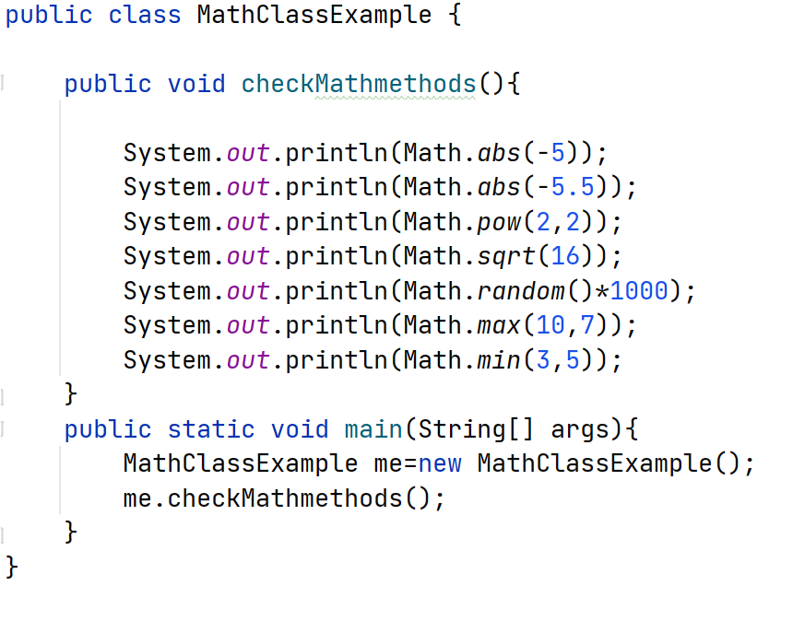
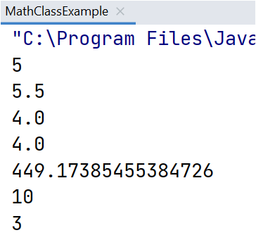
2.9 Using The Math Class
Below are few static methods of Math class that will be asked in AP Exam.

Slide 33
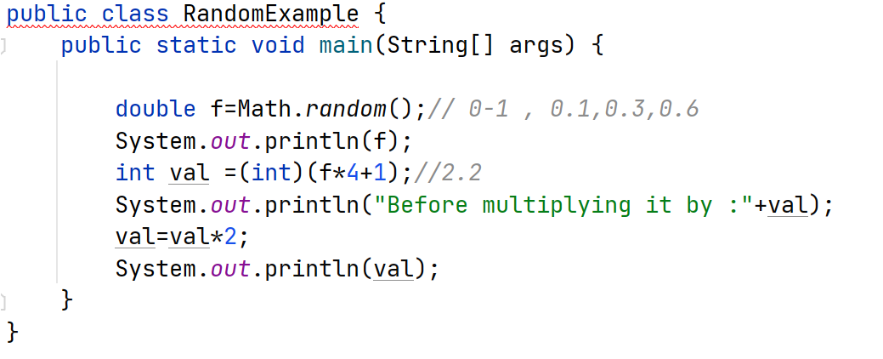
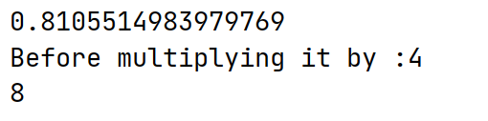
2.9 Using The Math Class
Very Important Topic ::: Math.random() method can be manipulated to produce a random int or double in a defined range.
Returns number between 0(inclusive) and 1(exclusive)

