Slide 1
Computer Science A
Session1

Slide 2
OBJECTIVE
Boolean Expressions
if Statements and Control Flow
if-else Statements
else if Statements
Compound Boolean Expressions
Equivalent Boolean Expressions
Comparing Objects

Slide 3
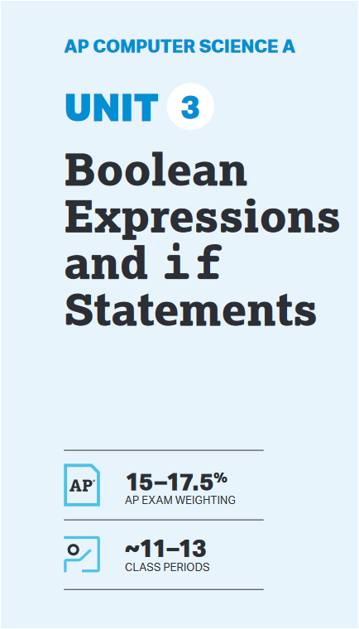
UNIT at a Glance

Slide 4
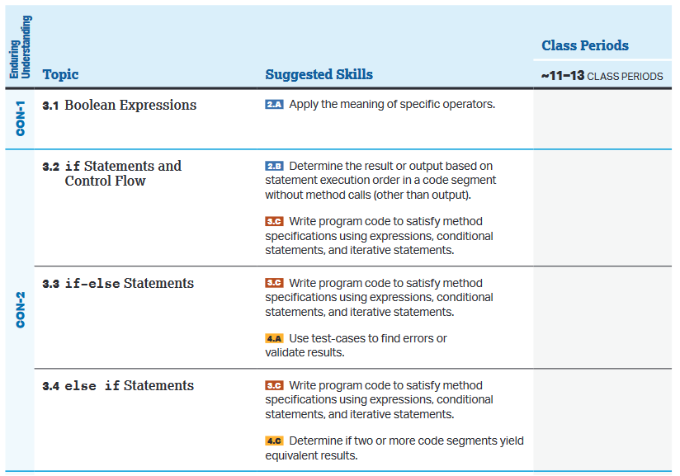
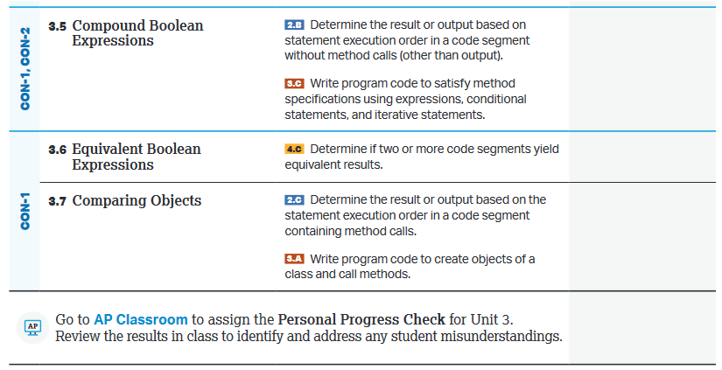
UNIT at a Glance

Slide 5
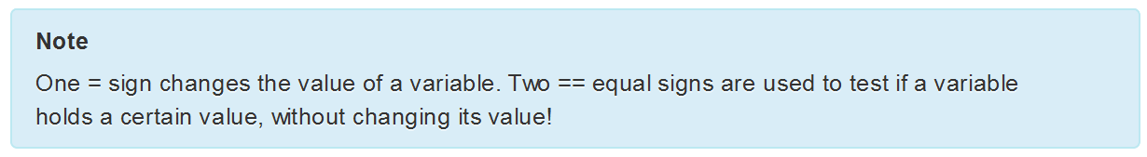
3.1 Boolean Expressions
Boolean Variables or Expressions can only have true or false values.
Primitive values (Like int, double) and reference values (String and any other class objects ) can be compared using relational operators. (i.e. == and !=)

Slide 6
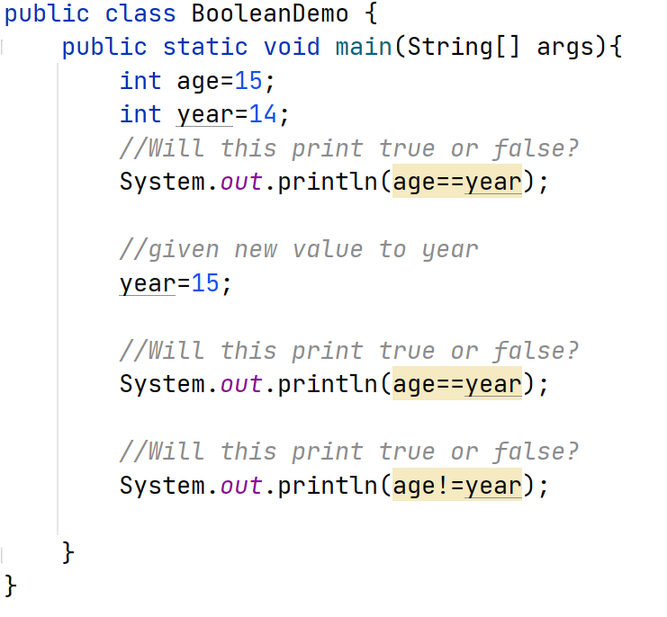
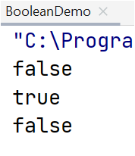
3.1 Boolean Expressions

Slide 7
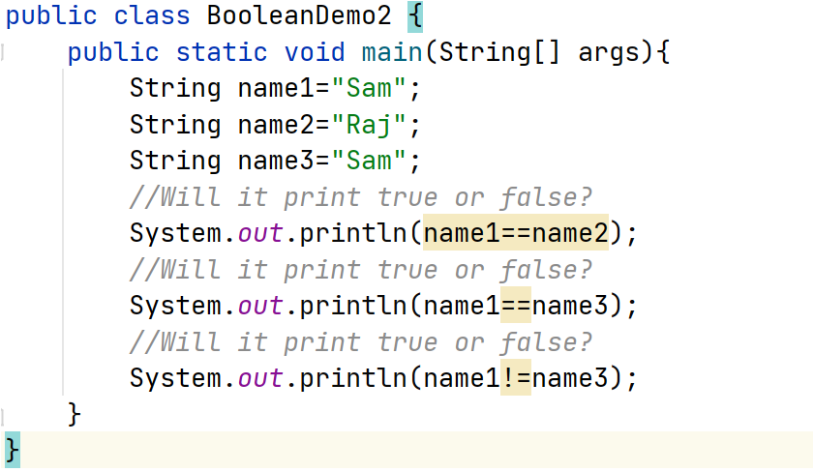
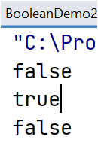
3.1 Boolean Expressions
We can also use == and != to test if two reference values like Ken and Rin objects, refer to the same object.

Slide 8

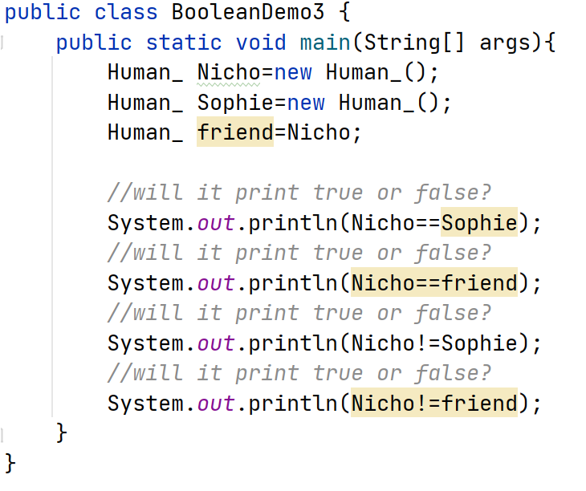
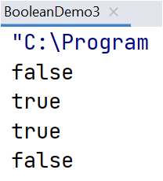
3.1 Boolean Expressions
Second Example:

Slide 9
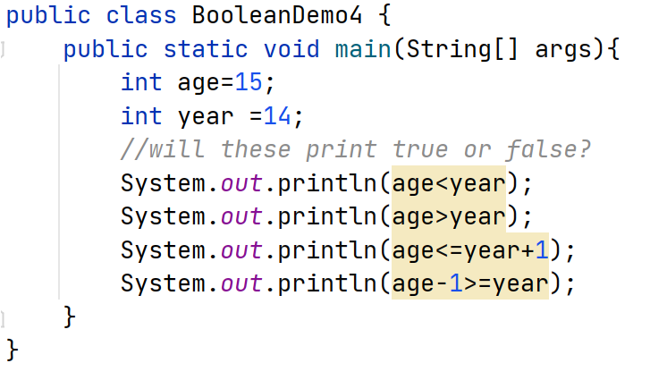
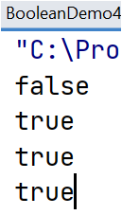
3.1 Boolean Expressions
Relational Operators (<,>,<=,>=).
The Relational Operators below in Java are used to compare numeric values or arithmetic expressions.

Slide 10
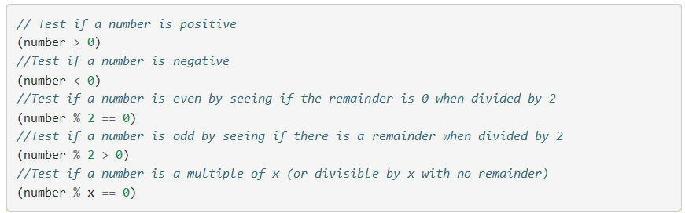
3.1 Boolean Expressions
Below are few Boolean Expression that very useful.

Slide 11
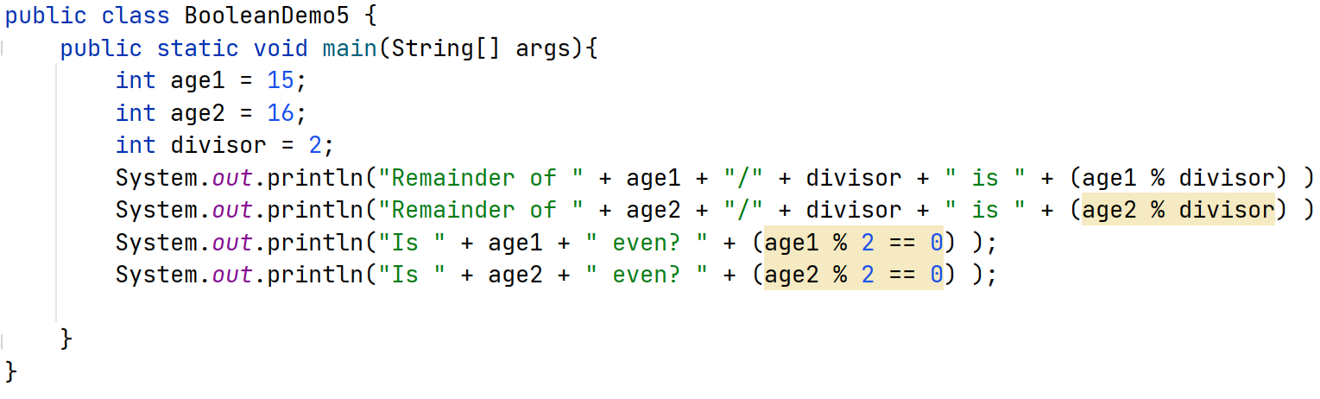
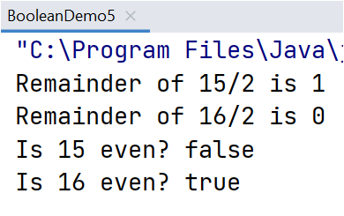
3.1 Boolean Expressions
Predict the output for below program.

Slide 12
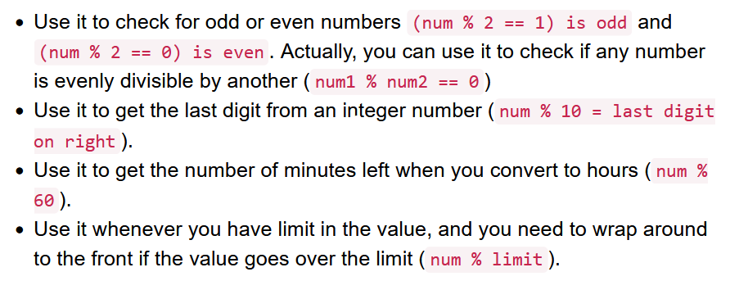
3.1 Boolean Expressions
Remember below logic when to use.

Slide 13
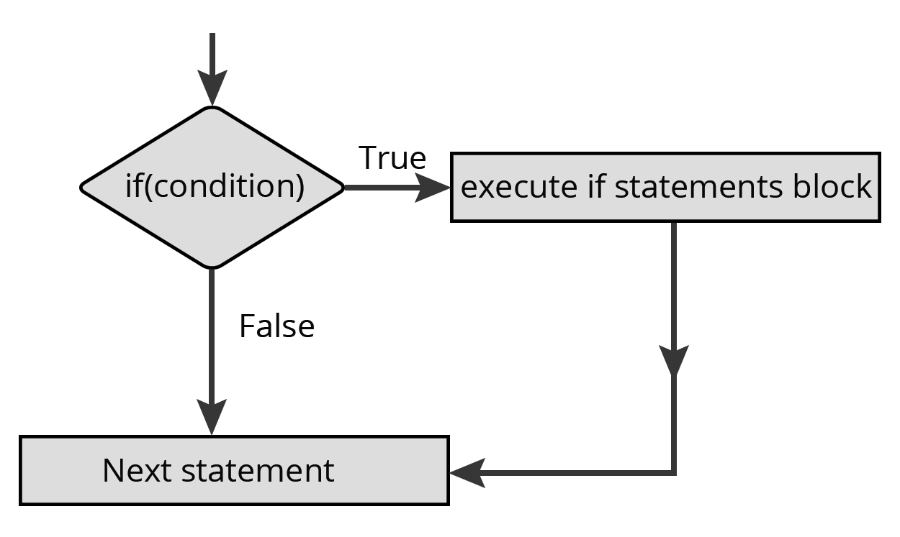
3.2 If Statements and control flow
If Statements Flowchart.

Slide 14
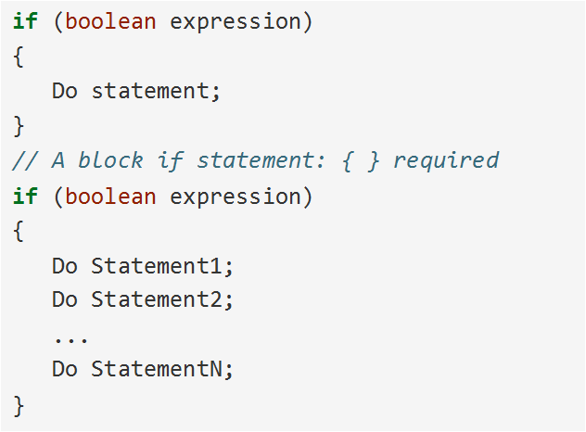
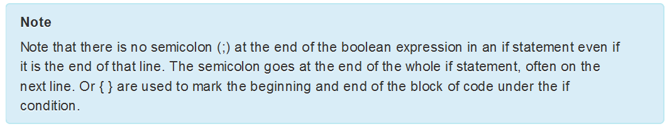
3.2 If Statements and control flow
If statement syntax.

Slide 15
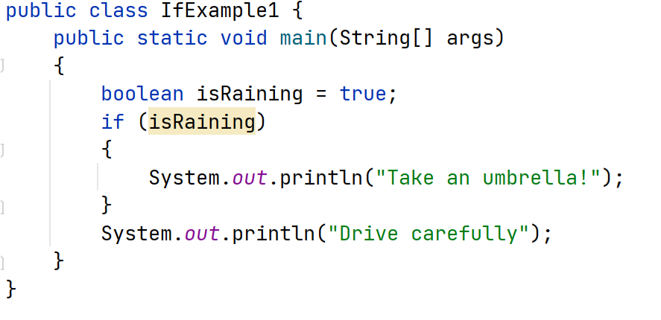
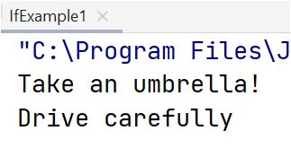
3.2 If Statements and control flow
Predict the output of the below code.

Slide 16
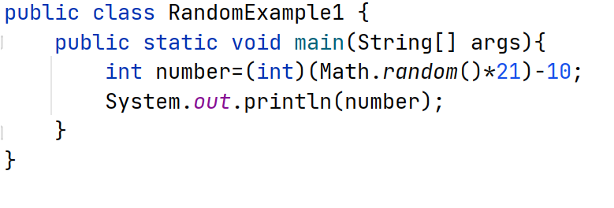
3.2 If Statements and control flow
Predict the output of the below code.
Generates random number between -10 to 10

Slide 17
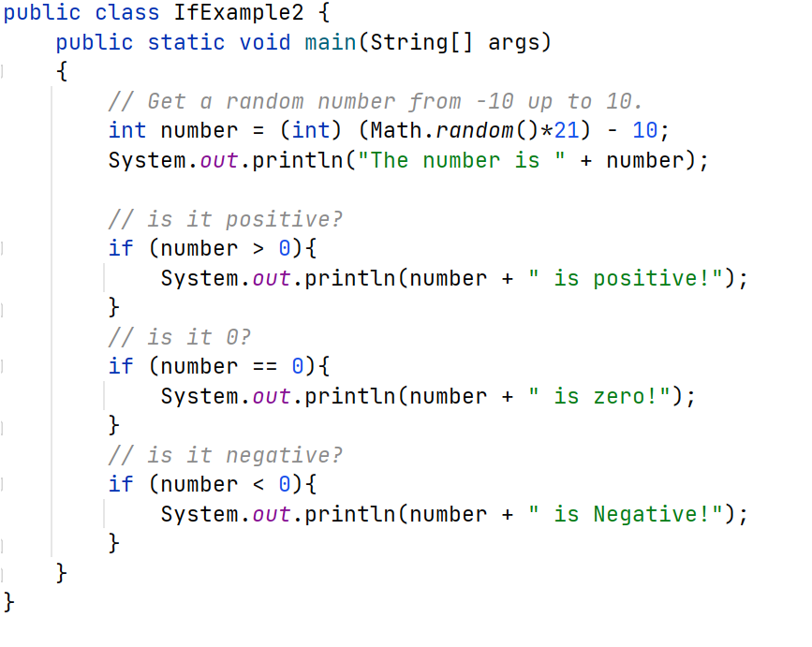
3.2 If Statements and control flow
Predict the output of the below code.
Generates random number between -10 to 10
And prints the respective if statements

Slide 18
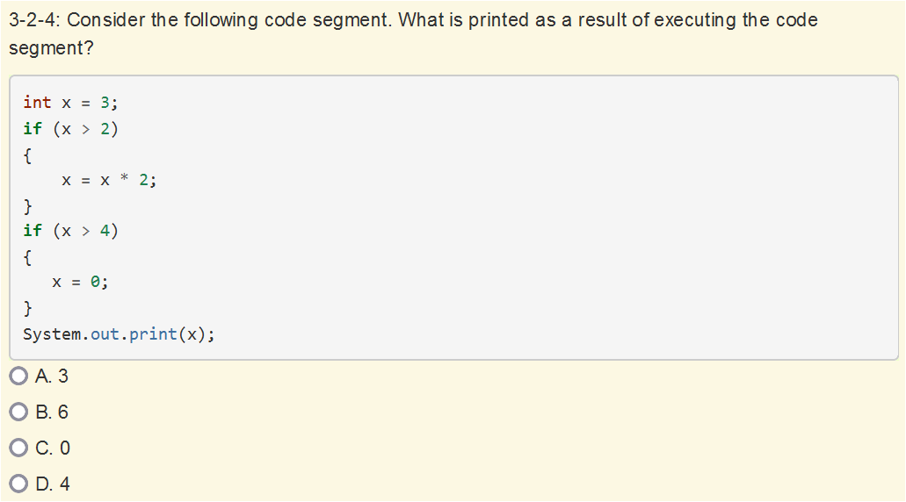
3.2 If Statements and control flow
Quiz
Ans→C

Slide 19
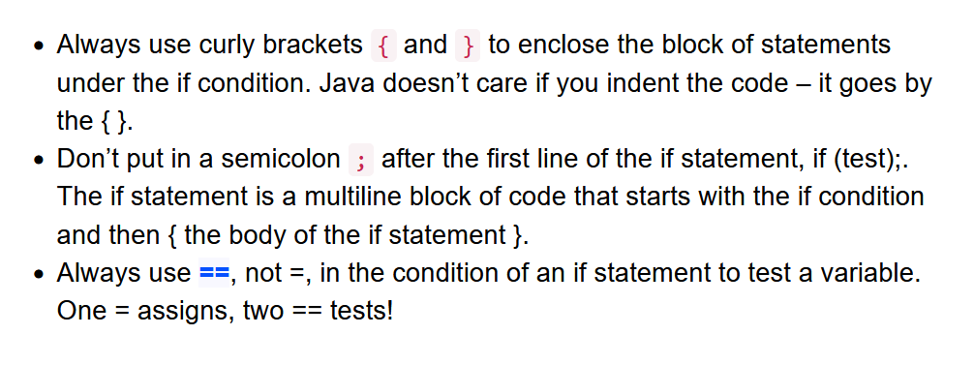
3.2 If Statements and control flow
Common Errors with if Statements

Slide 20
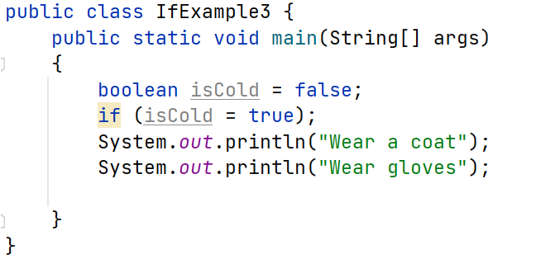
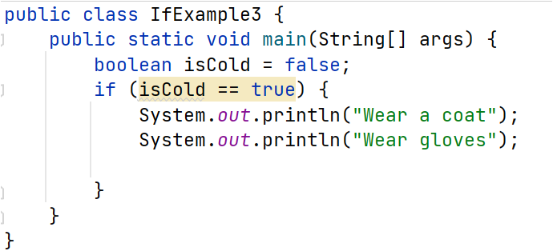
3.2 If Statements and control flow
What’s Wrong with the below code, Correct the code and tell output
Wrong Code Correct Code

Slide 21
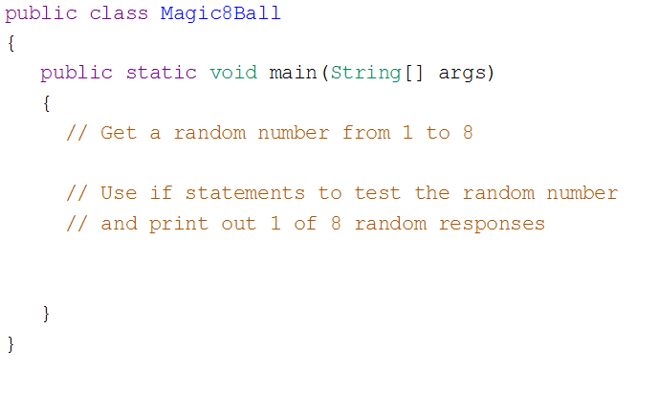
3.2 If Statements and control flow
Complete the Below code to implement magic 8 ball. HomeWork

Slide 22
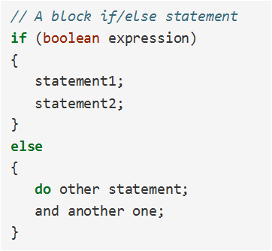
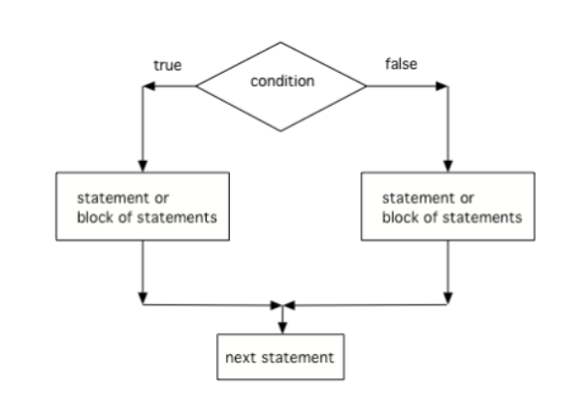

3.3 if-else statements
A two-way selection is written when there are two sets of statements- one to be executed when the Boolean condition is true , and another set for when the Boolean condition is false. In this case, the body of the “if” is executed when the Boolean condition is true, and the body of the “else” is executed when the Boolean condition is false.

Slide 23
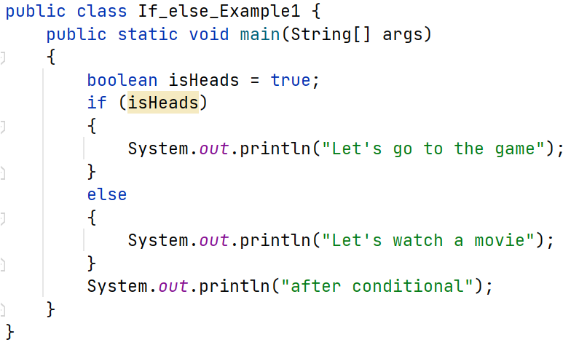
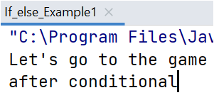
3.3 if-else statements
Predict the output

Slide 24
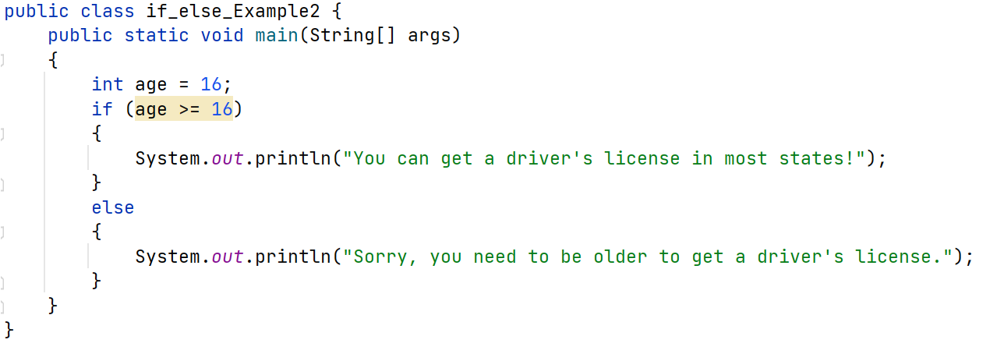
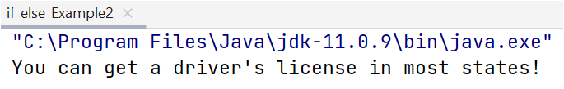
3.3 if-else statements
Predict the output

Slide 25
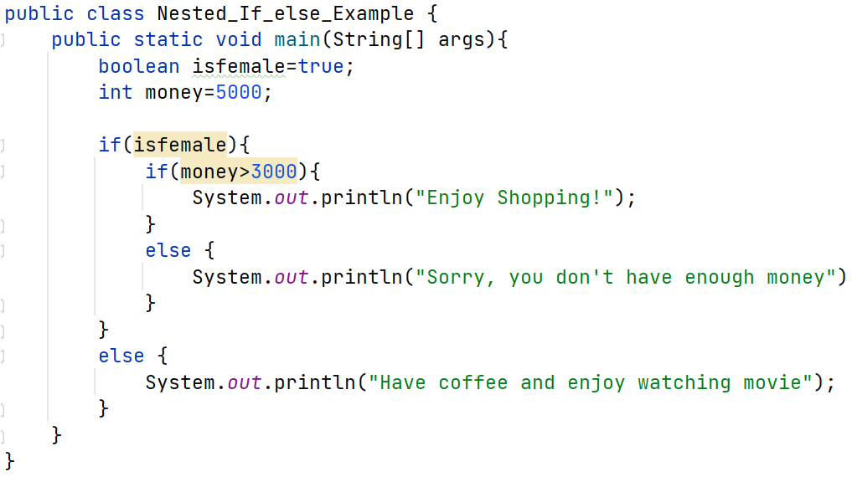
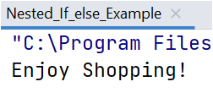
3.3 if-else statements
Predict the output : Nested If else statements

Slide 26
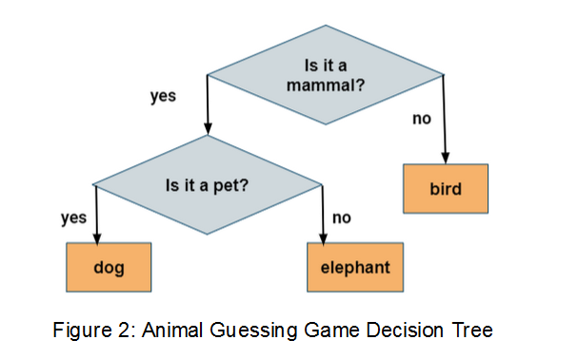
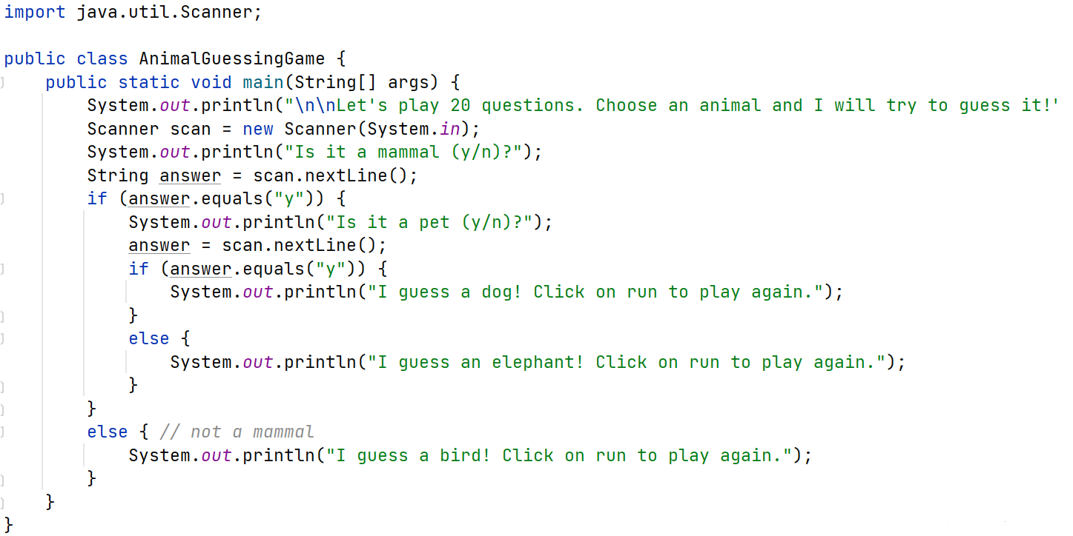
3.3 if-else statements
Implement Animal Guessing Program :

Slide 27
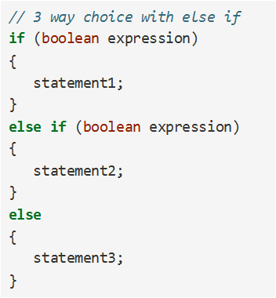
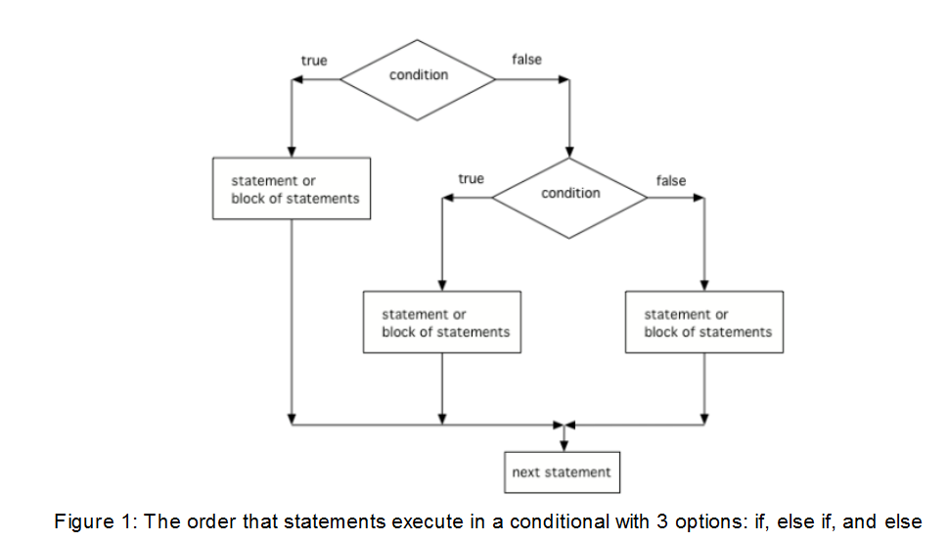
3.4 else if statements
A multi-way selection is written when there are a series of conditions with different statements for each condition.
Multi-way selection is performed using if-else-if statements such that exactly one selection of code is executed on the first condition that evaluates to true.

Slide 28
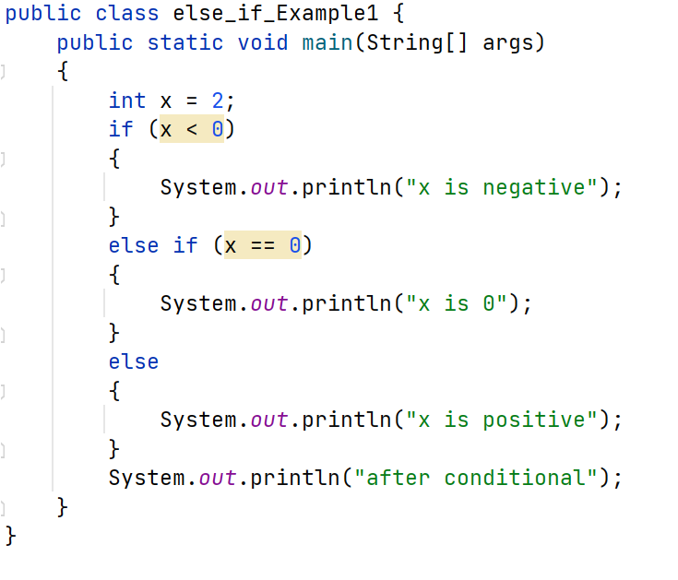
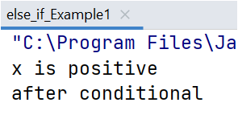
3.4 else if statements
Predict the output of the below code:

Slide 29
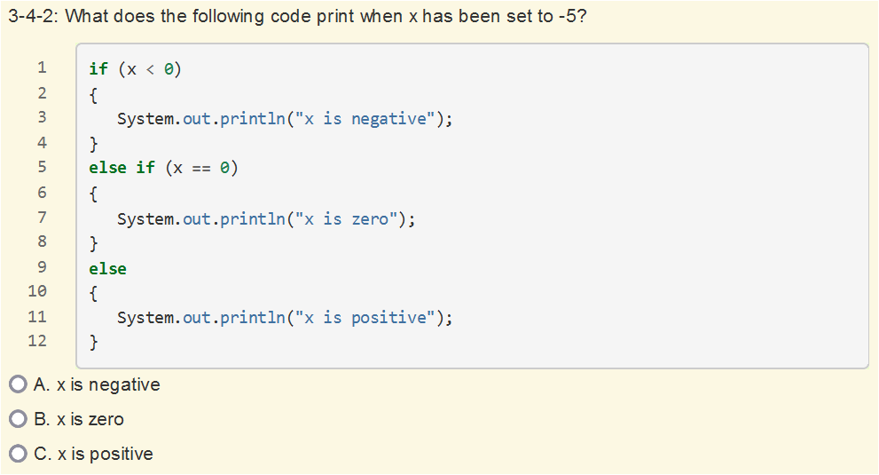
3.4 else if statements
QUIZ:
Ans→A

Slide 30
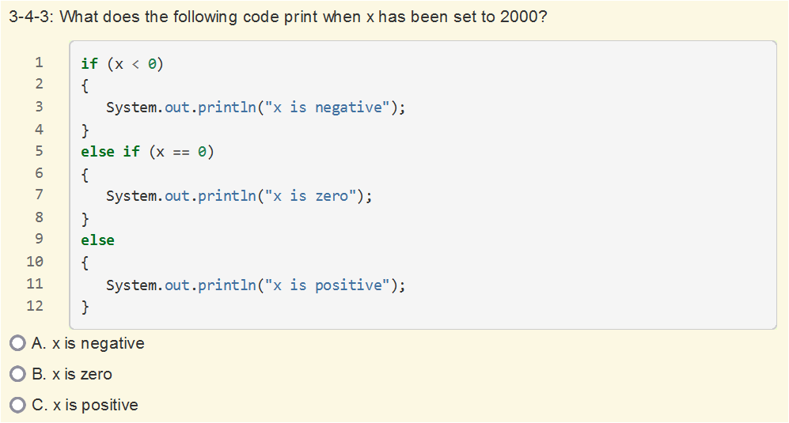
3.4 else if statements
QUIZ:
Ans→C

Slide 31
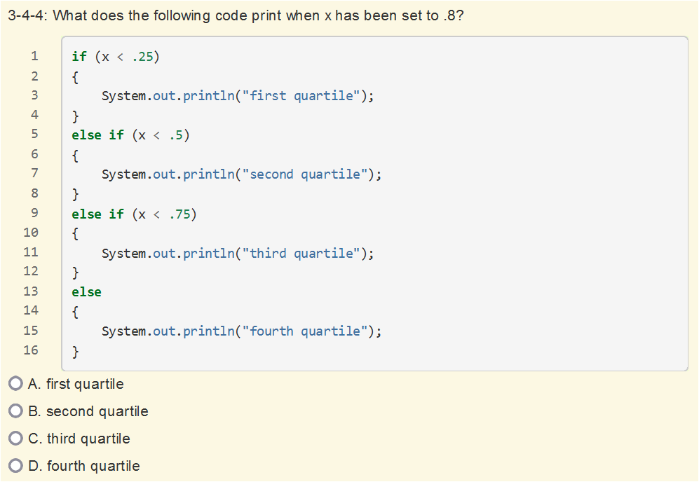
3.4 else if statements
QUIZ:
Ans→D

Slide 32
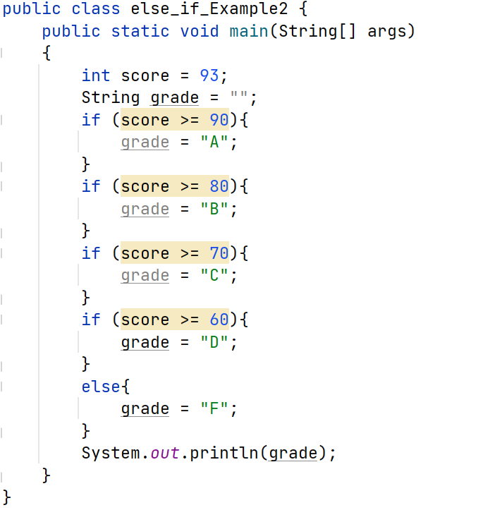
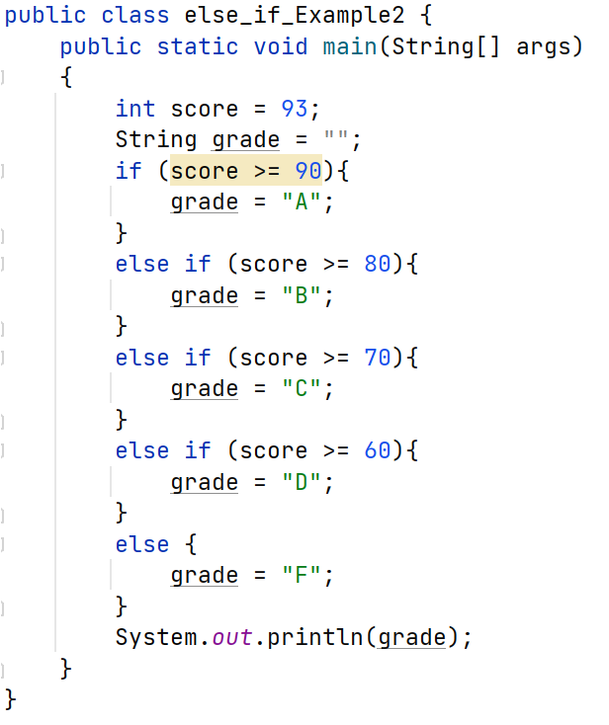
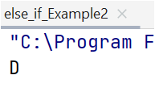
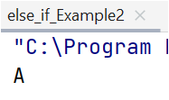
3.4 else if statements
Predict output : What’s Wrong with this Code?

Slide 33
3.5 Compound Boolean Expressions
Logical Operators : Not(!), And(&&) , Or(||)
! , && , || → This represents the order these operators will be evaluated.
An expression involving logical operators evaluates to a Boolean value:
Let’s see examples for each these operators…….

Slide 34
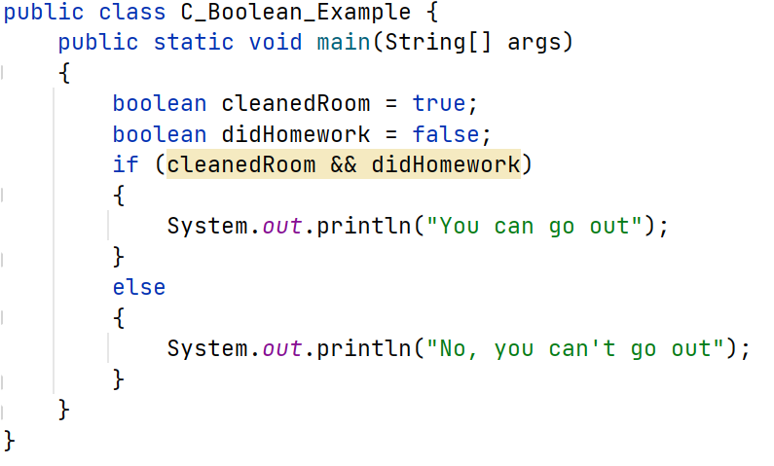

3.5 Compound Boolean Expressions
What if you want to go out and your parents say you can go out if you clean your room and do your homework? Focus on how to use And(&&) Operator

Slide 35


3.5 Compound Boolean Expressions
Predict the output:: Focus on how to use Or(||) Operator

Slide 36


3.5 Compound Boolean Expressions
Predict the output:: Focus on how to use Not(!) Operator.

Slide 37



3.5 Compound Boolean Expressions
Predict the output:: Focus on how to use And(&&) and Or(||) Operator.

Slide 38


3.5 Compound Boolean Expressions
Truth Table.
AND(&&)
Ans→ false

Slide 39


3.5 Compound Boolean Expressions
Truth Table.
Or(||)
Ans→ true

Slide 40

3.5 Compound Boolean Expressions
QUIZ
Ans→ A

Slide 41

3.5 Compound Boolean Expressions
QUIZ:
Ans→ B

Slide 42

3.5 Compound Boolean Expressions
QUIZ:
Ans→ A

Slide 43
3.5 Compound Boolean Expressions
Short Circuit Evaluation :
Both && and || use short circuit evaluation.
The second expression isn’t necessarily checked , if the result of the first expression is enough to tell if the compound expression is true or false.
If two boolean values/expressions are combined with a logical or (||) and the first expression is true, then the second expression won’t be executed, since only one needs to be true for the result to be true.
If two boolean values/expressions are combined with a logical and (&&) and the first expression is false, then the second expression won’t be executed. If the first expression is false, the result will be false, since both sides of the && need to be true for the result to be true.

Slide 44

3.5 Compound Boolean Expressions
QUIZ :
Ans→ B

Slide 45

3.5 Compound Boolean Expressions
QUIZ :
Ans→ A

Slide 46
3.5 Compound Boolean Expressions
QUIZ :
Ans→ A

Slide 47


3.6 Equivalent Boolean Expressions
De Morgan’s Laws:
An easy way to remember De Morgan’s Law :
Move the NOT inside , AND becomes OR.
Move the NOT Inside, OR becomes AND.
In Java , De Morgan’s Laws are written with the following operators:

Slide 48

3.6 Equivalent Boolean Expressions
You can also simplify negated expressions that have relational operators like < , > , ==.
Move the NOT , flip the sign.

Slide 49

3.6 Equivalent Boolean Expressions
Truth Tables:

Slide 50

3.6 Equivalent Boolean Expressions
Simplifying Boolean Expressions :

Slide 51


3.6 Equivalent Boolean Expressions
Predict the Output:

Slide 52

3.6 Equivalent Boolean Expressions
QUIZ:
Ans→B

Slide 53

3.6 Equivalent Boolean Expressions
QUIZ:
Ans→A

Slide 54

3.6 Equivalent Boolean Expressions
QUIZ:
Ans→C

Slide 55

3.6 Equivalent Boolean Expressions
QUIZ:
Ans→D

Slide 56

3.6 Equivalent Boolean Expressions
QUIZ:
Ans→A

Slide 57

3.6 Equivalent Boolean Expressions
QUIZ:
Ans→D

Slide 58


3.6 Equivalent Boolean Expressions
QUIZ:
Ans→B

Slide 59


3.6 Equivalent Boolean Expressions
Home Work: Complete the below code to check the three expressions

Slide 60

3.7 Comparing Objects
String Equality:
The equals() method for Strings compares two strings letter by letter, it compares values .
s1.equals(s2) is true if both s1 and s2 holds similar values.
The == is used to compare object variables, it returns true when the two variables refers to the same object or have same address.

Slide 61



3.7 Comparing Objects
Predict the output of the below code:

Slide 62

3.7 Comparing Objects
QUIZ:
Ans→B

Slide 63

3.7 Comparing Objects
QUIZ:
Ans→C

Slide 64

3.7 Comparing Objects
QUIZ:
Ans→C

Slide 65


3.7 Comparing Objects
Comparing with Null values :
One common place to use == or != with objects is to compare them to null to see if they really exist.

Slide 66


3.7 Comparing Objects
Null Pointer Exception:

Slide 67


3.7 Comparing Objects
Corrected Program :

Slide 68

3.7 Comparing Objects
Write the below code and write down the output of the code :

Slide 69

Multiple Choice Question Practice
Quiz1 :
Ans→ C

Slide 70

Multiple Choice Question Practice
Quiz2 :
Ans→ B

Slide 71
Multiple Choice Question Practice
Quiz1 :
Ans→ B

Slide 72

Multiple Choice Question Practice
Quiz3 :
Ans→ D

Slide 73


Multiple Choice Question Practice
Quiz4 :
Ans→ C

Slide 74

Multiple Choice Question Practice
Quiz5 :
Ans→ A

Slide 75

Multiple Choice Question Practice
Quiz6 :
Ans→ C

Slide 76

Multiple Choice Question Practice
Quiz7 :
Ans→ A

Slide 77



Multiple Choice Question Practice
Quiz8 :
Ans→ A

Slide 78


Multiple Choice Question Practice
Quiz9 :
Ans→ C

Slide 79

Multiple Choice Question Practice
Quiz10 :
Ans→ D

Slide 80

Multiple Choice Question Practice
Quiz11 :
Ans→ B

