Slide 1
Database Methods
C20012

Slide 2
What is a database?
Databases are used to store a wide variety of information
  text
  numbers
  pictures
  sounds
Databases are widely used
Any orderly repository of data is a database

Slide 3
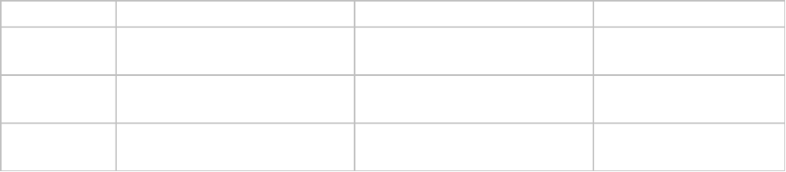
What are the parts of a database?
Databases consist of records
Records consist of fields
Fields contain the actual data of the database
  may be any form of digital data
The design of a database is similar in layout to a spreadsheet

Slide 4
How are databases made?
The purpose of the database should be clear
Design before building reduces errors
List all the data that must be stored
  these are the fields
Decide what sort of data will be stored
  this is the type of the data
Decide what size the data fields need to be
  allow for any unusual data values
Test the database upon completion

Slide 5
Other elements of a database
In a functioning database the output is also important
  reports present the contents of the database in a meaningful format
Queries are used to extract useful subsets of data
  not all data may be relevant to a current task
Commonly carried out functions may be automated with macros
  these are used in many other applications also

Slide 6
Parts of an Access database
Tables are used to contain the data
Forms are used to make the process of inputting data more attractive
  not necessary as data can be entered directly into the table if desired
Queries are used to select data subsets
  to select records by area code
  Access uses QBE
Reports are used to present the extracted data attractively
  telephone bills are reports

Slide 7
Starting Microsoft Access
The location of the database file is specified first
Define tables to contain the data
  this should have been designed in advance
Enter the data into the table
  ensure accuracy, as computer output is often not checked
  garbage in - garbage out

Slide 8
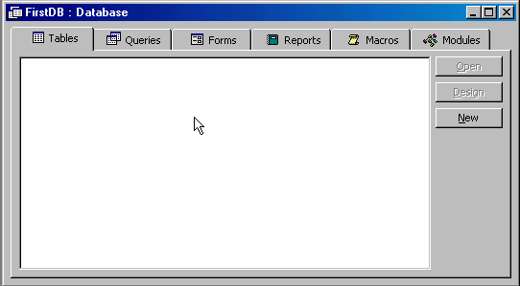
Main Access control center

Slide 9
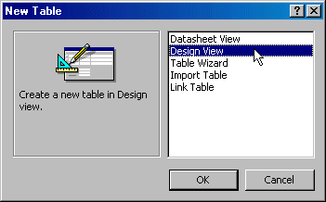
New table dialog

Slide 10
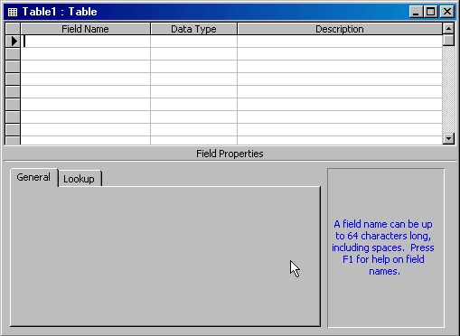
Table design view

Slide 11
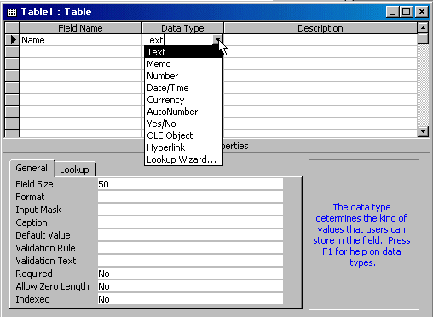
Selecting data types

Slide 12
Data types used
Text - for simple text entries etc
Number - for numeric data
  integer, long integer, byte
  single, double
Date/Time - stores dates and time
  long format, short format
  time only, date only, both
Currency
Yes/No
  logical true/false values

Slide 13
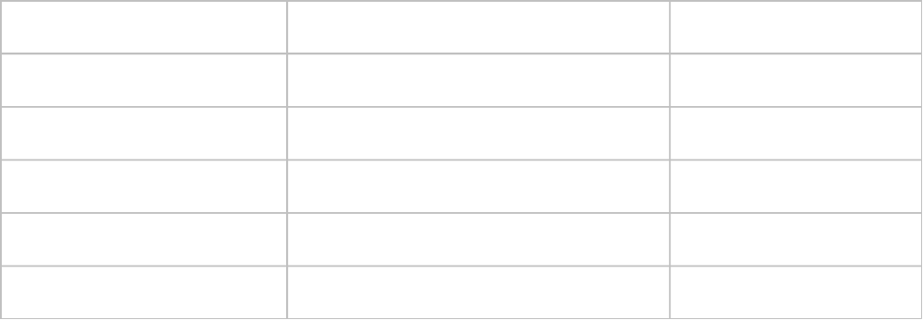
First sample database
Create a table with records of this type:
Save the table as PersonalDetails with no primary key

Slide 14
Primary keys
A key is used to uniquely identify individual records
The primary key is the most important
  secondary and other keys may be defined
Use of the primary key makes life easier for the database program
It is easier not to set a primary key in most exam situations, as working with keys can be awkward
If a key is used, auto-numbering should ensure uniqueness

Slide 15

Data sheet view

Slide 16

Sorting the data
Select the column to sort by
Click on the appropriate sort button

Slide 17
Changing the table design
The table may be changed after creation
  a properly designed table shouldn’t need alteration!
Fields can be renamed, deleted, added, re-ordered
Field sizes can be changed
  may lead to data loss
Field types can be changed
  may lead to data loss

Slide 18
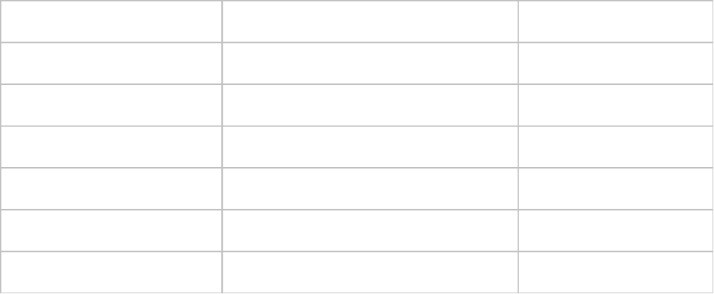
Changing the table design
Change the table structure to this:
Re-enter the name data

Slide 19

Printing the table contents
NCVA requires printouts as evidence of work
Printouts should be obtained at the correct time
  not all printing can be left to the end of the exam
Identify your printouts with your name added to the table name

Slide 20
Data entry using forms
Entering data directly into a table gives user full access to the table
  user also has access to the structure of the table
  may accidentally or deliberately change this
Data entry using input forms is often easier
  can more accurately reflect the paper forms used
  input form can look the same as the paper form
    paper form often known as a data capture form
  input form may contain helpful instructions and hints
Forms are created in a drawing environment and associated with a table

Slide 21
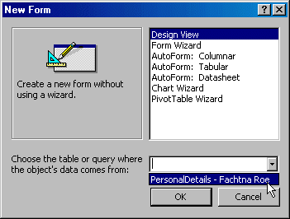
Creating a form
The new form must be associated with a table
  this tells Access where to store the entered data

Slide 22
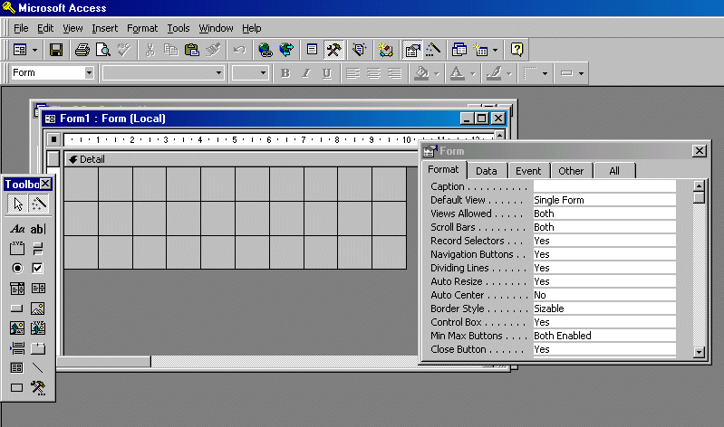

Slide 23
Creating the form controls
For each field:
  select the textbox tool and position on the form detail section
  set the Data/Control Source to the desired field name
  change the associated label (e.g. “Text0:”) to some more appropriate text - or remove
Ensure all fields are present
  create the input boxes in order for easy tabbing
NCVA gives marks for specific requirements
  ensure these are met
Save the form, adding your name to it

Slide 24
Form headers and footers
Form headers and footers appear once, at the top and end of the form
Page headers and footers will appear as many times as there are pages in the form
  forms generated may be for printing as data capture forms
NCVA may require entries in the form header
  ensure requirements are met - they may be quite simple
  use this section to specify your name

Slide 25
The exam instruction
Task 2 (8 marks)
Design and create a data input screen (FORM) and then use the data input screen to enter the sample`data shown in Figure 2 into the database structure ‘CASUALTY’ created in task 1.
With regard to the data input screen you should follow these guidelines:
a) All fields must have suitable field labels.
b) The input screen should have a title on top and centred.
c) There is no need for borders or other effects.
Your invigilator will award marks to your screen design during the examination.

Slide 26
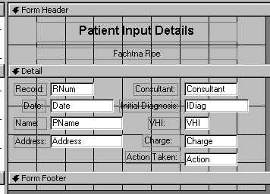
Design view of input form (1996)

Slide 27
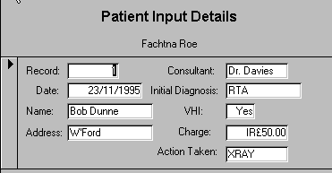
The completed input form (1996)

Slide 28
Tips for data entry
Count the fields
Count the records
Re-read each record to avoid cross-contamination
Recheck the data in reverse
Check for capitalisation
Dates may be in US or European format
Periods may be present for abbreviations
Logical fields may be handled more than one way

Slide 29
Printing the form
The form must be should be printed
  the form may be marked on-screen
Ensure it’s yours!
  put your name on the form in small text
Include the form with your other printouts
The form appearance on paper may not be as pleasing as on screen
  marks are awarded for creating the form with the necessary features, not for the forms ‘beauty’

Slide 30
NCVA exam reports
Usually seek common sample requirements
  e.g. mailing labels
Should be checked upon completion against listed requirements
Will usually involve sorting
  on more than one field
May be best carried out during the exam
  you can lose marks is you decide incorrectly
May need to add your name specially
Will probably require creating a Query first!

Slide 31
The exam instruction
Task 3 (12 marks)
The Accounts Officer in St. Paul’s wishes to send invoices only to those patients who have either been admitted to one of the Hospital’s wards or sent for X ray. You are asked to produce these mailing labels. For logistical reasons the Accounts Officer requests that the labels be printed in a particular sequence:-
1. Ascending order on the consultant field (primary sort field)
2. Descending order on the charge field (secondary sort field)
Each label should show the date as well as the patient’s name, address and record number.
The actual printing of the labels can take place at the end of the examination if you so wish.

Slide 32
Queries
Are one of the main reasons that databases are useful
  are equivalent to using a telephone directory
Convert data to information
  through selective retrieval
Extract only a subset of the data
  various criteria may limit the data listed
May not recover all fields in the records
  only relevant ones

Slide 33
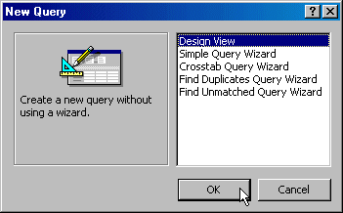
Creating a query
Has a similar initial dialog to that of forms and reports

Slide 34
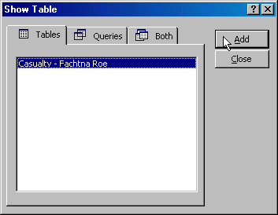
Data source selection
We must select the tables from which the data will be extracted by the query

Slide 35
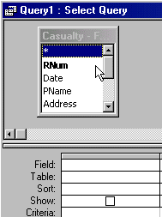
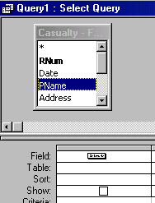
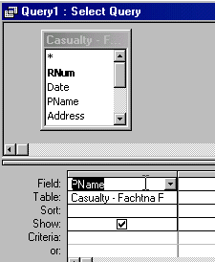
Click and drag to select fields
Select only the required fields - click and drag!

Slide 36
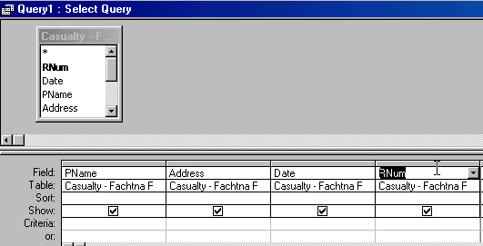
Display of fields
The query will display the selected fields only if they’re ticked

Slide 37
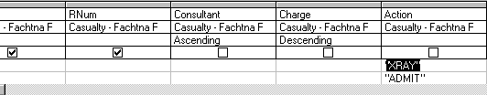
Satisfying the query requirement
Extra fields may be added to the query
  to control the records returned
  to sort the data
  the extra fields can be hidden

Slide 38
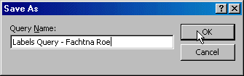
Saving the query
Add your name to the query as you save it

Slide 39
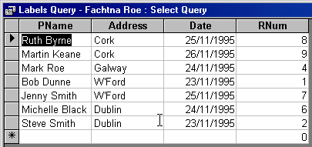
The query output
The data retrieved should be checked against the requirements list

Slide 40
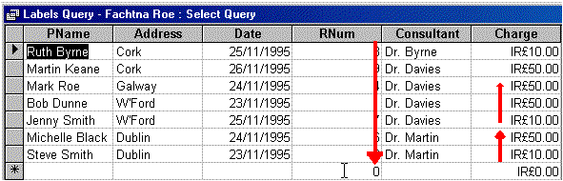
Verifying the query output
Displaying the hidden fields temporarily allows checking of the order of the data

Slide 41
The SQL view of the query
SELECT [Casualty - Fachtna Roe].PName, [Casualty - Fachtna Roe].Address, [Casualty - Fachtna Roe].Date, [Casualty - Fachtna Roe].RNum
FROM [Casualty - Fachtna Roe]
WHERE ((([Casualty - Fachtna Roe].Action)="XRAY" Or ([Casualty - Fachtna Roe].Action)="ADMIT"))
ORDER BY [Casualty - Fachtna Roe].Consultant, [Casualty - Fachtna Roe].Charge DESC;

Slide 42
Creating an NCVA report
It’s essential to realise that a report will very often need an underlying query
  first create the query
  test the query
  print the output
Once the query is created prepare the report
Print the report out put before continuing
  later instructions may involve changing or even deleting records
Simpler reports may not require queries but should still be printed

Slide 43
The exam instruction
Task 3 (12 marks)
The Accounts Officer in St. Paul’s wishes to send invoices only to those patients who have either been admitted to one of the Hospital’s wards or sent for X ray. You are asked to produce these mailing labels. For logistical reasons the Accounts Officer requests that the labels be printed in a particular sequence:-
1. Ascending order on the consultant field (primary sort field)
2. Descending order on the charge field (secondary sort field)
Each label should show the date as well as the patient’s name, address and record number.
The actual printing of the labels can take place at the end of the examination if you so wish.

Slide 44
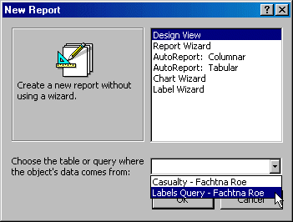
Creating a report
The new report must be associated with a table or query
  this tells Access from where to obtain the data to display

Slide 45
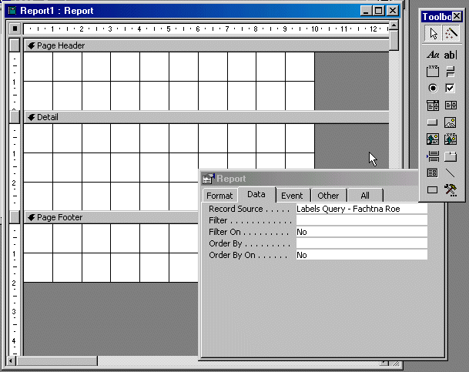

Slide 46
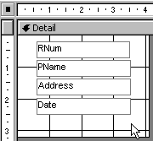
Design view of the report
Provide data controls and associate them with data fields - as previously done with input forms

Slide 47
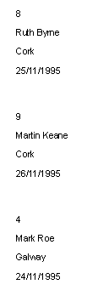
The completed mailing label
Should only include relevant fields
Check printed output against exam requirements
May involve using left/right alignment buttons and other tools to present data attractively

Slide 48
Saving the data (in case)
It is normal to secure your data before modification
  the NCVA may request saving of your ‘current data set’
It is advisable to print data sets when they are valid
  you may be required to change relevant records later
When requested to save data, duplicate the table
  copy and rename the table when requested to “save the current file”
Note that the duplicated file might later be accessed by name for queries, forms and reports to work.

Slide 49
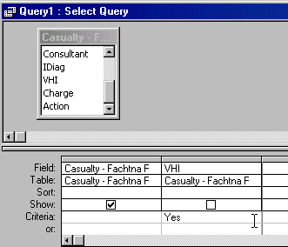
1996 - Task 4 (a)
Find and print (now or later) all records for patients who are members of the VHI.
Select all fields - but you don’t need to display what you’re selecting by

Slide 50
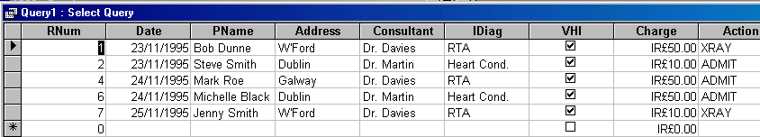
1996 - Task 4 (a)
The required data:
Check your results

Slide 51
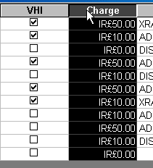
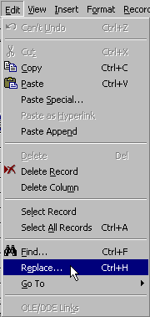
1996 - Task 4 (b)
Substitute all occurrences of the value 50.00 in the charge field with the value 30.00.

Slide 52
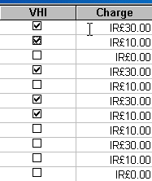
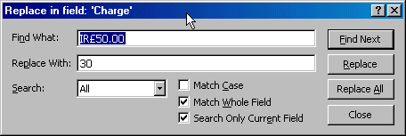
1996 - Task 4 (b)
Changes such as this one are what make earlier printing a good idea!
The table can be copied prior to the change

Slide 53
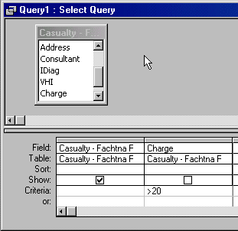
1996 - Task 4 (c)
Find and print (now or later) all records for patients who owe more than £20.

Slide 54
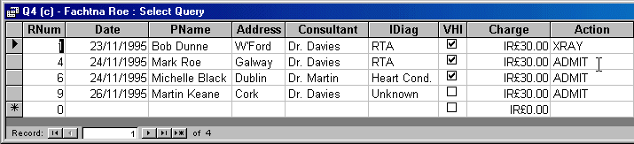
1996 - Task 4 (c)
Return all fields unless otherwise requested

Slide 55
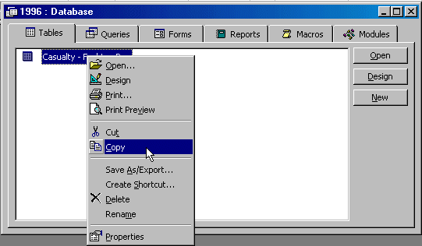
1996 - Task 4 (d)
Select and copy tables prior to major changes

Slide 56
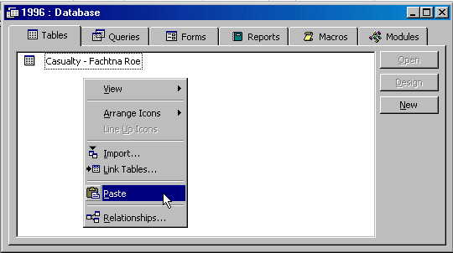
1996 - Task 4 (d)
Complete the copying process as per usual

Slide 57
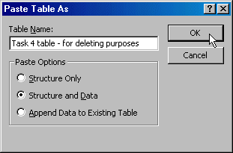
1996 - Task 4 (d)
The table should be fully pasted

Slide 58
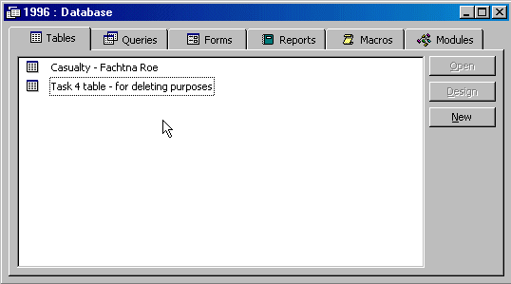
1996 - Task 4 (d)
A full list of tables is shown in the tables section

Slide 59
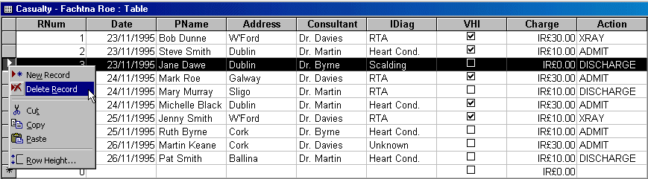
1996 - Task 4 (d)
Individual records can be deleted the same way as spreadsheet rows

Slide 60
1996 Task 5 - The Instruction
Using the original database created in tasks 1 and 2, design and print a report that shows for all records the following fields (and in the order listed)
  Patient’s name
  Patient’s address
  Consultant in attendance
  Diagnosis
  Action Taken
  Charge
The report should be headed ‘St. Paul’s CASUALTY Report’ and should show the print date. Choose suitable titles for each field listed above. The Charge column should be totalled.

Slide 61
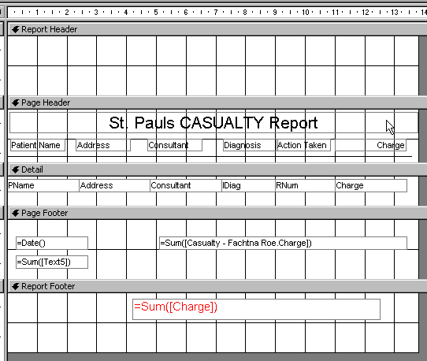
Report Creation

Slide 62
Creating The Report
Select the correct table
Ensure all fields are present
  and in the right order
Align and format columns suitably
Create headings in the correct header section
  report sections have different functions
Provide any formulae requested
  calculations will only function in the report footer
Check compliance with listed requirements

Slide 63
Report Functions
Most common requirement is totalling of some numeric field
  achieved using =SUM() function
  used as =SUM([FieldName])
Current date may be required
  achieved using =DATE() function
Functions must be inserted in the correct sections
Labels should be added if required

Slide 64
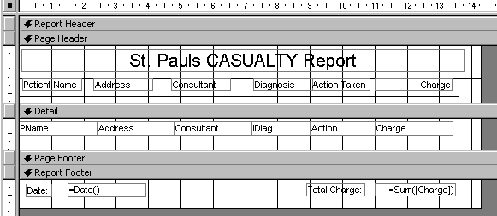
Task 5 - Completed Design

Slide 65
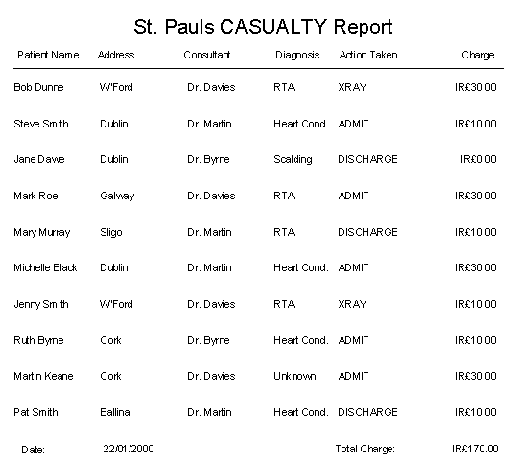
Task 5 - Completed Report

