Slide 1

A Rudimentary Implementation of Cryptocurrency
Presenters: Cecil Lam | Bryan Ngo | Annie Tu | Ran Xu

Slide 2
Transaction Design
Each Transaction is only allowed to be spent once
Transactions have unique identifiers:
Transaction Hash (trans_hash)
Transaction Signature (trans_sig)
Timestamp (time_st)
Can be configured to have varying inputs (in_sz) and outputs (out_sz)
Coins in a wallet must be spent in its entirety
Generates input hashes(in_hash) and input indices(in_index)
A hash and an index are coupled together to designate a recipient
These are necessary for record keeping of the block chain
Generates a public key (out_pubk) used for verification
Snippet of transaction implementation:
private:
string trans_hash;
string trans_sig;
int in_sz;
int out_sz;
string *in_hash;
int *in_index;
int *out_val;
string *out_pubk;
string time_st;

Slide 3

Block Design
string prev_blck_hash
Acts as a pointer to the previous block.
string hash_merkle_root
string block_hash
A hash of the merkle root and the nonce
int nonce
Gives a characteristic to the hash (leading 0’s)
int trans_count
string timestamp

Slide 4
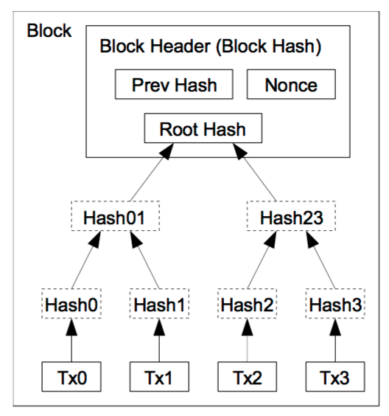
Why Mine?
Incentives
Take a hash of unconfirmed transactions and hash them together.
Creates the root hash.
Get contents of the Block Header (prevHash, rootHash, etc) and hash those together.
Creates some random string
The miner’s goal: find some 32 bit number (nonce) that, when hashed with the block header, creates “0s” + string.
Miner who finds the number (nonce) is rewarded a certain number of BTC
Difficulty
It would take several years for a computer to solve a hash
AKA Proof of Work

Slide 5
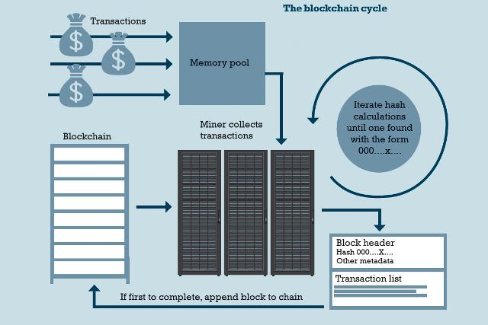

Slide 6
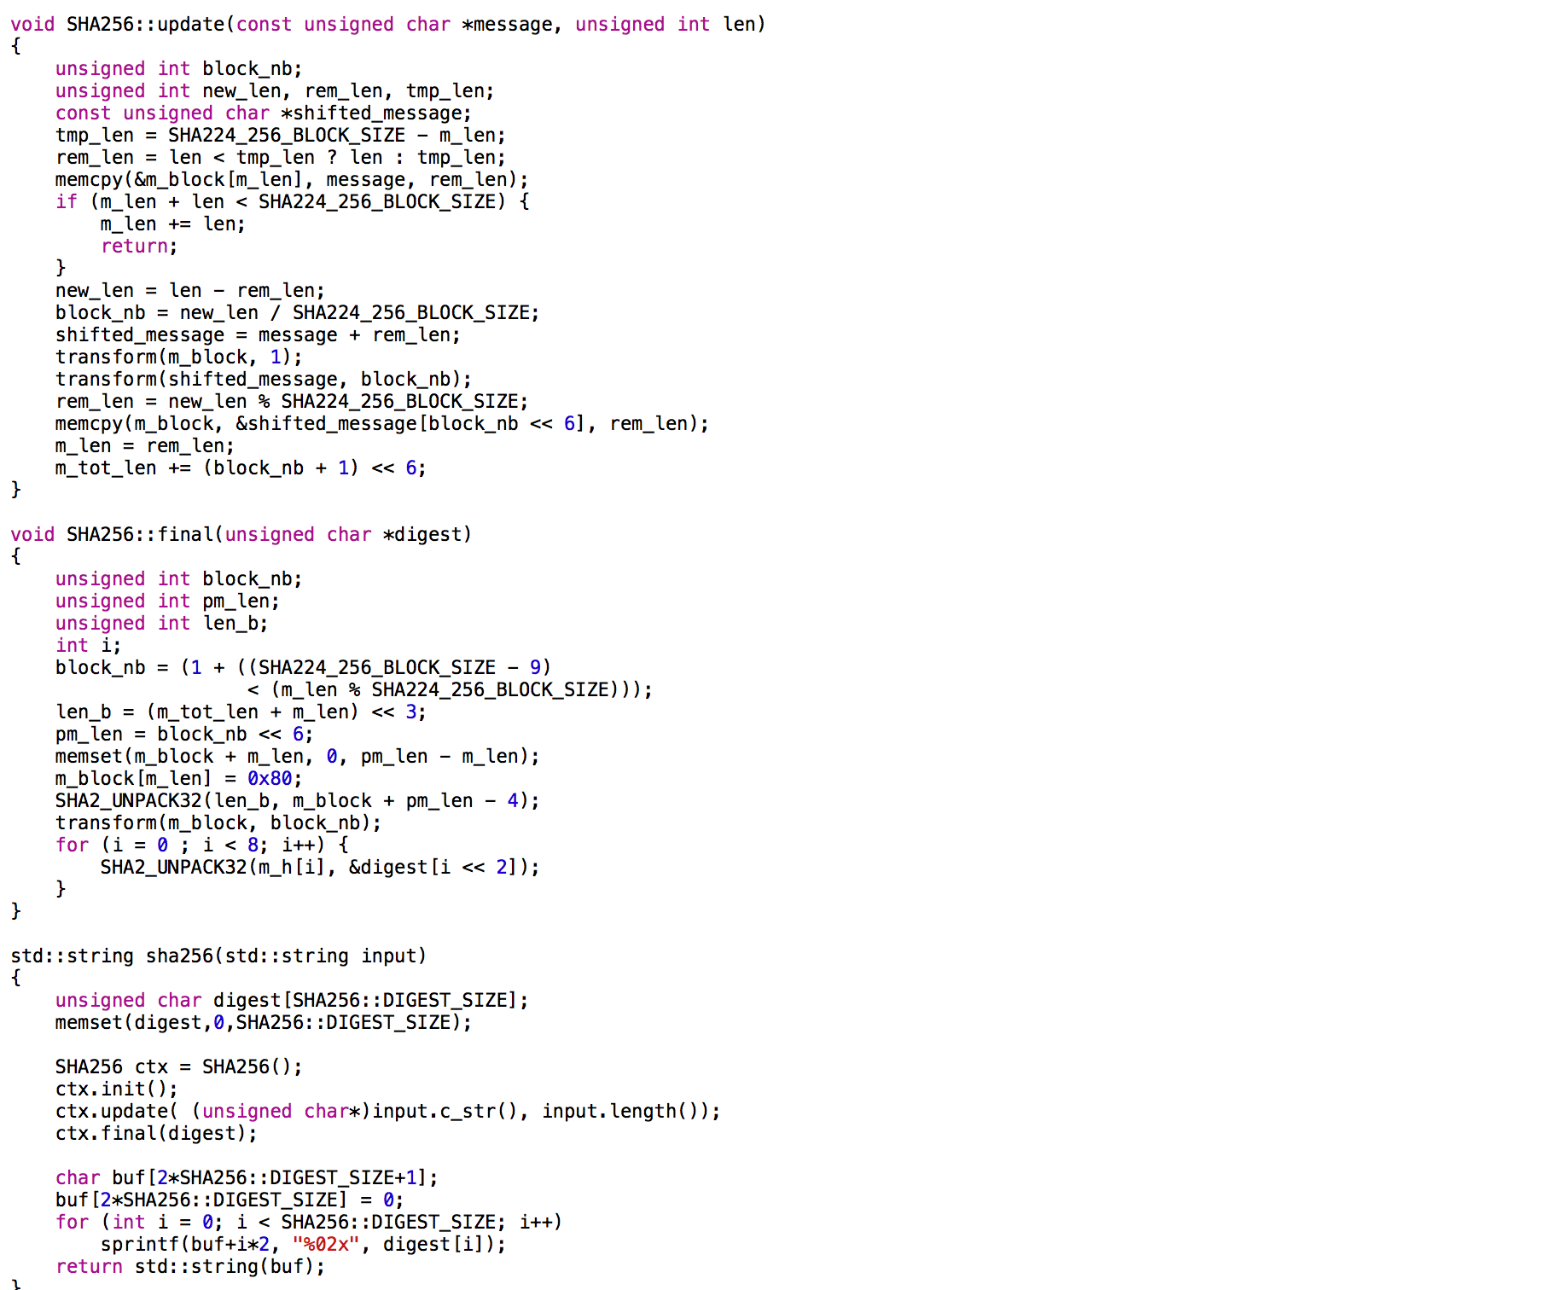
DEMO

