Slide 1
A new approach for the world of
Decentralization
+ Messaging
Harrison Nguyen, Davey Jay Beliss,
Soham Koradia, Ian Skebba

Slide 2

Problem
Can a person speak without consequence?

Slide 3
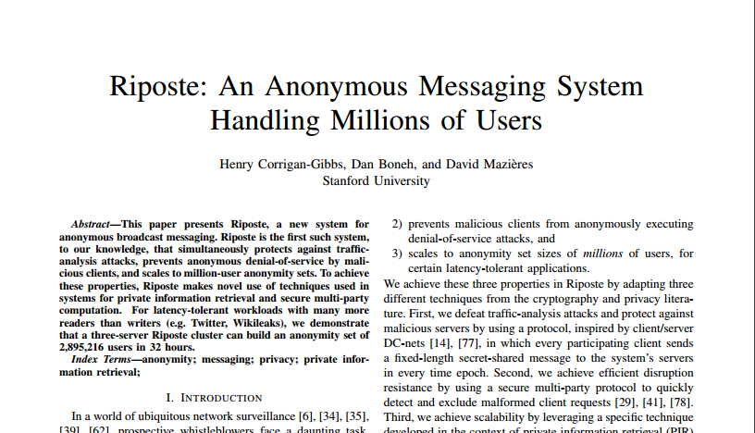
Proposed Solution
Notes:
Riposte:
Stanford recently proposed a solution called Riposte, an anonymous, twitter-like program.
Users send their message to the system, which is then XORed with a randomly created bit string, broken up, and sent to multiple secure clients.
After a set amount of time the clients combine the broken up messages and publish the whole message to a main central server that holds all of these messages “anonymously” for people to view.
A flaw in this system is the centralized servers that can be compromised or shut down by the government or other agencies.

Slide 4
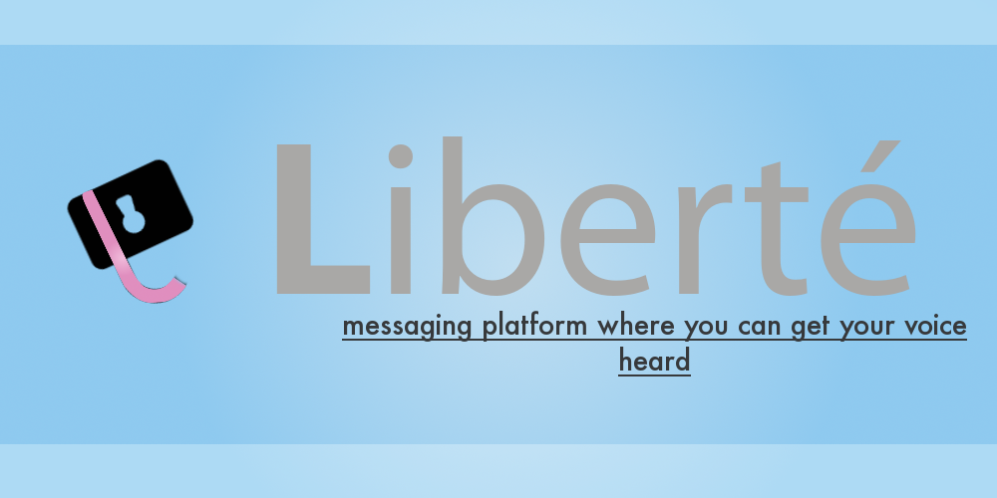
Our Solution
A Decentralized
Decentralization + Messaging done right
Notes:
Riposte:
Stanford recently proposed a solution called Riposte, an anonymous, twitter-like program.
Users send their message to the system, which is then XORed with a randomly created bit string, broken up, and sent to multiple secure clients.
After a set amount of time the clients combine the broken up messages and publish the whole message to a main central server that holds all of these messages “anonymously” for people to view.
A flaw in this system is the centralized servers that can be compromised or shut down by the government or other agencies.

Slide 5
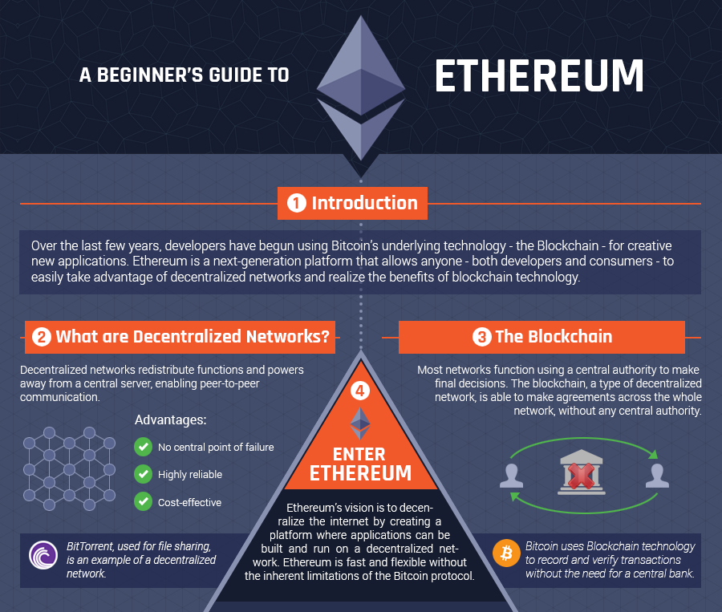
Etherium
© 2015 DocBot Inc. All rights reserved.
Notes:
Etherium is an existing blockchain that uses a Turing complete language.
Developers pay Ether as currency, or fuel, to run their applications.
Using Etherium allows users to pay Ether in order to publish a message to the network and allows us to store messages in a block chain efficiently to create a forum like anonymous database which can never be changed.
Etherium also uses smart contracts, which ensure that both the user and developer honor their agreements.
We use this to guarantee a user receives our token after sending their ether to a dead address

Slide 6
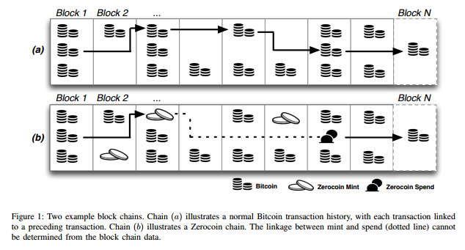
Zerocoin
*Zerocoin: Anonymous Distributed E-Cash from Bitcoin
Visualization of how the protocol works
Notes:
In our proposed system, we use a model similar to zerocoin, except once the coin is pinned to the board, it is lost forever.
Zerocoin is a cryptocurrency designed to bring total anonymity to transactions in Bitcoin.
Pencil and paper example from Zerocoin paper:
User creates a serial number S and encrypts it with another number r, to create a coin C.
User pins the coin C to the bulletin board along with $1 of physical currency.
To redeem a coin, the user (using a disguise) proves they know the serial number to an existing coin via a zero knowledge proof.

Slide 7
The Message
Users “burn” some amount of etherium for a token to spend
They append their message to a block and hash the block with a nonce
The block is then sent across the network to the other servers
Miners mine the block until they find the nonce, broadcasting the solution
Others verify the solution by checking to see that the nonce given is indeed valid
The block is added to the blockchain, where it could then be read by others
Notes:
Users “burn” some amount of etherium for a token to spend (this allows them to post anonymously) and append their message to a block and hash the block with a nonce
The block is then sent across the network to the other servers
Miners mine the block until they find the nonce, broadcast the solution, others verify the solution by checking to see that the nonce given is indeed valid, and after confirming this, the block is then added to the blockchain, where it could then be read by others

Slide 8
Security
One of the beauties of the underlying platform is that it comes up with a great way to counteract common attacks such as DDOS, and exploits such as building ASICs.
The only way for the blockchain to be changed is if a malicious entity can outcompute all other miners
It is highly improbably to flood the network with messages as each message requires some amount of “ether”
Miners benefit from attackers because the ether the attackers pay will be given to them
© 2015 DocBot Inc. All rights reserved.

Slide 9
Conclusion
We proposed a method to anonymously post messages online to a decentralized system.
We hypothesized a framework using Etherium’s network and zerocash protocol.
We created a system in which messages cannot be traced to the users.
Free Speech throughout the World.

Slide 10
Questions?

Slide 11
Thank you for
listening!

