Slide 1
VTC: Digital Elections
Raymundo Beristain-Barajas, Anton Rotter-Siere, Kevin Tran,
Graciela Vargas Roque, Reed Wirthman

Slide 2
Overview of Voting Equipment in the US
Two common types of voting equipment are used in US elections:
Optical Scan Paper Ballot System
Direct Recording Electronic Systems (DRE)

Slide 3
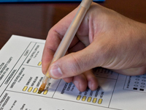
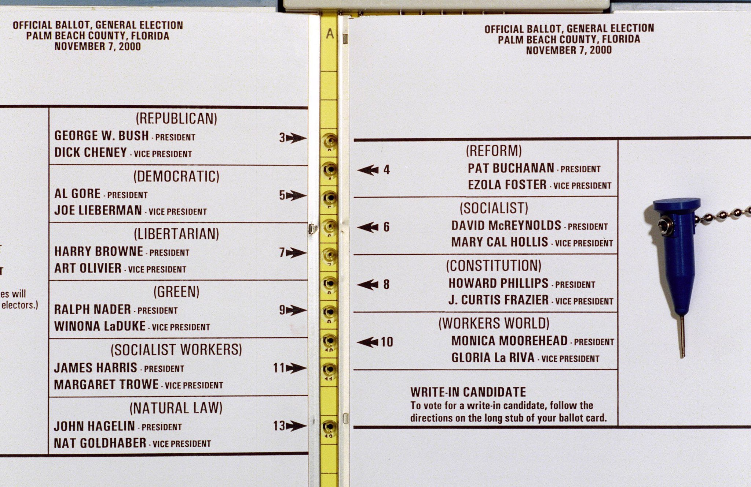
Optical Scan Paper Ballot System
Voters mark paper ballots that are subsequently tabulated by scanning devices.
Notes:
On most optical scan ballots, voters indicate their selections by filling in an oval (on ES&S and Premier/Diebold ballots), completing an arrow (Sequoia ballots), or filling in a box (Hart Intercivic ballots.)
Ballots may be either scanned on precinct-based optical scan systems in the polling place (Precinct Count) or collected in a ballot box to be scanned at a central location (Central Count.)Voters mark paper ballots that are subsequently tabulated by scanning devices.

Slide 4
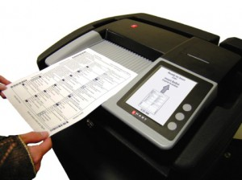
Optical Scan Paper Ballot System Problems
In 2011, the U.S. Election Assistance Commission responsible for inspecting voting equipment found three problems with the ballot reader (ES&S):
Random screen-freezes
Failure to log errors
Skewing of ballots as they're fed into the machine
Notes:
Random screen-freezes that prevent ballots from being fed.
Failure to log errors in a file that would let election officials know of problems.
Skewing of ballots as they're fed into the machine, making votes cast in some parts of the ballot unreadable.
Primaries recount potentially
http://www.stltoday.com/news/national/govt-and-politics/recounts-possible-in-both-of-missouri-s-presidential-primaries/article_f5156665-b874-51a0-afde-36cef52dee47.html
2000 Florida recount : Bush vs Gore
Butterfly ballot… unclear who they were voting for
Altering of registration:
http://www.justicegazette.org/will-new-yorkers-get-to-vote.html

Slide 5
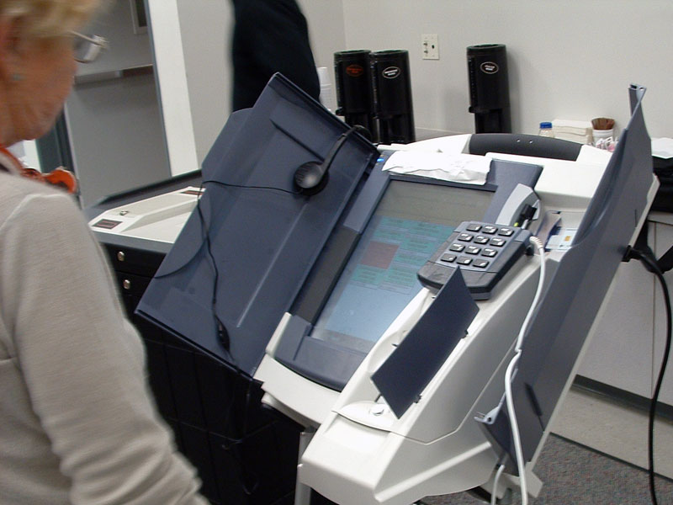
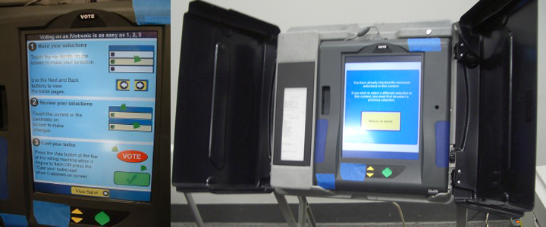
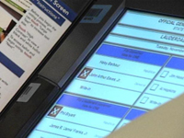
Direct Recording Electronic Systems (DRE)
Notes:
Voters record their votes directly into one of the three basic computer interfaces (pushbutton, touchscreen or dial)
“Glitch” in electronic voting:
https://www.youtube.com/watch?v=QdpGd74DrBM

Slide 6
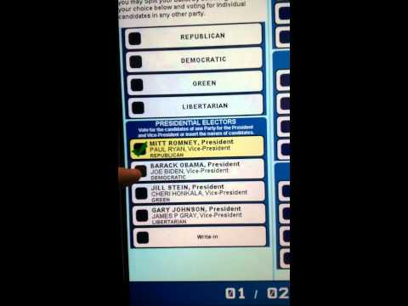
Direct Recording Electronic Systems (DRE) Problems
Malicious code
(Note: the machines and its code are proprietary).
Record differently
Notes:
Because the machines rely on complicated software, it is possible that someone could insert malicious code that would add, subtract, or change votes (Note: the machines and its code are proprietary).
In the best known potential exploit, the hidden code would cause the DRE to record a different vote from what the voter sees on the face of the machine.

Slide 7
Costs to Consider
Paper ballots must be printed. If there are several different ballot styles and/or language requirements, printing costs can add up. Costs for printing ballots are estimated at 35 cents to 65 cents per ballot.
DREs costs range from $2,500-$3,000 per unit.
DREs annual maintenance estimated at $100-$200/unit. As equipment ages, maintenance costs rise.

Slide 8
Votecoin: Voting
Individual registers to vote with their government issued ID.
Receives a public and private key
Gets redirected to VTC download link
2) On election day, voter submits vote through their personal electronic device with the VTC app
3) After vote is cast, voter can trace block ID and number of confirmations

Slide 9
Votecoin: Vote Verification
Vote verifiers aggregate the digital ballots into a block
Verifying hardware works on solving a SHA-256 hash by finding the appropriate nonce that will result in the given target
Once the block has been added to the blockchain of votes, the verifier gets compensated with 5 VTC

Slide 10
Votecoin: The Currency
In order to incentivize people to operate verification hardware and software, we must compensate them with a cryptocurrency unique to this platform.
At first, VTC will be nearly worthless
Over time, with merchant adoption and consumer use, VTC can be spent in online or retail stores.

Slide 11
Votecoin: Potential Problems
If individuals are required to provide their government issued ID in order to receive a public and private key, their anonymity may be compromised.
Specialized hardware can make it increasingly difficult for other verifiers to solve a block. This will lead people to combine their computational power via “mining pools” which undermines the idea of a decentralized system.

Slide 12
References
Korte, Greogry. "Federal Agency Finds Defects in Ballot Scanners." USA TODAY. N.p., 22 Dec. 2011. Web. 01 June 2016. <http://usatoday30.usatoday.com/news/politics/story/2011-12-22/defective-voting-machines/52172034/1>.
"Voting Equipment in the United States." Verified Voting. N.p., 12 Oct. 2010. Web. 01 June 2016. <https://www.verifiedvoting.org/resources/voting-equipment/>.

