Slide 1
PROJECT
Decomp-Java
Utility to display java sources from CLASS files,to help in reversing engineering java programs and perform security auditing.
Presented by :- Karan Kumar
Roll no :- 8718120

Slide 2
TOOL INSPIRATION........
Decompiling java bytecode or .class code is always so headache for reverse engineers and security researcher ,
So i write this utility which can give same java source code to read and find vulnerabilties in java program.

Slide 3


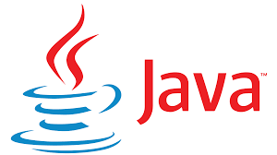

Technologies used in “Decomp-Java”
NOTE:-To demonstrate the working of tool practically i made vulnerable web apps using same scenerious as in real world vulnerabilities.
In Decomp-Java
In Vulnerable labs
Java - Main programing language.
ANTLR :- ANTLR (ANother Tool for Language Recognition) is a tool for processing structured text.
Fife – for UI parsing and showing.
Gradle – for building the app
Java-Swing – for building window based gui.
Java-Awt – Abstract Window toolkit.
Procyon – Java Decompiler
Docker - To deploy the container of vulnerable labs which is sandbox from main host.
Docker-Compose - To run containers with single command.
Spring-Web-Framework – Java Framework to build web apps.

Slide 4
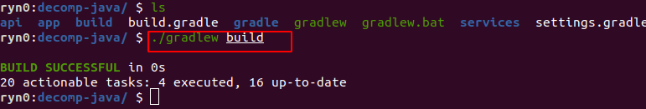
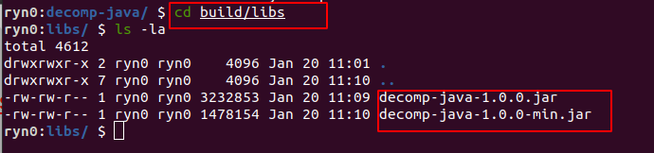
Build Instruction for ‘Decomp-Java’.
You should setup whole java environment in system.
For linux run this in project directory
For windows run gradlew.bat in project directory.
You should find .jar build file at build/libs -

Slide 5
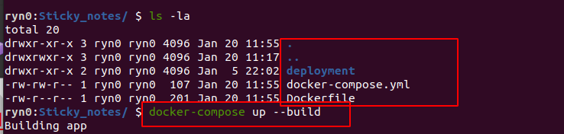
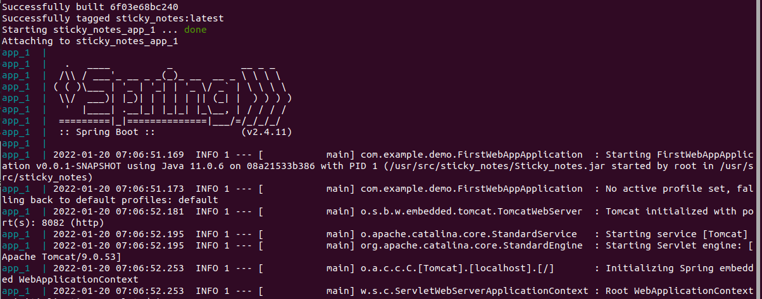
INSTALLATION INSTRUCTIONS TO INSTALL “Vulnerable web app”
Go to directory having vulnerable app source code specially docker-compose.yml file.
Enter this command to start docker container and webapp available at : http://127.0.0.1:8082

Slide 6
INTRODUCTION TO THE TECHNOLOGIES USED IN “Decomp-Java” AND “Vulnerable Web App”.

Slide 7
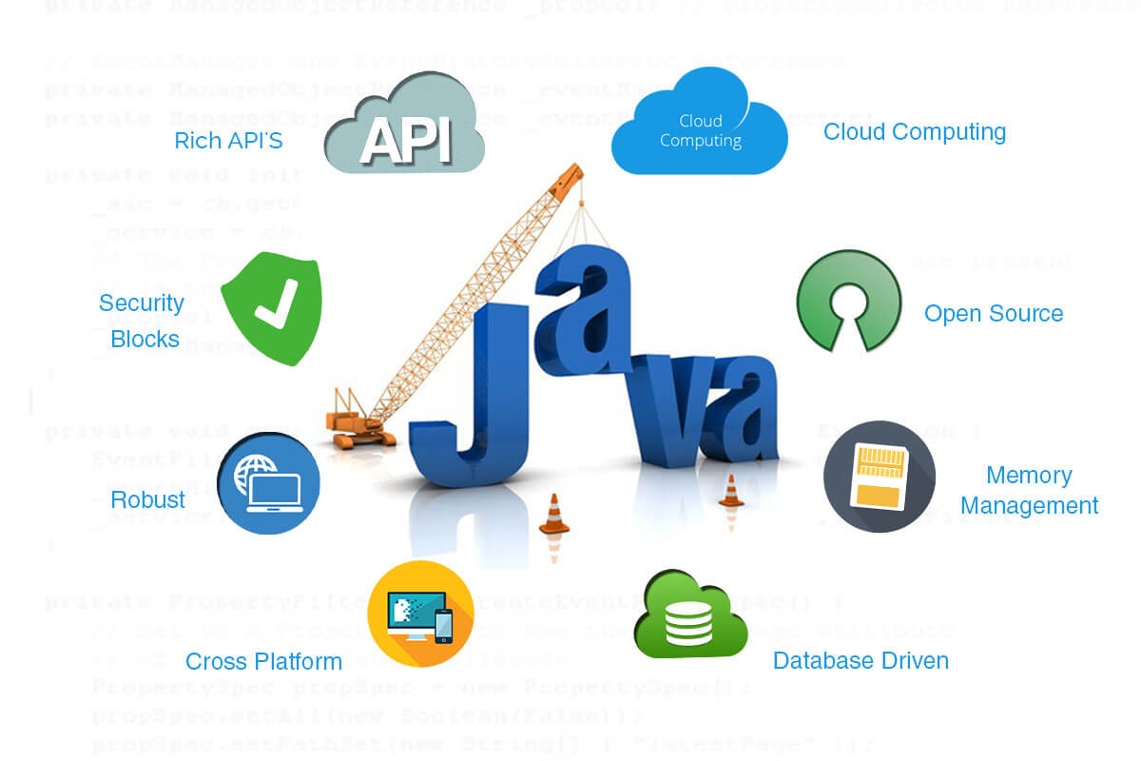

Slide 8
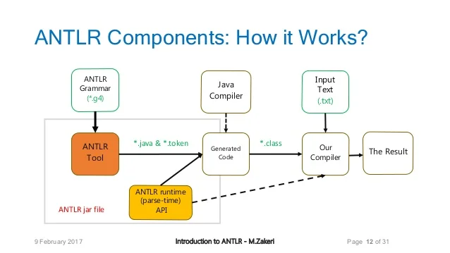

Slide 9

Procyon is a suite of Java metaprogramming tools focused on code generation and analysis.

Slide 10
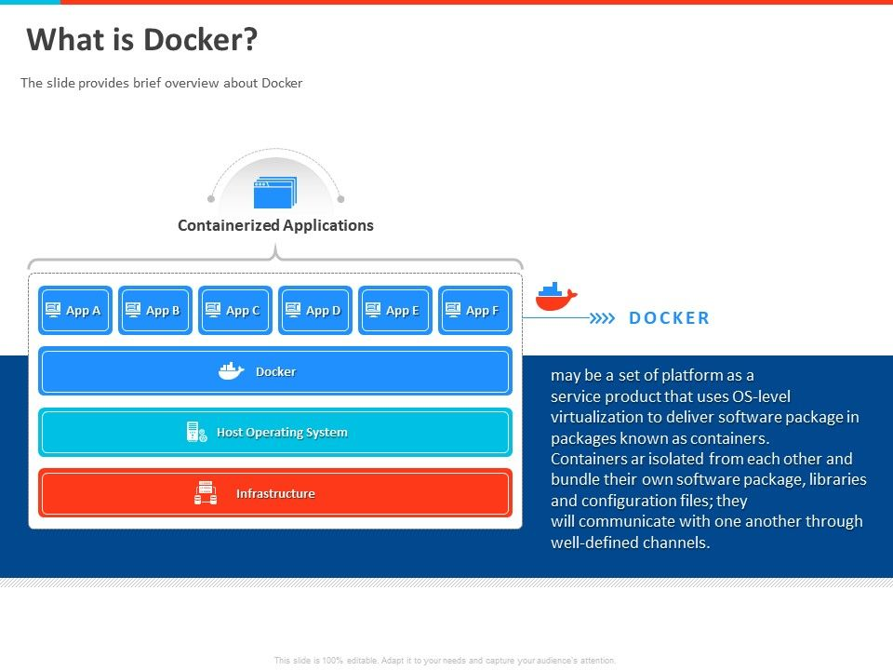

Slide 11
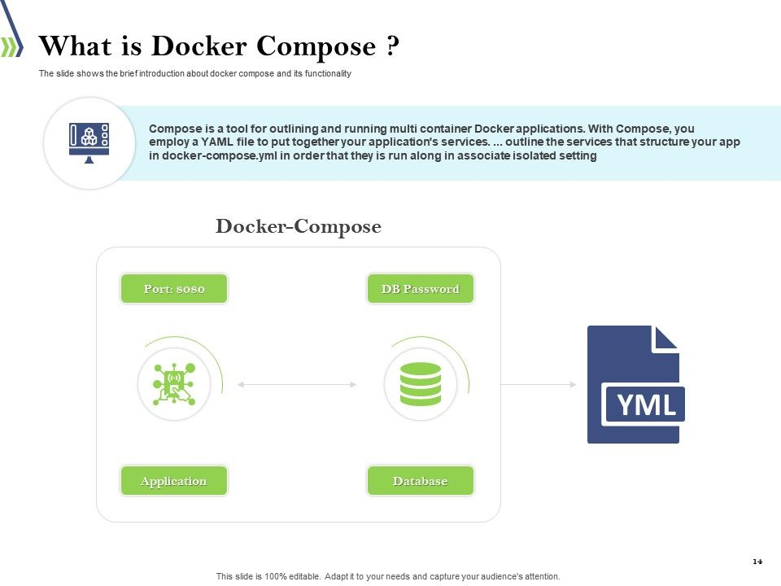

Slide 12
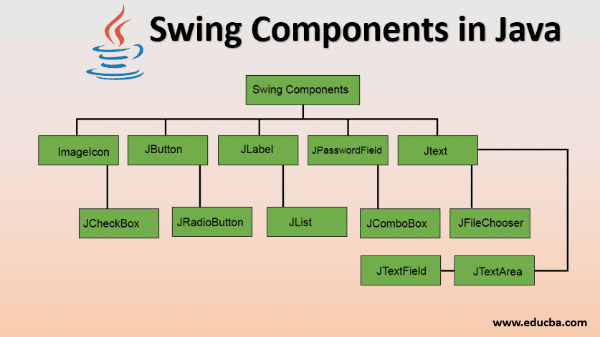

Slide 13
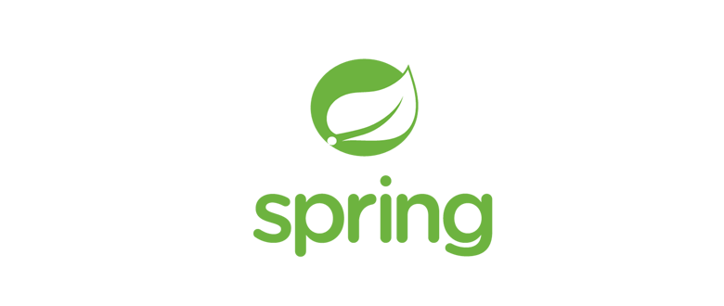
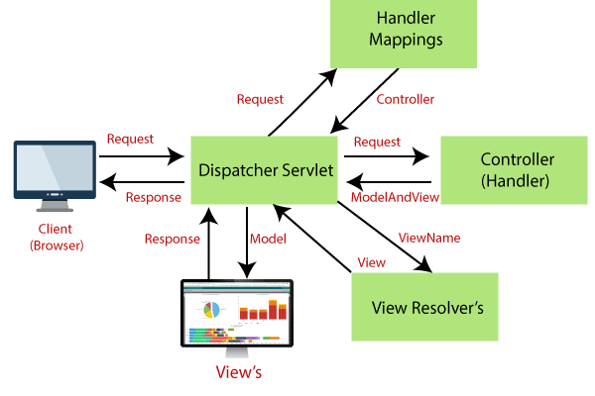

Slide 14
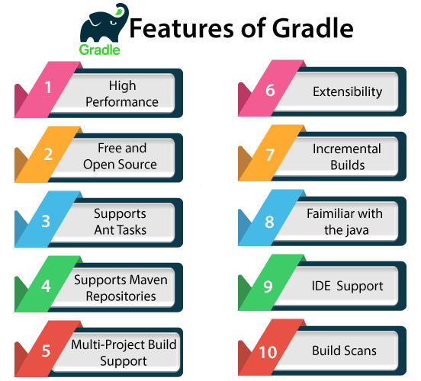

Slide 15
“Decomp-Java” Look and usage.

Slide 16
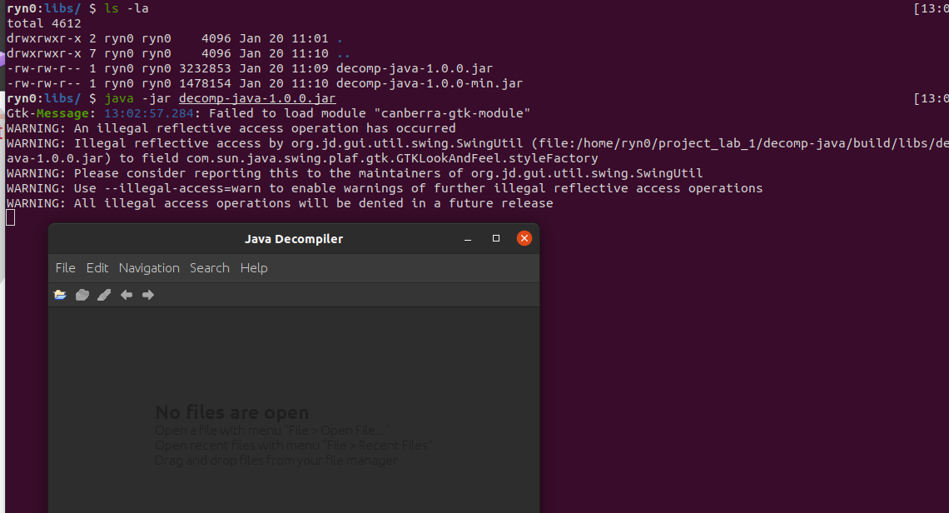
You can run “decomp-java” using this command in linux.

Slide 17
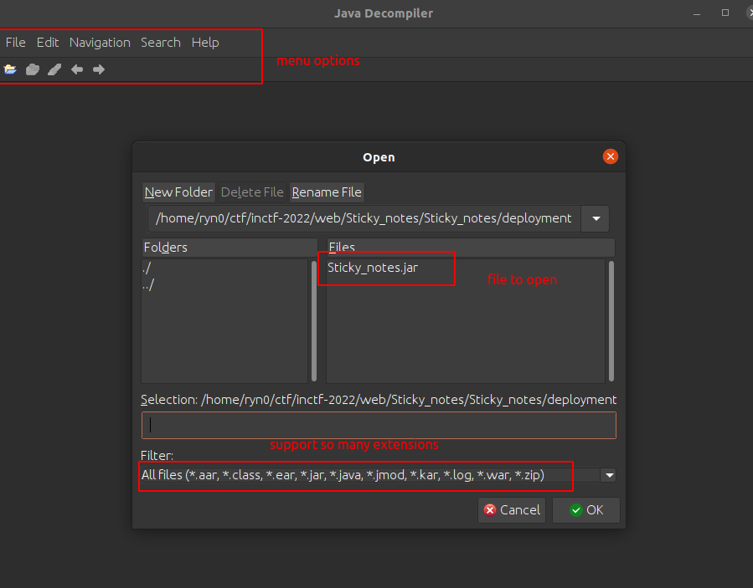

Slide 18
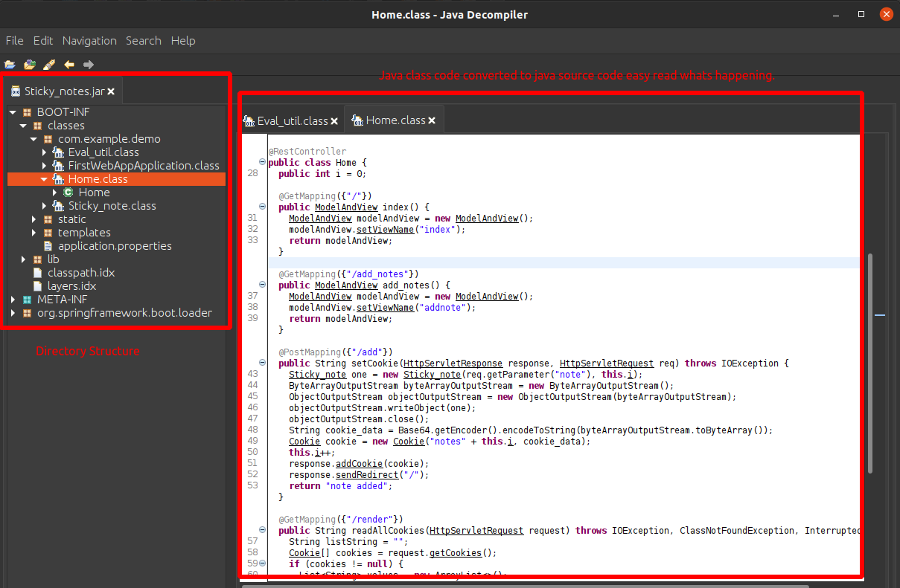

Slide 19
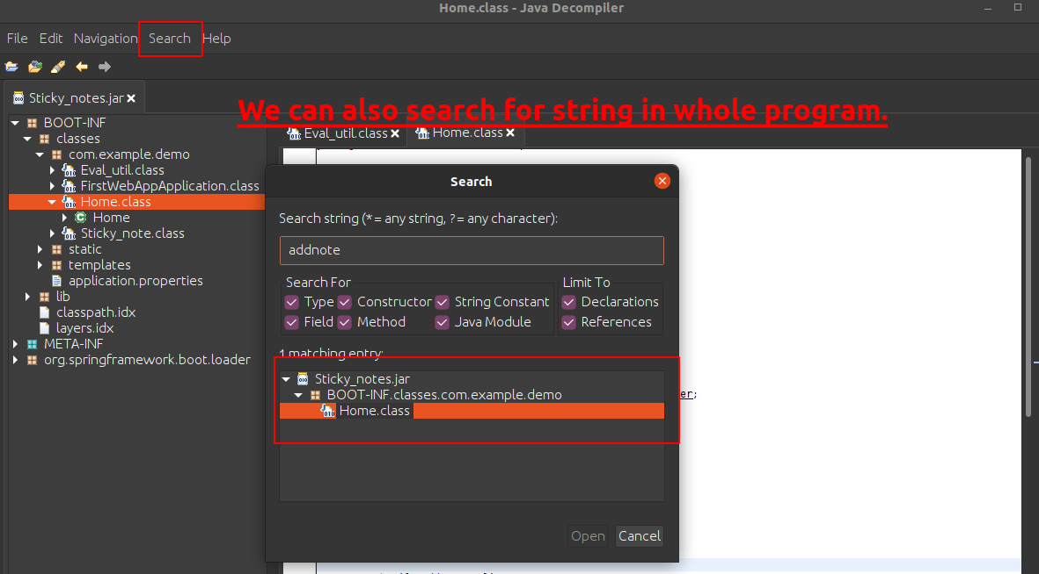

Slide 20
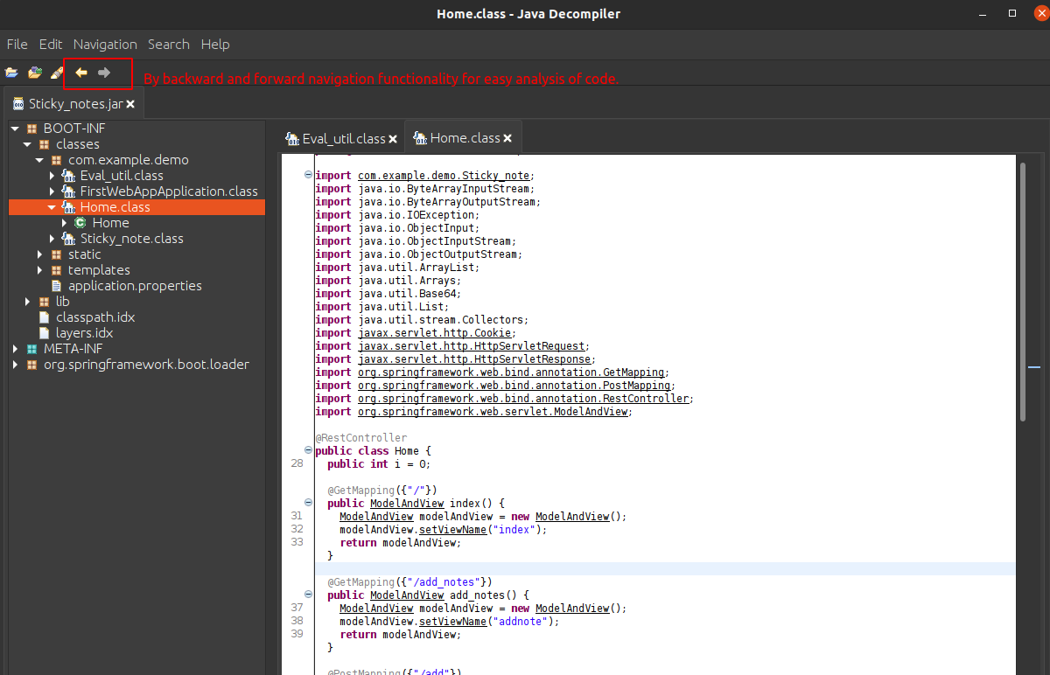

Slide 21
Usage of ‘Decomp-Java’ by exploiting real world web app functionality.

Slide 22
Key points to remember before we begin to exploitation.
Here i am going to show only practical exploitation ,for steps and procedure.
i am going to use vulnerable apps made by me,always remember in real world there is not same scenerios like this app.
To demonstrate our payload work,According to vulnerable web app our target is to get reverse shell from website server and steal flag.txt file in order to proove we pwn the web app.
This web app made intentionally vulnerable to show how attack works.
Warning , my intention here is to demonstrate the working of “decomp-java” tool , hereby i declare i am testing on my own app , doing such activity require permission of app creator and please donot deploy this on server cause these apps are vulnerable and can be used for criminal and malicious activities, doing pentesting or exploiting without permission is criminal offense.
And after deploying you can access your app at http://127.0.0.1:8082.

Slide 23
At first , we should familarize with some terms used to exploit this app.

Slide 24
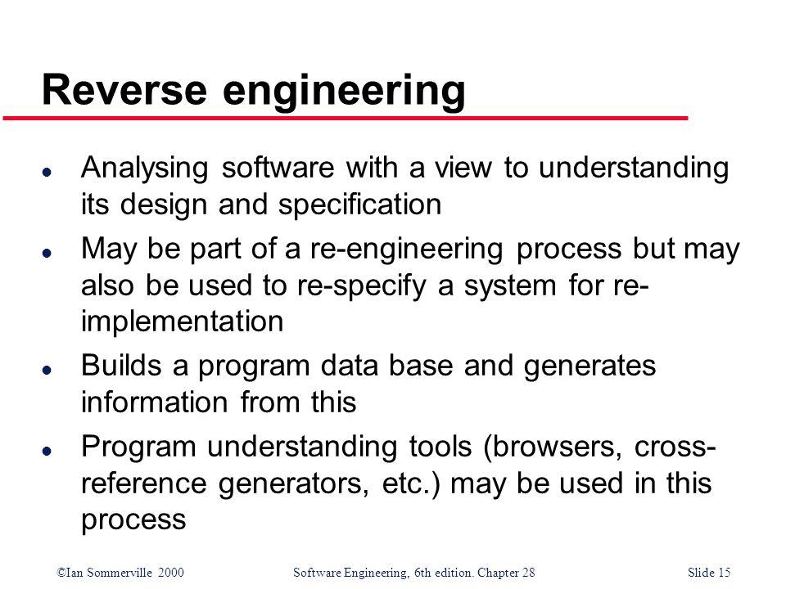

Slide 25
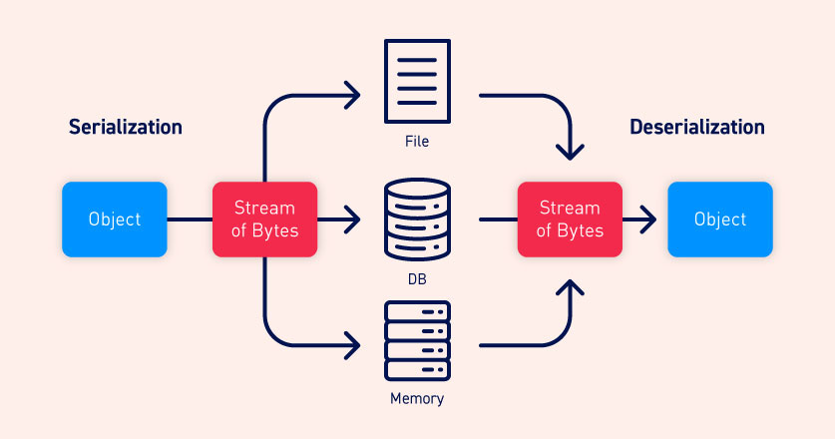

Slide 26
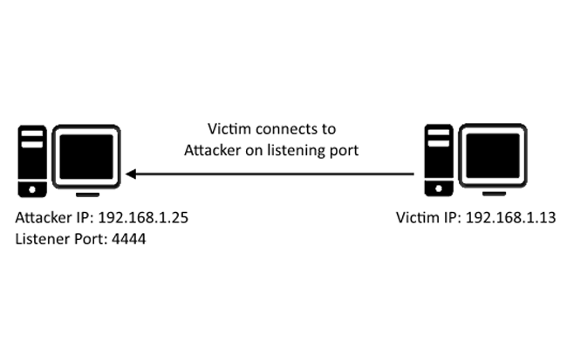
What is reverse shell ?

Slide 27
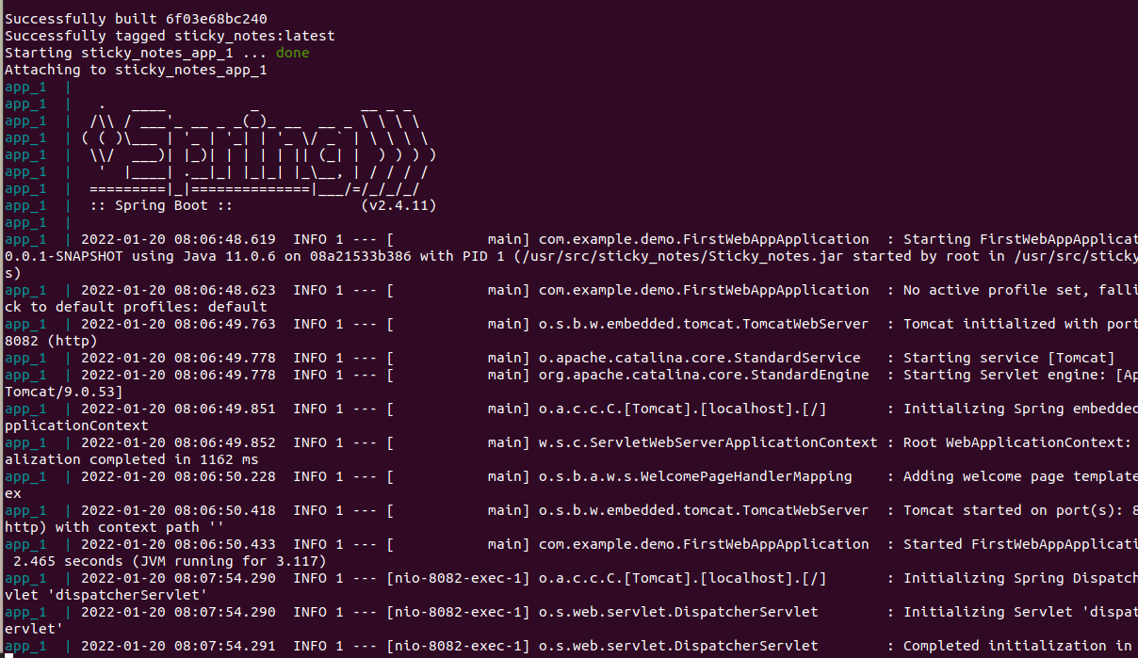
Start the web app.

Slide 28
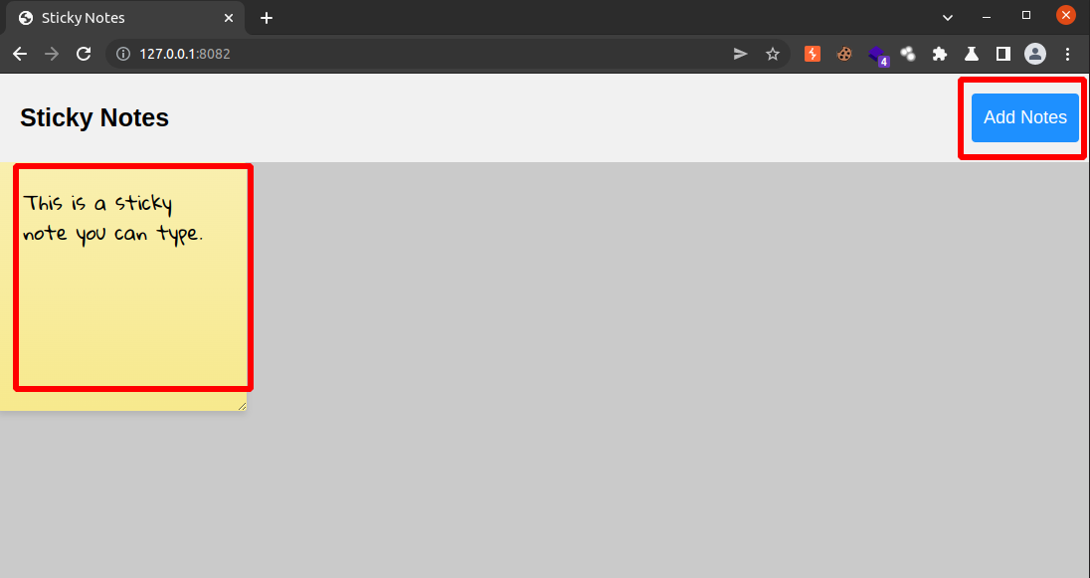
Navigating to http://127.0.0.1:8082/ ,you should see web app where you can create notes specific to your self only.

Slide 29
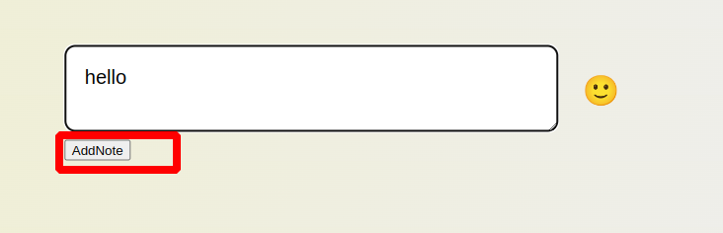
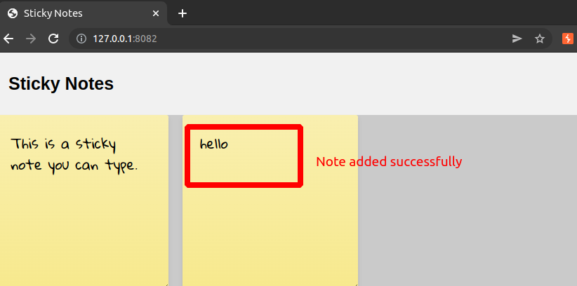
So this is spring web app made using java having .jar file as you see above, now we try to reverse this app in “decomp-java” tool to find whats happening on this app. And we know in spring web app source code start from BOOT-INF/classes/<package-name>. There are so many .class files we need to check Home.class whatshappening on webapp.

Slide 30
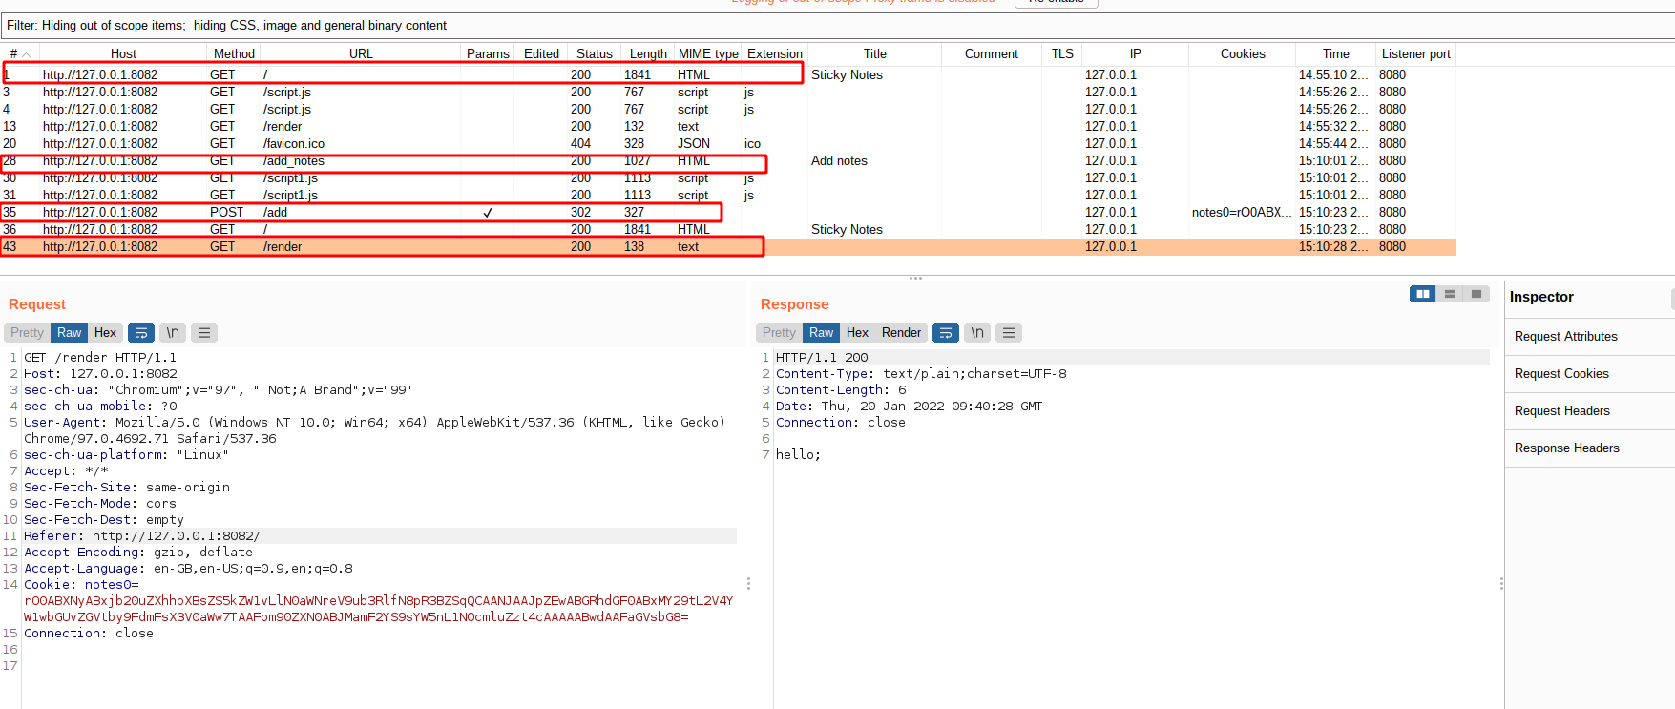
HTTP traffic(burpsuite)

Slide 31

Lets start with reverse engineering vulnerable app “Sticky_notes.jar”

Slide 32
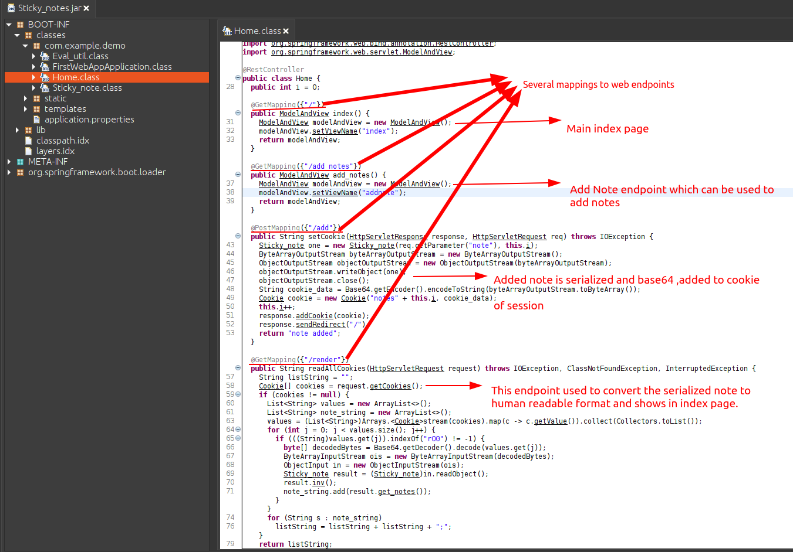

Slide 33
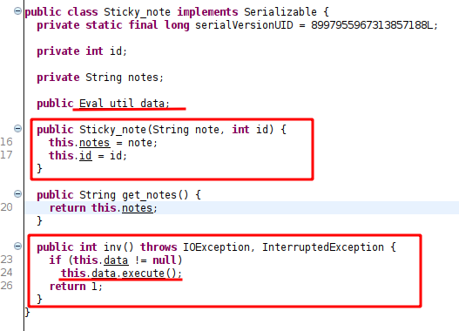
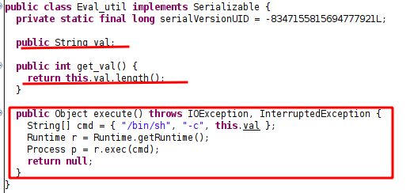
Class to store the notes as objects
Util class having usefull gadget to exploit this web app to get rce(although if this is not given we can use inbuilt classes and library from spring framework to get remote code execution), this is given for ease of readers.

Slide 34
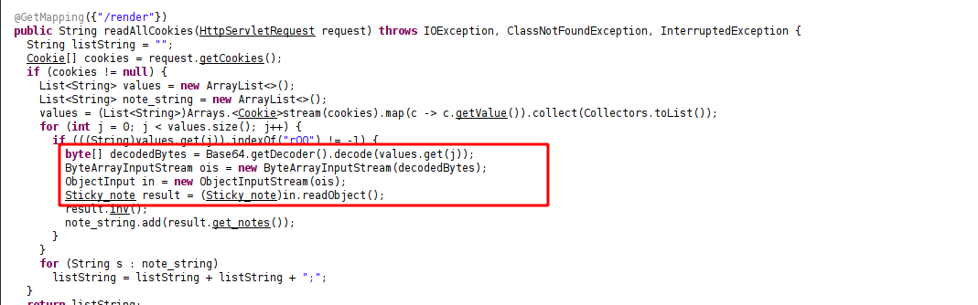
So After reversing app source code , Where the vulnerability lies. vulnerability lies in this code
So After reversing app source code , Where the vulnerability lies. vulnerability lies in this code
After analysing code i found , readObject method of ObjectInputStream used here is to deserialize the note to class object. Is vulnerable to deserialization vulnerability in java so we can exploit this to get reverse shell from server.

Slide 35
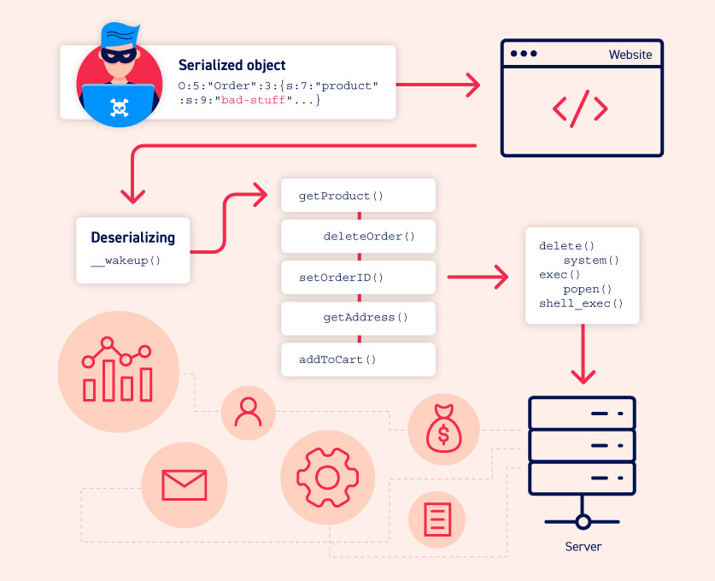
Insecure deserialisation vulnerablility

Slide 36
There are many methods to exploit insecure deserialisation vulnerability, specific to attacker, but i am using here best approach of using “JAVA REFLECTION API” to generate payload which give us reverse shell.

Slide 37
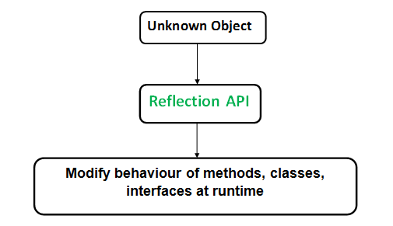
What is Java Reflection API ?

Slide 38
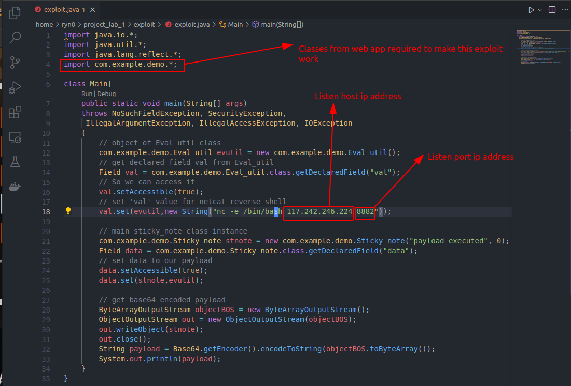
Exploit Code
Exploit Code

Slide 39
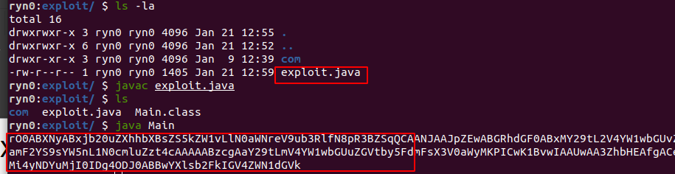
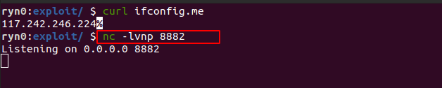
Exploit code output
We should listen for upcoming connections before injecting payload

Slide 40
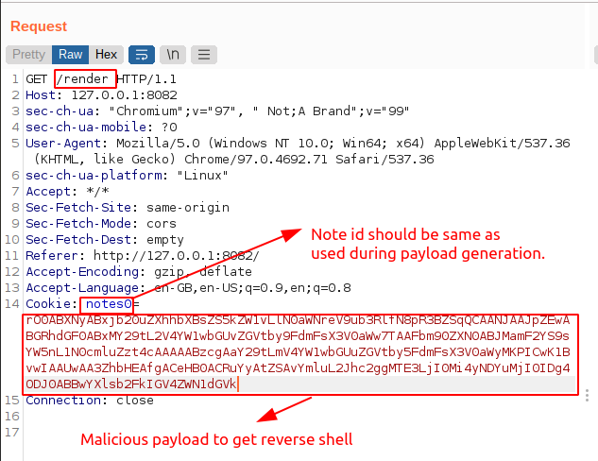
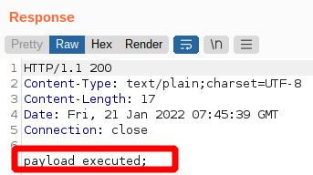
Attacking the webapp.

Slide 41
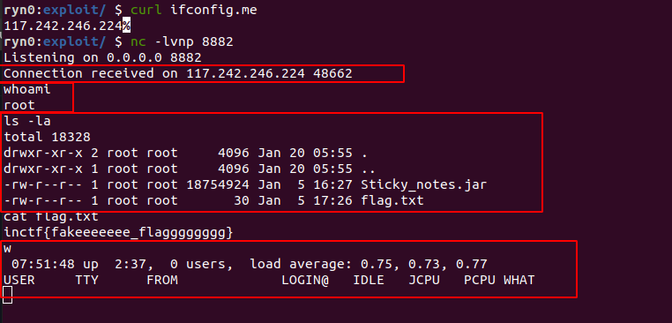
When you see at “netcat” window you got reverse shell, “hurray” now attacker can do whatever he/she can

Slide 42
Final words ..
Thats all for this amazing tool , this tool will be open for contribution , some feature still donot exist in this tool. The main target of this representation, so maybe i can influence someone to contribute in information-security(due to shortage of proffessionals) and will secure our world from cyber threats.

Slide 43
THANK YOU

