Slide 1
TCP based Web application Lab
Contents :-
Overview of TCP based Web application:
Code details:
Implementation:
Presenter -
Md Raiyaan Tarique - 2022290
Md Ashif - 2022288

Slide 2
Overview for TCP based web application
About Assignment:
A TCP-based Web Application is a simple assignment in which we built a simple server designed to handle http requests that are sent from hosts(Web Browsers or any application that send http messages) and client(part 3 of this assignment) using the Transmission Control Protocol (TCP). The server will listen for requests, process the request on the server, and return responses - just like a real web server.
Section 1 :Overview:-

Slide 3
Overview for TCP based web application
Section 1 :Overview:-
Purpose:
Learn how the web uses TCP for communication.
Build a web server that can handle http requests from hosts and our own client application.
Understand how HTTP (the protocol used for websites) works.
Practice taking on many requests at once by using threading.
Build a simple client to test the function of the server.

Slide 4
Section 2 :Code details:-
Code Components:
Part_1.py(Server for part 1):
Initialization: The server imports necessary modules, defines constants, and creates a TCP socket.
Binding and Listening: The server binds the socket to a specific IP and port and starts listening for incoming connections.
Main Loop:
  The server enters an infinite loop to continuously accept client connections.
  For each incoming connection:
    The server receives data from the client.
    The received message is parsed to extract the requested filename.
    If the filename is "BreakOut", the server sends a 410 Gone(this is not actually the real implementation of these codes by http, but we used it to our convenience here) response and closes the connection.
    If the file exists, the server sends a 200 OK response and the file content.
    If the file doesn't exist, the server sends a 404 Not Found response.
    The server handles exceptions and sends appropriate error responses.
    The client connection is closed.
Explanation:
  This server handles one client connection at a time.
  It listens for incoming connections and processes requests sequentially.
  The server can serve requested files or send error responses based on the filename.
  The "BreakOut" filename is used as a signal to terminate the server.

Slide 5
Code Components:
Part_2.py(Server for part 2):
Section 2 :Code details:-
Initialization: The server imports necessary modules, defines constants, and creates a TCP socket.
Binding and Listening: The server binds the socket to a specific IP and port and starts listening for incoming connections.
Main Loop:
  The server enters an infinite loop to continuously accept new client connections.
  For each incoming connection:
    A new thread is created to handle the client connection.
    The thread's target function is handle_client.
Handle_client function:
  Receives data from the client.
  Parses the message to extract the requested filename.
  If the filename is "BreakOut":
    Sends a 410 Gone response(this is not actually the real implementation of these codes by http, but we used it to our convenience here) and closes the connection.
  If the file exists:
    Sends a 200 OK response and the file content.
  If the file doesn't exist:
    Sends a 404 Not Found response.
  Handles exceptions and sends appropriate error responses.
  Closes the client connection.
Explanation:
  This server is multi-threaded, allowing it to handle multiple client connections concurrently.
  Each incoming connection is assigned to a separate thread, improving performance and responsiveness.
  The handle_client function handles the actual processing of requests within each thread.
  The overall flow is similar to part_1.py, but with the added concurrency.

Slide 6
Section 2 :Code details:-
Code Components:
Client :
Initialization: The client imports necessary modules, parses command-line arguments, and creates a TCP socket.
Connection Establishment: The client connects to the specified server over the specified port.
Request Sending: The client connects to the specified server over the specified port.
Response Reception: The client receives the server's response by first initializing the handshaking with the server.
Response Parsing: The client parses the received response to extract the status code and content.
Output: The client prints the received status code and content to the console.
Connection Closing: The client closes the socket.
Explanation:
  The client program serves as an interface for interacting with the server.
  It takes command-line arguments to specify the server details and the requested filename.
  The client establishes a TCP connection to the server.
  It sends an HTTP GET request, including the filename and client information.
  The client receives the server's response, which includes the status code and content.
  The client parses the response to extract the relevant information.
  The client prints the results to the console, providing feedback to the user.
  Finally, the client closes the socket to terminate the connection.
.

Slide 7
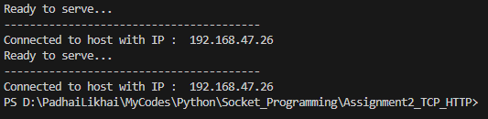
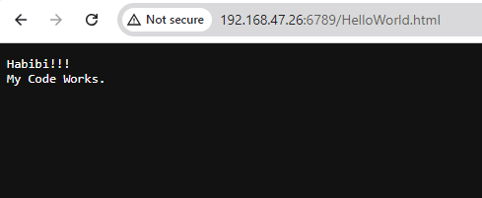
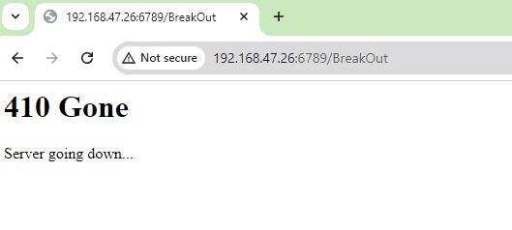
Server Part 1:
Section 3 :Implementation:-

Slide 8
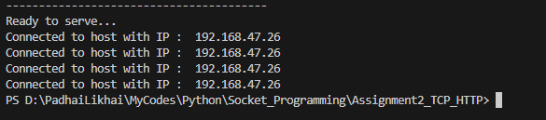
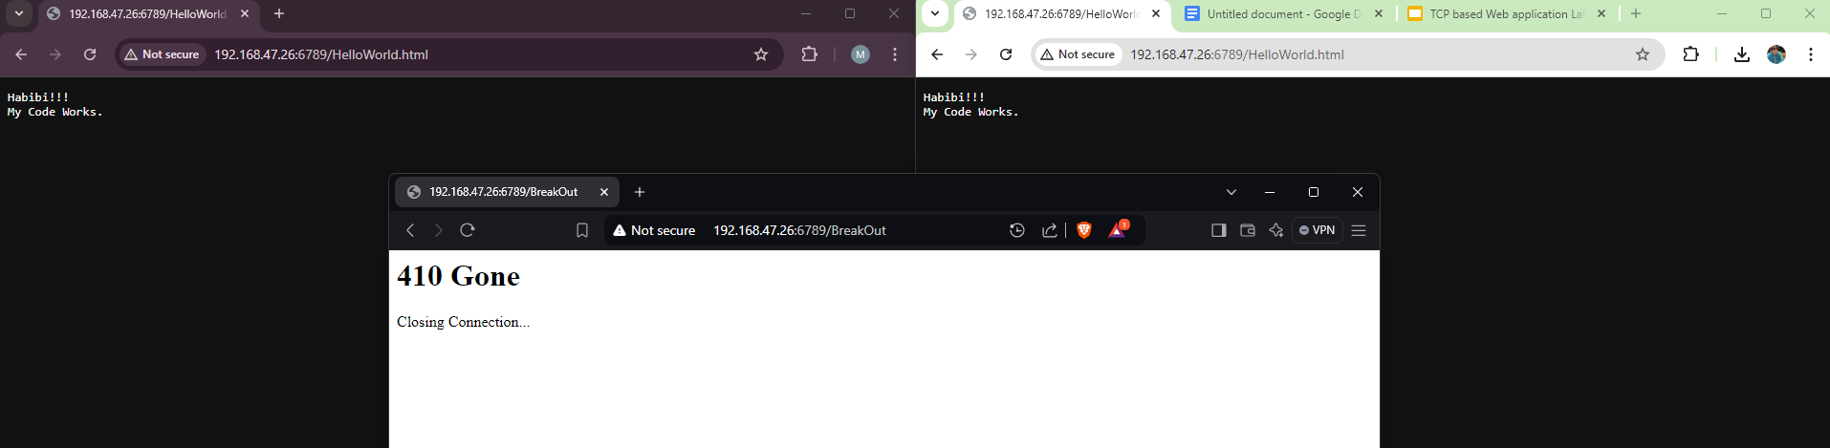
Server Part 2:
Section 3 :Implementation:-

Slide 9
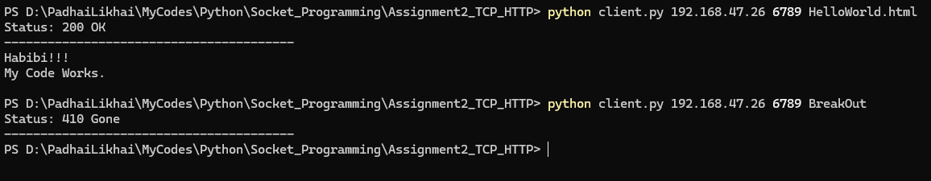
Client:
Section 3 :Implementation:-

Slide 10
Thank You
raiyaan22290@iiitd.ac.in
ashif22288@iiitd.ac.in

