Slide 1
UDP PINGER AND HEARTBEAT SENSOR
Presenter -
Md Raiyaan Tarique - 2022290
Md Ashif - 2022288
Contents -
Overview of UDP Pinger and Heartbeat Sensor
Code details
Implementation

Slide 2
Section 1 :
Overview of UDP Pinger and Heartbeat Sensor
Definition and Purpose
The UDP Pinger is a network utility designed to send and receive packets to measure round-trip time (RTT) and packet loss, while the Heartbeat Sensor continuously monitors the availability of a server by sending periodic messages.
Protocol characteristics
Both tools utilize the User Datagram Protocol (UDP), which is connectionless and allows for faster transmission of data without the overhead of establishing a connection, making them suitable for real-time applications.
Applications in networking
These tools are essential for network diagnostics, performance monitoring, and ensuring system reliability, particularly in environments where uptime is critical, such as cloud services and online gaming.

Slide 3
Section 2 :
Code details
Part A : UDP Pinger
● Socket Creation: Creates a UDP socket using the socket.socket() function, specifying the address family (AF_INET for IPv4) and socket type (SOCK_DGRAM for UDP).
● Ping Request Generation: Generates ping requests by creating a string with a sequence number and the current time.
● Packet Transmission: Sends ping requests to the server using the sendto() method of the socket, specifying the message and the server's address.
● Response Reception: Receives server responses using the recvfrom() method, which also returns the sender's address.
● RTT Calculation: Calculates the RTT by subtracting the send time from the receive time.
● Statistics Calculation: Maintains lists to store RTT values and failed packets. It calculates the minimum, maximum, average RTT, and packet loss rate.
● Timeout Handling: Uses a try-except block with the exception of handling cases where responses are not received within a specified time(or responses are not received for any other reason, for that matter).
CLIENT:
● Socket Binding: Binds the socket to a specific port and IP address using the bind() method.
● Packet Reception: Receives ping requests using the recvfrom() method.
● Response Generation: Creates a response message by converting the received message to uppercase.
● Packet Transmission: Sends responses back to the client using the sendto() method.
Server:

Slide 4
Section 2 :
Code details
Part B : UDP Heartbeat Sensor
● Socket Creation: Creates a UDP socket using the socket.socket() function, specifying the address family (AF_INET for IPv4) and socket type (SOCK_DGRAM for UDP).
● Heartbeat Message Generation: Generates heartbeat messages with a sequence number and timestamp.
● Packet Transmission: Sends heartbeat messages to the server using the sendto() method.
● Response Reception: Attempts to receive responses from the server within a timeout.
● Server Down Detection: Counts consecutive failed heartbeat attempts and declares the server down if the count exceeds a threshold.
CLIENT:
● Socket Creation: Creates a UDP socket using the socket.socket() function, specifying the address family (AF_INET for IPv4) and socket type (SOCK_DGRAM for UDP).
● Socket Binding: Binds the socket to a specific port and IP address using the bind() method.
● Packet Loss Simulation: Simulates packet loss based on a user-defined percentage.
● Heartbeat Message Processing: Receives heartbeat messages, extracts the sequence number and timestamp, calculates the elapsed time, and sends a response.
Server:

Slide 5
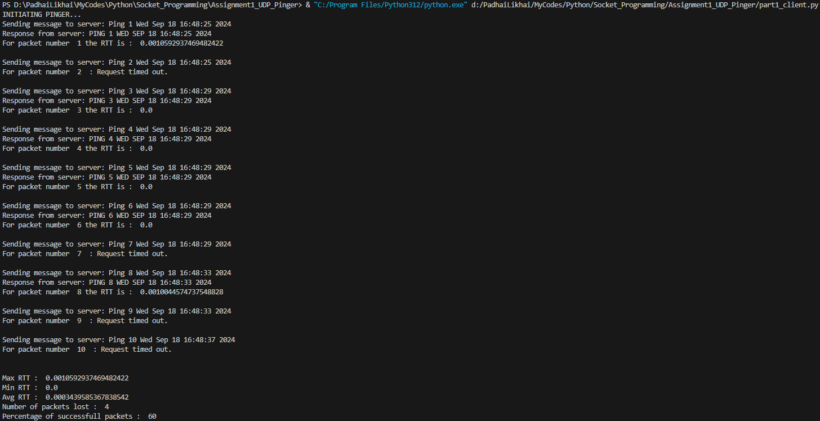
Section 3 :
Implementation
Part A : UDP Pinger
Client:
Server:

Slide 6
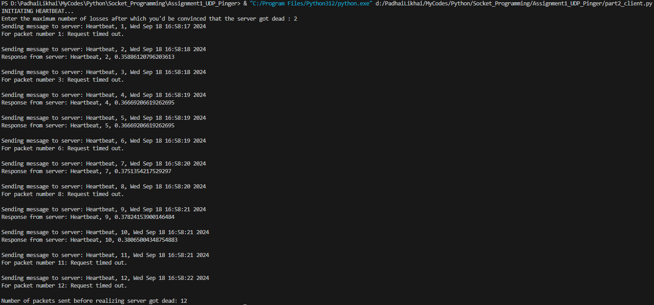
Section 3 :
Implementation
Part B : UDP Heartbeat Sensor
Client:
Server:

Slide 7
raiyaan22290@iiitd.ac.in
ashif22288@iiitd.ac.in
THANK YOU!

