Slide 1
DU POC – Top Netflix Films/TV
Demo by Meredith Jaworski
Notes:
Both: Good afternoon! My name is Meredith Jaworski and I’m a data engineer at Daugherty Business Solutions. And I’m Ryan Ernst and I’m a Technical Business Analyst also at Daugherty Business Solutions. Today we’re going to be discussing our point of concept which we did on the top Netflix films and TV shows. With this data we are going to showcase the most popular films and tv shows on Netflix ranked according to their views in the first 28 days of their arrival on Netflix. We’re also going to showcase the most popular shows by country by week.

Slide 2

Conceptual Model
Data profile and assessment
Data cleaning
DDL for implementing model
Loading data
Data visualizations
Notes:
Meredith: In today’s presentation we’ll be reviewing the conceptual model we created for our data, our data profile and assessment, the cleaning that we did to the data, the DDL used for implementing the tables in our Postgres database, how that data was loaded into Postgres and the visualizations we created for the data.

Slide 3
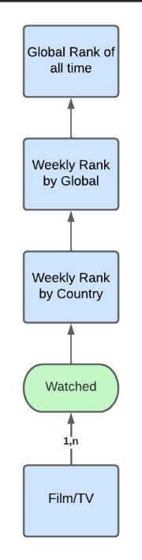
Conceptual Model
Notes:
Ryan: For the conceptual model, we used Lucidchart to model the relationships in our data.

Slide 4
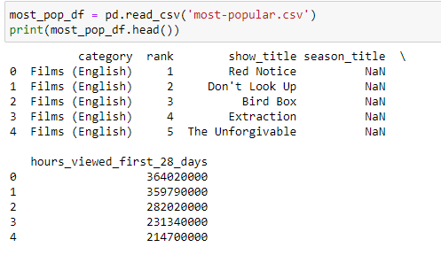
Most Popular CSV

Slide 5
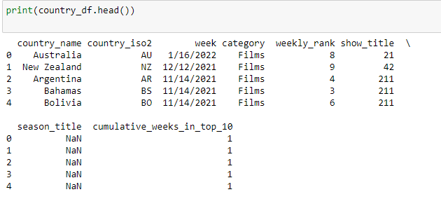
Country Weekly CSV

Slide 6
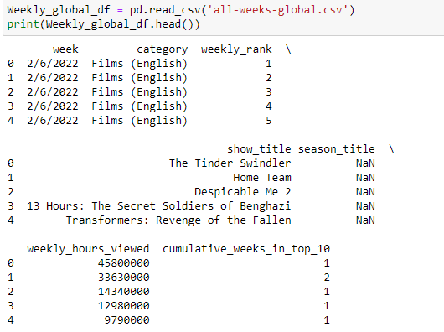
Global Weekly CSV

Slide 7
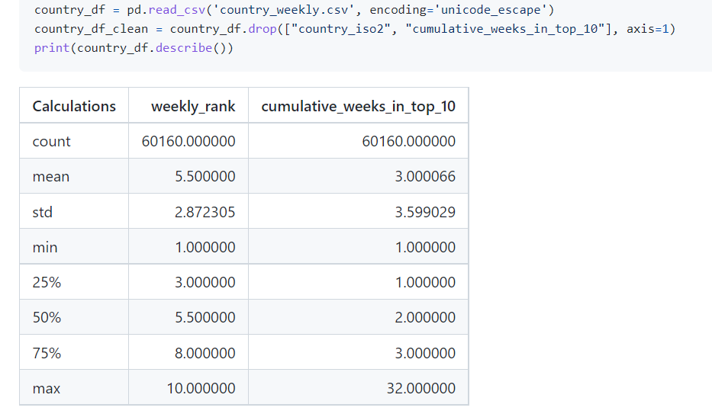
Data Profiling
Notes:
Ryan: Description of the profiling

Slide 8
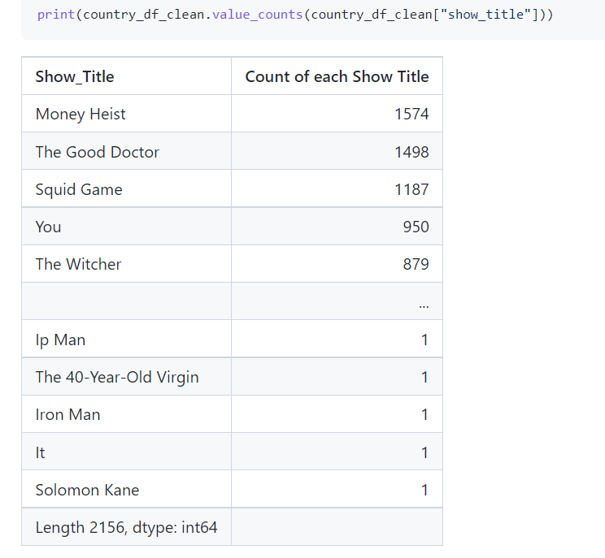
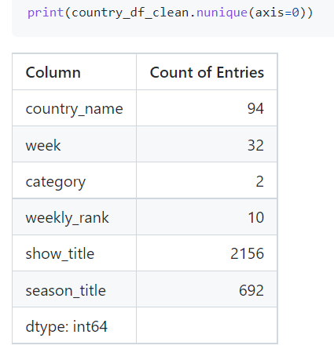
Data Profiling
Notes:
Ryan: Brief description of the charts.

Slide 9
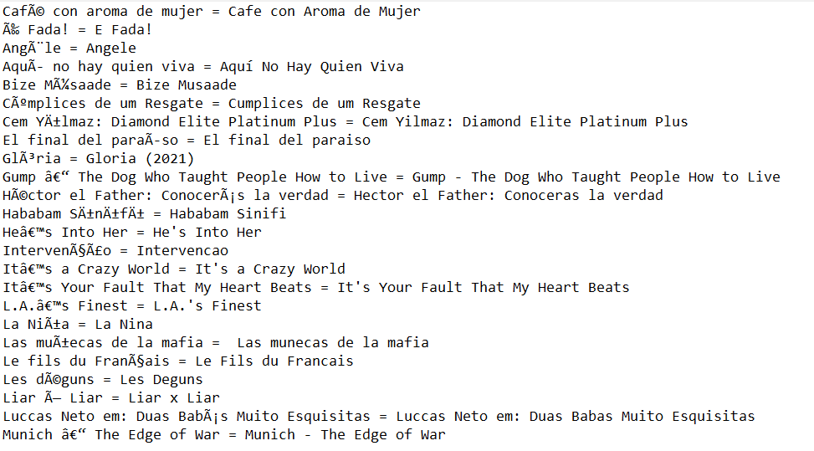
Data Cleaning
Notes:
In cleaning the data, we learned one of our first valuable lessons about how to work with data. We discovered early on that our data contained a lot of non-English characters in the show titles and season titles when our data was imported from Kaggle. This seemed to be due to translation issues with the titles. So, to clean these titles, we first decided to review the data for any titles that had these issues and then look up their corresponding titles in English and replace the characters with their English counterpart. However we soon discovered two things: this process took a very, very long time to complete and was labor intensive, and after further reflection, we should have found a way to resolve these issues in Python. By the time we came to these realizations, this cleaning was already mostly complete, so we decided to complete it. This was an important lesson in both time management and having a coding mentality.

Slide 10
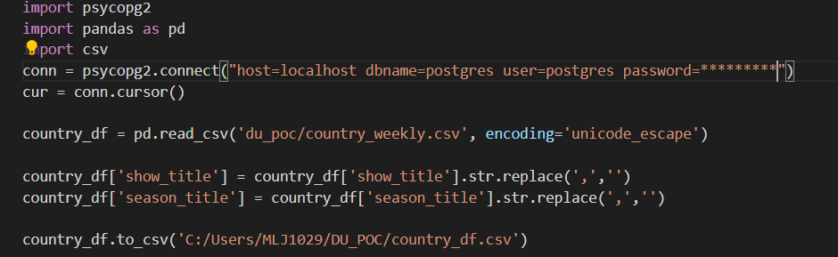
Comma Cleaning
Notes:
One thing we did notice about our data after we cleaned the characters was that there were still commas in the names of some show and season titles. To fix this issue, we created the above code to replace those commas with spaces so that when the CSV file is loaded to the database, it won’t read those commas as the delimiter and put the show or season title onto the next column.

Slide 11
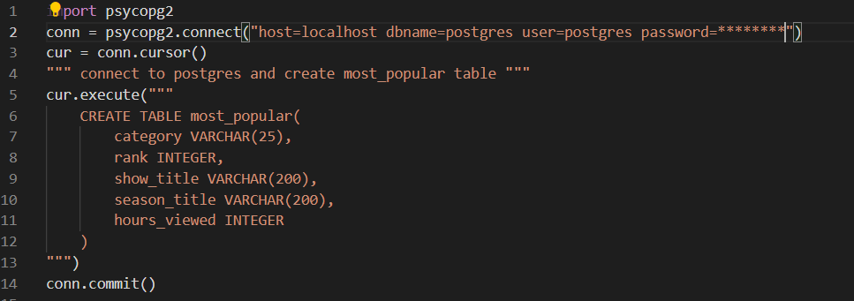
DDL for Most Popular Table
Notes:
To create the table most_popular, we imported the psycop2 module and then used it to connect to our postgres database. From there we created a cursor to work with the database and used cur.execute to write out the DDL for our table including the columns and data types. We then used conn.commit to commit that table to the database.

Slide 12
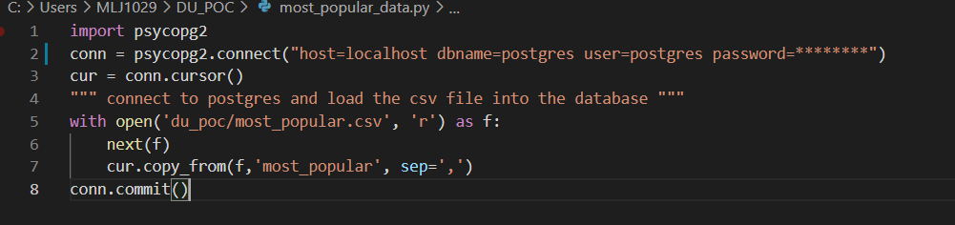
Loading the data into the database
Notes:
We then created a new py file to add the csv file Most Popular to the database. Here we again imported the psycopg2 module and connected to the database. We then opened the file with ‘with open’ and copied our csv file into the table we created in the previous py file. This allowed our csv file to be copied to the database and the data to populate the table we had previously created.

Slide 13
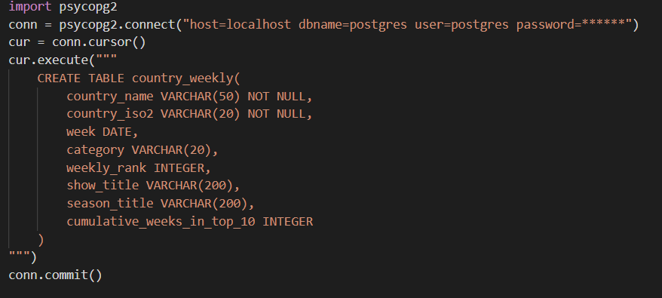
DDL for Country Weekly Table
Notes:
To create the table Country Weekly, we imported the psycop2 module and then used it to connect to our postgres database. Just like with our other table, we created a cursor to work with the database and used cur.execute to write out the DDL for our table including the columns and data types. We then used conn.commit to commit that table to the database.

Slide 14
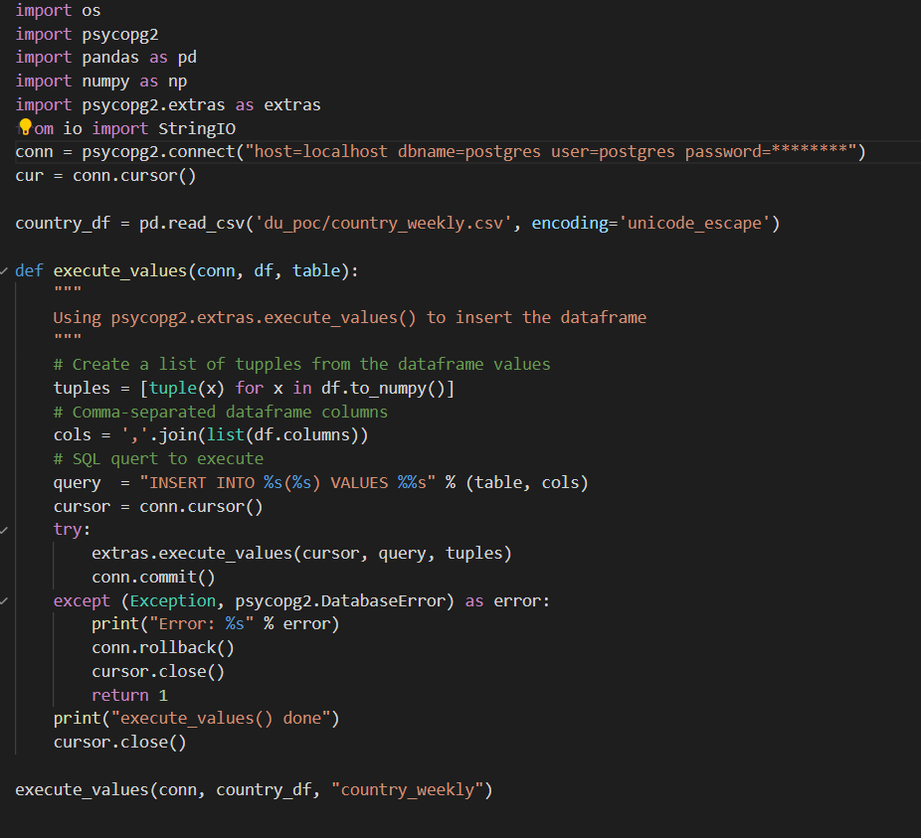
Loading Data for Country Weekly Table
Notes:
To add the data to the Country Weekly database, we used the execute values function to help with any remaining characters that may affect the data transfer. In this instance, we created a list of tuples from the values in the dataframe and then we created a variable for our columns, and used a SQL query to execute the process of loading the values from the table into the columns. Then we used try except to first use psycopg2’s extras_execute_values to execute the transfer of the data and then commit it or throw an exception if it was unsuccessful. If the values were printed we receive the message “execute_values done”. We then run the function, transferring the data to the correct table.

Slide 15
DU_POC_Netflix Top Views | Tableau Public
DU_POC_Netflix | Tableau Public
DU_POC_Netflix_Graph | Tableau Public
Notes:
Ryan: Data Viz

Slide 16
Reflections
Notes:
In this project we learned a lot about teamwork. At the beginning of the project, we decided to work on this project together, dividing up the work as needed, but talking through each step. This was a great way to keep communication open, allowing us to ask questions and clarify any misunderstandings between us. The drawback to this, we realized, was it took us longer to realize our missteps – such as with the data cleaning – and rollback those issues since we were both committed to that process. We also learned a lot about how long each step of this process would actually take in practice. At the beginning of each four hour stretch we had goals that we wanted to achieve by the end of that time, and more often then not, we did not meet those goals. This was helpful in reassessing what still needed to be done and delegating work between us but was overall a lesson in things not going as planned and the value of making a new plan.

Slide 17
Questions?

Slide 18
References
Tutorial: Use Python and SQL to load data from CSV files into Postgres (dataquest.io)
Pandas to PostgreSQL using Psycopg2: Bulk Insert Performance Benchmark | Naysan Saran
Home | Tableau Community

