Slide 1
STEAM ANALYSIS DASHBOARD
A user-friendly tool for observations between steams’ user base and all the video games they play.
Anny Tritchler | Ryan Mangeno | Melissa Cardenas

Slide 2
THE DASHBOARD
Are you an inspiring video game developer looking for direction?
An insidious publisher trying to harm competition?
Curious user interested in trends near you?
An EA executive looking to justify cutting funds through grossly generalized information?
OUR DASHBOARD MAY BE FOR YOU!

Slide 3
REFERENCES & TOOLS
The Steam Database
https://academictorrents.com/details/eba3b48fcdaa9e69a927051f1678251a86a546f3
GeoJSON template for every country:
https://github.com/johan/world.geo.json/blob/master/countries.geo.json
Alpha 2 and Alpha 3 codes for every country:
https://gist.github.com/tadast/8827699#file-countries_codes_and_coordinates-csv
Flask
Dash
Dash_Core
Dash_HTML
Dash_Bootstrap
HTML
CSS
Bootstrap
Javascript
Python
Sqlite3
Plotly
Pandas
Pathlib
OS
CSV
JSON
D3

Slide 4


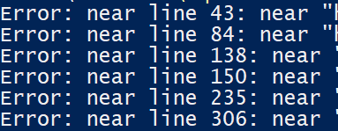

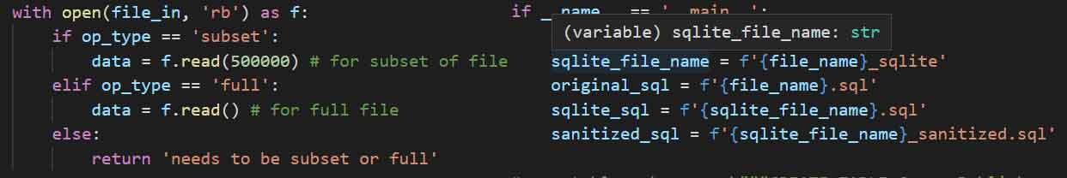

TROUBLES ‘N’ TURMOIL
160GB Database
Memory Error Big Data, Big Problems User Input Shenanigans \\, Big Tables, Slow Queries

Slide 5
EXPLORATION
Regional influences drive video game trends.
Does regional household income influence the way gamers play and choose games?
Are there correlations between genres and socializing?
What type of games influence a player to create parties and make friends?

Slide 6
EXPLORATION
The Steam Database
https://academictorrents.com/details/eba3b48fcdaa9e69a927051f1678251a86a546f3
GeoJSON template for every country:
https://github.com/johan/world.geo.json/blob/master/countries.geo.json
Alpha 2 and Alpha 3 codes for every country:
https://gist.github.com/tadast/8827699#file-countries_codes_and_coordinates-csv
Flask
Dash
Dash_Core
Dash_HTML
Dash_Bootstrap
HTML
CSS
Bootstrap
Javascript
Python
Sqlite3
Plotly
Pandas
Pathlib
OS
CSV
JSON
D3

