Slide 1
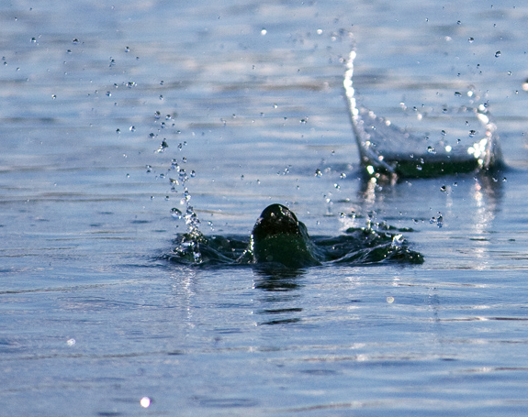
Bonus Lecture: Escape!

Slide 2
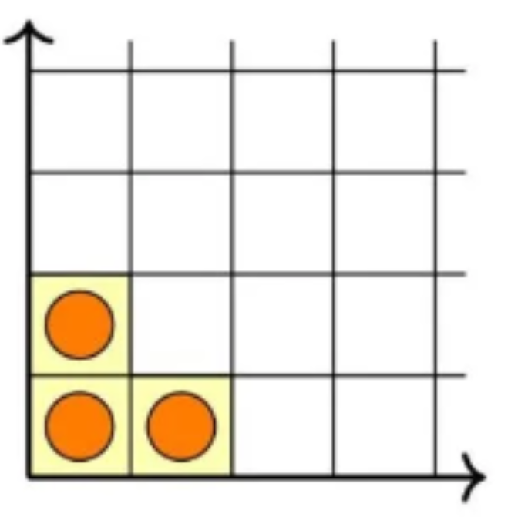
Escape!
Escape! is played on a grid extending infinitely up and to the right.
Initially, the bottom-left three squares have a stone.

Slide 3
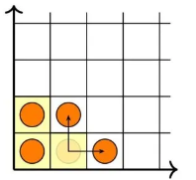
Escape!
Escape! is played on a grid extending infinitely up and to the right.
Initially, the bottom-left three squares have a stone.
If the cells immediately up and to the right of a stone are empty, then you may remove that stone, and add new stones in the two empty cells.

Slide 4
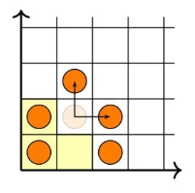
Escape!
Escape! is played on a grid extending infinitely up and to the right.
Initially, the bottom-left three squares have a stone.
If the cells immediately up and to the right of a stone are empty, then you may remove that stone, and add new stones in the two empty cells.
Then repeat. You win as soon as all three of the initially-filled squares are vacated.

Slide 5
Escape!
Try it! tinyurl.com/bdd3ttub
How many moves do you think it will take you to win?
1-10
10-25
25-50
50-100
100+
I don’t think I can win this game

Slide 6


Slide 7
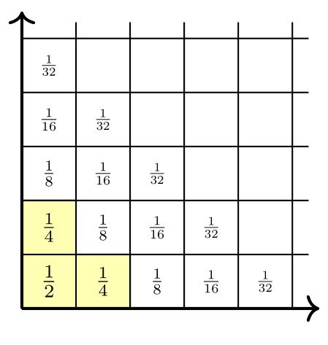
Escape! Analysis
In Escape!, as the game board changes (over moves), can we invent a useful quantity that is guaranteed to stay the same?

Slide 8

Escape! Analysis
Write numbers in the squares of the game board like this.
Initially, the sum of cells with stones in them is
$$\frac{1}{2}+\frac{1}{4}+\frac{1}{4}=1.$$
As you move stones, this never changes: the sum of cells with stones will always be $1$.
So What?

Slide 9







Escape! Analysis
The infinite sum of all cells in the game board is $2$.
The sum of the three starting cells is $1$.
If we vacate the three starting cells, and the sum of cells with stones adds up to $1$, then we must have a stone in every other spot in the board.
That requires infinitely many stones!
→ Impossible to win Escape! in finitely many moves.
$$…$$
$$=1/8$$
$$=1/4$$
$$=1/2$$
$$=1$$
$$=2$$

Slide 10
Potential Function Proofs
A “potential function” is a quantity that changes (or doesn’t) in a predictable way, as a system changes.
Here, the potential function was the sum of numbers in cells with stones.
Used in Computer Science to analyze the behavior of algorithms:
Your data structures and variables change over a while/for loop – but what properties are guaranteed to stay the same?
Later Bonus Lectures: More potential function proofs, with even sneakier potential functions.

