Slide 1
Sales Analysis Dashboard
Created by Ujwal Rathod
Power BI Project

Slide 2
Project Overview
This dashboard provides insights into sales performance using data from the Superstore dataset.
Key Highlights:
- Total Sales vs Target
- Sales Trend Over Time
- Profit Distribution by Segment
- Product-level Sales
- Regional Filtering for deeper analysis

Slide 3
KPIs and Metrics
The dashboard tracks and displays key performance indicators (KPIs):
- Total Sales
- Total Profit
- Sales Target Comparison
- Sales Trend Year-wise
- Segment-wise Profit Share
- Top Selling Products

Slide 4
Interactivity Features
The dashboard allows users to:
- Filter data by Region (Central, East, South, West)
- Track changes over time using line and KPI visuals
- View detailed breakdowns using donut and bar charts

Slide 5
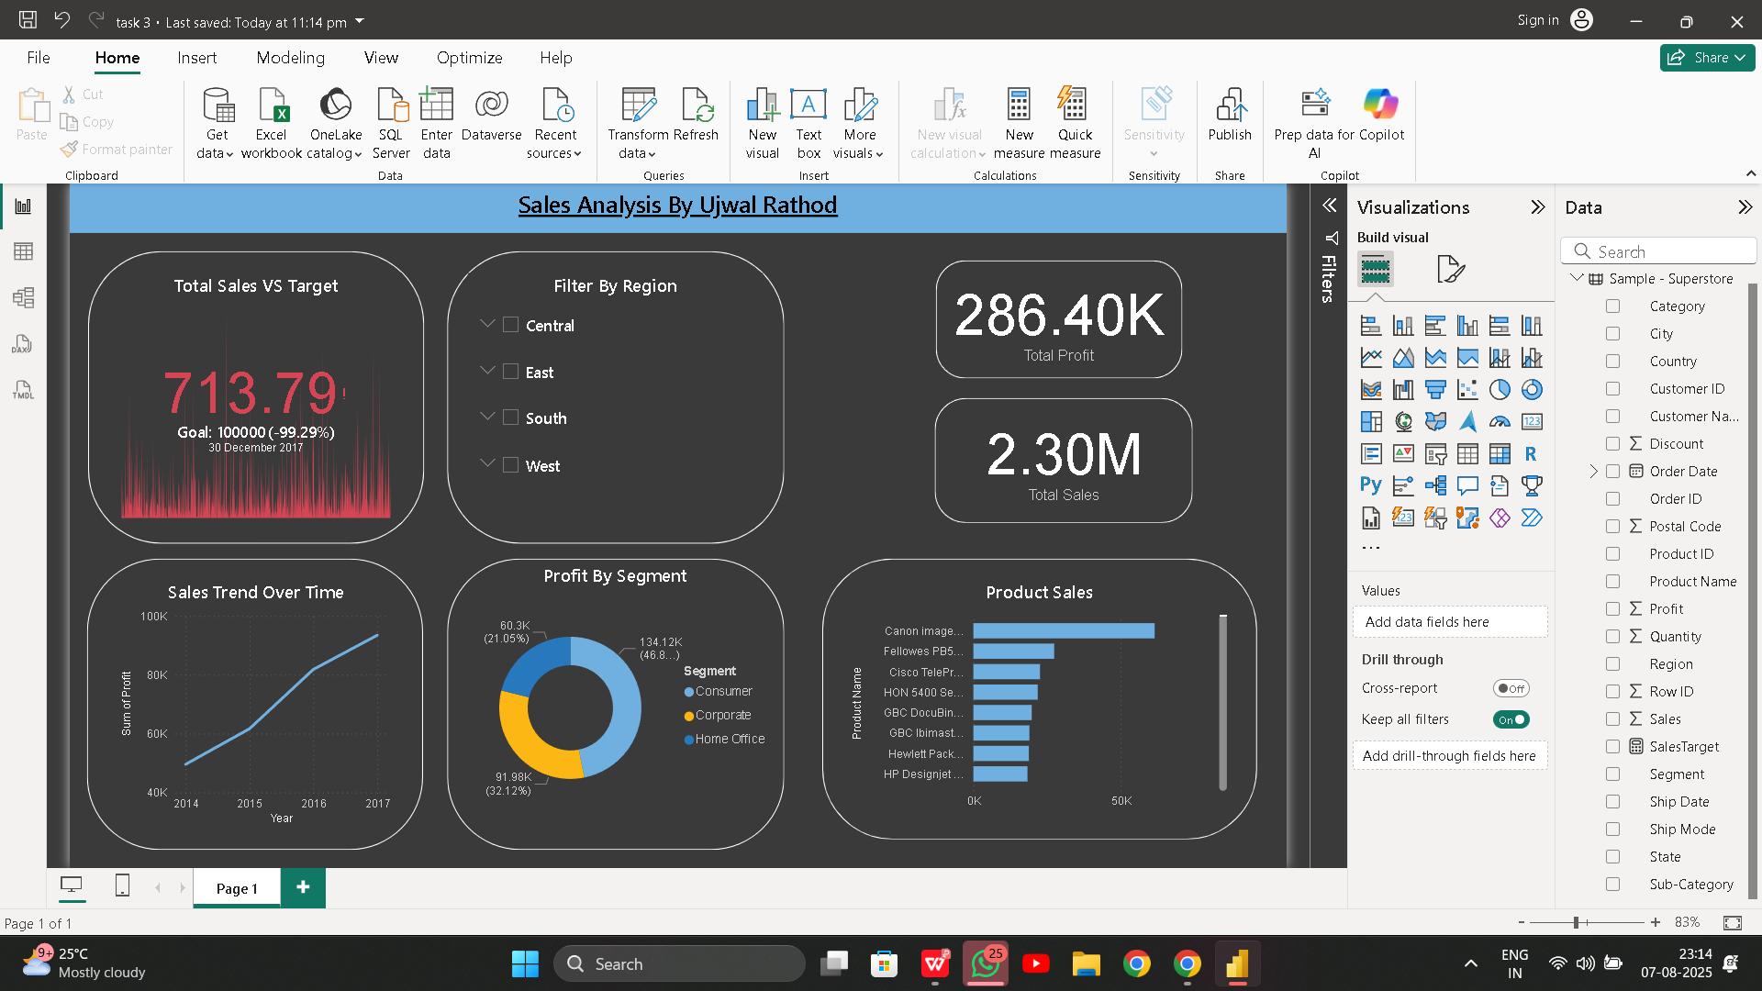

Slide 6
Conclusion
This Power BI dashboard effectively demonstrates how data can be transformed into meaningful insights.
It provides a high-level summary of sales trends, performance vs targets, and regional performance.
The interactivity and visual storytelling enhance decision-making capabilities.

