Slide 1



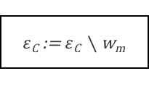
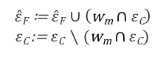

$$input$$
y, W
処理1
$ε$_{C} ≔ $ε$, $\hat{ε}$_{F} = Φ
ループ１
for
m := 1 to |W|
条件1
if y_{m} = 0
No
処理2
Yes
$ε$_{C} := $ε$_{C} $∖$ w_{m}
end for
ループ2
2nd for
m := 1 to |W|
条件2
|w_{m}$∩ε\text{C}$| = 1
No
処理3
Yes
$\hat{ε}F$ ≔ $\hat{ε}F∪\left(\text{w}\text{m}∩ε\text{C}\right)$
$ε\text{C}$:= $ε\text{C} ∖(\text{w}\text{m}∩ε\text{C})$
end 2nd for
$$output$$
$ε$_{C} , $\hat{ε}F$

