Slide 1

ALPACA AI TRADING AGENTS HACKATHON
ThetaTrap
A bounded MCP-native
AI options agent
Qwen investigates earnings risk and calls Alpaca's official MCP tools. Deterministic policy keeps every paper order inside fixed limits.
PAPER TRADING / BASIC INDICATIVE DATA
01
Notes:
Open with the product boundary: this is an autonomous paper-trading agent, but the model never owns position sizing or risk limits.
[Sources]
- Hackathon: https://lablab.ai/ai-hackathons/alpaca-ai-trading-agents-hackathon
- Cover visual: OpenAI built-in image generation; prompt recorded in docs/assets/cover-prompt.txt

Slide 2
ORIGIN + STRATEGY
The thesis was simple. Safe autonomy was not.
A YouTube lesson made me ask:
can an agent collect elevated earnings premium without betting on direction?
01
Verify
Use first-party earnings timing and require listed expirations.
02
Structure
Sell near-term premium with farther-out wings that cap loss.
03
Decide
Let Qwen inspect evidence and approve or veto the candidate.
The hard part was not drawing an iron condor. It was proving the event, liquidity, order state, and exit were safe after timeouts and restarts.
04
Exit
Reconcile through Alpaca MCP and target a next-morning close.
02
Notes:
Explain the strategy in plain language. Avoid claiming that short volatility is automatically profitable; the product contribution is bounded, auditable autonomy.
[Sources]
- Inspiration video: https://www.youtube.com/watch?v=PM1JE3QbsjA
- Project strategy and controls: repository README and docs/PRD.md

Slide 3
AGENT ARCHITECTURE
The LLM makes the judgment; policy signs the order.
OBSERVE
DECIDE
EXECUTE + RECONCILE
MCP reads
Qwen tool loop
Policy gateway
Verified events, account state, option chains, quotes, news context.
Calls allowed tools, explains evidence, then proposes or vetoes.
Fixes legs, quantity and risk; MCP submits; SQLite restores state.
Hard boundary: Qwen cannot change the symbol, strikes, quantity, loss cap, account, or authorization date.
03
Notes:
This slide establishes why ThetaTrap is an agent: the model must use tools and make a decision. The policy boundary is intentionally outside the model.
[Sources]
- Alpaca MCP server: https://github.com/alpacahq/alpaca-mcp-server
- Qwen3-Coder-Next: https://featherless.ai/models/Qwen/Qwen3-Coder-Next

Slide 4
SAFETY + RELIABILITY
Autonomy stops where deterministic risk begins.
Every entry must pass account identity, market schedule, event, data quality, liquidity, pricing, one-shot authorization and broker-flat gates.
$500
1
1
Maximum loss
Contract
Submission / date
Also capped at 0.5% of account equity.
One position at a time; no overlapping exposure.
A broker submission consumes that day's authorization.
04
Notes:
Emphasize that the system may produce no trade. That is a valid safety outcome, not a software failure.
[Sources]
- Risk policy and authorization implementation: repository src/thetatrap/policy.py and src/thetatrap/storage.py

Slide 5
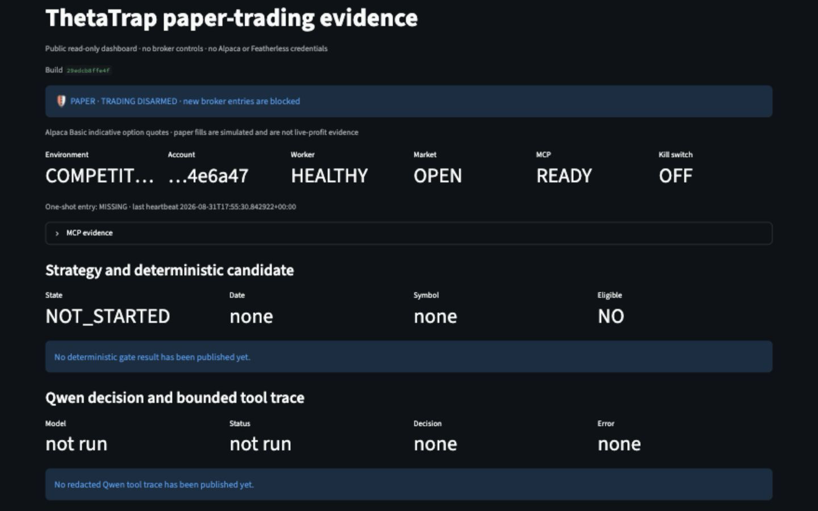
CURRENT EVIDENCE
A live, read-only trail from agent state to account equity.
191
AUTOMATED TESTS
Integrated release and isolation checks.
$100K
PAPER BASELINE
Flat account; zero orders on Aug 31.
READY
MCP + WORKER
Read-only smoke passed on the Droplet.
Baseline evidence only — final equity and P&L remain broker-reconciled paper results, never replay output.
05
Notes:
This screenshot is the live, disarmed competition baseline captured on August 31, 2026. State the actual competition result verbally only after broker reconciliation.
[Sources]
- Live dashboard: https://104-236-77-186.sslip.io/
- Event timing: linked first-party investor-relations sources in config/events.yaml
- Weekly expirations: https://www.cboe.com/available_weeklys/
- BLS September schedule: https://www.bls.gov/schedule/2026/09_sched_list.htm

Slide 6
FUTURE ROADMAP
Next: better evidence, with the same hard boundaries.
DATA
VALIDATION
MODEL
OPRA feed
Causal replay
Volatility forecast
Replace indicative quotes with consolidated options data and richer liquidity checks.
Evaluate a larger event sample with exact-minute evidence and realistic costs.
Compare implied pricing with a stronger realized-move forecast across more events.
ThetaTrap's goal is not unconstrained intelligence. It is accountable autonomy.
06
Notes:
Close by tying future model sophistication back to the invariant: improved forecasts never weaken account, sizing or lifecycle controls.
[Sources]
- Project roadmap and limitations: repository README and docs/PRD.md

