Slide 1
Formal demography in family demography
- Alternative indicators -
Ryo Mogi
18 November 2022
@ Cedeplar workshop

Slide 2
Myself
Tokyo → Rome → Barcelona → Oxford → Odense (no more!)

Slide 3
Myself
Tokyo → Rome → Barcelona → Oxford → Odense (no more!)
Like
Gym
Play soccer and other ball sports
Hiking
Cooking
Reading and watching movies

Slide 4

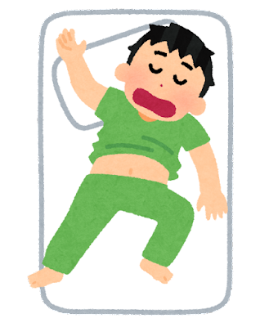
Myself
Tokyo → Rome → Barcelona → Oxford → Odense (no more!)
Like
Gym
Play soccer and other ball sports
Hiking
Cooking
Reading and watching movies
Have 1.5 years-old daughter

Slide 5
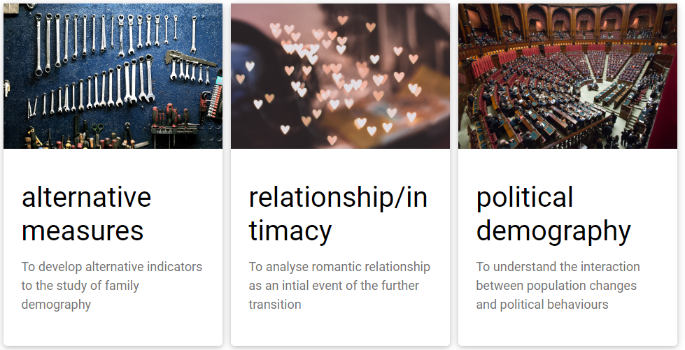
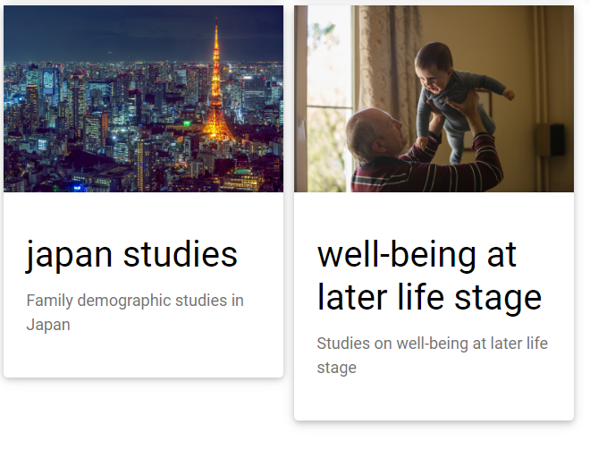
My 5 research avenues

Slide 6
Contents
Presentation (40 mins talk + 15 mins Q&A)
Introduce alternative indicators to understand fertility changes
What does these indicators add?
New findings
(5 mins break)
Hands-on training (1 h)
To know how to calculate two key indicators
Using R

Slide 7
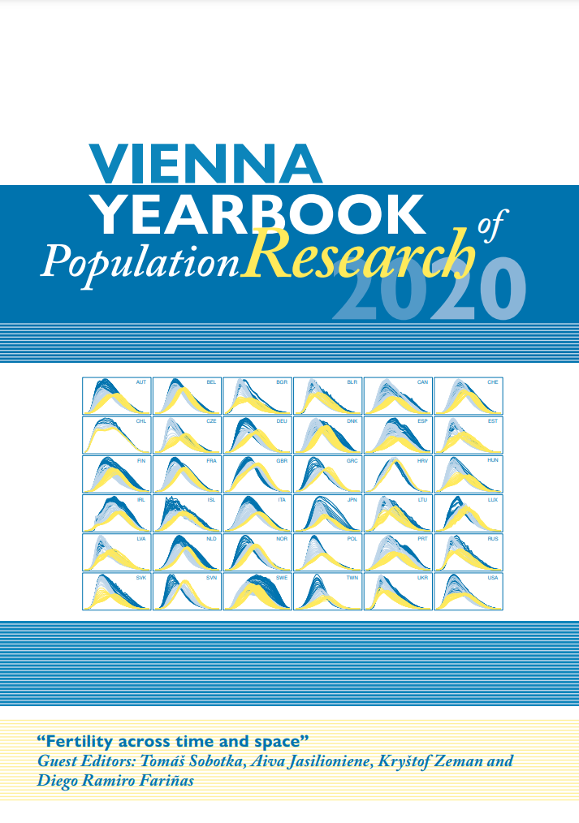
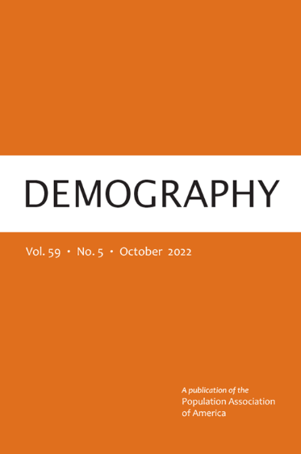
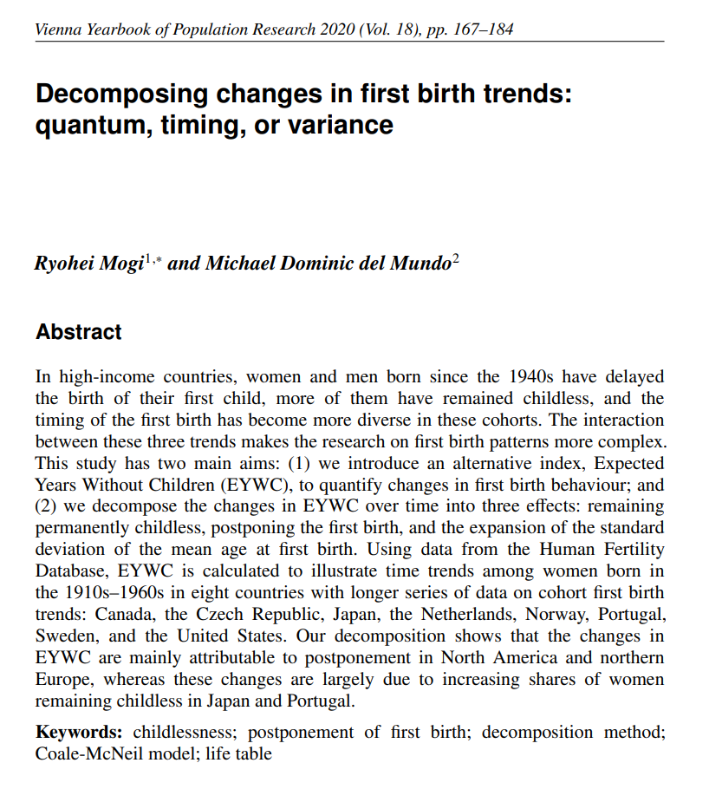
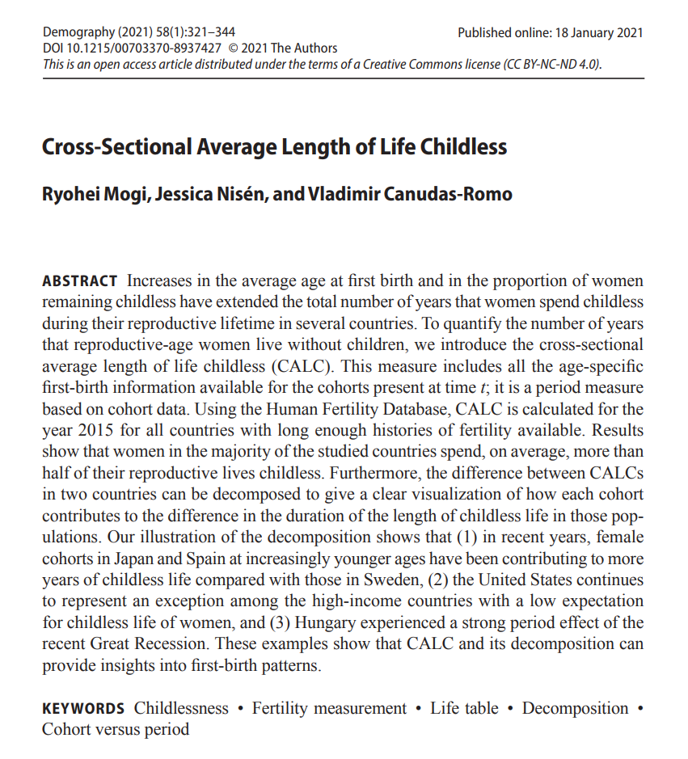
Main references

Slide 8
(1.1) What and why?

Slide 9
Common measures in family demography
Quantum: % of people who have experienced an event
Timing: mean age at event experienced
Rate: age-specific event rate

Slide 10
Common measures in family demography
Quantum: % of people who have experienced an event
Timing: mean age at event experienced
Rate: age-specific event rate
Duration: average number of years in a certain life-status

Slide 11
Common measures in family demography
Quantum: % of people who have experienced an event
Timing: mean age at event experienced
Rate: age-specific event rate
Duration: average number of years in a certain life-status
→ life expectancy

Slide 12
Common measures in family demography
Indexes | Disadvantages
Quantum | Incapable to capture the changes in timing
Timing | Incapable to capture the changes in quantum
Rate | Difficult to capture both changes compare across time and countries

Slide 13
Why important?
Methodological advantage
Entire population (vs. mean age)
One value (vs. age-specific rate)

Slide 14
Why important?
Methodological advantage
Entire population (vs. mean age)
One value (vs. age-specific rate)
How many years left in the reproductive life
Union/reproductive decision & timing highly depends on age
“Biological fertility clock”

Slide 15
Why important?
Methodological advantage
Entire population (vs. mean age)
One value (vs. age-specific rate)
How many years left in the reproductive life
Union/reproductive decision & timing highly depends on age
“Biological fertility clock”
How dominant of people remaining in this status

Slide 16
(1.2) EYWC

Slide 17
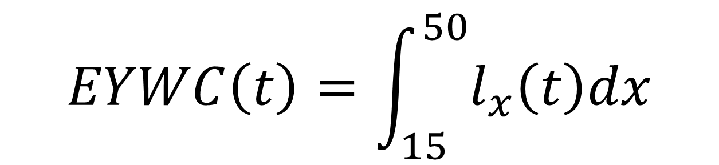
EYWC
Expected Years Without Children
= the average time spent without children from age 15 to 50
$$EYWC\left(t\right)=\int_{15}^{50}{l_{x}\left(t\right)dx}$$

Slide 18
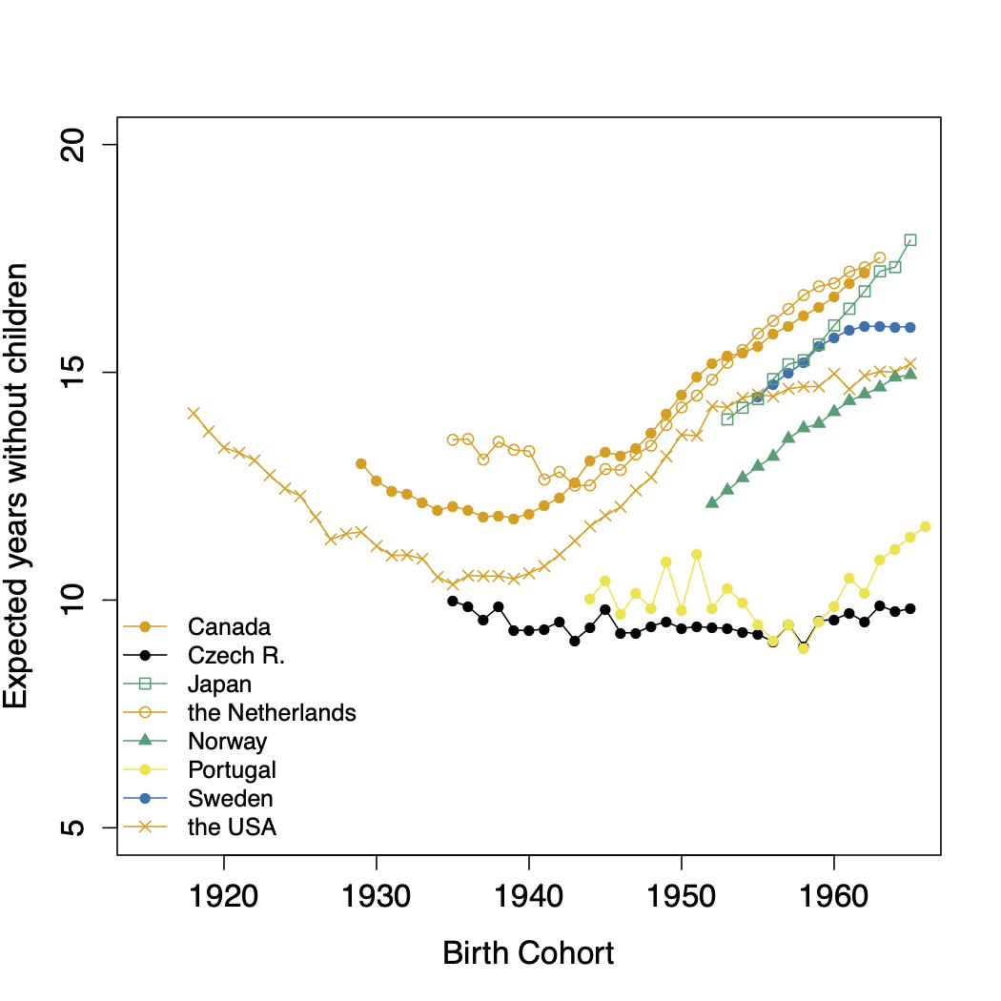
General increase in EYWC

Slide 19
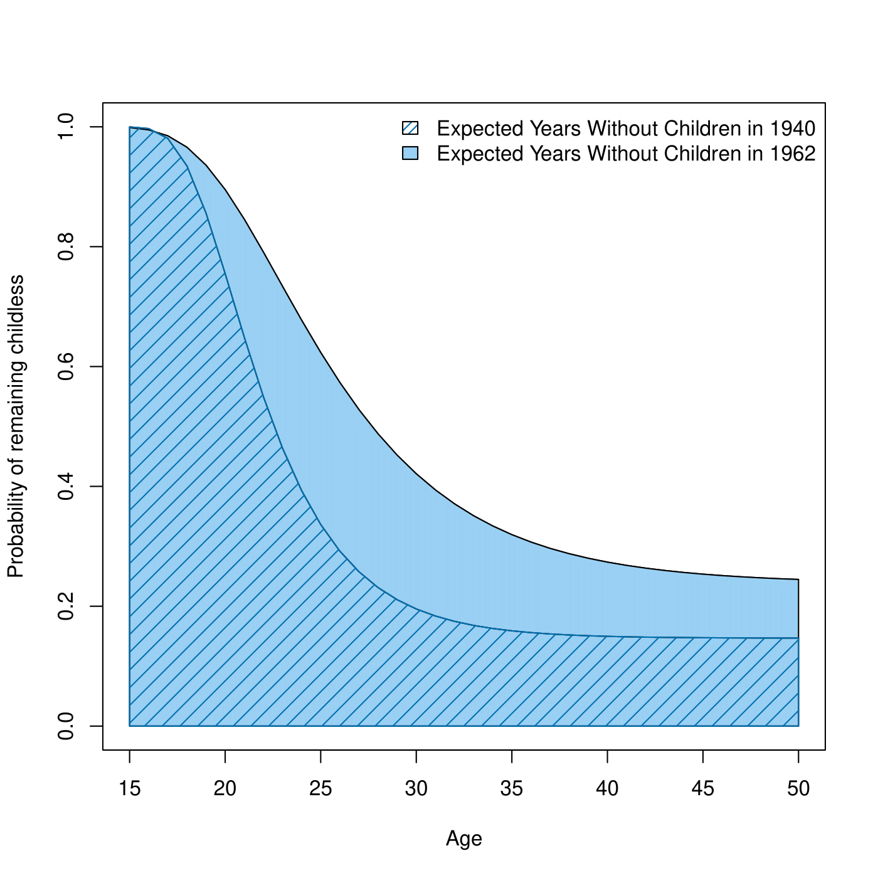
Postponement of 1st birth or childless?

Slide 20
Postponement of 1st birth or childless?
Postponement

Slide 21
Postponement of 1st birth or childless?
Postponement
childless

Slide 22
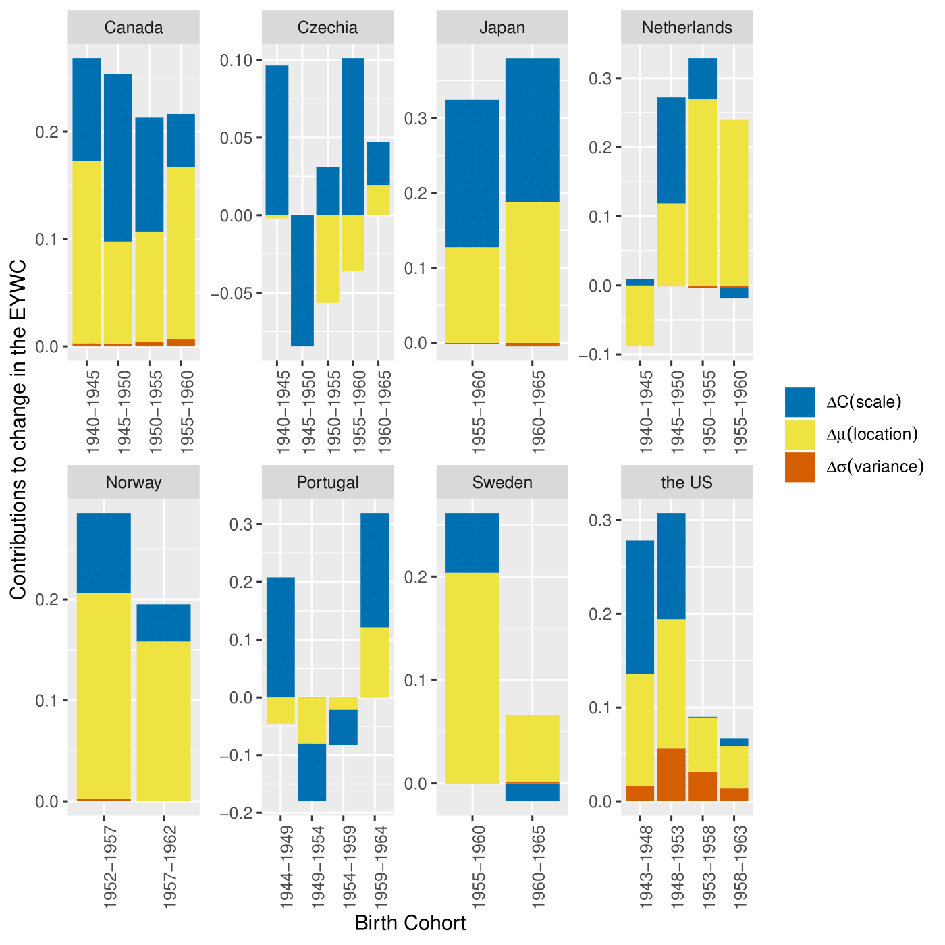
Postponement of 1st birth or childless?

Slide 23
(1.3) CALC

Slide 24
Another issue on demographic indexes
Period: tempo-effect
Cohort: complete cohort

Slide 25
Another issue on demographic indexes
Period: tempo-effect
Cohort: complete cohort
Period based measure
including the cohort information

Slide 26
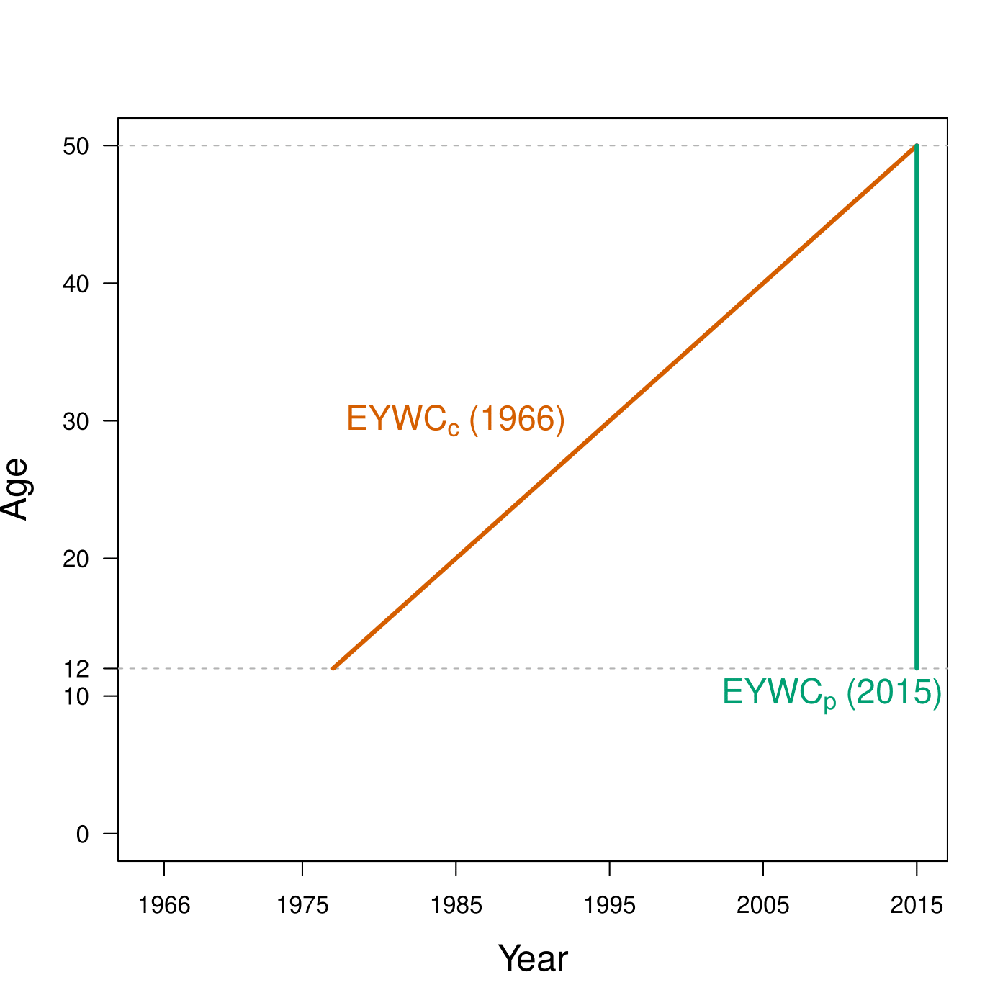
Cross-sectional average length of life childless

Slide 27
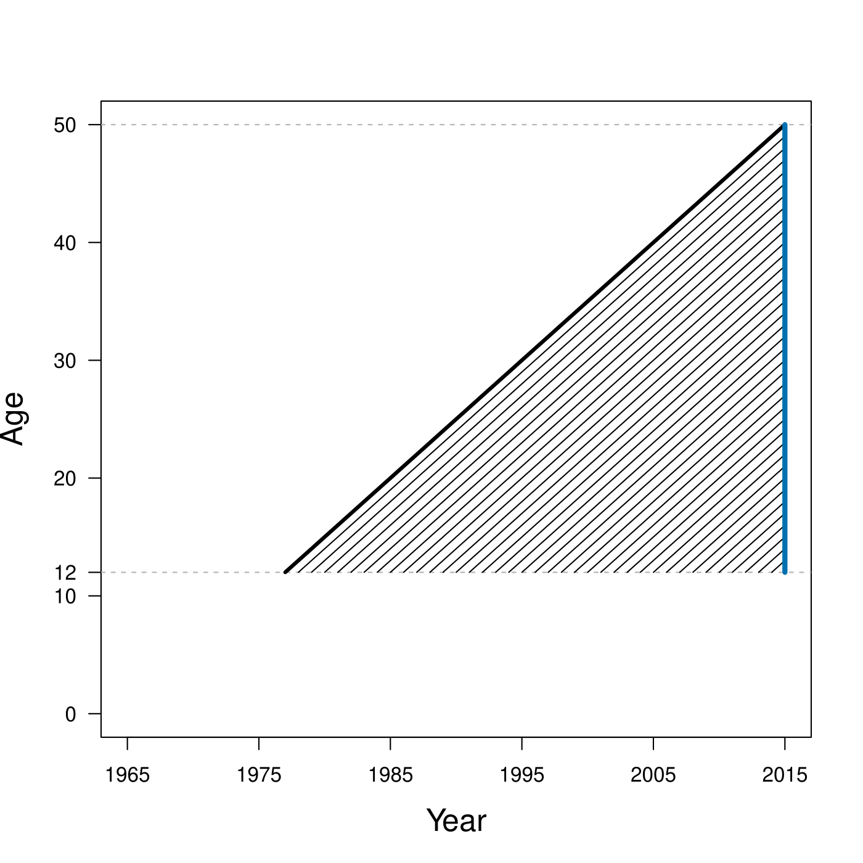
Cross-sectional average length of life childless

Slide 28
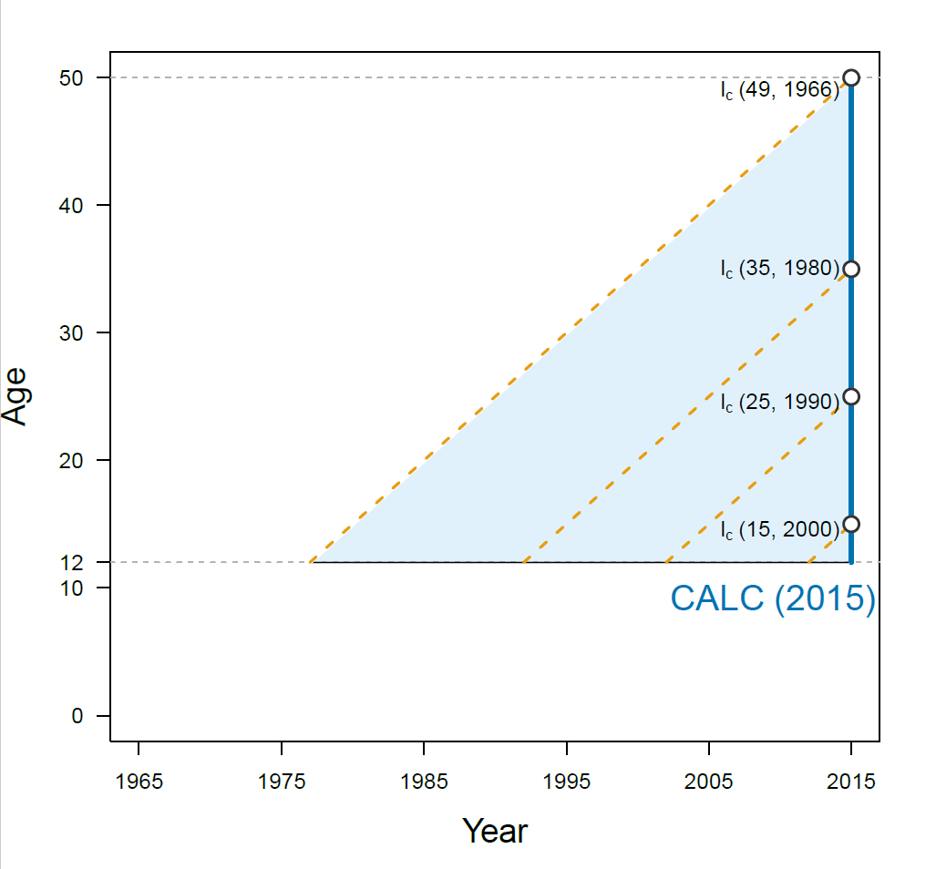
Cross-sectional average length of life childless

Slide 29
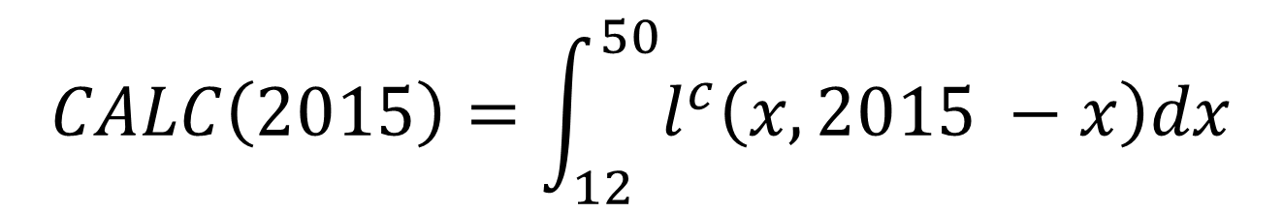
Cross-sectional average length of life childless
Cross-sectional Average Length of Life Childless
= the average time spent without children from age 12 to 50
$$CALC\left(2015\right)=\int_{12}^{50}{l^{c}\left(x, 2015 −x\right)dx}$$

Slide 30
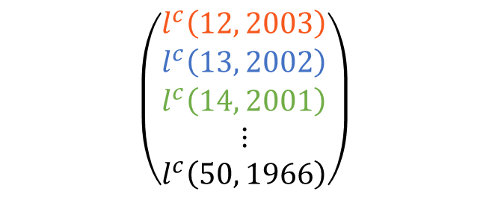
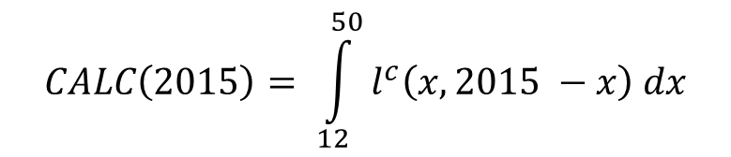
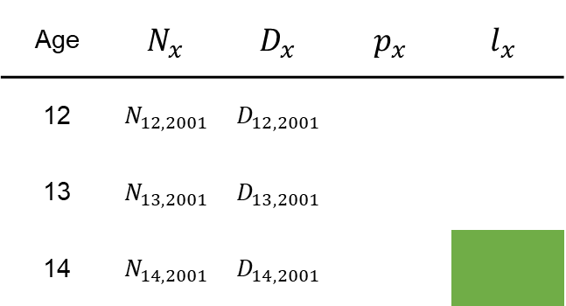
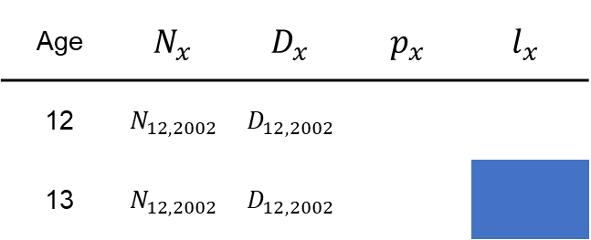
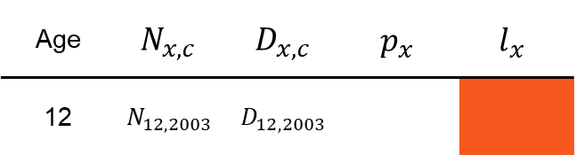
Cross-sectional average length of life childless
$$CALC\left(2015\right)= \int_{12}^{50}{l^{c}\left(x, 2015 −x\right) dx}$$
2003 bc
Age | $$N_{x, c}$$ | $$D_{x, c}$$ | $$p_{x}$$ | $$l_{x}$$
12 | $$N_{12, 2003}$$ | $$D_{12, 2003}$$
$$\left(\begin{matrix}l^{c}\left(12, 2003\right) \\ l^{c}\left(13, 2002\right) \\ \begin{matrix}l^{c}\left(14, 2001\right) \\ ⋮ \\ l^{c}\left(50, 1966\right)\end{matrix}\end{matrix}\right)$$
2002 bc
Age | $$N_{x}$$ | $$D_{x}$$ | $$p_{x}$$ | $$l_{x}$$
12 | $$N_{12, 2002}$$ | $$D_{12, 2002}$$
13 | $$N_{12, 2002}$$ | $$D_{12, 2002}$$
2001 bc
Age | $$N_{x}$$ | $$D_{x}$$ | $$p_{x}$$ | $$l_{x}$$
12 | $$N_{12, 2001}$$ | $$D_{12, 2001}$$
13 | $$N_{13, 2001}$$ | $$D_{13, 2001}$$
14 | $$N_{14, 2001}$$ | $$D_{14, 2001}$$

Slide 31
Cross-sectional average length of life childless
Average years spent childless from age 12 to 50
2/3 of their reproductive life

Slide 32
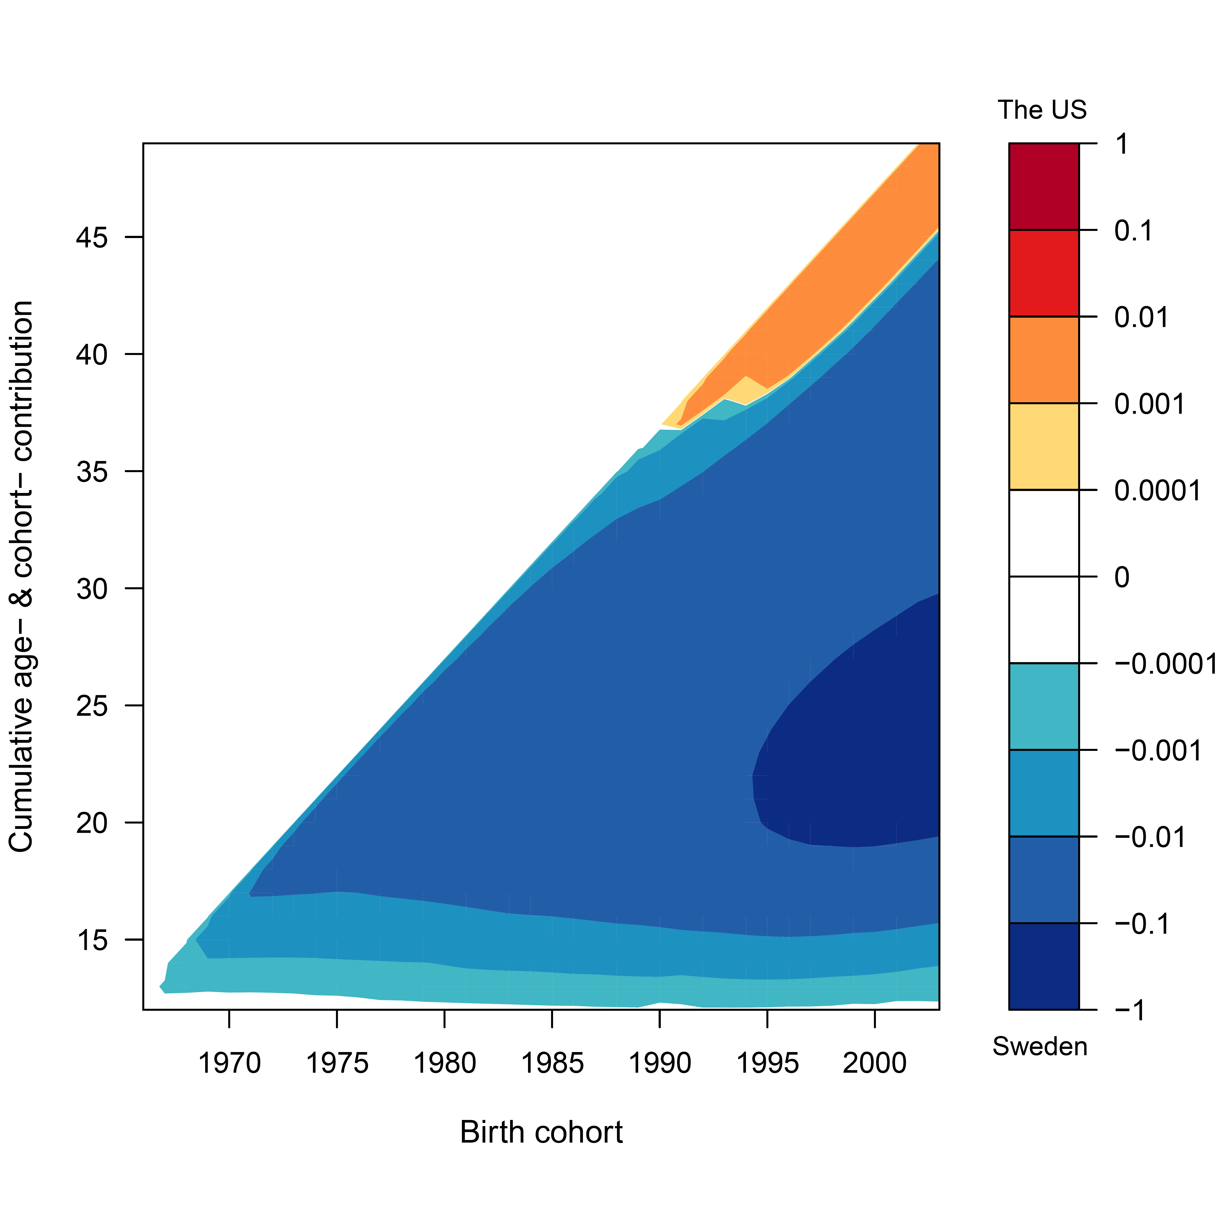
Decomposition
The US
SWE: catch-up effect
SWE: less birth
Risk of childless
Sweden

Slide 33
More results
https://rmogi.shinyapps.io/CALC/

Slide 34
Other references
Mogi, R., Lazzari, E., Nisén, J., & Canudas-Romo, V. (2022). Cross-sectional average length of life by parity: International comparisons. Population Studies.
Mogi, R. & Canudas-Romo, V. (2020). Cross-sectional average length of life by parity: Illustration for the US cohorts in reproductive ages in 2015. In Schoen, R. (Ed.), Analyzing Contemporary Fertility (pp. 293–306). Springer.
Mogi, R. & Canudas-Romo, V. (2018). Expected years ever married. Demographic Research 38(47): 1423–1456.

