Slide 1
OS Project 1
Operating System, Spring 2020
Copyrightⓒ. Saebyeol Yu. All Rights Reserved.

Slide 2
Assignment 0:
Compiling Linux kernel +
Adding a simple system call

Slide 3
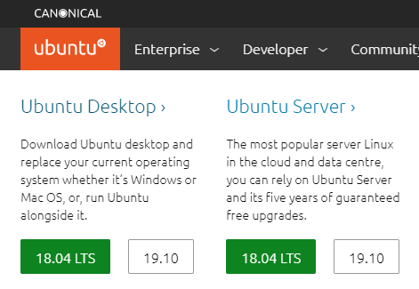
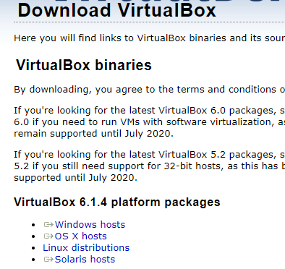
1
Install Ubuntu and VirtualBox
Ubuntu Desktop 18.04 LTS Download
https://ubuntu.com/#download
2. VirtualBox Download and Install
https://www.virtualbox.org/wiki/Downloads

Slide 4
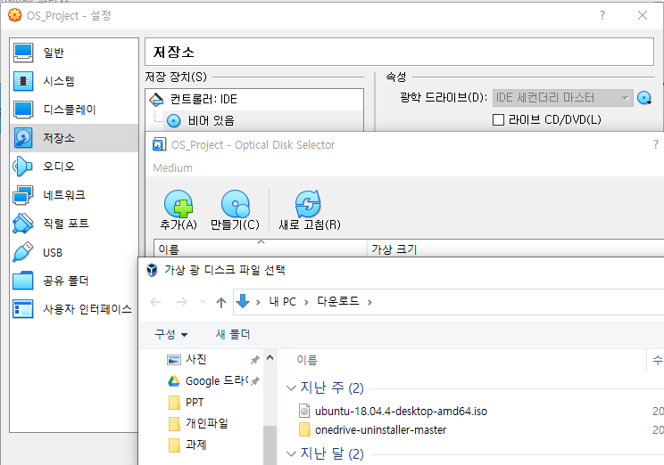
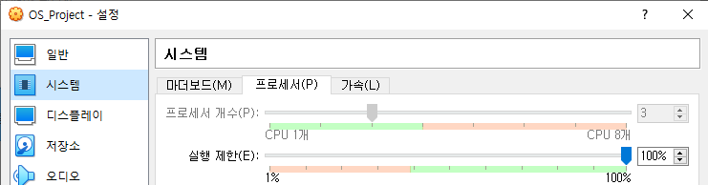
1
Install Ubuntu and VirtualBox
3. Virtual Box Configuration
Memory : roughly 4096MB
Virtual Hard disk(VDI) : at least 50GB
해당 가상환경의 설정에서
저장소-컨트롤러:IDE-비어있음-광학드라이브 Click
다운받은 ubuntu-18.04 선택 후 확인
Set the number of processor to be 1 less than the number of physical cores of the PC CPU

Slide 5
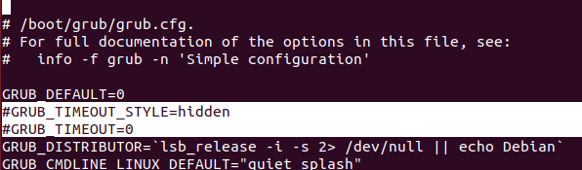
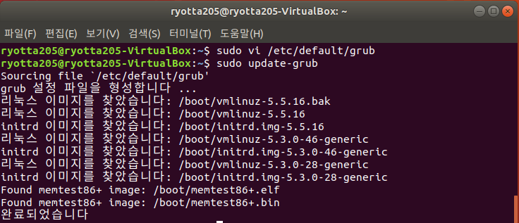
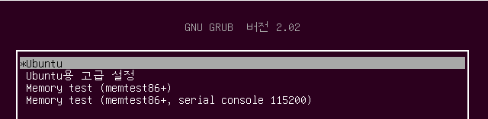
1
Install Ubuntu and VirtualBox
4. Boot Ubuntu
5. Modify grub Configuration
$ sudo vi /etc/default/grub
Adding # in the following two lines
GRUB_TIMEOUT_STYLE=hidden
GRUB_TIMEOUOT=0
Upon rebooting the following screen is displayed.
$ sudo update-grub

Slide 6

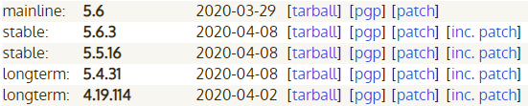
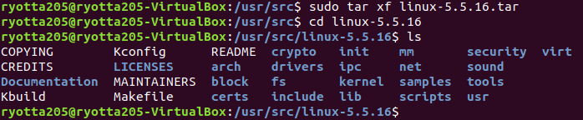
2
Install new Linux kernel
1. Check the current kernel version and download the 5.5.16 version kernel.
$ uname –r
2. Download new kernel (kernel version should be 5.5.16)
$wget https://cdn.kernel.org/pub/linux/kernel/v5.x/linux-5.5.16.tar.xz
or
https://www.kernel.org/
3. Kernel decompression and Package download
$ sudo mv linux-5.5.16.tar.xz /usr/src/
$ cd /usr/src
$ sudo xz -d linux-5.5.16.tar.xz
$ sudo tar xf linux-5.5.16.tar
$ cd linux-5.5.16
$ ls
$ sudo apt update
$ sudo apt install build-essential libncurses5 libncurses5-dev bin86 kernel-package libssl-dev bison flex libelf-dev

Slide 7
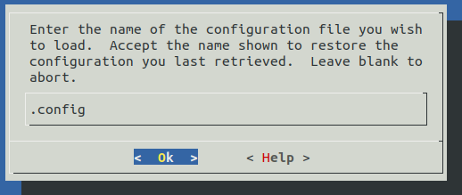
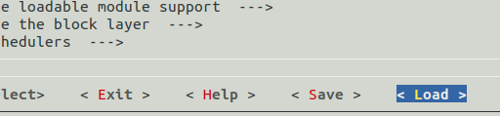
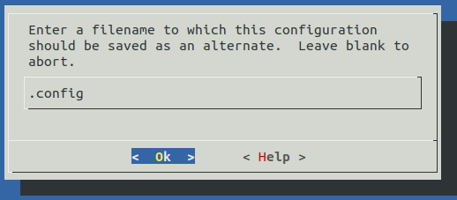
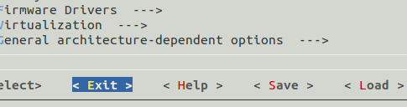
2
Install new Linux kernel - Compile
4. Use the current kernel configuration as it is.
$ cd /usr/src/linux-5.5.16
$ sudo cp /boot/config-5.3.0-28-generic ./.config
$ sudo make menuconfig
Using the arrow keys
Load – Ok – Save – Ok - Exit
②
①
③
④

Slide 8
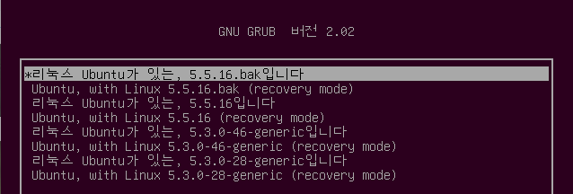

2
Install new Linux kernel - Compile
5. Compile and Install
Compile and install the downloaded kernel and kernel module
$ sudo make –j3
Number of after j = number of allocated CPU cores
$ grep –c processor /proc/cpuinfo Use this to check the number of allocated CPU cores
$ sudo make modules_install
$ sudo make install
$ sudo reboot
Depending on performance, 30 minutes ~ 5 hours is required
Upon rebooting the following screen is displayed. (Ubuntu용 고급 설정 선택)

Slide 9
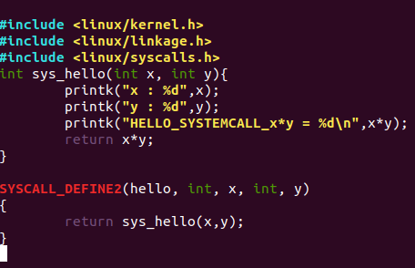
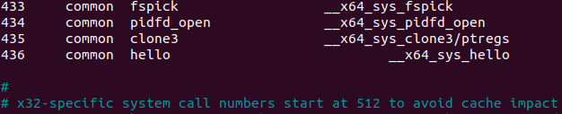
3
Adding a System Call
hello.c
1. Make a simple System call
$ cd /usr/src/linux-5.5.16
$ sudo vi kernel/hello.c
2. Register a System call in System call table
$ cd /usr/src/linux-5.5.16
$ sudo vi arch/x86/entry/syscalls/syscall_64.tbl
436 common hello __x64_sys_hello
syscall_64.tbl

Slide 10
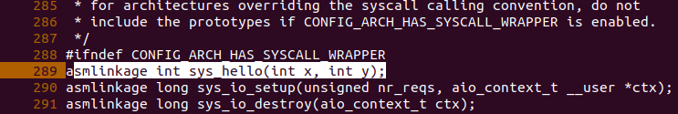
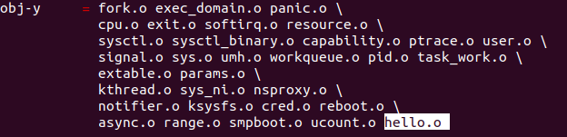
3
Adding a System Call
3. Declaration a System call prototype
$ cd /usr/src/linux-5.5.16
$ sudo vi include/linux/syscalls.h
Register under ‘#ifndef CONFIG_ARCH_HAS_SYS_CALL_WRAPPER’
asmlinkage int sys_hello(int x, int y);
4. Modify Makefile
$ cd /usr/src/linux-5.5.16
$ sudo vi kernel/Makefile
Add ‘hello.o’ to the end of ‘oby-y’

Slide 11

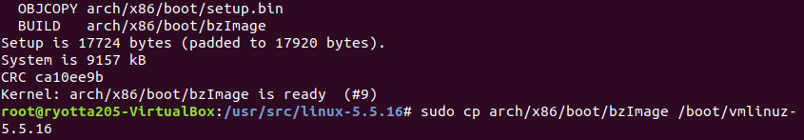
3
Adding a System Call
5. Recompile
Compile only kernel image and exchange (5~10 minute)
$ cd /usr/src/linux-5.5.16
$ sudo make bzImage –j3
(Number of after j = number of allocated CPU cores)
$ sudo cp arch/x86/boot/bzImage /boot/vmlinuz-5.5.16
$ reboot

Slide 12
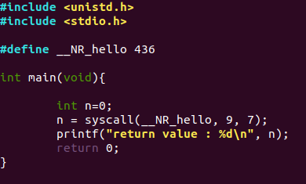
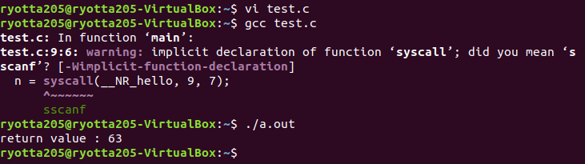

3
Adding a System Call
test.c
6. Test
$ vi test.c
$ gcc test.c
$ ./a.out
$ dmesg

Slide 13
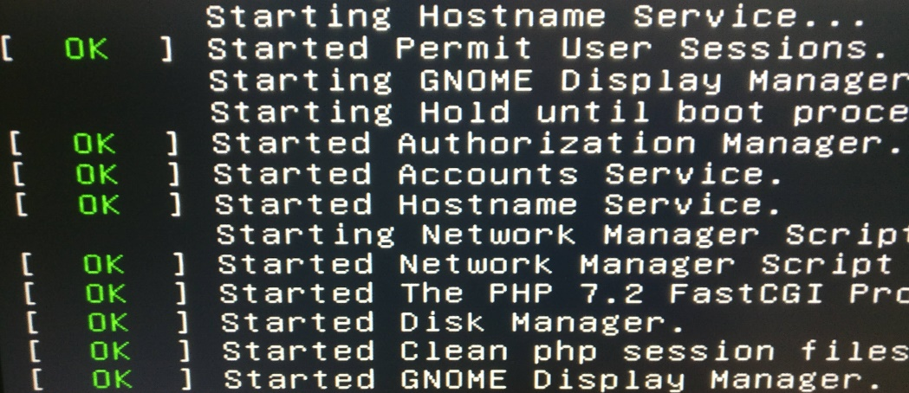
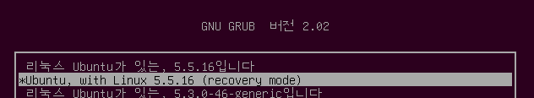
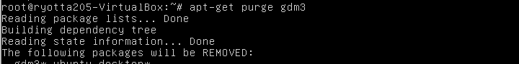
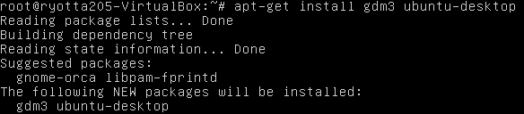
4
Troubleshooting
1. 만약 부팅 중 Ubuntu 로고에서 오랫동안 멈춰 있다면 재부팅
여러 번의 재부팅 이후로도 안된다면 2번 진행
2. 만약 부팅 중 Started GNOME Display Manager에서 멈춰 있다면
Recovery mode 진입 후
root – Enter
$ apt-get purge gdm3
$ apt-get install gdm3 ubuntu-desktop
$ reboot

Slide 14
Assignment 1:
Adding “sys_mygetsid()“ system call

Slide 15
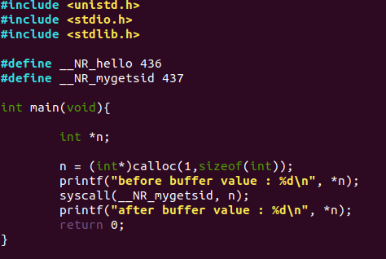

1. Add sys_mygetsid()
Test user 프로그램 소스코드: sys_mygetsid()
sys_mygetsid(int* buffer)
매개변수로 전달한 포인터 변수에
자신의 학번을 전달하는 system call
실행결과
dmesg 확인결과

Slide 16
2. 제출 및 평가
제출 자료 (lms에 제출)
Linux kernel image (vmlinuz) file
source code of the system call
source code of the test user program
Result of execution (Screenshot)
평가
1. sys_hello() System call 추가 (20점)
2. System call 추가 후 Compile 성공 (10점)
3. Compile된 커널로 부팅 성공 (10점)
4. sys_mygetsid() 구현 (20점)

Slide 17
Assignment 2:
Adding “sys_sread()”, “sys_swrite()“
system call

Slide 18
1. Add sys_swrite(), sys_sread()
sys_swrite(int fd, char* buf, int len): A secure version of sys_write() system call
buf 포인터 변수가 가리키는 메모리 공간에 저장된 데이터를 암호화(encryption)한 뒤, fd가 가리키는 파일에 len 크기 만큼 저장하는 system call
Encryption 방법: 데이터의 모든 비트를 반전 시킴
예) 원본 데이터 (01110000) → 암호화된 데이터 (10001111)
sys_sread(int fd, char* buf, int len): A secure version of sys_read() system call
fd가 가리키는 파일에서 len 크기만큼 읽어 복호화(decryption)한 뒤, buf포인터 변수가 가리키는 메모리 공간에 저장하는 system call
파일에서 읽은 데이터는 복호화한 뒤 buf에 저장해야 함

Slide 19
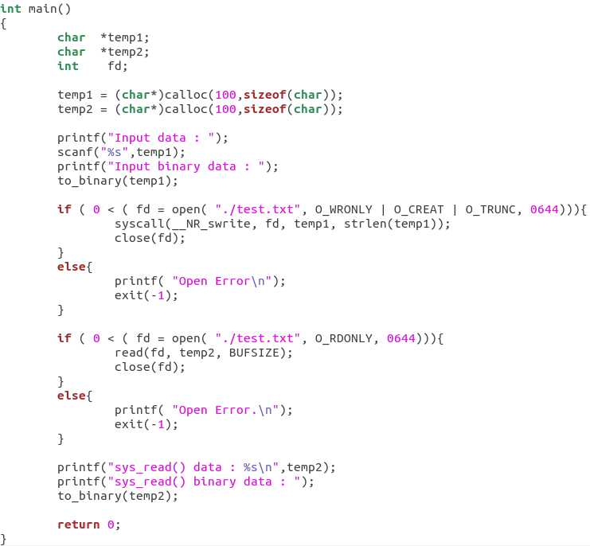
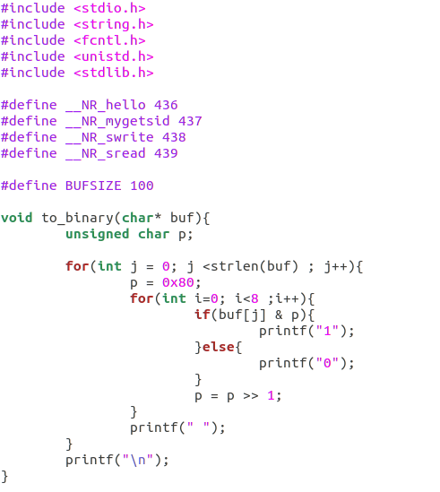
1. Add sys_swrite(), sys_sread()
Test user 프로그램 소스코드: sys_swrite()

Slide 20
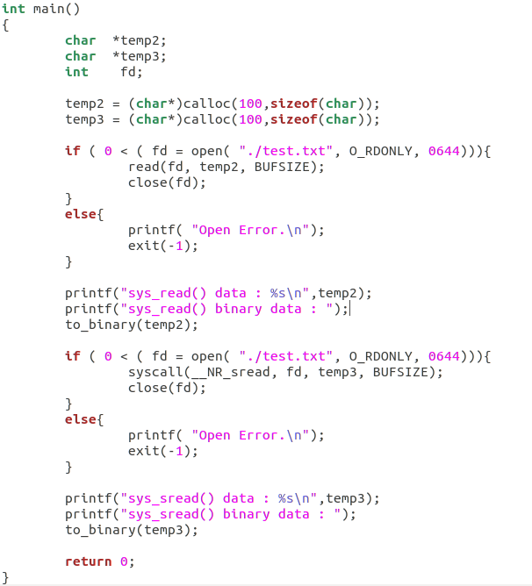
1. Add sys_swrite(), sys_sread()
Test user 프로그램 소스코드: sys_sread()

Slide 21


1. Add sys_swrite(), sys_sread()
Test user 프로그램 소스코드: sys_sread() 실행결과
dmesg 확인결과
Test user 프로그램 소스코드: sys_sread() 실행결과
dmesg 확인결과

Slide 22
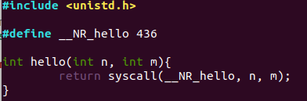
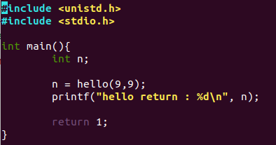
2. Make a library for sys_swrite(), sys_sread()
How to make a library?
Static Library
hello.c
$ vi hello.c
$ gcc –c hello.c
$ ar rc libhello.a hello.o
$ vi static.c
$ gcc static.c –o static –L./ -lhello
$ ./static
static.c
결과

Slide 23


2. Make a library for sys_swrite(), sys_sread()
hello.c
How to make a library?
Shared Library
$ vi hello.c
$ gcc –fPIC –c hello.c –o hello.o
$ gcc –shared –o libhello.so.0.0.0 hello.o
$ sudo cp libhello.so.0.0.0 /usr/lib/libhello.so.0.0.0
$ sudo ln –s /usr/lib/libhello.so.0.0.0 /usr/lib/libhello.so
$ sudo vi /etc/ld.so.conf.d/libhello.conf
$ sudo ldconfig
$ vi shared.c
$ gcc shared.c –o shared -lhello
$ ./shared
$ ldd shared
shared.c
libhello.conf
ldd shared
결과

Slide 24
2. Make a library for sys_swrite(), sys_sread()
Make a library providing user-level wrapper functions for sys_swrite() and sys_sread() system calls.
Library function name should be sread() and swrite() for sys_sread() and sys_swrite(), respectively

Slide 25
3. 제출 및 평가
제출 자료 (lms에 제출)
Linux kernel image (vmlinuz) file
source code of the system call
source code of the test user program
source code of the library
Result of execution (Screenshot)
평가
sys_sread() system call 추가(5점)
sys_swrite() system call 추가 (5점)
3. sys_sread() 구현 (10점)
4. sys_swrite() 구현 (10점)
5. Library 구현 (10점)

Slide 26
Question
Email : jhyn207@gmail.com
Message : 010 - 4905 - 1749
Copyrightⓒ. Saebyeol Yu. All Rights Reserved.

