Slide 1

AdaBoost: A Powerful Ensemble Learning Algorithm
AdaBoost, short for Adaptive Boosting, is a widely used ensemble learning algorithm that combines multiple weak learners to create a strong predictor. It's known for its simplicity and effectiveness, making it a popular choice for various machine learning tasks.

Slide 2
Weak Learners and Strong Learners
Weak Learners
Strong Learners
These are models that perform slightly better than random guessing on a given task. They can be simple decision trees or linear models.
These are models that achieve high accuracy on a task. AdaBoost aims to create a strong learner by combining multiple weak learners.

Slide 3
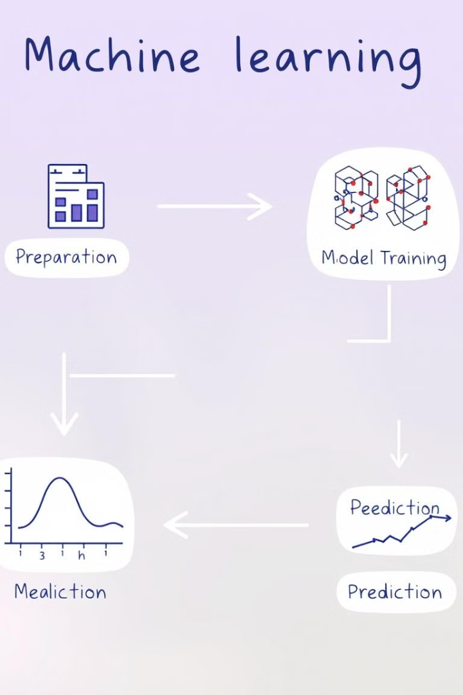
The AdaBoost Algorithm
1
Step 1: Initialize Weights
Each training instance is assigned an equal weight. The initial weights are used for the first weak learner.
2
Step 2: Train Weak Learners
Each weak learner is trained on the data, giving more importance to misclassified instances. The weights are updated after each iteration.
3
Step 3: Combine Predictions
The final prediction is based on a weighted combination of the predictions made by all weak learners.

Slide 4

Intuition Behind AdaBoost
1
Focus on Errors
2
Iterative Improvement
AdaBoost focuses on instances that are difficult to classify, giving them higher weights.
By sequentially training weak learners and adjusting weights, AdaBoost progressively improves the overall prediction accuracy.
3
Ensemble Wisdom
The combined wisdom of multiple weak learners often surpasses the performance of any individual learner.

Slide 5
Advantages of AdaBoost
High Accuracy
Robustness
AdaBoost often achieves high accuracy, particularly in cases where the data is complex or noisy.
It's less susceptible to overfitting compared to some other algorithms, making it robust to noisy data.
Versatility
AdaBoost can be applied to various tasks, including classification, regression, and feature selection.

Slide 6




Limitations and Challenges
Susceptibility to Outliers
Computational Complexity
Interpretability
Outliers can disproportionately influence the weighting process, potentially leading to biased models.
Training AdaBoost can be computationally expensive, especially for large datasets.
Understanding the decision-making process of AdaBoost can be challenging due to its ensemble nature.

Slide 7
Applications of AdaBoost
Image Recognition
Object detection, face recognition
Fraud Detection
Identifying suspicious transactions, credit card fraud
Medical Diagnosis
Predicting diseases, analyzing medical images

Slide 8




Conclusion and Key Takeaways
High Accuracy
Robustness
AdaBoost delivers powerful performance and is known for its accuracy.
It's resistant to overfitting and handles noisy data well.
Versatility
Understanding
AdaBoost is applicable to a wide range of machine learning tasks.
While powerful, its inner workings can be complex to understand.

