Slide 1
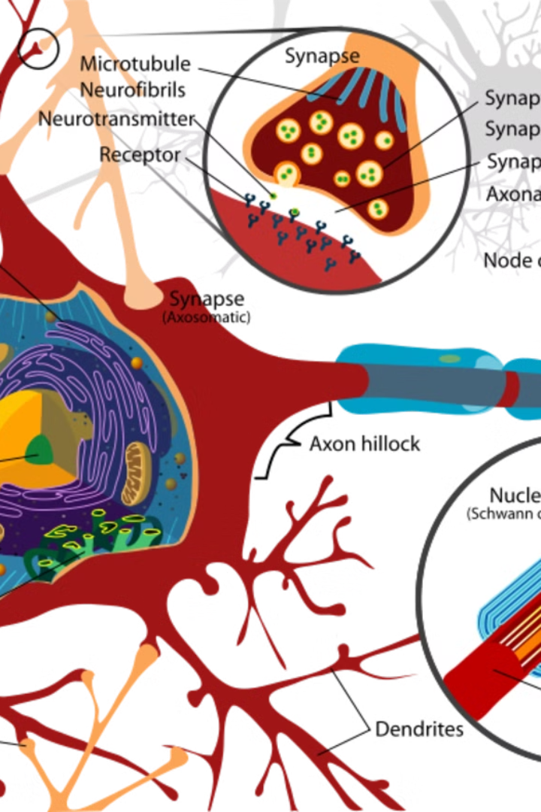
Artificial Neural Networks: The Brain-Inspired Revolution in AI
Artificial neural networks (ANNs) are a powerful type of machine learning inspired by the human brain. They are composed of interconnected nodes, called neurons, that process and transmit information.

Slide 2
What Are Artificial Neural Networks?
Computational Models
Learning Algorithms
ANNs mimic the structure and function of the human brain, using interconnected nodes to process information.
They learn from data through training, adjusting connections between nodes to improve accuracy.
Pattern Recognition
ANNs excel at identifying patterns and relationships in data, enabling them to make predictions and solve complex problems.

Slide 3



The Inspiration from the Human Brain
Neurons
The basic units of computation in the brain, similar to nodes in ANNs.
Synapses
Connections between neurons, analogous to the weights in ANNs.
Learning
The brain adapts and learns by strengthening or weakening connections, similar to ANNs adjusting weights.

Slide 4
The Structure of Artificial Neural Networks
Input Layer
Hidden Layers
Output Layer
Receives raw data as input, representing features or characteristics.
Perform complex computations and transformations on the input data.
Produces the final output of the network, representing predictions or classifications.

Slide 5

Training Artificial Neural Networks
Weight Adjustment
Feedforward
Connection weights are adjusted to minimize errors and improve accuracy.
Data is passed through the network from input to output.
1
2
3
Backpropagation
Errors are calculated and propagated back through the network.

Slide 6
Activation Functions and Layers
1
Activation Functions
2
Layers
Multiple layers increase the network's capacity to extract features and make accurate predictions.
Introduce non-linearity, allowing networks to learn complex relationships.
3
Deep Learning
Networks with many hidden layers can model highly complex data and learn intricate patterns.

Slide 7
Applications of Artificial Neural Networks
Image Recognition
Computer Vision
Object Detection
Natural Language Processing
Machine Translation
Text Summarization
Recommender Systems
Personalized Recommendations
Content Filtering

Slide 8
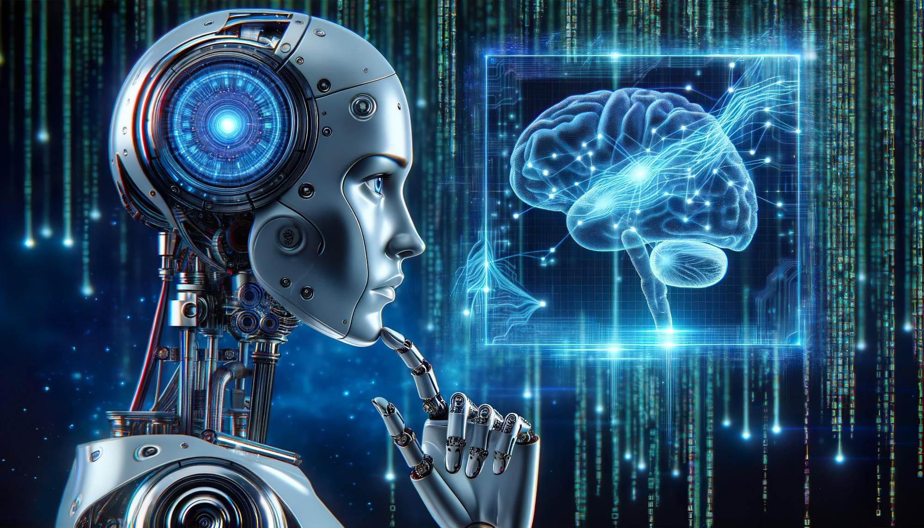




Advantages and Limitations of Artificial Neural Networks
Powerful Learning
High Accuracy
ANNs can learn complex patterns and make accurate predictions.
ANNs often outperform traditional methods in tasks requiring pattern recognition.
Data-Driven
Black Box Nature
ANNs rely on large amounts of data for training and improvement.
Understanding how ANNs make decisions can be challenging, leading to explainability issues.

