Slide 1
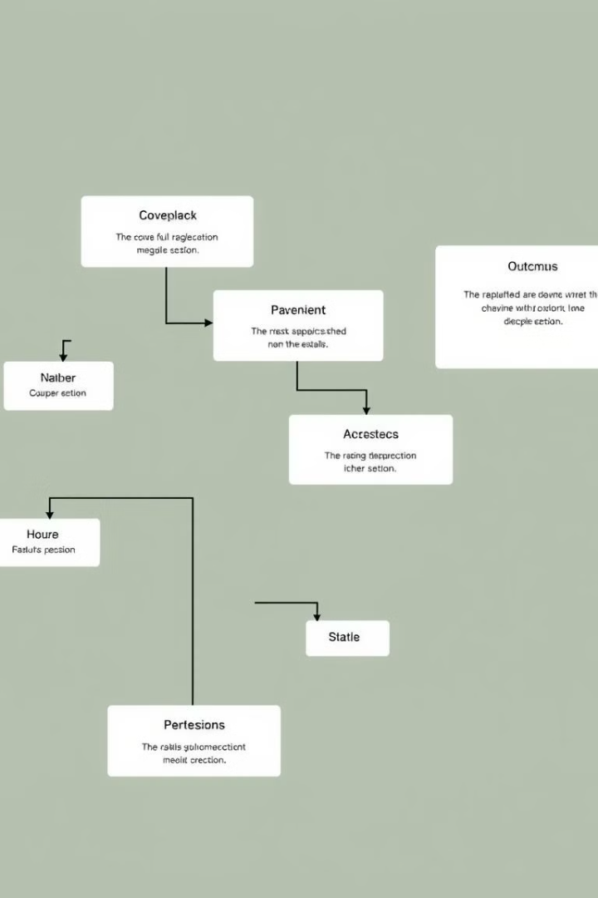
Decision Tree in Machine Learning
Decision trees are a powerful and versatile machine learning algorithm used for both classification and regression tasks. They work by recursively partitioning the data based on the most informative features, creating a tree-like model that is easy to interpret and visualize.

Slide 2
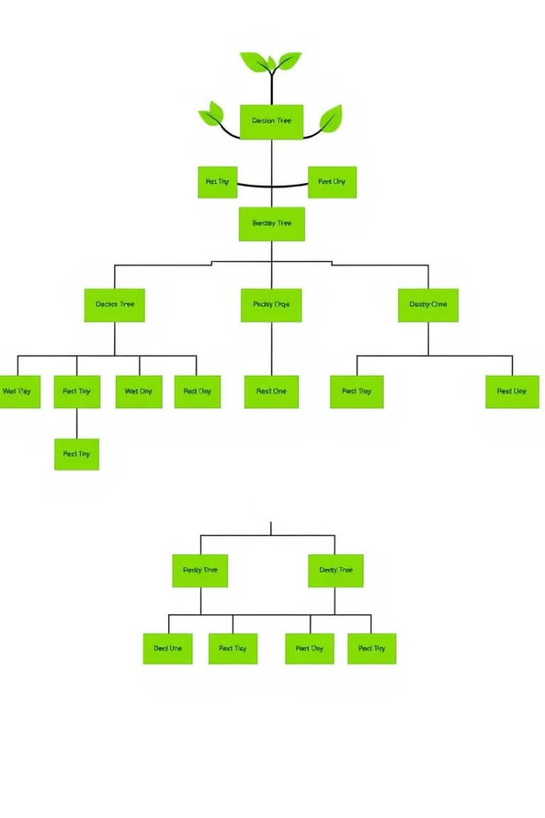
What is a Decision Tree?
1
Hierarchical Structure
2
Recursive Partitioning
A decision tree is a flowchart-like model with nodes representing features, branches representing decisions, and leaves representing outcomes.
The algorithm recursively selects the most informative feature to split the data, creating a tree-like structure.
3
Interpretability
Decision trees are highly interpretable, making it easy to understand how the model makes predictions.

Slide 3
Key Concepts of Decision Trees
Root Node
Internal Nodes
Leaf Nodes
The starting point of the tree, where the algorithm selects the most informative feature to split the data.
Nodes that represent a decision based on a feature, and have two or more child nodes.
The final nodes of the tree, which represent the predicted class or regression value.

Slide 4
Building a Decision Tree
1
Feature Selection
Choose the most informative feature to split the data at each node.
2
Recursive Partitioning
Recursively split the data based on the selected feature until a stopping criterion is met.
3
Pruning
Simplify the tree by removing branches that do not significantly improve the model's performance.

Slide 5
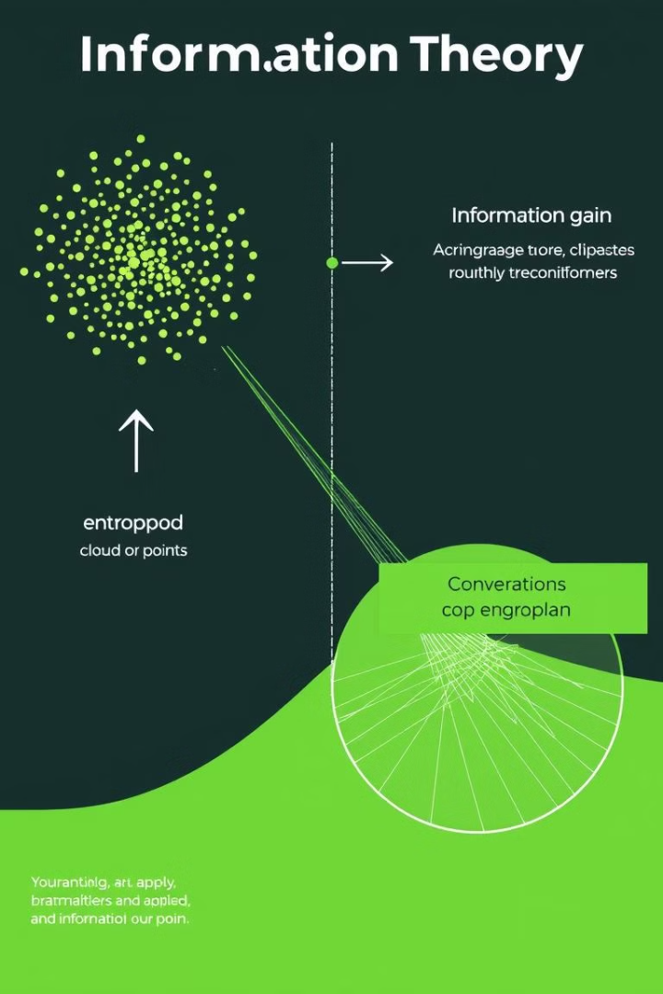
Entropy and Information Gain
Entropy
Information Gain
A measure of the uncertainty or impurity in a dataset, used to determine the best feature to split on.
The reduction in entropy after splitting the data on a particular feature, used to guide the tree-building process.
Maximizing Information Gain
The decision tree algorithm selects the feature that maximizes the information gain at each split.

Slide 6



Implementing Decision Trees in Python
scikit-learn
Powerful machine learning library in Python with built-in decision tree algorithms.
Pandas
Data manipulation and analysis library for preparing data for decision tree models.
Matplotlib
Visualization library for creating plots and visualizations of decision tree models.

Slide 7
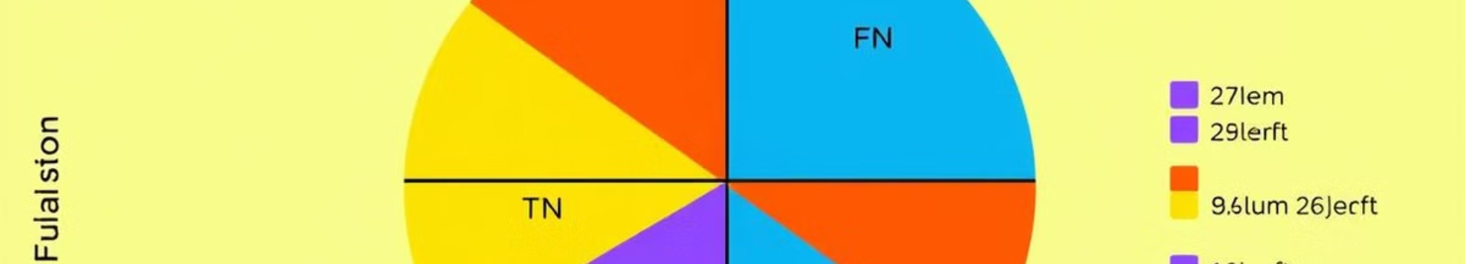
Evaluating Decision Tree Performance
Accuracy
The overall proportion of correct predictions made by the model.
Precision
The proportion of true positives among the positive predictions.
Recall
The proportion of true positives among the actual positive instances.
F1-Score
The harmonic mean of precision and recall, a balanced metric.

Slide 8
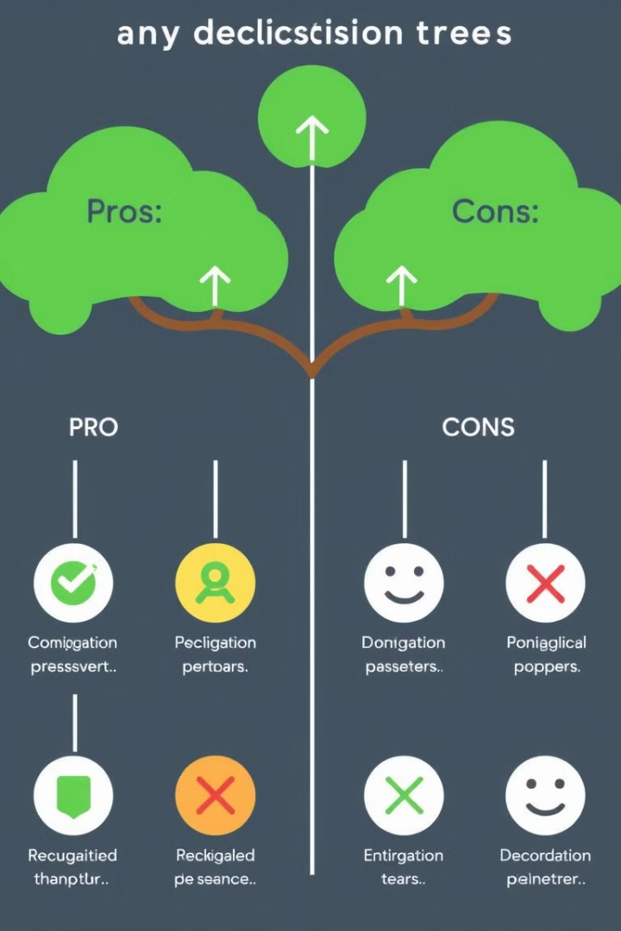


Advantages and Limitations of Decision Trees
Advantages
Interpretable, handle both numerical and categorical data, and can capture nonlinear relationships.
Limitations
Prone to overfitting, may have difficulty with imbalanced datasets, and can be unstable to small changes in data.

Slide 9
Applications and Future Trends
Applications
Future Trends
Decision trees are widely used in fields like healthcare, finance, and marketing for classification and prediction tasks.
Ongoing research focuses on improving decision tree algorithms, integrating them with deep learning, and applying them to larger and more complex datasets.

