Slide 1

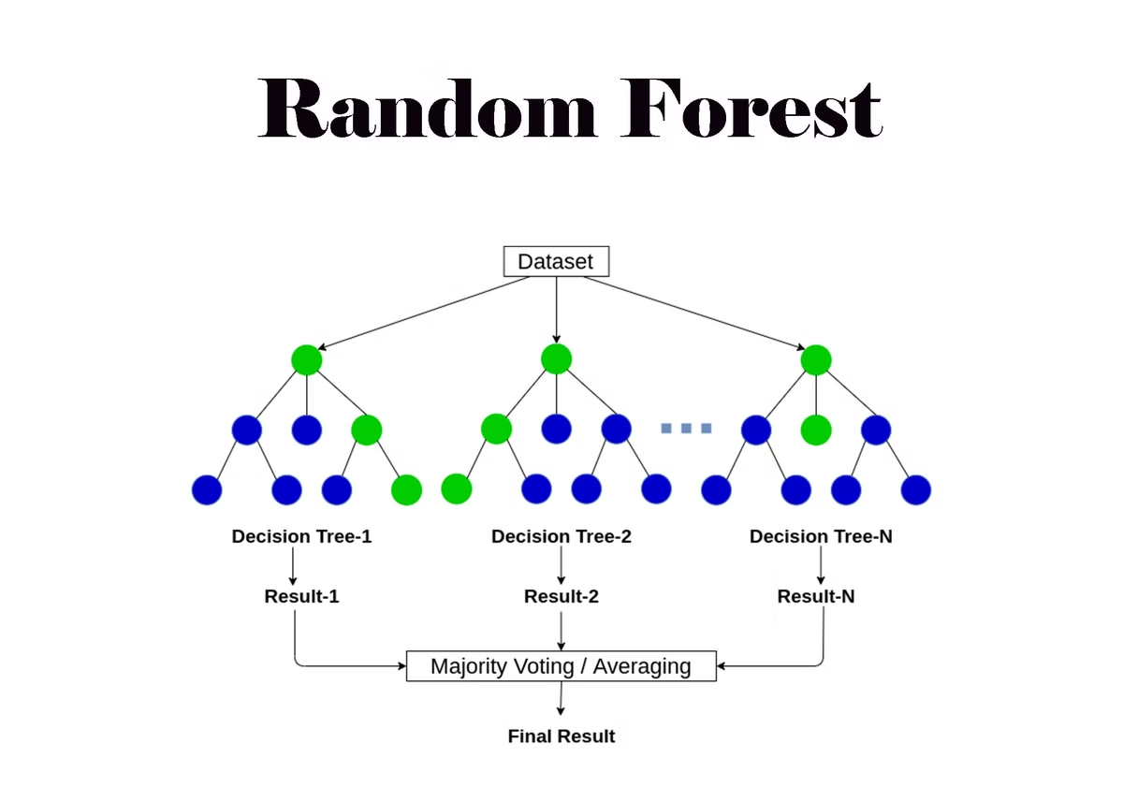
Random Forest Algorithm
Random forests are a popular ensemble learning method in machine learning.
They combine multiple decision trees to improve prediction accuracy and reduce overfitting.

Slide 2

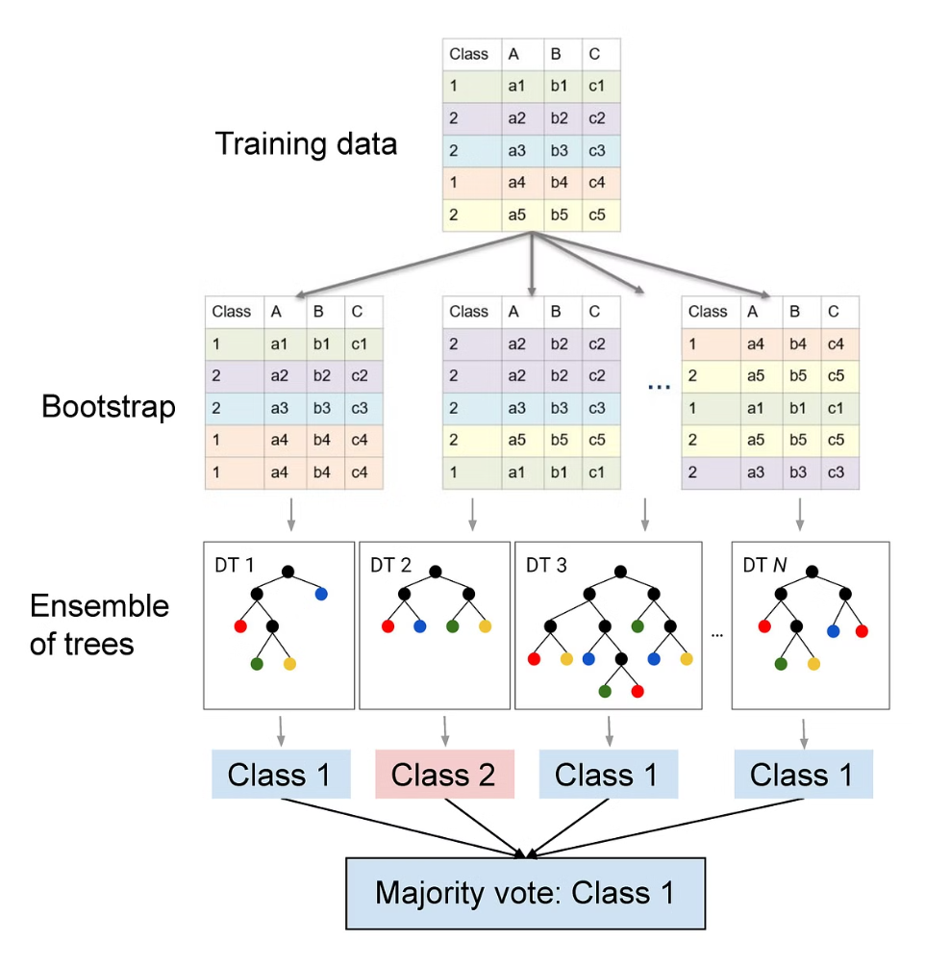
What is Random Forest?
1
Ensemble Learning
2
Decision Trees
Random forests are a type of ensemble learning algorithm that combines multiple decision trees.
Each decision tree in a random forest is trained on a random subset of the data and features.
3
Prediction
Predictions are made by averaging the predictions of all the trees in the forest.

Slide 3

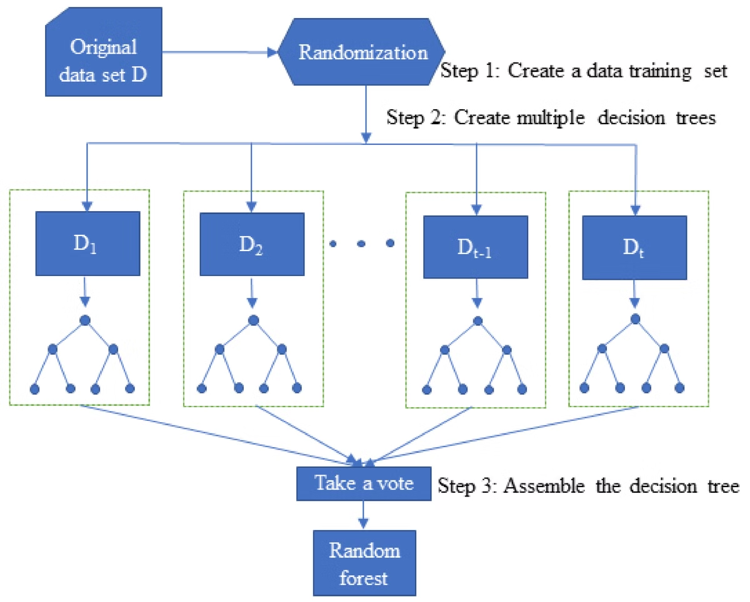
How does Random Forest work?
1
Bagging
Randomly select a subset of data points (with replacement) to train each tree.
2
Feature Randomization
Randomly select a subset of features to consider at each node of each tree.
3
Tree Building
Grow each tree to full depth without pruning, allowing for variance and capturing different patterns.

Slide 4
Key Advantages of Random Forest
High Accuracy
Robustness
Feature Importance
Combining multiple trees reduces variance and improves prediction accuracy.
Random forests are less susceptible to overfitting and can handle noisy data.
Random forests provide a way to assess the importance of different features in the model.

Slide 5

Random Forest Hyperparameters
Hyperparameter
Description
Number of Trees
The number of decision trees in the forest.
Maximum Depth
The maximum depth of each decision tree.
Minimum Samples Split
The minimum number of data points required to split a node.

Slide 6

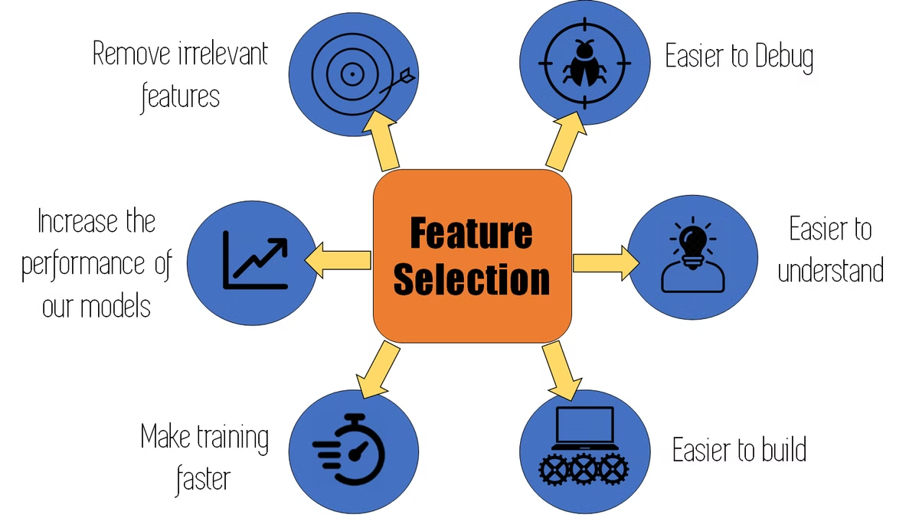



Random Forest Feature Importance
Feature Importance
Random forests measure feature importance by how much each feature contributes to the accuracy of the model.
Permutation Importance
Features are randomly shuffled and the decrease in model accuracy is measured.
Feature Ranking
Features are ranked based on their importance, providing insights into the most influential variables.

Slide 7

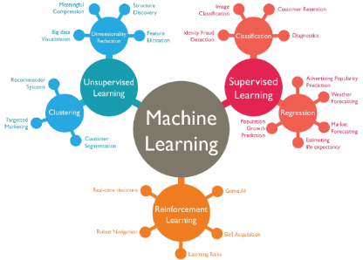



Random Forest in Machine Learning
Classification
Regression
Anomaly Detection
Random forests can be used to classify data into different categories, such as spam detection or image recognition.
They can predict continuous values, like house prices or stock prices.
Random forests can identify unusual data points that deviate from the norm.

Slide 8

Random Forest Applications and Use Cases
Healthcare
Finance
Disease prediction, patient risk assessment.
Fraud detection, credit risk assessment.
E-commerce
Recommendation systems, customer segmentation.

