Slide 1
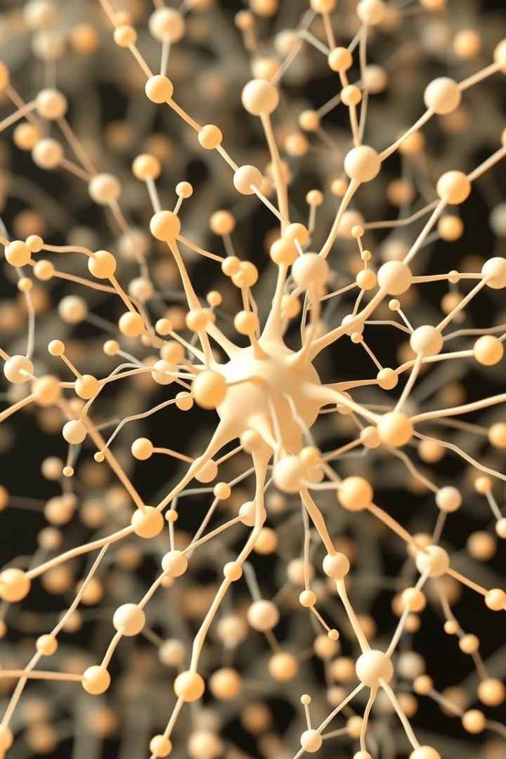
Recurrent Neural Networks (RNNs)
This presentation will delve into the world of recurrent neural networks, exploring their structure, capabilities, and applications in various fields.

Slide 2
Understanding Sequential Data and Time Series
Sequential Data
Time Series
Data points are ordered, with the order of information being crucial for understanding.
A special type of sequential data where data is collected over time, revealing patterns and trends.

Slide 3
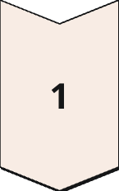
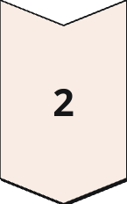
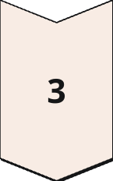
The Chain-Like Structure of RNNs
Hidden State
Information from previous steps is stored and passed on to the next.
Input
The current data point is processed by the network.
Output
The network generates an output based on the input and hidden state.

Slide 4
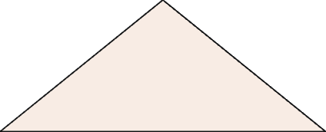
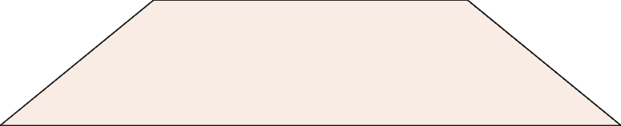
Vanishing and Exploding Gradient Problems
Vanishing Gradients
1
Gradients become too small, hindering learning.
Exploding Gradients
2
Gradients become too large, causing instability.

Slide 5
Long Short-Term Memory (LSTM) Networks
1
1. Memory Cells
2
2. Gates
3
3. Improved Gradient Flow
Store information for long periods, solving the vanishing gradient problem.
Control the flow of information into and out of the memory cells.
Enables LSTM to learn long-term dependencies in data.

Slide 6



Gated Recurrent Unit (GRU) Networks
Simpler Structure
GRU is a more streamlined version of LSTM, with fewer gates.
Computational Efficiency
GRU is faster and requires less computational resources than LSTM.
Comparable Performance
In many cases, GRU performs comparably to LSTM while being more efficient.

Slide 7

Applications of RNNs
Language Modeling
Machine Translation
Predicting the next word in a sequence, enabling natural language processing tasks.
Translating text from one language to another by learning patterns and relationships between languages.
Speech Recognition
Converting spoken audio into text, enabling voice assistants and transcription services.

Slide 8

Conclusion and Future Directions of RNNs
1
Powerful Tool
RNNs are a powerful tool for analyzing sequential data.
2
Expanding Applications
RNNs are becoming increasingly popular for various tasks.
3
Continued Research
Research continues to improve RNN performance and address limitations.

