Slide 1

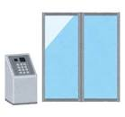
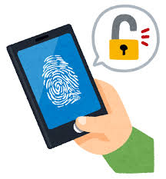
Fingerprint Authentication
Use a fingerprint as a key.
unlock a door lock, a smartphone, and so on.
Uses touch sensor to read a fingerprint.
Notes:
(Enter) Fingerprint system allows a fingerprint to be used as a key to unlock a door lock, a smartphone, and so on. (Enter) This uses touch sensor to read a person’s fingerprint. (Enter)

Slide 2

Fingerprint Authentication
It is a touch system.
only need to touch the reader once.
Mistake rate 0.01%
changes by the finger condition.
Notes:
(Enter) It is a touch system, so the user must touch the sensor to make it read the fingerprint. Users only need to touch the reader once. (Enter) This system only has a 0.01% mistake rate giving it a high accuracy rate. However, this rate changes by the finger condition. (Enter)

Slide 3


Fingerprint Authentication
Can copy another person’s fingerprint.
⇒ A risk of being unlocked by a third party.
Notes:
(Enter) There is a few risks of it being unlocked by a third party because a third party can copy another person’s fingerprint by collecting it.

