Slide 1
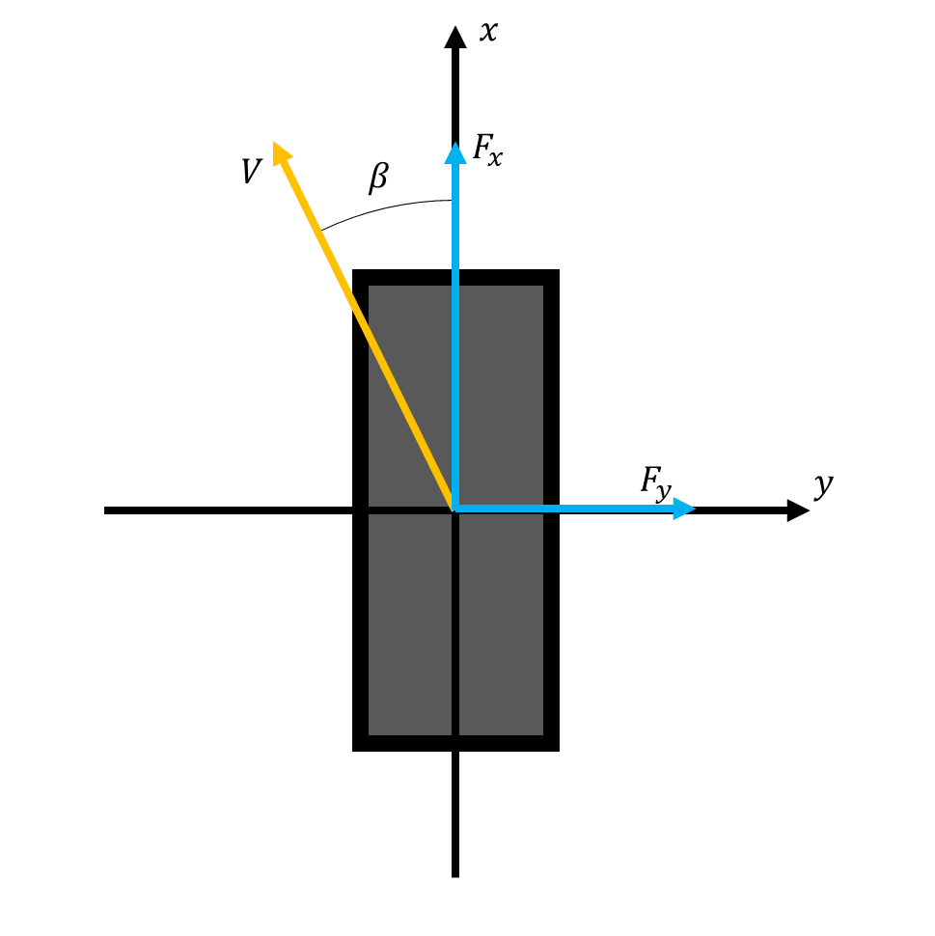






$$x$$
$$F_{x}$$
$$V$$
$$β$$
$$F_{y}$$
$$y$$

Slide 2
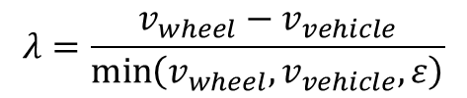
$$λ=\frac{v_{wheel}−v_{vehicle}}{\min\left(v_{wheel}, v_{vehicle}, ε\right)}$$

