Slide 1
N-Queen
BACKTRACKING PROBLEM

Slide 2
INTRODUCTION
The N-Queens problem is a classic chess puzzle where N queens must be placed on an N×N chessboard so that no two queens threaten each other.
It's a significant problem in computer science, used to teach backtracking algorithms and constraint satisfaction.

Slide 3
2. PROBLEM STATEMENT
Formal definition:
Place N queens on an N×N chessboard so that no two queens can attack each other.
Challenge:
The number of possible arrangements grows factorially with N, making brute-force approaches impractical for large N.
Constraints:
No two queens can be in the same row
No two queens can be in the same column
No two queens can be on the same diagonal

Slide 4
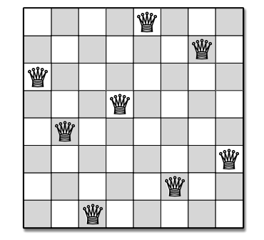
. SOLUTION APPROACH
We use a backtracking algorithm to solve the N-Queens problem efficiently.
Backtracking is a general algorithm for finding all (or some) solutions to computational problems, that incrementally builds candidates to the solutions.
Key concepts:
Recursion: The algorithm calls itself with smaller subproblems
Constraint satisfaction: We check if a queen placement is safe before proceeding

Slide 5
CODE STRUCTURE
Main components:
main(): Entry point, handles user input
solveNQueens(): Initiates the solving process
solveNQueensUtil(): Recursive function implementing the backtracking algorithm
isSafe(): Checks if a queen can be placed safely
printBoard(): Visualizes the current board state
Global variables:
board: 2D vector representing the chessboard
boardSize: Size of the chessboard
recursiveCalls: Counts number of recursive calls
iterationCount: Tracks total iterations
solutionCount: Keeps track of solutions found

Slide 6
6. USER INTERACTION
Input parameters:
Board size: User can specify the dimensions of the chessboard
Find all solutions: Option to find one or all possible solutions
Delay: User can set the delay between steps for visualization
Output display:
Current board state with placed queens
Iteration count: Shows current number of attempts
Solution count: Displays number of solutions found

Slide 7
10. CONCLUSION
The N-Queens problem showcases the power of backtracking algorithms
Visualization helps in understanding complex algorithms and their execution
This implementation balances between solving the problem and providing an educational tool
Applications extend beyond chess, into areas like constraint satisfaction problems and optimization

Slide 8
Thank you!

