Slide 1
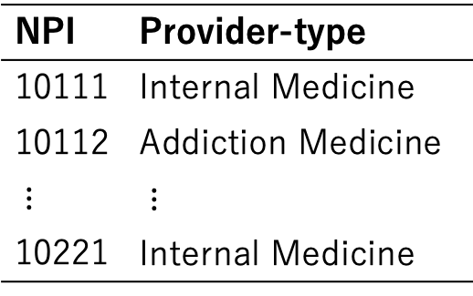
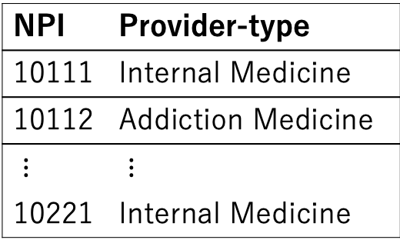
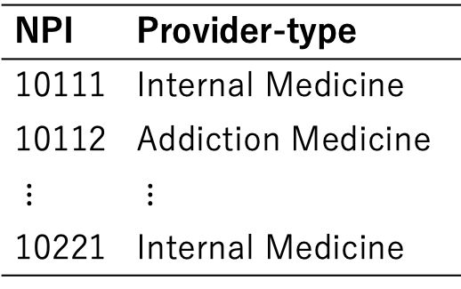
NPI | Provider-type
10111 | Internal Medicine
10112 | Addiction Medicine
$⋮$ | $⋮$
10221 | Internal Medicine
NPI | Provider-type
10111 | Internal Medicine
10112 | Addiction Medicine
$⋮$ | $⋮$
10221 | Internal Medicine
NPI | Provider-type
10111 | Internal Medicine
10112 | Addiction Medicine
$⋮$ | $⋮$
10221 | Internal Medicine

Slide 2






