Slide 1
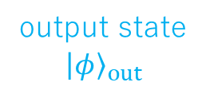
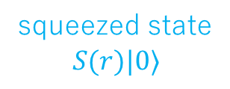
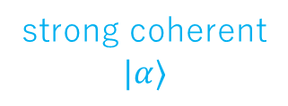
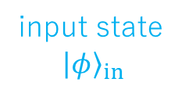


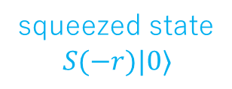
input state
$${\left|φ\right\rangle }_{in}$$
50:50
BS
$$|x⟩⟨x|=m_{x}$$
squeezed state
$$S(r)|0⟩$$
50:50
BS
$$|p⟩⟨p|=m_{p}$$
squeezed state
$$S(−r)|0⟩$$
output state
$${\left|φ\right\rangle }_{out}$$
99:1
BS
strong coherent
$$|α⟩$$
EOM
EOM
phase
modulation
amplitude
modulation

