Slide 1
Making Bullet-Hell Generation Safer with 3SAT and Hamilton Paths
3SAT
+
Starting a research project in an I Wanna-style engine built with Siv3D
Hamilton
Path
20-minute research introduction
01

Slide 2
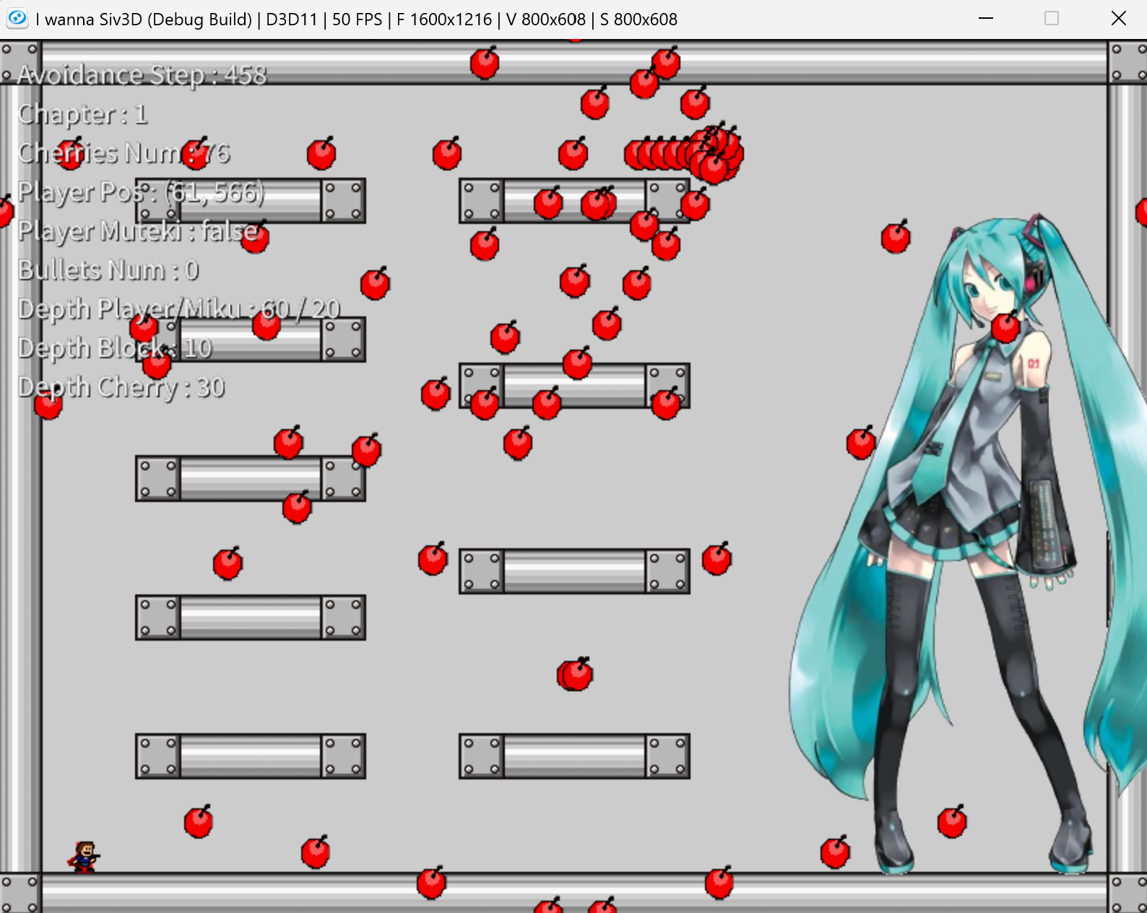
I build the kind of games I love to play
A short introduction to the perspective behind this project.
Ryota Izumi
I enjoy I Wanna fangames
My favorite stages are Avoidance-style bullet hells
I am developing an I Wanna engine with Siv3D
Design interest: patterns that feel musical, readable, and fair.
02

Slide 3
Avoidance turns survival into a performance
The player dodges a scripted barrage—often synchronized to music—until the sequence ends.
Typical rules
One hit usually means death
The player has a small, precise hitbox
Patterns evolve with the song
Learning through retries is expected
03

Slide 4
Siv3D provides a controllable testbed for I Wanna mechanics
The engine lets the same runtime support ordinary stages, Avoidance patterns, and research prototypes.
1
2
3
4
Core movement
I Wanna objects
Avoidance control
Research layer
Run, jump, double jump, collision
Blocks, cherries
Timed spawns, music cues, scripted motion
Generate, validate, and replay candidate patterns
04

Slide 5
A beautiful barrage can still create an impossible state
Music synchronization, spectacle, and difficulty interact—so manual or automatic generation may accidentally trap the player.
Musical timing
Visual impact
Guaranteed escape
Spawns and transitions must land on beats and phrases.
Dense motion and dramatic changes make the pattern memorable.
At least one survivable route must remain through the barrage.
Research goal: encode survivability constraints so generation becomes easier to design and safer to trust.
05

Slide 6
Constraint problems can act as generation scaffolds
Instead of placing every hazard directly, define choices and checks that preserve at least one valid route.
1
2
3
4
Describe
Encode
Solve
Build
Represent candidate routes or safe regions
Translate design rules into 3SAT or a graph
Find a satisfying assignment or Hamilton path
Convert the solution into timed stage elements
06

Slide 7
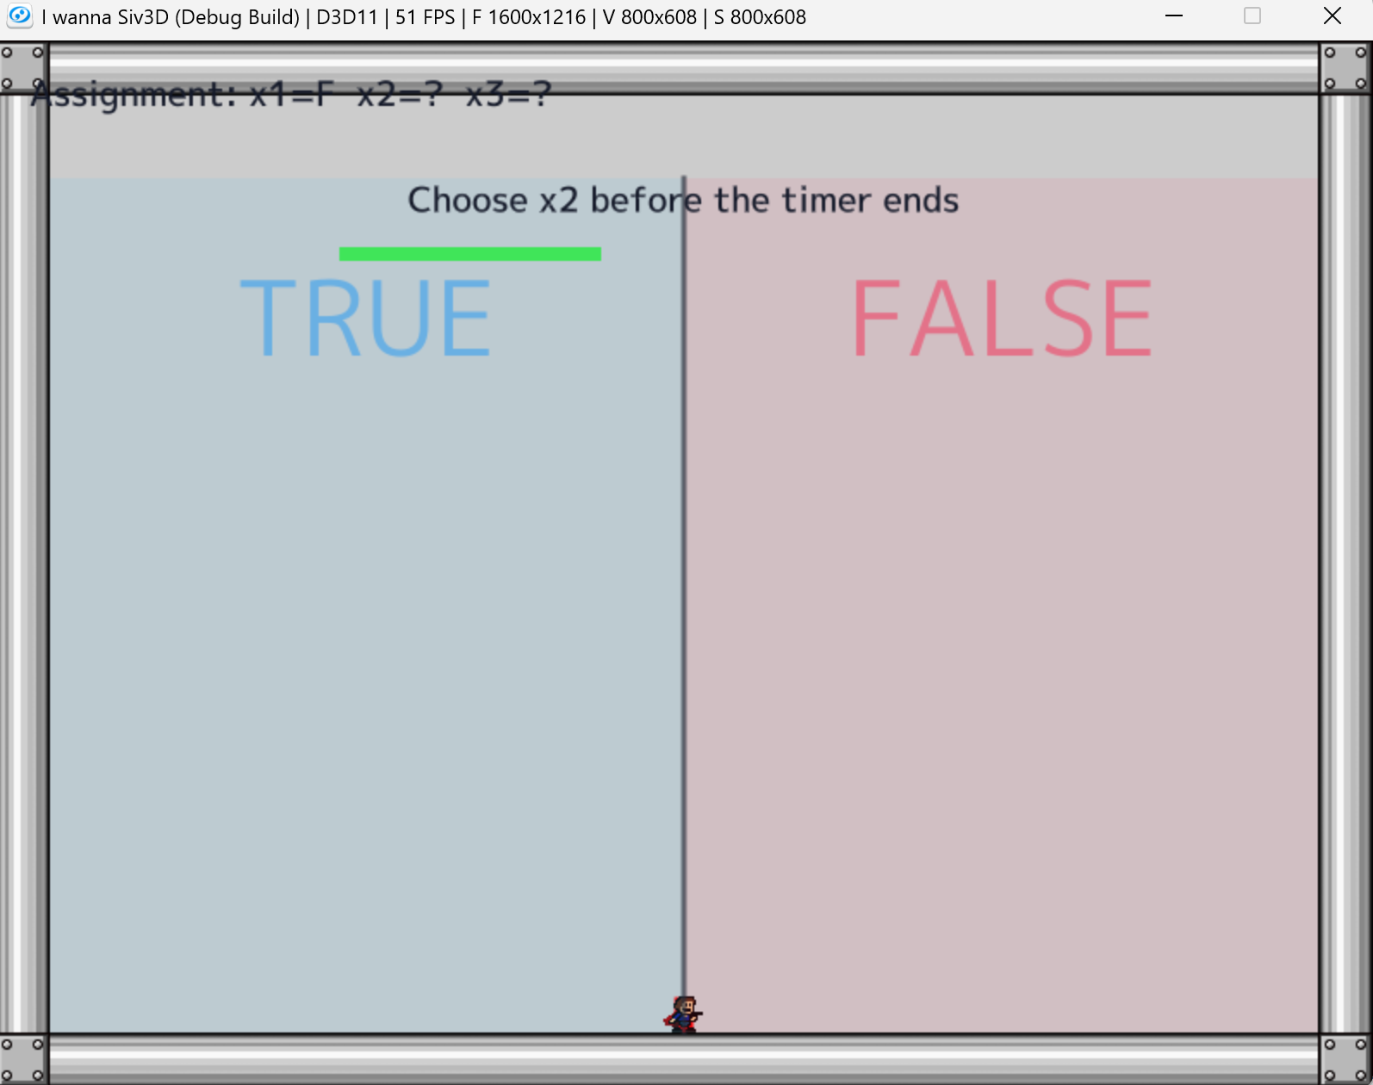
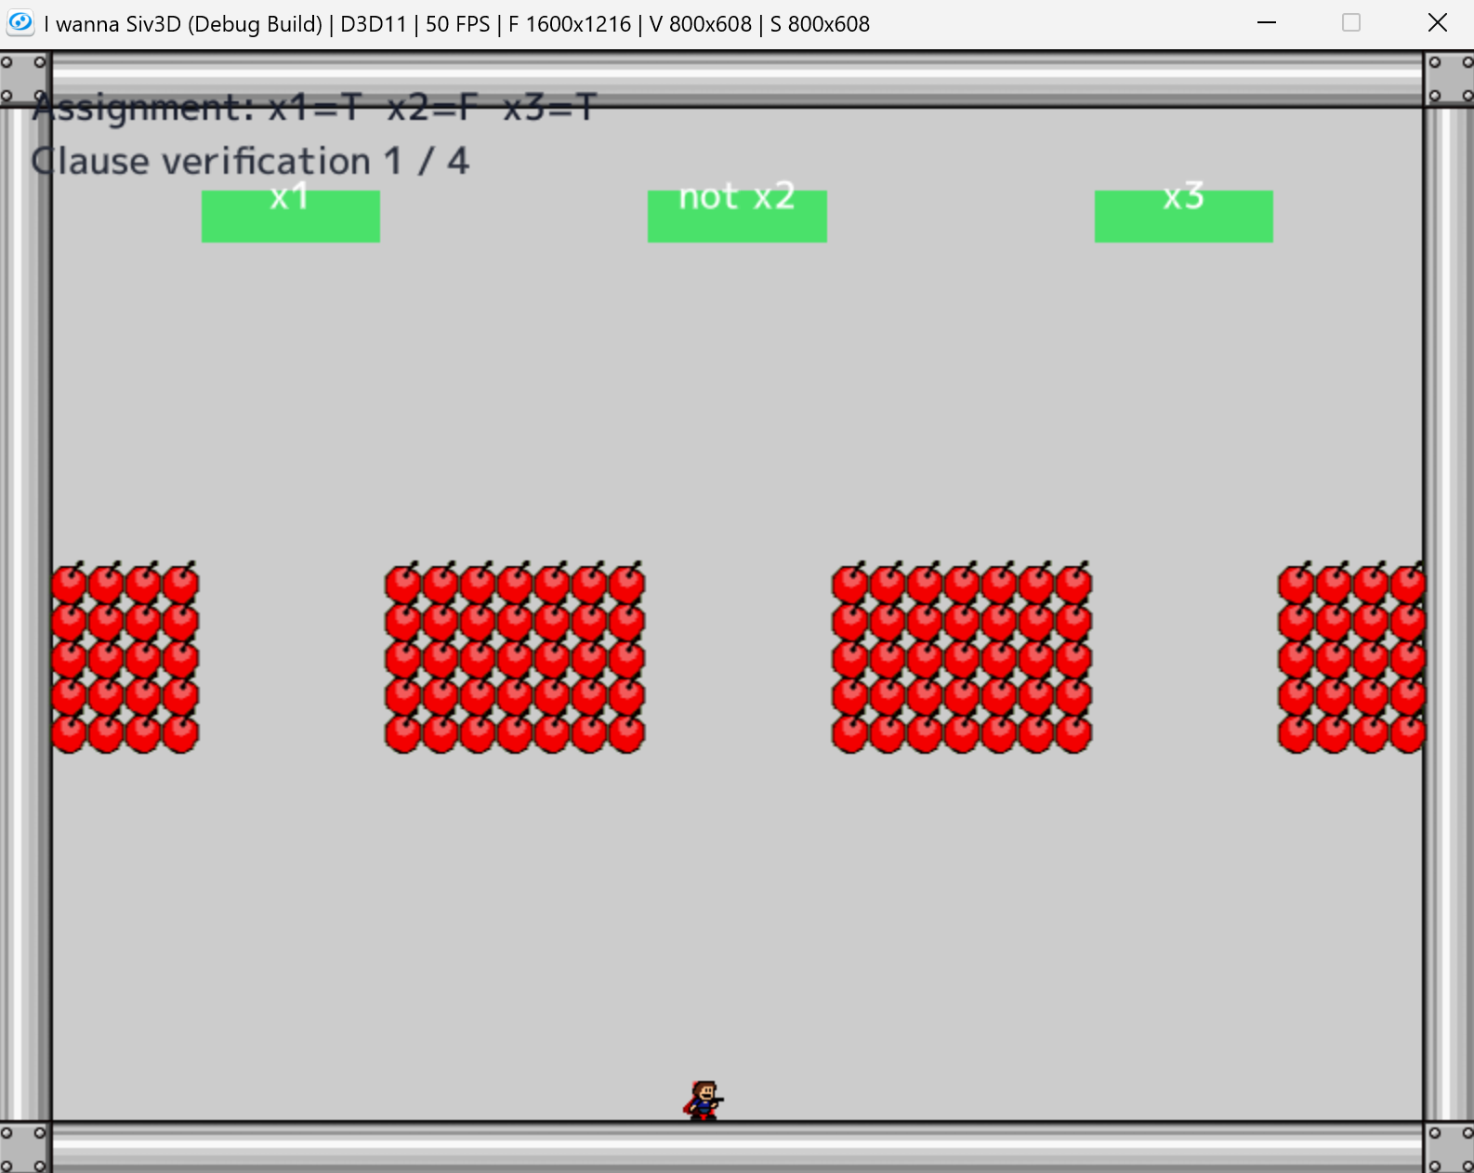
3SAT turns route choices into a playable logic test
The player commits to truth values, then each clause becomes a gate that must have one satisfied literal.
ASSIGN
VERIFY
Choose TRUE or FALSE before the timer ends.
A clause is passable when at least one literal is true.
07

Slide 8
The prototype preserves the meaning of a 3SAT formula
A satisfying assignment corresponds to a complete route through every clause check.
Formula
Game mechanic
Clearability condition
Variable
Forced TRUE / FALSE choice
One value is committed
Literal
Route-linked condition
Positive and negated values differ
Clause
Pass / fail barrage gate
At least one literal opens the route
Solution
Complete sequence of choices
Every clause can be survived
08

Slide 9
Live demo: the 3SAT stage in action
The prototype will be launched here to show assignment, clause checks, failure, and a successful clear.
Watch for
Timed truth assignment
LIVE DEMO / SCREENSHOT
Clause-by-clause feedback
Insert one full-frame gameplay image here
What happens on failure
How the stage communicates a valid route
09

Slide 10
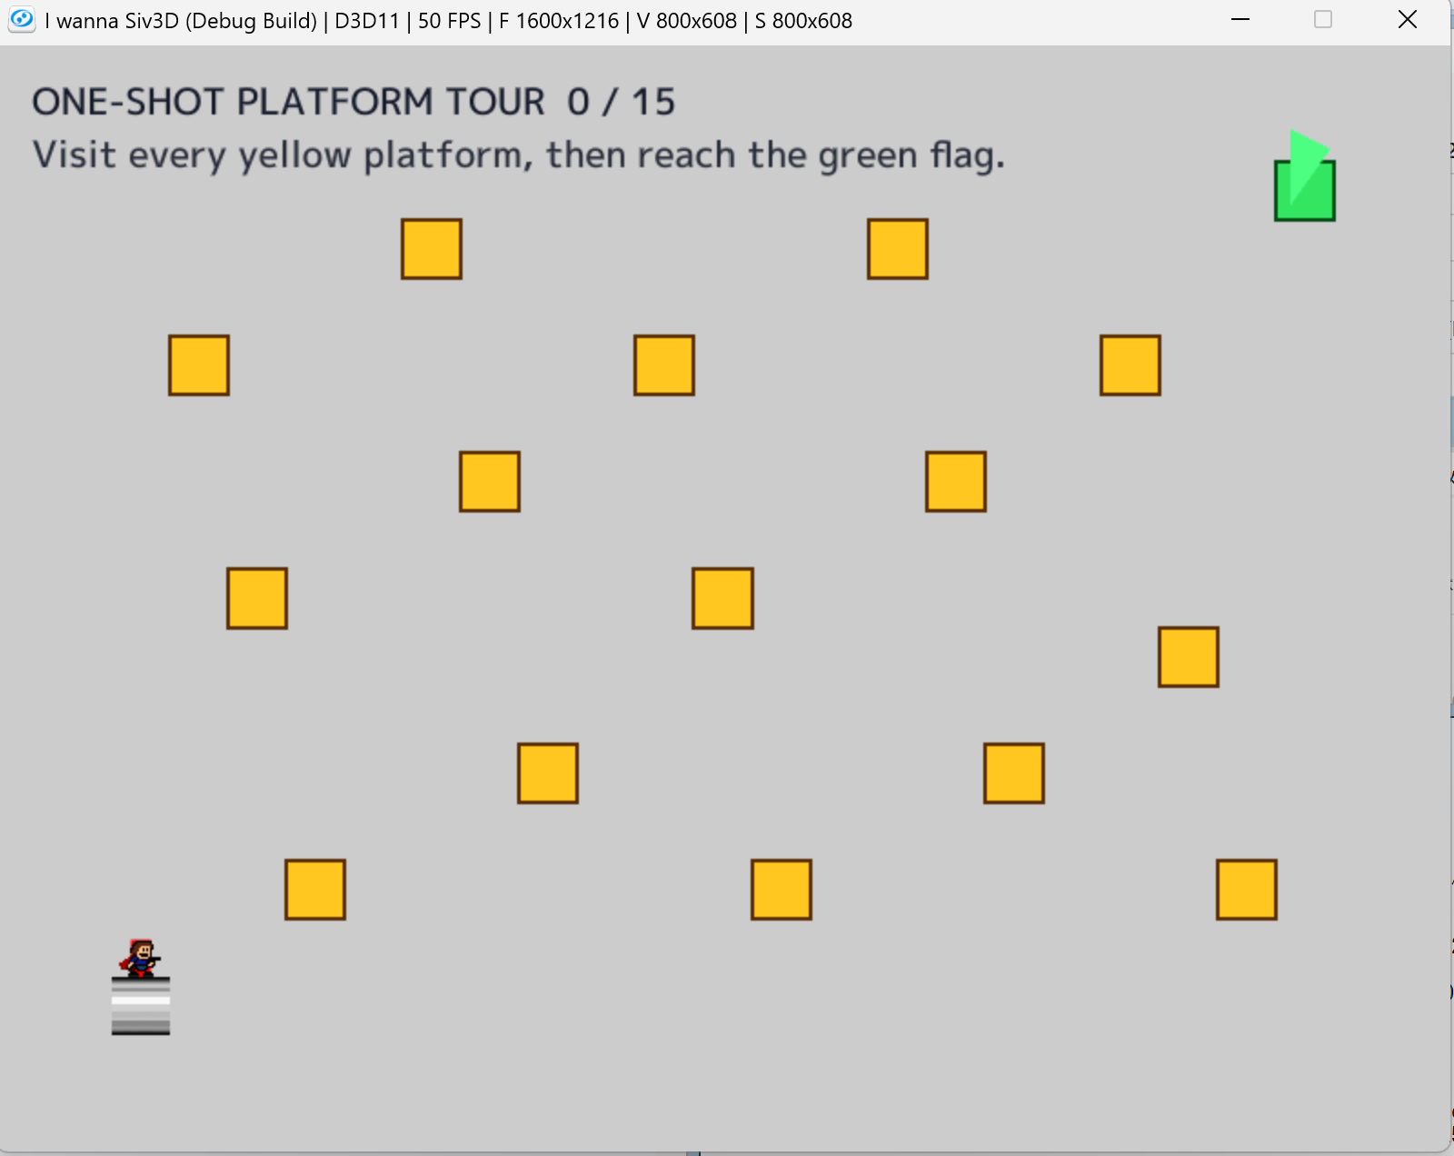
Hamilton Path creates one-shot route planning
Visit every platform exactly once, follow valid connections, then reach the goal.
Generation idea
Vertices become safe platforms
Edges define permitted transitions
Visited vertices cannot be reused
A Hamilton path supplies a complete survivable route
10

Slide 11
Next, move from prototypes to reliable pattern generation
The immediate work is to implement, evaluate, and improve the two approaches.
Implement
Improve
Evaluate
Build a playable Hamilton Path example inside an actual Avoidance or stage sequence.
Refine the 3SAT example: readability, pacing, difficulty, and integration with music.
Check both logical correctness and whether players experience the result as fair and fun.
Can formal constraints help us author expressive bullet hells without sacrificing a guaranteed route?
11

