Slide 1
MIKUMARI Clock Primary
MIKUMARI port numbers
0-16: Primary (TX)
2
0
15
1
16
*GN-2006-1
TDC 32-63 ch
TDC 0-31 ch
＊前のバージョンにあったMIKUMARIの状態を記録するTDCは廃止
SFP2
SFP1
*GN-2006-4
16
Not in use
Data link
NIM
IN
NIM
OUT
These power supply connectors are connected.
Recommend to put a cover on unused side for your safety.
LED1: PLL locked
LED2: 0
LED3: Heartbeat frame state
LED4: DAQ is running
NIM IN1: Scaler reset
NIM IN2: Trigger (veto) in
NIM OUT1: Heartbeat signal
NIM OUT2: TCP connection
DIP1: SiTCP IP setting
DIP2: Not in Use
DIP3: Not in Use
DIP4: Not in Use

Slide 2
MIKUMARI Clock Hub
MIKUMARI port numbers
0-15: Primary (TX)
16: Secondary (RX)
2
0
15
1
16
*GN-2006-1
TDC 32-63 ch
TDC 0-31 ch
＊前のバージョンにあったMIKUMARIの状態を記録するTDCは廃止
SFP2
SFP1
*GN-2006-4
16
Not in use
Data link
NIM
IN
NIM
OUT
These power supply connectors are connected.
Recommend to put a cover on unused side for your safety.
LED1: PLL locked
LED2: MIKUMARI (16) link up
LED3: Ready for DAQ
LED4: DAQ is running
NIM IN1: TDC 64 ch
NIM IN2: Trigger (veto) in
NIM OUT1: Heartbeat signal or Trigger out (from LACCP)
NIM OUT2: TCP connection
DIP1: SiTCP IP setting
DIP2: Trigger out
DIP3: Not in Use
DIP4: Not in Use

Slide 3
AMANEQ StrLrTdc
MIKUMARI port numbers
0: Secondary (RX)
TDC 96-127 ch
TDC 64-95 ch
0
*GN-2006-1
TDC 32-63 ch
TDC 0-31 ch
SFP2
SFP1
*GN-2006-4
0
Not in use
Data link
NIM
IN
NIM
OUT
These power supply connectors are connected.
Recommend to put a cover on unused side for your safety.
LED1: PLL locked
LED2: MIKUMARI (0) link up
LED3: Ready for DAQ
LED4: DAQ is running
NIM IN1: TDC 128 ch
NIM IN2: Trigger in
NIM OUT1: Heartbeat signal or Trigger out (from LACCP)
NIM OUT2: TCP connection
DIP1: SiTCP IP setting
DIP2: Trigger out
DIP3: Stand alone mode
DIP4: Not in Use

Slide 4
今回の運用
MikuClockPrim, MikuClockHub
ParingをOFF。Trailing dataが返ってくる。
AMANEQ StrLrTdc, CIRASAME StrTdc
ParingをON。TOTが入ったleading dataだけ返ってくる。

Slide 5
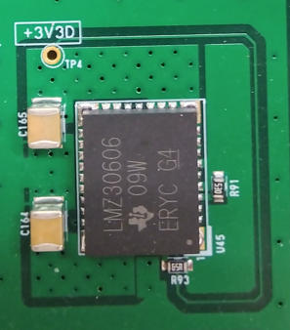
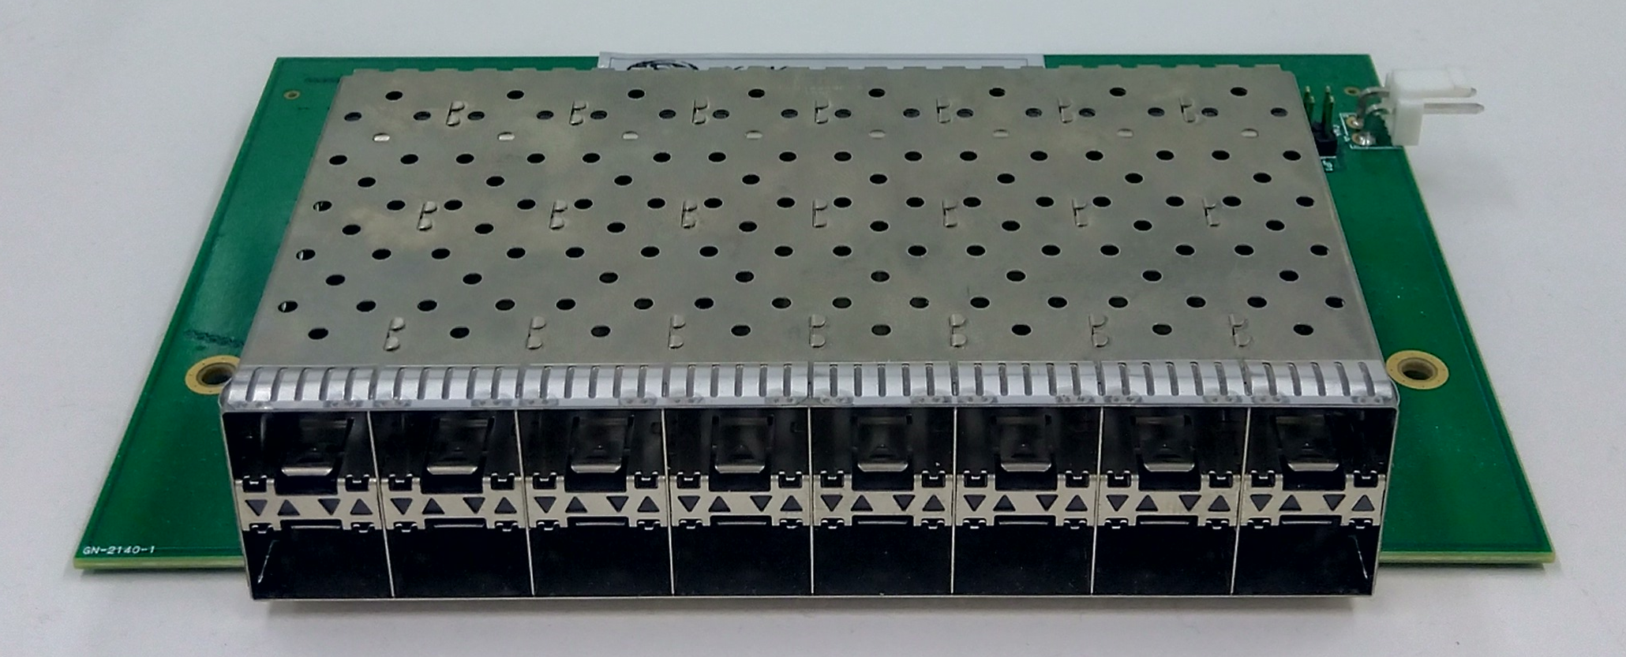
2
0
15
1

