Slide 1
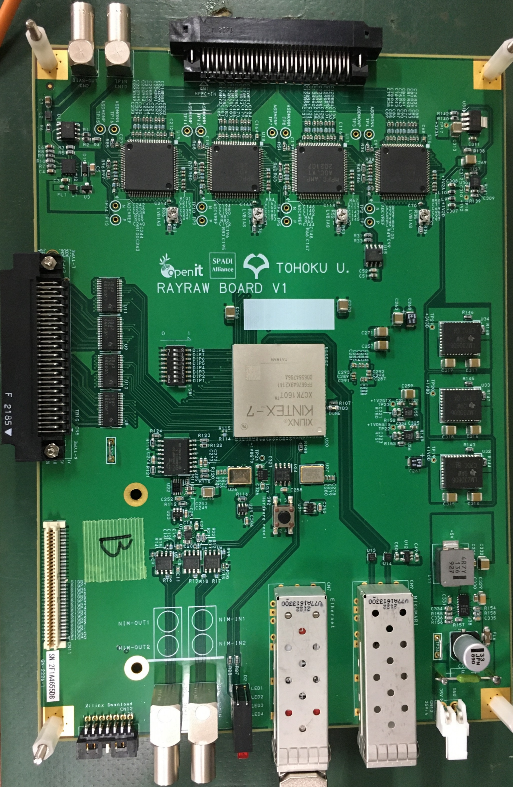
SiPM input
APD bias
YAENAMI ASICs
Comparator
outputs
FPGA
(XC7K-160T-2FFG676)
SFP
(Data link)
SFP
(MIKUMARI)
Power
(DC 20-35V)

Slide 2
MPPC input
Coaxial
Coaxial
RAYRAW module
Test input
YAENAMI4
(8ch)
YAENAMI3
(8ch)
YAENAMI2
(8ch)
YAENAMI1
(8ch)
40V-70V
MAX
19232
Comparator
output
32
32
ADC
(waveform data)
FPGA
8
DIP Switch
32
Comparator
output
GTX
2
2
Logic
translate
Jitter
cleaner
Logic
translate
Power
supply
Coaxial
Coaxial
SFP1
SFP2
Coaxial
Coaxial
DC +20-35V
NIM IO

