Slide 1
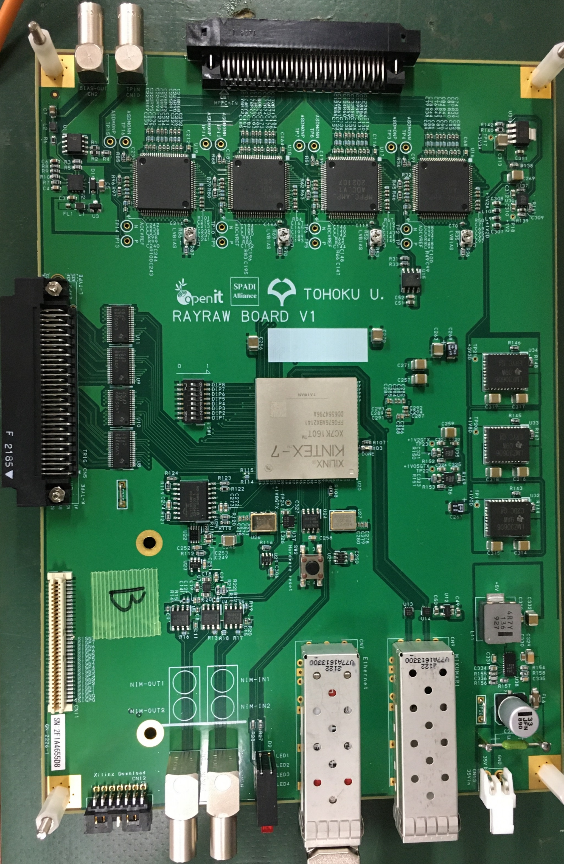
Bias out
Test in
SiPM input
APD bias
YAENAMI ASICs
Comparator
outputs
FPGA
(XC7K-160T-2FFG676)
SFP
(Data link)
SFP
(MIKUMARI)
Power
(DC 20-35V)

