Slide 1

POE2 FLIP ASSISTANT
One decision. Five tabs. Still uncertain.
Evidence-backed decisions for Path of Exile 2’s player-driven economy.
David Ryšánek· AI Makerspace AIEC1 Demo Day
poe2.coach
Notes:
35 seconds. Hello, my name is David. I play Path of Exile 2. In this game the economy is made by players, and prices move every day. When I have currency, I must decide: flip, farm, craft, or hold. To answer that, I open five tabs. In my own workflow that often takes one or two minutes. And I am still not sure. So I built PoE2 Flip Assistant. It gives me evidence I can look at, and then I decide.

Slide 2
THE USER PROBLEM
The information is fragmented
WHO THIS IS FOR
Path of Exile 2 players who want to understand the economy and make better decisions—from learning crafting basics to choosing what to flip, farm or craft.
Market prices
Live listings
Price history
Crafting mechanics
Community knowledge
Aggregated, not per trade
Asking, not selling
Separate tool again
Patch-sensitive
Scattered, unverified
Flip, farm, craft, or hold?
One decision · often 1–2 minutes of tab-switching · still uncertain
NEW TO POE2 CRAFTING
ECONOMY-FOCUSED PLAYER
EXPERIENCED PLAYER
Needs mechanics, costs and crafting steps explained clearly.
Wants to compare current opportunities without switching between multiple tools.
Wants faster verification, current evidence and transparent assumptions.
Notes:
55 seconds. Here is the problem. The information a player needs is not in one place. Market prices are in one service. Listings are somewhere else. Price history is a third place. Crafting mechanics change with patches, so old guides get wrong. And a lot of real knowledge only lives in community posts. A new player does not know where to look. An experienced player knows where to look, but loses time verifying across tools. Both end at the same place: one decision, made from pieces, and not much confidence in it.

Slide 3
THE PRODUCT
One workflow, four pillars
Ranked opportunities, modeled craft economics and sourced explanations — in one workflow.
Observe
Compare
Ask
Verify
Decide
Market
Farming
Crafting
Coach
Conversion, observations and Top Flip heuristics with price history
FarmAdvisor ranks basket momentum and liquidity
Curated recipes with modeled EV, hit rates and steps
Read-only agent answering with tools, citations and disclaimer
An economic decision cockpit for Path of Exile 2 players.
Market data finds the opportunity, deterministic models evaluate it, the Coach explains the evidence, and the player decides. The app never trades, clicks in game, or controls gameplay.
Notes:
50 seconds. The product follows one workflow. Observe the market. Compare the options. Ask the Coach. Verify the evidence. Then decide. Four parts do the work. Market gives conversion and current observations. Farming ranks what is hot right now. Crafting gives curated recipes with a modeled expected value. And the Coach answers questions with sources attached. One important point: this is decision support. The app does not trade, it does not click in the game, and it does not whisper sellers. The player always executes.

Slide 4
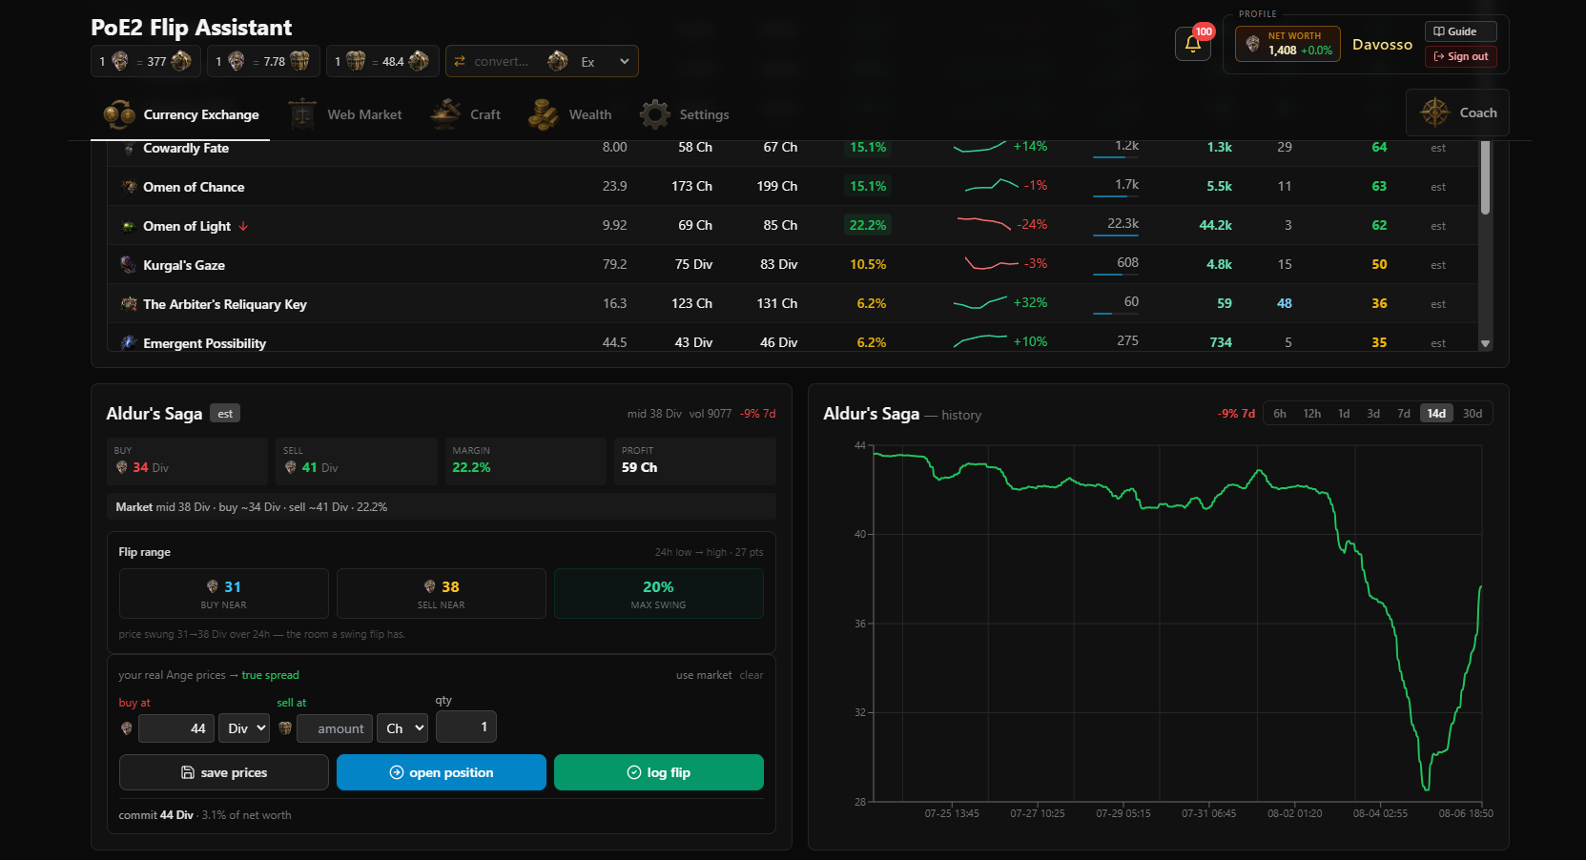
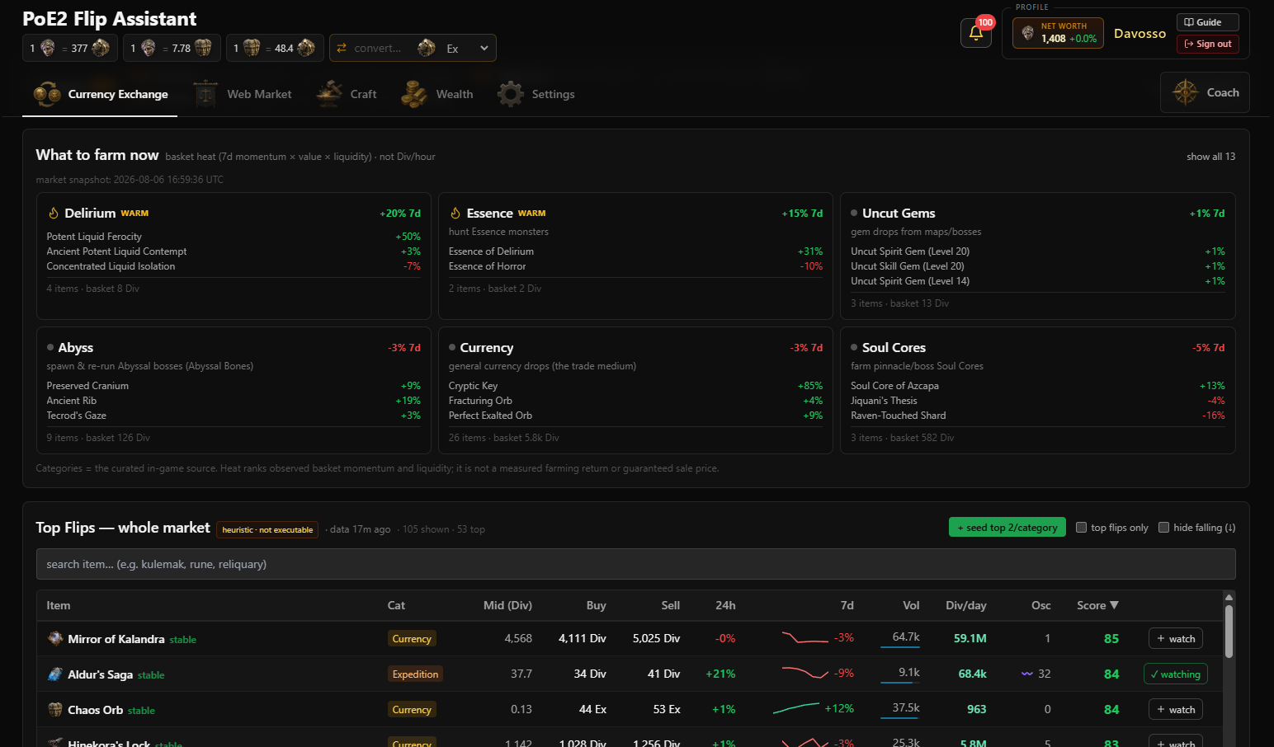
LIVE DEMO
Market and farming in the live product
SCREEN RECORDING STARTS HERE
“I have 20 Divine Orbs. What is the best evidence-backed use of my currency right now?”
01Market finds a candidate
02FarmAdvisor offers an alternative
Currency Exchange and Top Flip
What to farm now, by heat and liquidity
Steps 1 and 2 of 4 — each screen is shown full-size in the live demo.
Notes:
This slide opens the live demo, about 3 minutes across both demo slides. Start with the scenario on the slide: I have twenty Divine Orbs, what is the best evidence-backed use of my currency right now? Everything I show now answers that one question. Step one, Currency Exchange. I pick an item, I see buy near, sell near, the margin, and the price history for two weeks. Note the label: this is a heuristic, not an offer I can execute. Step two, FarmAdvisor. It shows which categories are hot now, by momentum and liquidity. It is market heat, not Divine per hour.

Slide 5
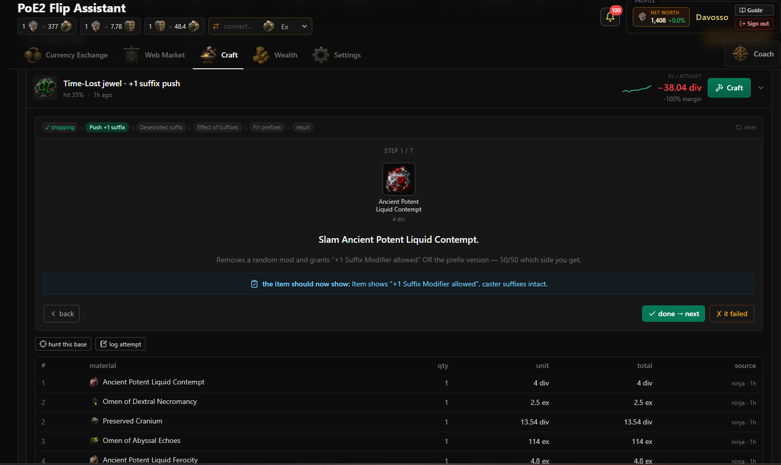
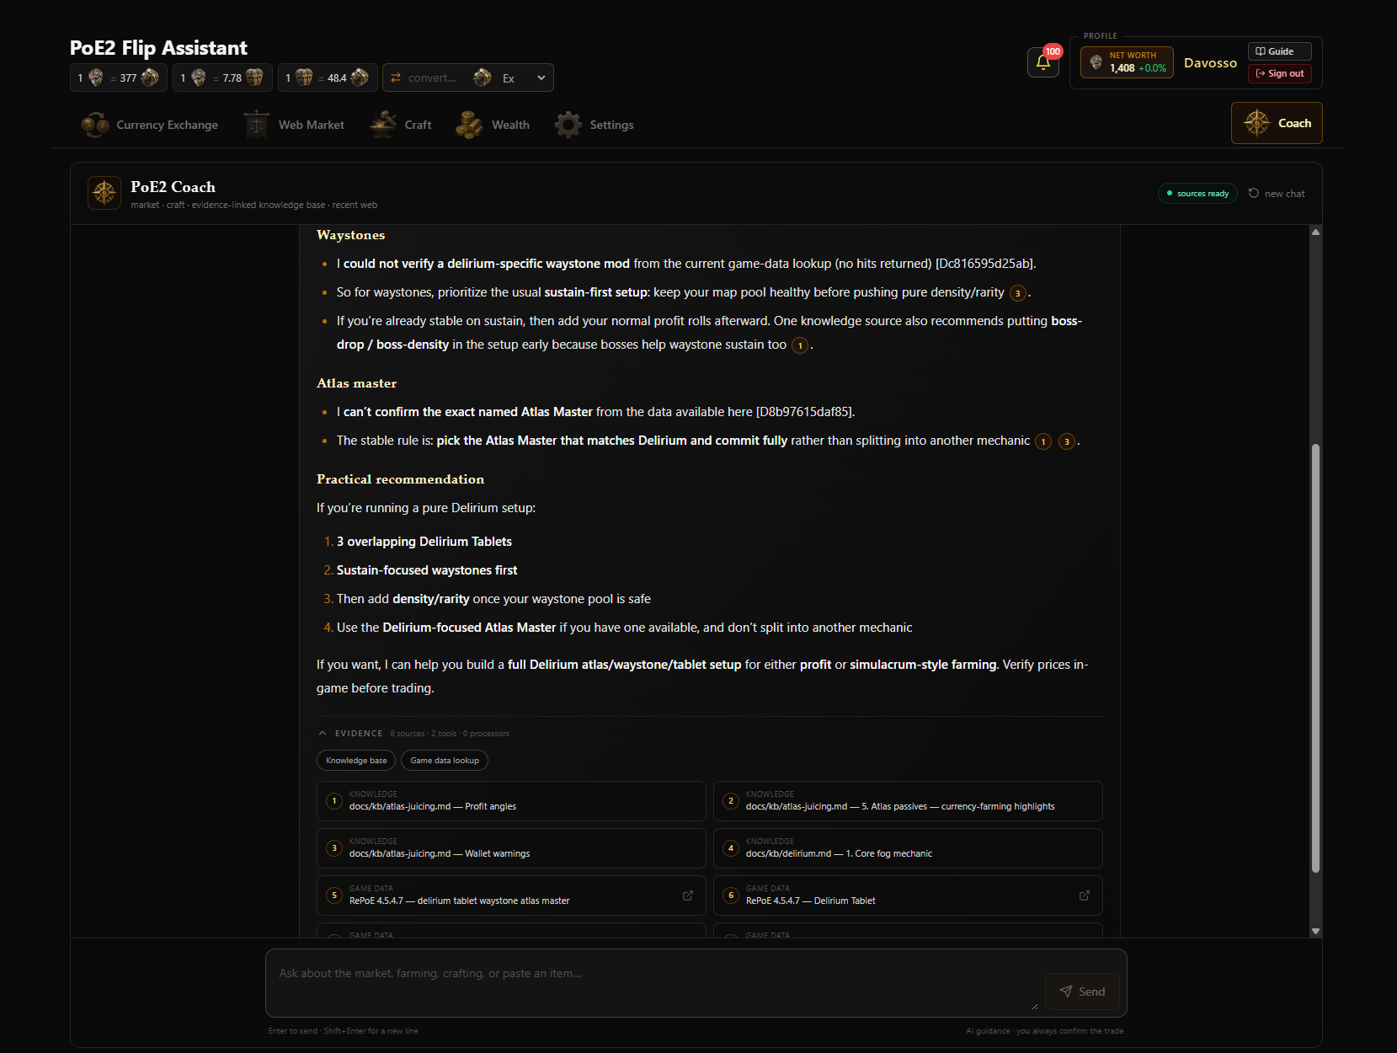
LIVE DEMO
Craft economics and the Coach
TOOLS, SOURCES, AND LIMITATIONS SHOWN
Same 20 Divine Orbs — the third option, and the explanation behind all three.
03Crafting shows cost, EV and risk
04Coach explains the differences
Curated recipe with modeled EV per attempt
Answer with tools, source cards and disclaimer
Steps 3 and 4 of 4 — each screen is shown full-size in the live demo.
Notes:
Part two of the live demo, same twenty Divine Orbs. Step three, a curated craft. Seven steps, materials with costs, a hit rate, and a modeled expected value per attempt — here it is negative, so the honest answer is do not craft this. Step four, the Coach. I ask a question, it uses market, knowledge and game-data tools, and cited claims link back to visible source cards, and the response shows which tools were used. At the end it always tells me to verify prices in game. So the flip, the farm and the craft are now on the same table, with the evidence next to them. Then return to the deck.

Slide 6
HOW IT WORKS
From question to inspectable answer
›
›
›
Player
Next.js application
Market/Craft services and LangGraph Coach
Evidence-linked response
Asks with currency in hand
Authenticated, HTTPS, scoped threads
guard → agent ↔ tools · OpenAI model
Source cards, freshness, human verification
‹
back to the player, who verifies and decides
↑
feeds the services and the Coach on every request
GROUNDING LAYER
Market history · curated knowledge · versioned RePoE · external observations
Guardrails, rate limiting and citation validation run before the answer reaches the player.
Notes:
60 seconds. Quickly, how it works. The player uses an authenticated Next.js app over HTTPS. Behind it are the market and craft services, and a FastAPI Coach built as a LangGraph workflow: a guard first, then the agent, and the agent calls tools. Reasoning uses an OpenAI model. Under all of that sits the grounding layer, and it feeds the services and the Coach on every request: market history in SQLite, a curated knowledge base stamped with the patch, a versioned RePoE game-data snapshot for deterministic lookups, and external observations. And the last stage is the part I care about most. Every answer comes back with evidence cards, freshness, and a disclaimer to verify in game. The value is not the stack. The value is that the player can inspect where the answer came from.

Slide 7
EVALUATION EVIDENCE
Three frozen evaluation sets
Standalone certification prototype — small frozen datasets
Retrieval
18 cases
Agent behaviour
8 cases
Guardrails
19 cases
94.44%
100%
0% › 100%
hit@4 — same for dense and hybrid
exact tool selection, 8 of 8 cases
attacks blocked, before vs after guardrails
0.7176 › 0.7222
100%
MRR, dense vs hybrid — better ranking, no extra coverage, slightly higher latency
disclaimer compliance, 8 of 8 cases
100%
benign requests still allowed
7 of 7
grounded citations where citations were required
Citation compliance means the cited source ID was valid — not that every statement is true. These results do not evaluate the integrated production deployment.
Notes:
75 seconds. Now the evidence. I ran three evaluation groups on the standalone certification prototype. Retrieval: eighteen cases. Dense and hybrid both hit at four, ninety-four point four percent. Hybrid ranked a little better, MRR zero point seven-two instead of zero point seven-two before rounding, but it did not find more documents, and it was a little slower. So I kept it honest and did not call hybrid a win. Agent behaviour: eight cases. Exact tool selection, one hundred percent across eight cases. Disclaimer compliance, one hundred percent across eight cases. Grounded citations where they were required, seven of seven. Guardrails: nineteen cases. Before guardrails, attacks got through every time. After, all of them were blocked, and benign questions still passed. Two limits, and I want to be clear. These sets are small and curated. And citation compliance means the source ID was valid — it does not prove every sentence is true. These numbers also do not measure the production app.

Slide 8
SAFETY AND HONEST BOUNDARIES
What it does, what it does not
WHAT THE PRODUCT DOES
WHAT IT DOES NOT DO
Decision support
No automation, trading or gameplay control
Observed market data
No guaranteed execution or sale price
Modeled expected value
No guaranteed profit or Divine per hour
Evidence-linked answers
No guarantee that a cited claim is true
Deterministic game-data lookups
Not yet a complete crafting planner
The human verifies prices and executes every action.
Notes:
60 seconds. I want to be direct about the boundaries, because in a game economy it is easy to promise too much. What the product does: it supports a decision, it shows observed data, it models expected value, and it links answers to sources. What it does not do: it does not automate anything, it does not guarantee that a listing becomes a sale, it does not promise profit, and citations do not make an answer true. The deterministic game-data layer is also not a full crafting planner yet. The player verifies the price and the player performs the action. Every time.

Slide 9
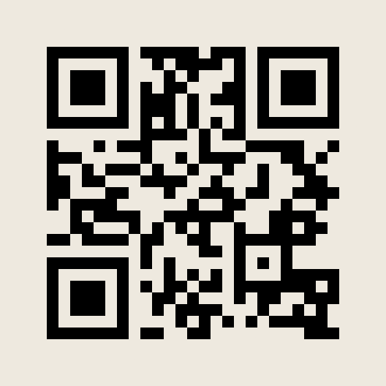

WHAT COMES NEXT
Turn fragmented game knowledge into a decision you can inspect
CURRENT
NEXT
Integrated product on trusted HTTPS
Deterministic craft planner
Deterministic game-data inspection
Production-specific eval suite
Evidence-backed Coach
More item-level crafting cases
User feedback and iteration
Patch-aware data maintenance
Certification & evaluation artifact
Live product
github.com/RysanekDavid/poe2-flip-coach-certification
poe2.coach
poe2.coach
Notes:
45 seconds. Where it stands today: the product is integrated and live on HTTPS at poe2.coach, with deterministic game-data inspection and an evidence-backed Coach. Next, five things. A deterministic craft planner. An eval suite for the production app, not only the prototype. More item-level crafting cases. Feedback from real players, and iteration on it. And keeping the data patch-aware, because Path of Exile 2 keeps changing. The goal is simple: turn fragmented game knowledge into a decision you can inspect. The product is on the left QR code, the certification and evaluation artifact on the right. Thank you.

