Slide 1
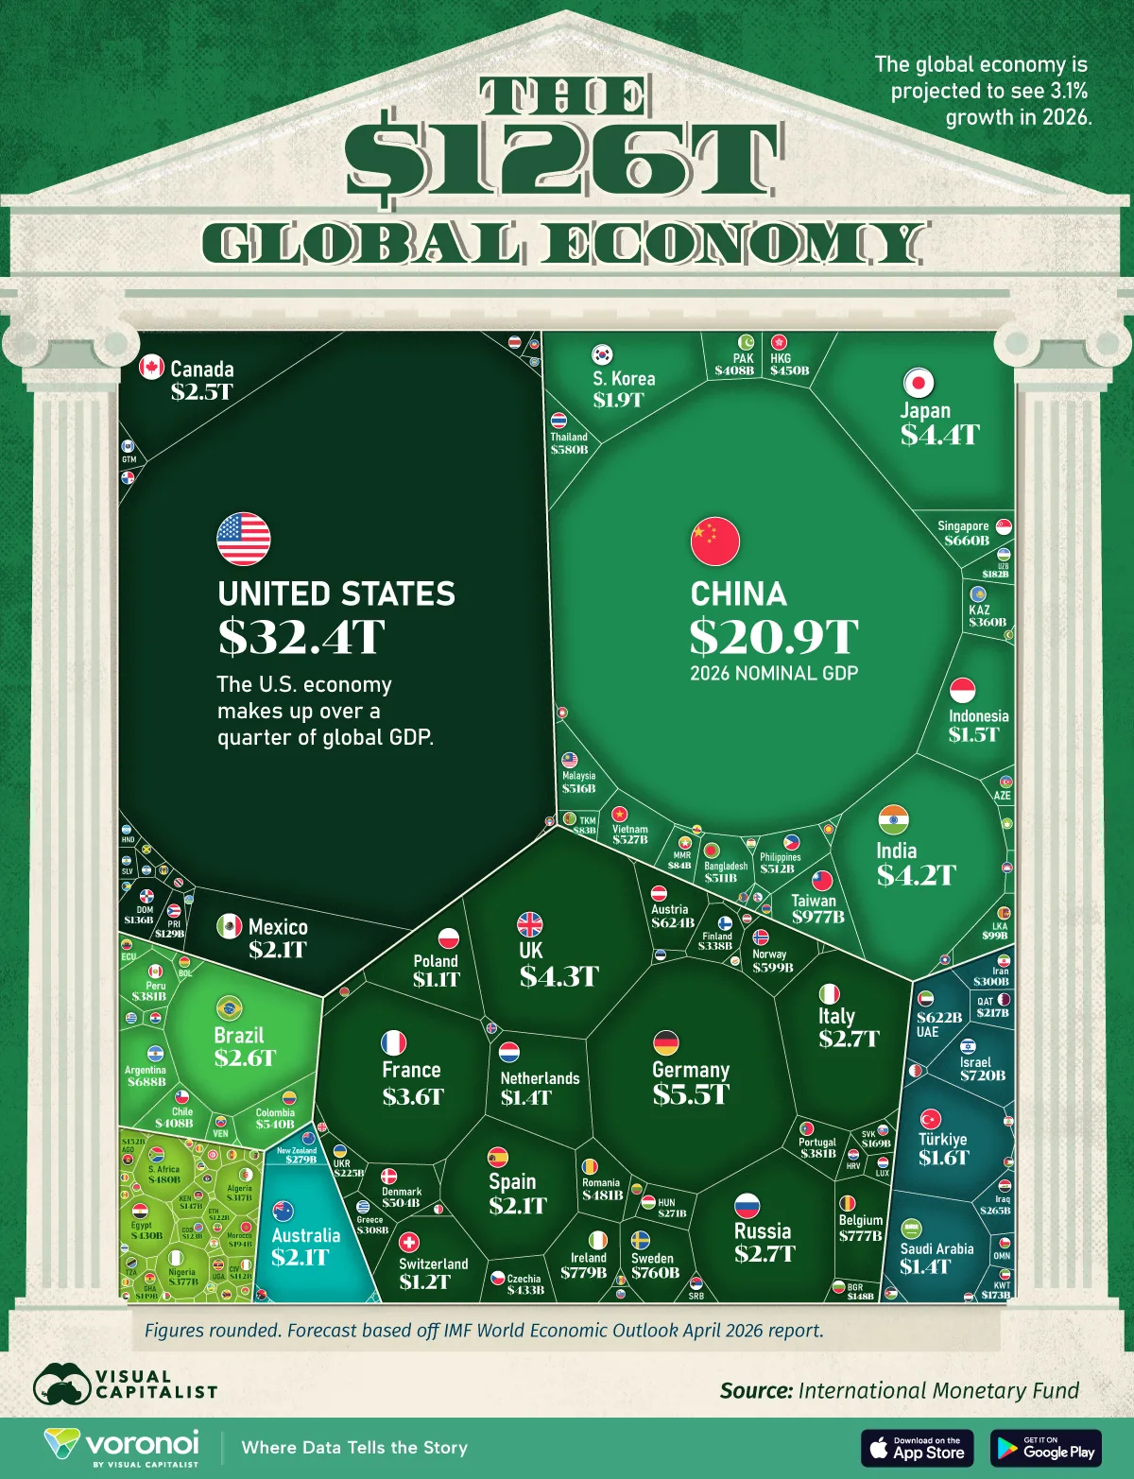
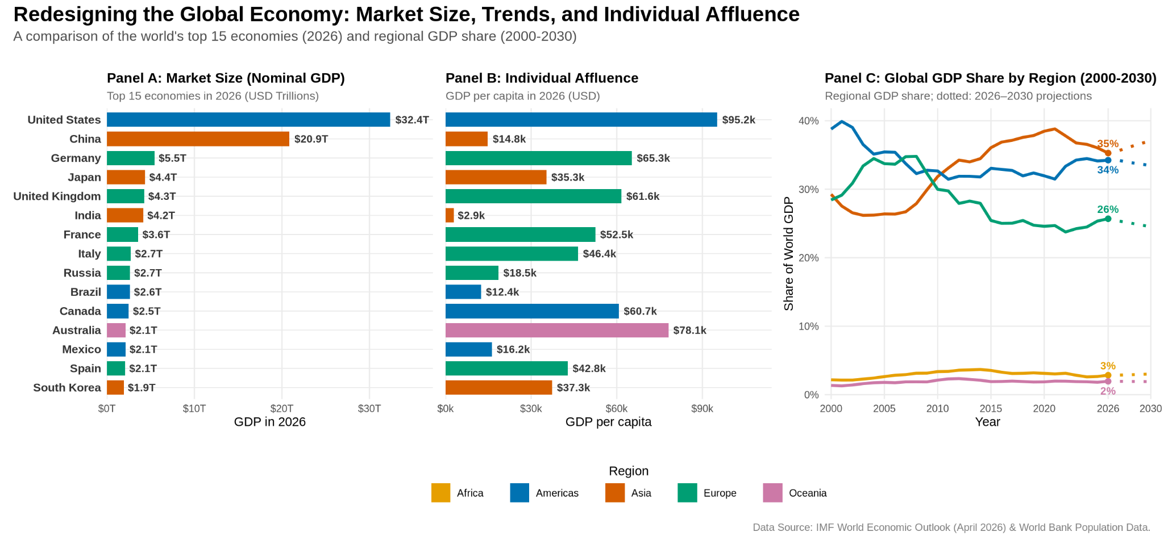


The $126 Trillion Global Economy — Beyond a Snapshot
VISUALISING THE GLOBAL ECONOMY
Team Lavender
Ang Jing Yi Clairer · Ryson Toh · Kenny Leck
Lim Fang Jun · Foo Guo Wei
The Original
Introduction
Our Redesign
In 2026 the world economy is projected at about $126 trillion, but output is highly concentrated and its centre of gravity is moving. Knowing where economic weight sits, how it is shifting between regions, and which economies have higher output per person informs trade, investment, and policy decisions (patterns a single-year treemap cannot show).
Panel A ranks the 15 largest economies by nominal GDP, allowing more precise comparisons than the areas in the original treemap.
Panel B retains the same country order, enabling market size and GDP per capita to be compared row by row.
Panel C tracks each region’s share of world GDP from 2000 to 2030, with dotted lines representing projections after 2026. This reveals long-term regional shifts that a single-year snapshot cannot show.
Key insight: A large economy does not necessarily have high output per person. Asia’s share of world GDP rises from approximately 29% in 2000 to 35% in 2026, while Europe’s and America’s share declines, indicating a shift in global economic weight towards Asia.
Design Brief
Audience: Economic and trade-policy analysts prioritising global markets and partnerships.
Task: Rank and compare the absolute market size of economies in 2026, and reveal the shift of economic weight toward Asia since 2000.
Revisions: Side-by-side ranked bars for GDP and GDP per capita; a line chart of regional share over time; a colour-blind-safe one-hue-per-region palette; standardised units (USD trillions).
Our Redesign
Data
IMF WEO (Apr 2026) — nominal GDP (NGDPD) · World Bank — population (SP.POP.TOTL). Cleaned in Quarto/R: dropped aggregate rows, standardised ISO-3 codes & regions, converted to USD trillions, merged population. 190 economies; 2026 total $125.7T.
Critique
Strengths
Visually striking — draws attention to a large dataset
Regional colours — show continental groupings
Clear Emphasis — largest economies stand out clearly
References
Weaknesses (→ what we fixed)
Areas hard to compare precisely → ranked bars
Small economies unlabelled → top 15 + labels
Mixed billions and trillions → standardised units
One-year snapshot hides trends → time series
GDP size ≠ prosperity → GDP per capita
IMF WEO (Apr 2026); World Bank WDI; Visual Capitalist (2026); Okabe & Ito (2008).

