Slide 1
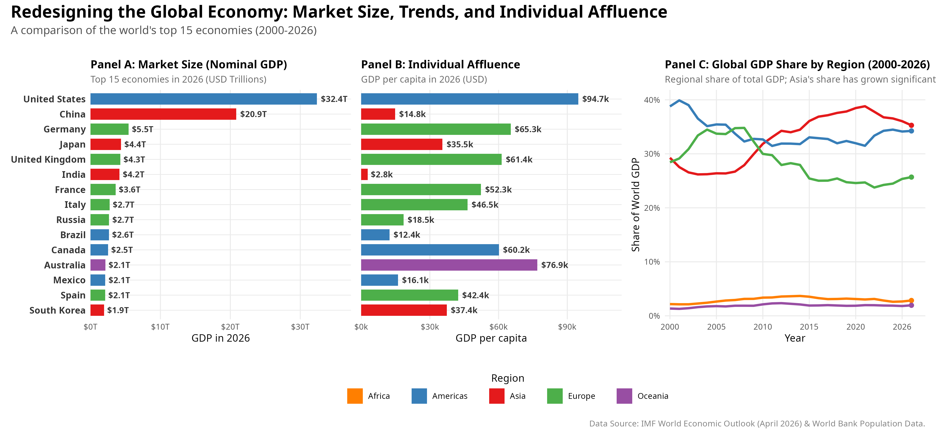
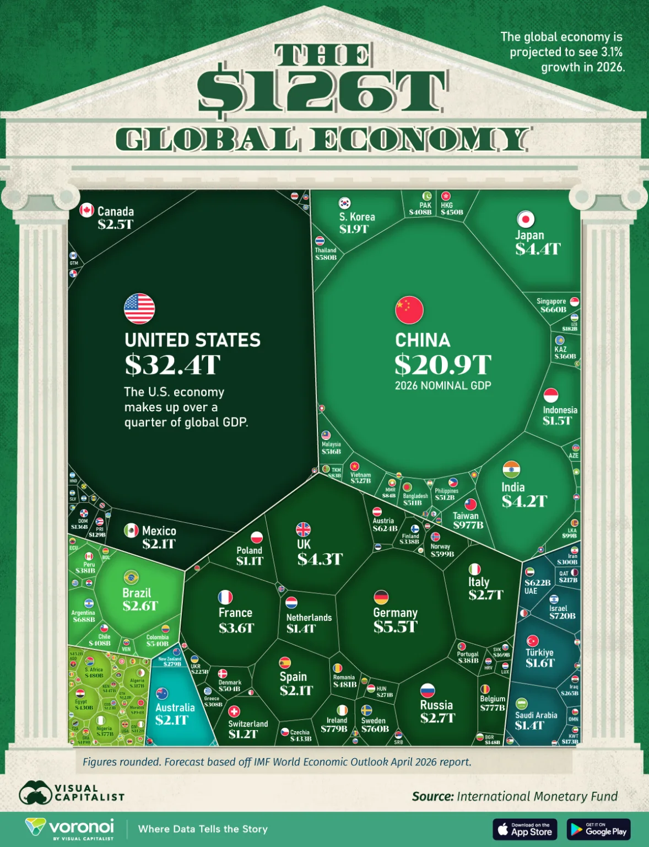
THE ORIGINAL
OUR REDESIGN
DESIGN BRIEF
This visualization displays the GDP for 195 countries and economies, as 2026 projections from the IMF’s April 2026 World Economic Outlook. It uses a voronoi treemap to display the country and its share of the $126T global total
This redesign is intended for economic and trade-policy analysts prioritizing global markets
and trade partnerships.
The goal is to clearly rank and compare the total absolute market size of individual economies for the year 2026.
In addition, it also aims to show that the economic weight is shifting towards Asia since 2000.
Revisions:
Side by side horizontal bar chart comparison for nominal GDP and individual affluence
Line chart to show the GDP share by region trend
Distinct colour palette for each region
Standardized units in USD trillions
WHAT CHANGED
INSIGHTS
DATA
A higher nominal GDP does not automatically correlate to a higher GDP per capita
Asia gaining economic weight from 2007 onwards
IMF WEO Apr 2026 (NGDPD): Nominal GDP
World Bank WDI (SP.POP.TOTL): Population
Source: Visual Capitalist (2026),
Ranked bars replace areas
One consistent unit (USD trillions) across the whole chart
Colour-blind-safe palette: one distinct hue per region
GDP per capita separates market size from prosperity
Showing of “Asia shift”story by adding GDP Share by Region panel
Strengths
High visual salience, draws readers in
Region colour shows macro clusters
REFERENCES
Visual Capitalist (2026). The $126T Global Economy in One Chart. Available at: https://www.visualcapitalist.com/the-126t-global-economy-in-one-chart/
Weakness
Area is hard to compare precisely
Units mix billions and trillions
Region colours repeat / look alike
No ranking, per-capita, or trend
One year's data cannot prove Asia's shifting economic weight
CSC3107
Team Lavender

