Slide 1
Professional Studies 1
Student Name Blake Peck
DUE DATE: 9/3/2021

Slide 2
Introduction
Introduction:
This assessment will cover the process of planning actions that could further your career goals and then undertaking actions that move you forward on a career pathway.
The assessment will include:
Nominating career goal.
Listing and undertaking short-term actions
Planning long term actions
Collect feedback on the actions you plan and undertake
Evaluate your processes and actions
The assessment instructions:
All sections marked in green must be edited/filled out by you.
Screen cap images are requested for some information. This is to ensure information is not lost due to internet hyperlinks becoming broken. Please ensure you screen capture information clearly so it can be read and assessed.

Slide 3














Introduction
Introduction:
This assessment will cover the process of planning actions that could further your career goals and then undertaking actions that move you forward on a career pathway.
Conclusion – 33
Self Evaluation – 4 - 7
Occupations – 16 - 17
Networks 2 – 24 -25
Soft skills – 8 - 11
Tech skills – 18 - 19
Information – 26 - 28
Financials – 29 - 30
Hero reference – 12 - 13
Studios – 20 - 21
Cool tools – 14 - 15
Networks 1 – 22 - 23
Job Adverts – 31 - 32

Slide 4
Self Evaluation|Self Introduction
What are your goals? What are the right goals for you? What do you need to do to achieve your goals?
The questions below are designed to give you an overview of yourself to help plan where you should focus your time and energy. This will give you better insight to choose goals and plan how to achieve them.
Take some time to answer these questions (and consider others like them).
 | Self Introduction
Why are you studying at AIE? | I’m studying at AIE to learn about programming and get a job after the course get a job in a game company.
What hobbies do you have that are closely related to your AIE course work. | At most I do little bits of programming which is what I do at AIE.
Do you have hobbies that are not at all related to your course work? | I play ttrpg know as table top role-playing games, mostly DnD aka Dungeons and Dragons.
Do you think you have an “artistic” side to your character? | Yes as I have throughout high school I did Graphic/Viscom and studio Art having done digital art, painting, photoshop, illustrator, sketch-up which I made a model of speakers, Homes and Headphones. This has lead to having a good understander on art and graphic.
Do you think you have an “technical” side to your character? | From what I read about being a technical person I don’t think I am.

Slide 5
Self Evaluation|Self Introduction
 | Self Introduction
Do you feel you are a creative person? How can you be sure? | Sometimes I feel I’m a creative person in which I could up with ideas for say running a DnD games, that the players wouldn’t expect or have a great story/twist. But on the other hand I think I’m not as when having to brainstorm ideas I would stick to one idea and never try something else.
What job role specialisation do you find most interesting, right now? Why? | Programming as it just interesting how they can write code from start to finish and the progression and pace they do it at and finish off with the coding which does something amazing. The idea of just code things to do simply task or hard task just by code is interesting. More of the endless possibilities there are with writing code.
What software is the most interesting to you, right now? Why? | Photoshop mostly cause I have used it for so long and there are still many things I never got to do. Photoshop stands out to me is cause of the outcome of a project and how rewarding it is when finish.
Can you describe a strength that might serve you well whilst studying to become a professional? | A strength I say that will serve me well for programming is my albitite to hyper forces which allows for me to stay forces for a long time working on something and not get distracted.
Can you describe one weakness relevant to your study you feel might need some improvement? | Quitting or giving up to quickly which can because of many reasons but when it happens I don’t even try to make any more attempts.

Slide 6
Self Evaluation|Self Introduction
 | Self Introduction
Describe one of your strengths that might give you an advantage in the workplace? | Able to quickly pick up on things and become very good and programming
Describe one of your weaknesses that might give you trouble in the workplace? | When in some workplaces I will not ask for help for people higher than me or anyone.
Do you think you are an introvert or an extrovert? | More or less an Introvert.
Do you find it difficult or easy to communicate concepts and ideas to other individuals? If not why? | Yes it is very difficult to communicate my ideas to others and the way I come up with things are very hard for me to explain with words.

Slide 7
Self Evaluation|Self Introduction
 | Self Introduction
Do you like to express your self in writing? Do you feel you write well? | Overall I just don’t like writing as I’m the worse at writing either be cause I can spell, read, or slow at writing.
Do you feel you are good with math and numbers? Could you write, read or use a math formula? (Eg: F=ma or S=d/t or C=2πr) | I’ll say that it’s something I’m better at than most other thing mostly writing.
Do you have any coding, scripting or programming skills? | Some skills in coding/programming which I could improve on.
Do you have traditional or digital art skills? (Eg: drawing, illustration or painting skills?) | Some what I would say mostly digital art with a tablet but used photoshop over illustrator as there brush and drawing felt very stiff while photoshop were more curved smooth lines.

Slide 8
Soft skills|Definition
Research what is meant by the term “Soft skills”.
In your own words write a short, accurate description of what the term “Soft Skills” means in the context of a workplace.
The meaning of the term Soft Skills in a work context.
Soft skills are basically personal skills one has that is about how the person act in a situation. There no really a skill one can be taught when compared to hard skills. Soft skills include the person personality which ranges from a lot and motivation which can determine how the people around the Individual are also motivated. Soft skills are an important factor when in a work place mostly in a group as if the group have great soft skills can lead to success or bad soft skills with the group falling apart.

Slide 9
Soft skills|List of skills and meanings
What are common soft skills? What do they mean?
Compile a list of different but common types of soft skills (approx. 7).
Write in your own words a description of each soft skill
Types of soft skills | Different words used describe the same type of soft skill
Listening | Being able to understanding what the person who is talking to them.
Public Speaking | Having the confidence to be able to speak to your best Infront of random strangers.
Visual Communication | Able to communication your ideas to someone through images and graphs.
Creativity | Coming up with ideas by using your imagination and coming up with something original.
Logical Thinking | Can Analysing situation and come up with a reasonable answer and able to explain their answer.
Enthusiasm | Able to not only have themselves but it will rub off to the people around them to keep the Atmosphere with positive energy.
Thinking Outside The Box | To think differently then others or from another perspective.

Slide 10
Soft skills|Personal vs Team
Research soft skills that have a team focus and ones that have a personal focus.
In your own words make 2 lists.
One list of soft skills that are largely personal
One list of soft skills focused around teams in a workplace context.
Soft Skills – Personal focus | Soft Skills – Team focus
Creativity Critical Thinking Desire to Learn Research Motivation independence Multitasking Resilience Persuasion | Verbal Communication Leadership Project Management Mentoring Enthusiasm as yours can rub off on the team Teamwork Giving Clear Feedback Dependability as in the team can trust you with the work Dealing with difficult personalities able to work with anyone no matter their personality

Slide 11

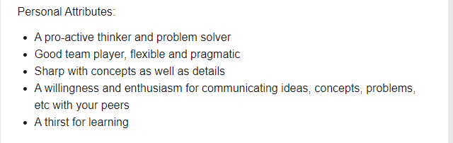
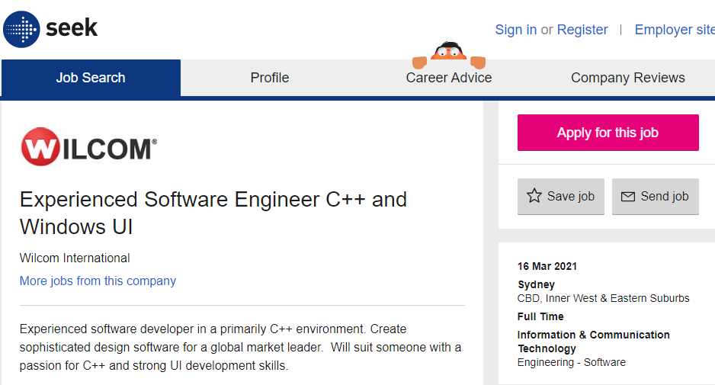
Soft skills|Identify
Take a screen shot of a 2 job adverts.
Identify and highlight some of the soft skills listed in each advert.
Job advertisement #1 | Job advertisement #2
It talks about wanted someone who has verbal and written communication skill, have good management skills being about the project and personal management, have critical thinking skills, and working strong as a contributing team member meaning teamwork skills. | For the skills they look for in someone come to problem solving skills, teamwork skills, flexibility skills, enthusiasm skill for not themselves but for there peers, and a desire to learn skills.

Slide 12
Hero Reference|Cool people
Research professionals currently working in industry.
Find 2 professionals who's work you find inspirational.
Post a link to their portfolio or examples of their work and explain what inspires you.
List of cool pros | Name | Link to work examples | Why are you inspired?
Cool pro #1 | Andrew Wang | https://www.linkedin.com/in/andrewfwang | System Engineering
Cool pro #2 | Yoshihito Iwanaga | https://jp.linkedin.com/in/yoshihito-iwanaga-8051a11a0/en-us?trk=people-guest_people_search-card | Development Programmer

Slide 13
Hero Reference|Pro Skills
What skills do your chosen pros have? What softskills do you think they might need to have?
What software do they use? If you don’t know the software, they use what software do you expect they use?
What job roles do they have? What job roles could they have?
In your own word write a short description of the skills these people have and the software they use. Also describe you job title they actually hold or what job title you think they could hold.
List of cool pros | Tech skills and soft skill set | Software knowledge | Actual or Possible Job title.
Cool pro #1 | Tech skill would be information technology to understand how to use the technology the best. Soft skill would be communication his ideas to the team. | how to use MonoGames to it’s best ability | Chief Technical Officer
Cool pro #2 | Tech skilled would be graphic engine. Soft skill would be creativity. | How to use the graphic technology in the Havok engine. | Graphic Engine Development Programmer

Slide 14
Cool tools|Software
List 2 pieces of software you think are really cool.
In your own words explain what the software actually does.
Explain what about the software interests you?
List of cool software tools | Name | What does it do? | Why does it interest you?
Software #1 | RenderDoc | Debugger that makes it easy to capture a single frame. | How easy it makes getting a single frame
Software #2 | GitKraken | Backs up work and can be access on any device | How it shares the work across all users and can work at it at the same time.

Slide 15
Cool tools|Software developers
Who develops the software?
Does the developer provide support to the user base? For example do they post tutorials on their website? Do they have forums for discussions? Does the developer post videos on YouTube?
Does the developer have some type of active social media?
List of software tools devs | Name | What training support is offered? | Are official forums available? | Do they have an active social media presence?
Software developer #1 | Baldur Karlsson | There is a “Getting Started” which help explain how to use RenderDoc | The creator uses Github repository for forums | Yes they have an active social media on Twitter
Software developer #2 | Axosoft | On there site you can find tutorial videos | No officical forums but there are forums that talk about Git Kraken like GitLab | They use Twitter as there active social media

Slide 16
Occupation|Job Roles
Research 3 studio job roles.
Identify 3 actual job titles use by professionals and studios.
In your own words give a brief description of what that job role is.
Job Title | Description of job role
Graphics Programmer | Graphics programmers are the one who use the software to make 2D or 3D graphic in the games, by writing code to display the 2D or 3D graphic on the screen.
UI Programmer | They are the ones who create the main menu that works or the HUD that the player see when playing the game, basically they create interface.
AI Programmer | They make the NPC in the game by writing script to do things in the game to enchant the player experience.

Slide 17
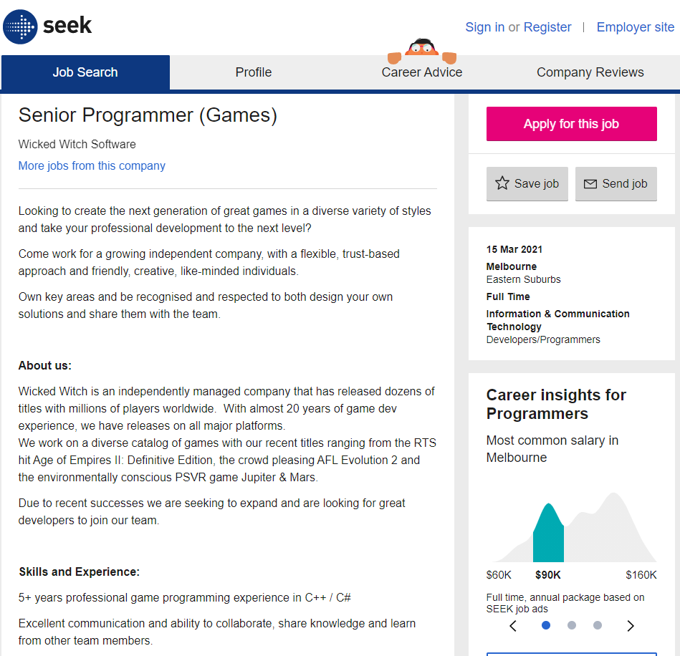
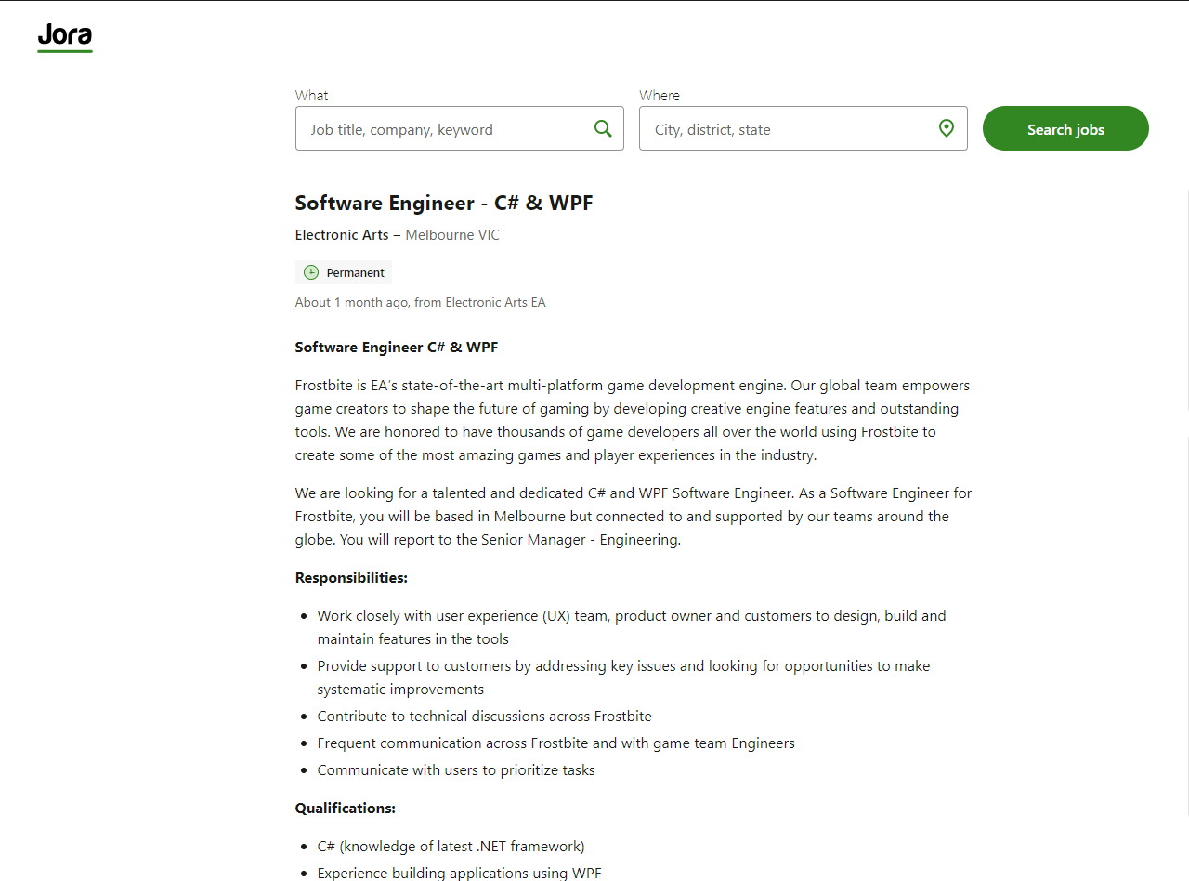
Occupation|Job Roles
Find 2 job advertisements you'd be interested in, each from a different source.
Highlight the source and paste a screen shot of each job advertisement below.
Also post a link to the source of the job adverts
Job advertisement #1 | Job advertisement #2
They are looking for a senior Programmer that does coding for Games and have many years in the Field of C++/C# | This job advert is looking for An software engineer in c#.
https://www.seek.com.au/job/51769594?type=standard#searchRequestToken=3a342077-a36a-4ceb-a85c-8013c8ebe01d | https://au.jora.com/job/Software-Engineer-5f1650df4e9ee93e2aa6ebd9b49d4b5b?from_url=https%3A%2F%2Fau.jora.com%2FGame-Programmer-jobs-in-Melbourne-VIC&sl=Melbourne+VIC&sol_srt=f86cac56-03a0-414b-ae94-6ecde0942d4d&sp=serp&sponsored=false&sq=Game+Programmer&sr=10&tk=eUQp_zfcFXK5dkelTy9z-YhCQbFNaf1JMx8aNNT2H

Slide 18
Tech skills|List
Compare 2 of your technical skills. These could be things like animating, modelling, rigging, unwrapping etc.
Discuss one technical skill you feel you are currently “good” at and would find easy to learn more.
Discuss one technical skill you feel you are currently “poor” at and would find it difficult to learn more.
Discuss why one skill is easy for you and the other is difficult.
Easy and confident skill technical skill | Difficult and poor technical skill
My math Skill is one of the technical skills that I’m the most confident with and with easy to do. I find that numbers are easier to understand than words, meaning I get work faster done with numbers than when writing that can take a very long time. | Debugging is a skill that I’m not very good at an is lacking within my programming skills. I find it hard to understand with the core mechanics of how to find what could be the problem with the code.

Slide 19
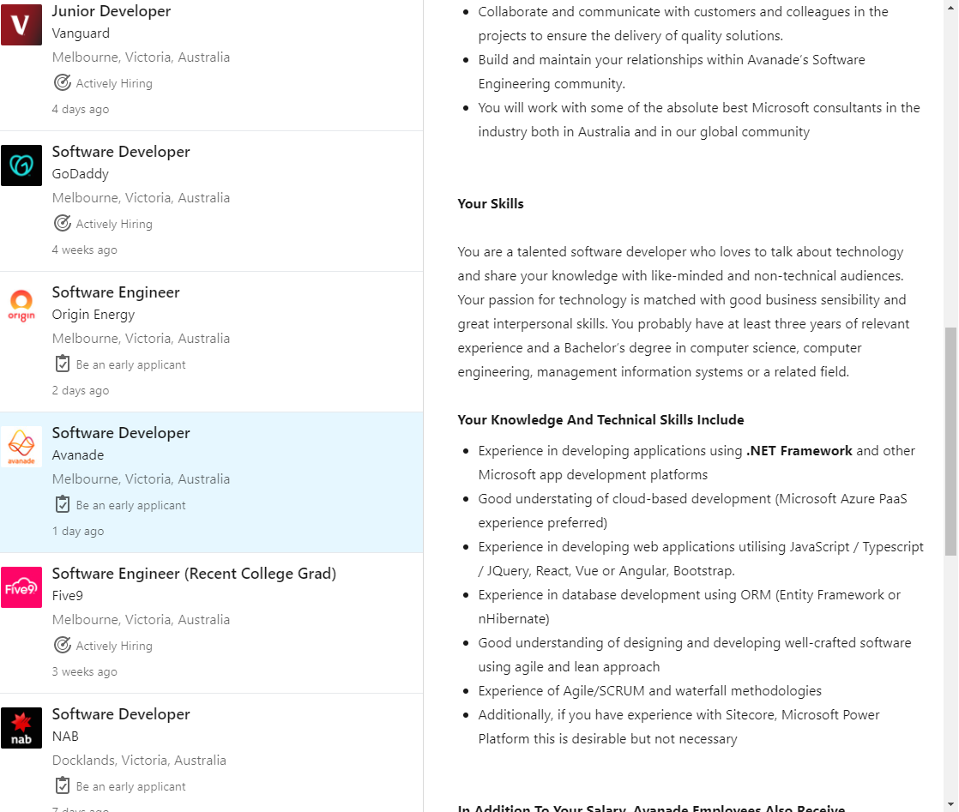
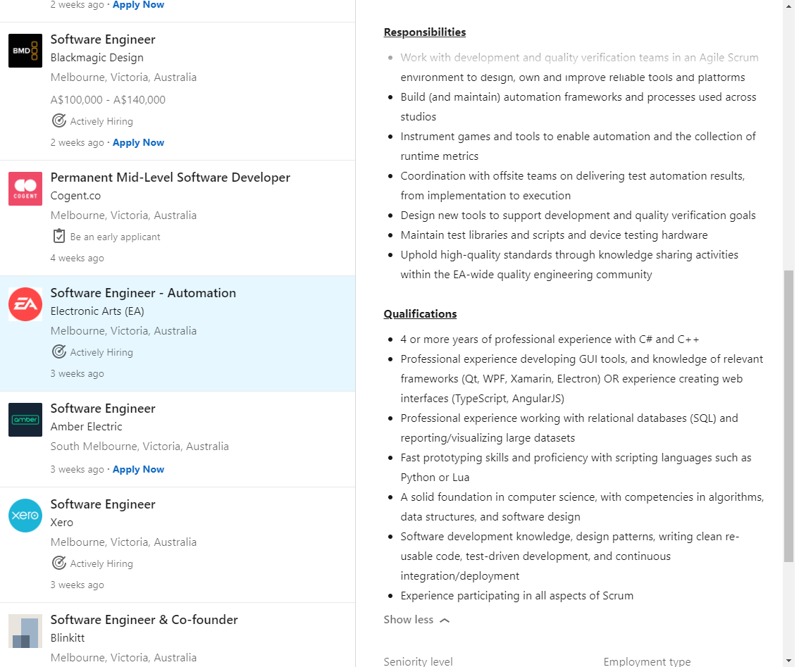
Tech skills|List
Take a screen shot of 2 job adverts.
Identify and highlight some of the technical skills in each advert.
Job advertisement – Tech Skills #1 | Job advertisement – Tech skills #2
Knowing how to code using Application as .Net Framework, Experience in developing web Applications using JavaScript, Database development. These Are some of the tech skills list in Advert. | Coding skills using C# and C++, Developing GUI skills, fast Prototyping skills with languages Like Python.

Slide 20
Studios|Studio list
Identify a few studios near to you (local studios) and post a link to their website. (3)
Identify some international studios and post a link to their website. (3)
Local studio name | Link to studio website
League of Geeks | http://www.leagueofgeeks.com/
Torus Games | http://www.torus.com.au/
Wicked Witch | https://www.wickedwitch.com/
International studio name | Link to studio website
Blizzard Entertainment | https://www.blizzard.com/en-sg/
Square Enix | https://www.square-enix.com/
Gearbox Software | https://www.gearboxsowftware.com/

Slide 21
Studio|Studio review
Choose one local and one international studio from your list.
Research them and report on some findings, focusing on what they produce or how they produce it. Ensure you are reporting accurate information.
Find out what software they use?
Find out how many staff they employ?
Find other information about how the studio produces its products?
Studio name | Production trivia
League of Geeks | Unity 11-50 employees When making a game they strive to achieve Critical, Cultural, and Commercial success in equal measures. That they call ‘The Three C’s’.
Gearbox software | Unreal Engine 500+ employees With the mission to Entertain the world.

Slide 22
Network 1|Personal close
Think about your immediate personal network. Think about the people who can offer you advice and feedback.
These are people who you can talk directly with. These people may include family, friends, fellow students, trainers, work colleges, etc
How many people in your immediate personal network could you:
call on for advice on artistic / technical matters.
call on for advice on soft skills related matters.
call on for advice on employment and job-related matters.
 | Personal close network (approximate size)
Artistic / technical matters | 10
Soft skill related matters | 5
Employment / job related matters | 7

Slide 23
Network 1|Personal Extended
Your personal extended network is made up of people who you are not in direct contact with.
This could include people you don’t know in person, but are a member of a group you are a part of (eg a social media group)
This could also include people you know of. You may need to talk “through” other people to make contact.
These people are “2 steps” away.
In the box below describe the scope and extent of your personal extended network.
Do you “know of” some people who could help you develop as a professional?
Do you have access to a group of people who could potentially support you? (eg a Facebook group)
Do you have some form of extended network you can get feedback or even advice from?
 | Extended network
Describe the extended network you have right now! | Not good as I don’t really connect with people on the network and haven't branch out to groups out there. Mostly my personal network is bad.
Are there any easy steps you could take to expand you current extended network? | Start trying to branch out to different groups on different website and try to connect to the other people.

Slide 24
Network 2|Community close
Look for 2 local communities you could personally interact with that could help you develop professionally. Focus on finding local groups that are near to where you are now, that you could have easy access to.
The community could offer …
A competition
Interaction with like minded people
Networking
Feedback
Answering questions
Describe (and link to) the communities in the box below.
 | Close / local community
Physical community | A bunch of people all come to gather and meetup and talk about game development ranging from por or indie game developer and share knowledge, network, etc. https://www.meetup.com/en-AU/MelbGameCreatives/
Online community | More like the physical but mainly focuses on Unreal engine and are done by zoom calls.

Slide 25
Network 2|Community Extended
Look for a big external event that would be valuable for you to attend. This could be a conference or expo that hosts industry developers, speakers and community. Write a short description of why it would be valuable to attend.
Find out the basic details of the event.
Link to the website
When is it on this year?
How much would it cost to attend. (approx.) Include ticket prices, travel, accommodation and anything else needed.
event name | Link to website | When is it on | Ticket prices | Travel expenses (approx.) | Accommodation expenses (approx.) | Other expenses (approx.) | Total cost
Pax AUS | https://aus.paxsite.com/ | 8-10 oct, 2021 | $60 | $4.50 | $130 | $25 food | $219.50
Why would it be worth attending?
Pax is a big event where people in the game development all come to see or present their games to the world and is a good why to talk to people and increase your personal network

Slide 26
Information|Sources News
Look for 2 information sources on industry news.
Carefully choose your sources to ensure you get industry news that is of good quality.
This could be from the following –
Social media source
Website / news articles
A specific individual
Briefly describe and link to the sources below.
 | Link | Name of source | Describe source | Why is it a “good quality” source?
News source #1 | https://www.gamedev.net/news/ | GameDev | It speaks of many different types of news that relates to game development | It’s not as much insight with what they write about but has build up a lot of follows so it is trusted.
News source #2 | https://www.nintendo.com/whatsnew/ | Nintendo | Goes over the new games and events that are happen. | It by the official company themselves, meaning it trust worthy.

Slide 27
Information|Sources Skills and tools
Choose a skillset and software tool you are interested in. For example Maya and Rendering.
Identify 2 sources of tutorial information for that skill set and software tool combination. Ensure you are choosing a good quality information sources. Link and discuss the source below.
 | Link | Name of source | Describe source | Why is it a “good quality” source?
Skill / tool set #1 | https://learn.unity.com/?_ga=2.26799604.89461857.1617957534-170533261.1617957534 | Unity Learn | Give the person using the site over 100 hours worth of content that people can watch to learn how to use unity | As it done by the people at unity so they understand how to use there own software
Skill / tool set #2 | https://www.unrealengine.com/en-US/onlinelearning-courses | Unreal Engine | It has course and guides on how to use unreal engine with live videos | It’s made by the people at unreal engine so they will know how to use there software

Slide 28
Information|Future
Games and VFX for film is a fast-moving industry.
Look for some emerging technologies, software tools, processes, hardware or workflow that interest you.
In the box below describe one emerging technology. Describe a few actions items you might need to take that could move you closer to participating in this new emerging technology.
Technology name | Describe new technology | Action items for participation
Real Time Ray Tracing | With the new Ray Tracing it is now allowing for the render of object shade and light to be done in real time | The items need to use the technology would be for the hardware an NIVIDIA graphic card, but most really the software NIVIDIA OPTIX for the ray tracing and Unity for the application to use the ray tracing

Slide 29
Financial|Costs
Select a small suite of software that could make the core of your professional home studio.
The suite of software should include both 2D and 3D editing tools as well as some additional software for tasks such as sculpting or rendering.
Ensure you are considering software licensing for professional (paid) work.
Software name | Link to website | Cost of professional licence
Unity | https://unity.com/ | $1,800 year
GitKraken | https://www.gitkraken.com/pricing | $49 year
Visual Studio | https://visualstudio.microsoft.com/vs/pricing/ | If for an individual it’s for free. While for a small business $59.09 a month
Blender | https://www.blender.org/download/ | Free for anyone to use

Slide 30
Financial|Hourly rate
Do some research on hourly rates for freelance 3D artists.
In the box below
Nominate an approximate figure you think is fair as an hourly rate.
Briefly discuss how you arrived at that figure.
 | Answers
Nominate an hourly rate | $35.27 hourly rate
Discussion of how you chose that rate | Because of the cost for equipment an 3D artist would need to use and the cost of the application they use can cost a lot with usually being every month to keep paying for the licence.

Slide 31
Job Adverts|Find and list
Look for 2 information sources that host industry job adverts.
Carefully choose your sources to ensure they are legitimate.
This could be from the following –
Social media source
Website / news articles
A specific individual
Briefly describe and link to the sources below.
 | Link | Name of source | Describe source | Why is it a “good quality” source?
Job advert source #1 | https://au.linkedin.com/ | Linkedin | A site where you can search for jobs in certain areas and giving a list of businesses jobs. | Cause LinkedIn is a greatly know site for networking and looking up profiles. While looking for jobs they give all the info that is needed like what there wanting and more.
Job advert source #2 | https://www.seek.com.au/ | Seek | A site where you can search for jobs in certain areas and giving a list of businesses jobs and the salary. | Seek is an Australia company and is know for being number 1 for jobs findings, so lots of job advert are put on there.

Slide 32
Job Adverts|Choose
Select 2 job adverts that you find interesting. Choose an advert for the type of job you’d like to see yourself in the future.
Ensure you are selecting from a good source. Preferably this is an info source you have reviewed and checked for quality before.
Describe why the chosen job adverts are appealing to you.
Identify what you think are the key soft skills and tech skills the job requires
 | Link to job advert | Title of position | Describe why it interests you | Soft skills and Tech skills
Job advert #1 | https://au.linkedin.com/jobs/view/software-engineer-release-at-electronic-arts-ea-2477206295?refId=626d250d-d3f3-449f-b2e5-4702a6508ca2&trackingId=r1Qo1fUTNUvUJQZ7XuEq5w%3D%3D&position=17&pageNum=0&trk=public_jobs_job-result-card_result-card_full-click | Software Engineer | Because the interests of working for a game company is what I want to work for. | For soft skills there are problem solving, teamwork and understanding them, management, and communication in writing and verbal For tech skills it shows coding using languages like C# and Python and experience with game engines
Job advert #2 | https://au.linkedin.com/jobs/view/game-programmer-at-jobs-on-jobactive-2471933081?refId=639c2ab8-4f17-405d-9d1a-3b9c8d59b502&trackingId=qYqf5YuNKJiCL2rzc3ieZA%3D%3D&position=1&pageNum=0&trk=public_jobs_job-result-card_result-card_full-click | Generalist programmer | Because the interests of working for a game company is what I want to work for and I like sport as well | Soft skills are management task schedule, communication with production team, resolve problems, work as a team, and strong Purple in written communication Tech skills coding in c#, and knowledge of debugging

Slide 33
Conclusion|Where to next?
This document is designed to help you explore and plan your professional development.
You have added a lot of data to this document. Make use of this data and draw a conclusion.
Review and analyse the information above and summaries into a few key conclusions.
What does the data show? | Link to job advert
What is one weakness you have where you should focus more attention? | Debugging is my weakness that I need to start research and practising to get a better understating how to use it as it will be an important tool
What is one strength you have that will be valuable in the future? | My math skill will help with programming that involves math equations like for a physics engine
What inspires you? | Working for a game company as they have had a real impact with my life and choices for career
What are your goals? | For a short term goal would be to make into a local game company as a programmer. For long term goal probably work for a company like gearbox software.
What is a short term action item you recommend you should do? | Start building up my portfolio so I can reach my short term goal and be ready when giving an offer.
What is a long term action item you recommend you should do? | start my way working in local company and as years go on build my network connection to reach gearbox to then start trying to work there.

Slide 34
Professional Studies 1|Submission
The following files must be uploaded to Canvas for assessment. All submitted files must adhere to the provided naming conventions.
Workbook:
This Workbook
2021_Professional_Studies_1_YourName.pptx

